Slide 1
IMDB Movie Analysis
By- ANJALI RAJPUT

Slide 2
Project Description
In this project the Datasets was provided and we were required to frame the problem.
I was expected to define my own problems and expected to shed light on it.
We are going to analyse the data by EDA(Exploratory Data Analysis) which is used to summarize ,visualize and understand the characteristics of the given dataset.
The Root Cause Analysis approach or 5 Why’s Analysis approach developed b SAKICHI TOYODA, founder of Toyota was used to create the report which convey the data story.

Slide 3
Approach
Approach towards the project means Overall strategy that outlines how the project will be executed or done to achieve its Objectives.
In this project first we need to import the dataset that provided and load that into Excel.
After loading the data use specific functions and formulae in excel in order to achieve the clean dataset to drive required insights.
Using 5 why’s approach for the deep understanding of the data and root cause problems.
Analysing the data for the various problem statements.
Using statistical and visualization tools to shed lights on results.

Slide 4


Tech-stack Used:
Ms excel ( for analysis )
MS Power-point( for making ppt of project )

Slide 5
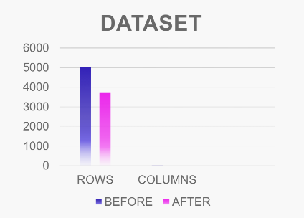
Cleaning data
Before Cleaning --
Total number of ROWS- 5044
Total number of COLUMNS- 28
After Cleaning --
Total number of ROWS- 3724
Total number of COLUMNS- 13
In the process of cleaning, 45 duplicates were removed and 3724 rows were obtained after removing the rows having blank cell and the unnecessary columns

Slide 6

Insights

Slide 7
MOST PROFITABLE MOVIES
 | TOP 10 MOVIES IN PROFIT | Sum of budget | Sum of gross | Sum of PROFIT
 | Avatar | 237000000 | 760505847 | 523505847
 | E.T. the Extra-Terrestrial | 10500000 | 434949459 | 424449459
 | Jurassic World | 150000000 | 652177271 | 502177271
 | Star Wars: Episode I - The Phantom Menace | 115000000 | 474544677 | 359544677
 | Star Wars: Episode IV - A New Hope | 11000000 | 460935665 | 449935665
 | The Avengers | 440000000 | 1246559094 | 806559094
 | The Dark Knight | 185000000 | 533316061 | 348316061
 | The Jungle Book | 350000000 | 725290282 | 375290282
 | The Lion King | 45000000 | 422783777 | 377783777
 | Titanic | 200000000 | 658672302 | 458672302
 | Grand Total | 1743500000 | 6369734435 | 4626234435
BASED ON THE ANALYSIS OF
GROSS V/S BUDGET,
AVTAR WAS THE MOST PROFITABLE MOVIE.

Slide 9
TOP 250 ENGLISH MOVIES
The Shawshank Redemption is the best English movie with average IMDB score of 9.3

Slide 10
TOP 10 FOREIGN LANGUAGE MOVIES
 | Row Labels | Average of imdb_score
 | The Good, the Bad and the Ugly | 8.9
 | Seven Samurai | 8.7
 | City of God | 8.7
 | Spirited Away | 8.6
 | Children of Heaven | 8.5
 | Samsara | 8.5
 | The Lives of Others | 8.5
 | A Separation | 8.4
 | AmÃ©lie | 8.4
 | Princess Mononoke | 8.4
 | Baahubali: The Beginning | 8.4
 | Das Boot | 8.4
 | Oldboy | 8.4
 | Grand Total | 8.523076923
THE GOOD,THE BAD AND THE UGLY
is the best Foreign movies(Italian) with highest
IMDB ratings.

Slide 12
BEST DIRECTORS
 | Row Labels | Average of imdb_score
 | Alfred Hitchcock | 8.5
 | Psycho | 8.5
 | Asghar Farhadi | 8.4
 | Charles Chaplin | 8.6
 | Christopher Nolan | 8.425
 | Damien Chazelle | 8.5
 | Majid Majidi | 8.5
 | Marius A. Markevicius | 8.4
 | Richard Marquand | 8.4
 | Ron Fricke | 8.5
 | S.S. Rajamouli | 8.4
 | Sergio Leone | 8.433333333
 | Tony Kaye | 8.6
 | Grand Total | 8.452380952
AKIRA KUROSAWA is the Best Director with
the Average IMDB rating of 8.7

Slide 14
TOP GENRE
 | GENRE | Count of genres
 | Action | 970
 | Adventure | 378
 | Animation | 46
 | Biography | 208
 | Comedy | 1036
 | Crime | 259
 | Documentary | 43
 | Drama | 698
 | Family | 3
 | Fantasy | 37
 | Horror | 165
 | Musical | 2
 | Mystery | 23
 | Romance | 3
 | Sci-Fi | 8
 | Thriller | 3
 | Western | 3
 | Grand Total | 3885
DRAMA, COMEDY, AND THRILLER WERE TOP
THREE GENRE BASED ON TGE MOVIES RELEASED
BY BEST DIRECTORS.

Slide 16
ACTOR ANALYSIS
 | Row Labels | Average of num_critic_for_reviews
 | Albert Finney | 750
 | Phaldut Sharma | 738
 | Peter Capaldi | 654
 | Craig Stark | 596
 | BÃ©rÃ©nice Bejo | 576
 | Suraj Sharma | 552
 | Ellar Coltrane | 548
 | Mike Howard | 546
 | Lou Taylor Pucci | 543
 | Joel Courtney | 539
 | Grand Total | 617.4545455
MERYL STREEP – 11
LEONARD DICAPRIO – 21
BRAD PITT - 17

Slide 18
DECADE ANALYSIS
 | helper-year |  | Row Labels | Sum of num_voted_users
 | 1920 | 1920s | 1920s | 196422
 | 1930 | 1930s | 1930s | 207002
 | 1940 | 1940s | 1940s | 146351
 | 1950 | 1950s | 1950s | 742720
 | 1960 | 1960s | 1960s | 3121043
 | 1970 | 1970s | 1970s | 7117872
 | 1980 | 1980s | 1980s | 19463438
 | 1990 | 1990s | 1990s | 60725295
 | 2000 | 2000s | 2000s | 179469850
 | 2010 | 2010s | 2010s | 125794186
 | 2020 | 2020s | Grand Total | 396984179
HELPER-YEAR COUMN WAS CREATED AND
VLOOL-UP FUNCTION WAS USED TO EXTRACT
THE YEAR RANGE.

Slide 20
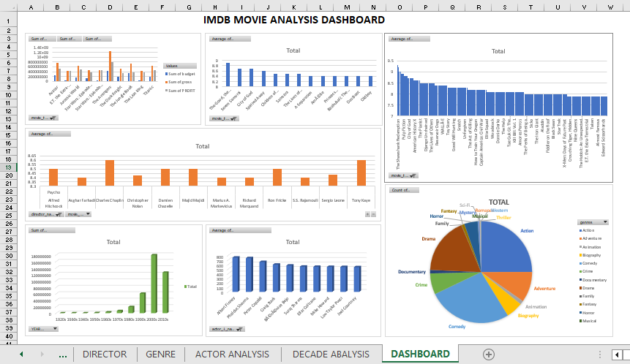
DASHBOARD

Slide 21
RESULT
Top 250 English
Movies
Shawshank Redemption in English with average rating of 9.2 and The Good ,The Bad and The Ugly in Italian with average voting of 8.9
Profitable Movies
Avatar was the most Profitable movie.
$52,35,05,847
Best Director
Akira Kurosawa with average rating of 8.7
Genre
Based on the best directors the top 3 genre were DRAMA, COMEDY and THRILLER
Actor
Critics favorite is Albert Finney (750)audience favorite is health Donahue (3400 votes)

Slide 22
Thank you anjalirajput2005@gmail.com

