Slide 1
Wireframes
YourAcademy
By – Team CodingWhizs

Slide 2
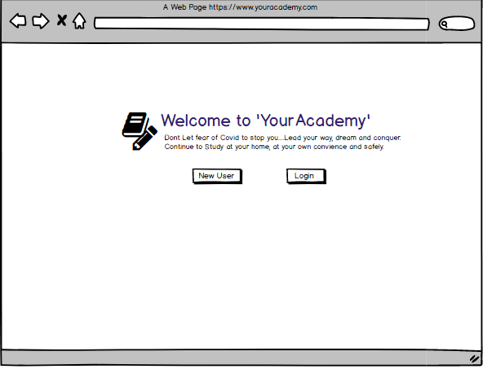

Slide 3
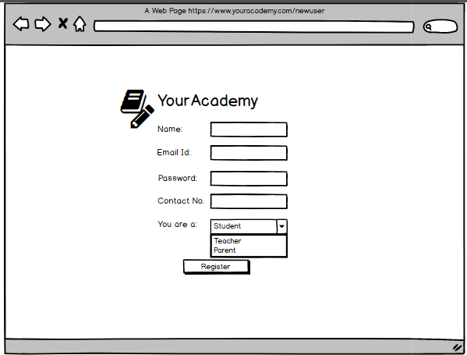

Slide 4
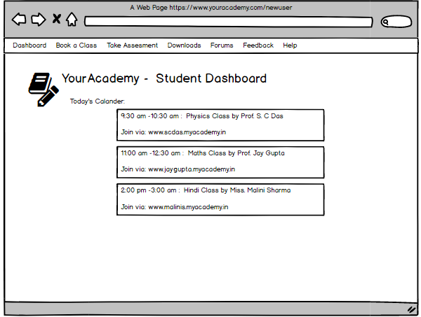

Slide 5
