Slide 1
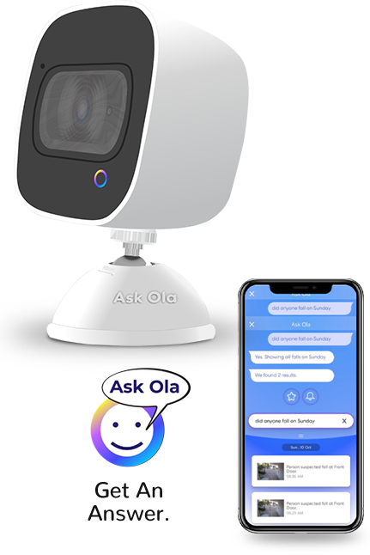
OLA Security Camera
Your personal security assistant

Slide 2
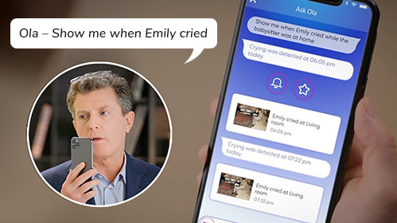
Personalized Assistant
World's 1st Talking Smart Security Camera
Talk & Search for specific events

Slide 3
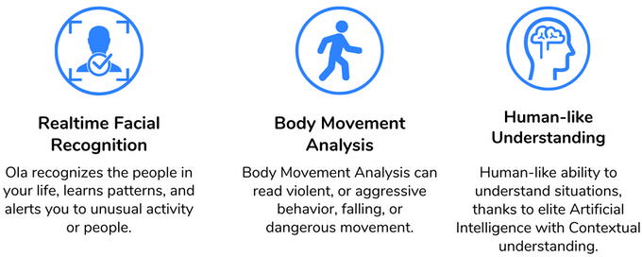
Recognizes people in your life and learn patterns
It can read violent or aggressive behaviour, falling or dangerous movement
Uses AI (NLP) with Contextual Understanding to understand various situations and answers accordingly

Slide 4

Alerts/Notifications
It has some in built alerts-
Custom alerts can also be created

Slide 5
Other Features
Night Vision
Full HD 1080p Video recording
2 way voice command
130 Degree view
Water resistant

Slide 6
Thank You!

Slide 7
References
https://www.askola.com/
https://www.indiegogo.com/projects/ask-ola-2-way-voice-command-smart-security-camera--2#/

