Slide 1
Data Science project

Slide 2
Agenda
The goal of this project is to do descriptive analysis to understand and infer from data of performance of BNS device and then performing the regressive analysis on predicting the “InBandwidth” of the device using different regression techniques.

Slide 3
What did we do with the data ?

Slide 4
Import all the required libraries
For reference these were the libraries that we used for our data analysis:
Statistics, pandas, numpy, scipy.stats, sklearn.decomposition, matplotlib.pyplot, sklearn, sklearn.model_selection, math, sklearn.linear_model, sklearn.preprocessing, sklearn.metrics

Slide 5
2. Data Cleaning
Checked for any missing values. (there were none in our data)
Outlier detection (there were 2178 outliers in our data)
We replaced the outliers with median (after replacing 545)
Calculated the statistics of data (mean,median etc.)

Slide 6
3. Data Preprocessing
The data is preprocessed by various methods like:
Normalisation
Standardisation
Feature Selection
PCA.

Slide 7
INFERENCES AND RESULTS FROM ANALYSIS

Slide 8
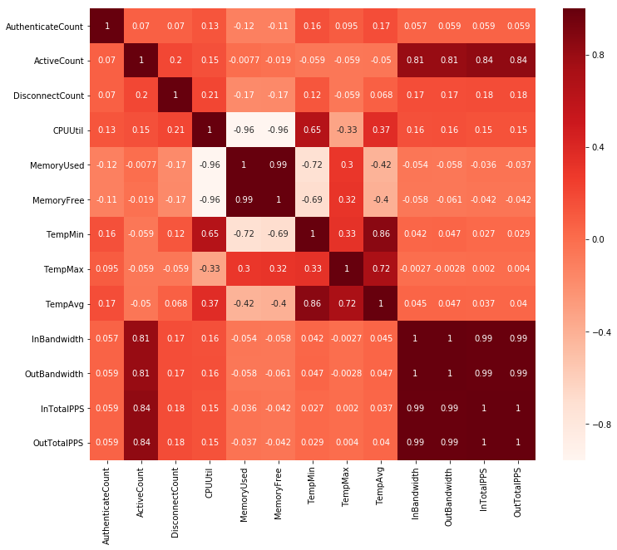
Correlation plot of each attributes
The inbandwidth is highly correlated to the OutBandwidth, InTotalPPS, OutTotalPPS, ActiveCount attributes.
Part of the reason can be because the number of active users determine the InBandwidth used for data transmission, more users would need more data bandwidth.

Slide 9
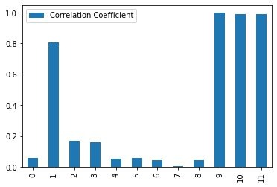
Columns of BNS device data

Slide 10
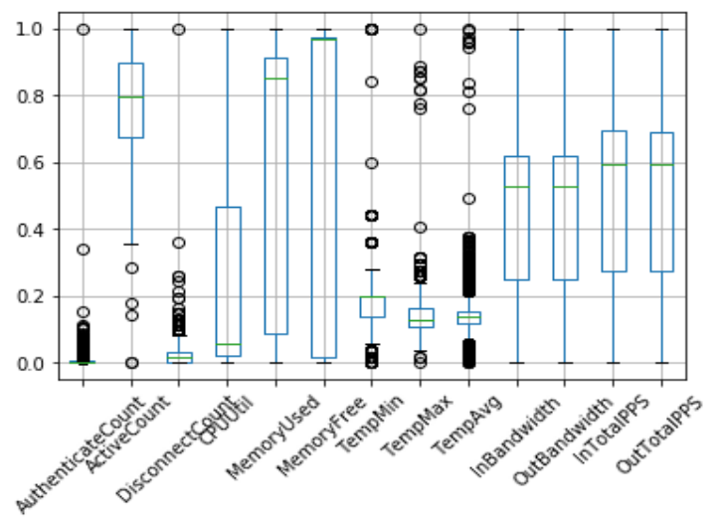
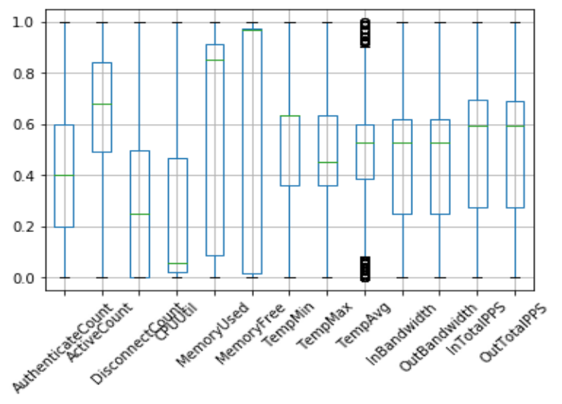
Box-plot of outliers
After outlier-removal with median the normalised data boxplot
Total outliers: 545
Actual normalised data with outliers
Total outliers: 2178

Slide 11
Results seen from box-plots
After replacing outliers with median more data comes under the IQR, so more data can be used for proper data analysis.
So a lot of data which would have been useless before can be of use now.

Slide 12
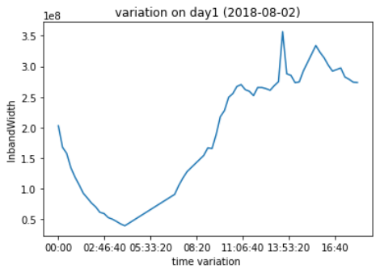
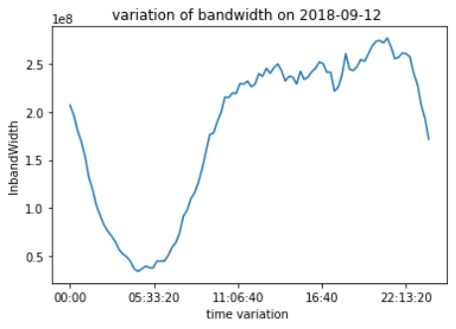
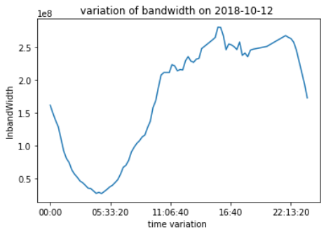
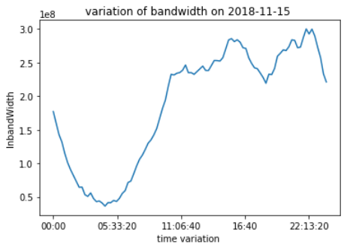
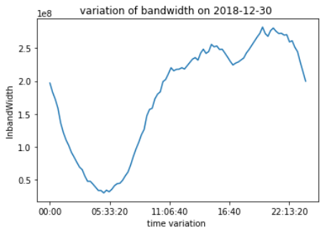
Target attribute variations on different months
August
September
October
November
December

Slide 13
Inferences from variation of Inbandwidth with time
We see that when the device start working on a particular day the inbandwidth of the device mainly decreases at first and then it increases to a maximum and then decreases.
The reason for this is that the Inbandwidth depends on the number of active users,input packets at that time so at the no. of users connected to the device is less and after sometimes it increases so inbandwidth also increases.

Slide 14
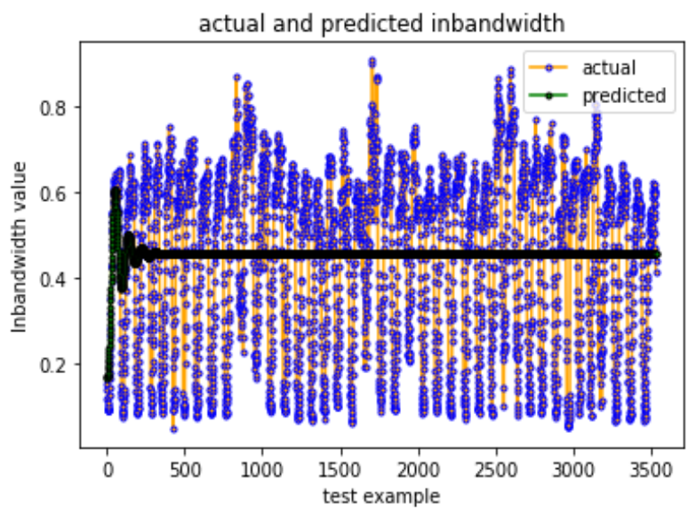
Auto Regression
Here we have 70% data as training data and 30% as test data
The optimal lag value which we obtain is 36
R_squared_score we get is 0.02476
data | Rmse values | R2-score
Actual data | 95353821.3 | 0.0247
Normalise data | 0.2099 | 0.0247
Standardised data | 0.9506 | 0.0247

Slide 15
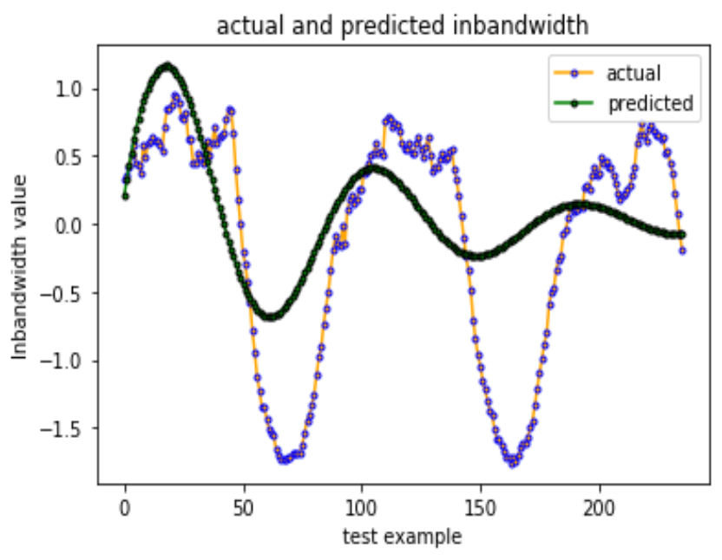
Auto-regression
In this case we take last 250 data as test data and predict the values using autocorrelation analysis.
The optimal lag value which we obtain is 39.
The rmse values obtained are:
data | RMSE values | R2-score
Actual data | 69412366.069 | 0.33947
Normalised Data | 0.15281 | 0.33947
Standardised Data | 0.69204 | 0.33947

Slide 16
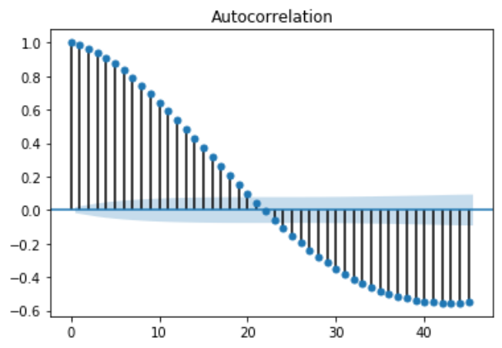
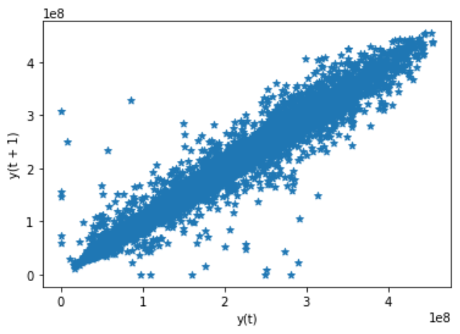
Auto-regression plot

Slide 17
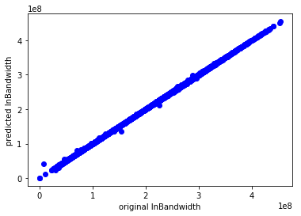

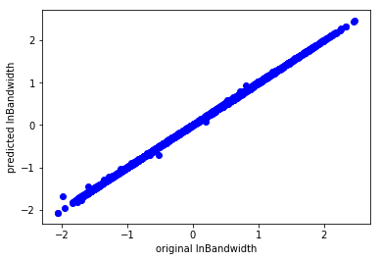

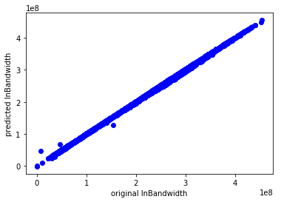
POLYNOMIAL CURVE FITTING (degree 2)
On untreated data
On data without ouliers
On standardised data
On normalised data
After feature selection
After PCA

Slide 18
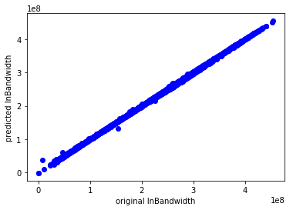

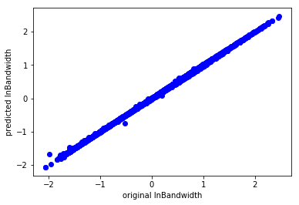
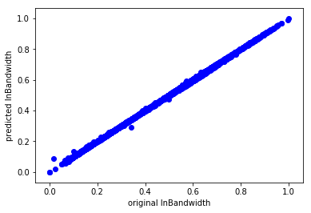
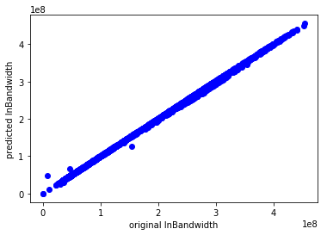
MULTIPLE LINEAR REGRESSION
On untreated data
On data without ouliers
On standardised data
On normalised data
After feature selection
After PCA

Slide 19
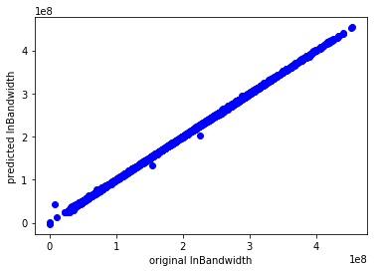
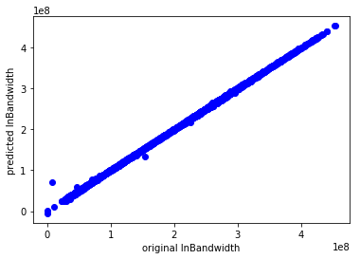
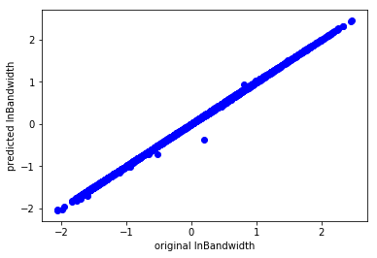
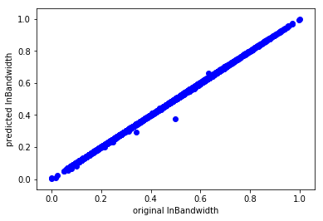
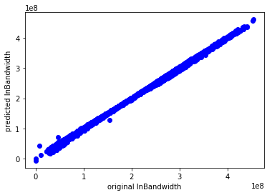
POLYNOMIAL CURVE FITTING (degree 3)
On untreated data
On data without ouliers
On standardised data
On normalised data
After feature selection
After PCA

Slide 20
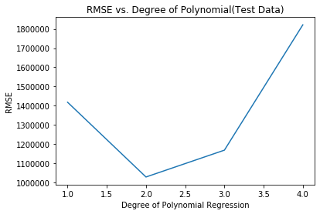
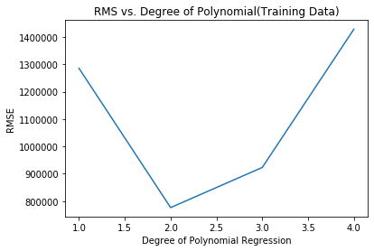
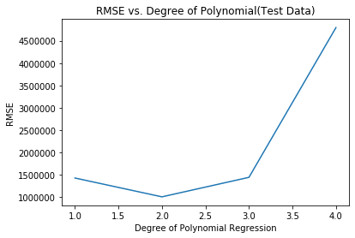
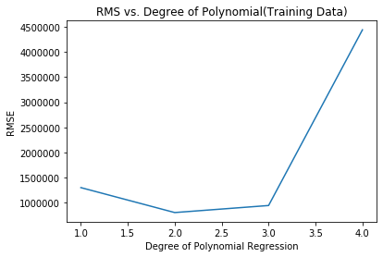
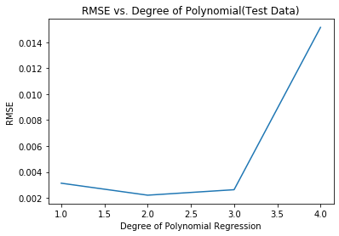
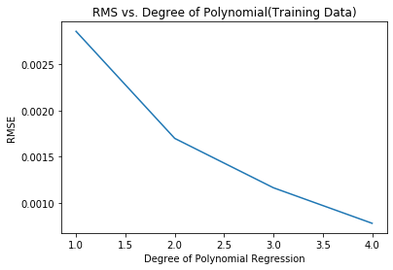
RMSE vs degree of polynomial
For feature selection
Feature selection
No outliers
No outliers
normalisation
normalisation

Slide 21
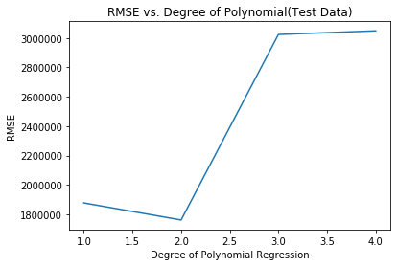
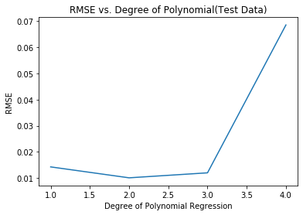
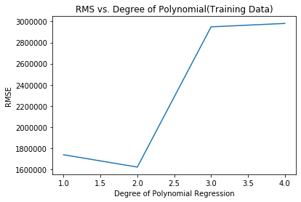
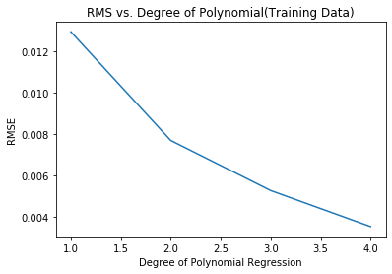
RMSE vs degree of polynomials
PCA Test
Normalisation Test
Original Data Test
PCA Train
Normalisation Train
Original Data Train

Slide 22
RMSE of test data comparison table
data | Linear regression | Polynomial regression (best degree=2) | auto-regression
Preprocessed data | 1426613.40 | 1005208.07 | 69412366.069
Normalised data | 0.0031 | 0.0022 | 0.15281
Standardised data | 0.0142 | 0.0100 | 0.69204
Polynomial regression is the best regression model among these as per given data.

Slide 23
R2_score of test data comparison table
data | Linear regression | Polynomial regression (best degree=2) | auto-regression
Preprocessed data | 0.99979 | 0.99990 | 0.33947
Normalised data | 0.99979 | 0.99990 | 0.33947
Standardised data | 0.99979 | 0.99990 | 0.33947
Polynomial regression is the best regression model among these as per given data.

Slide 24
CONCLUSIONS
Normalised data gave better results.
Polynomial curve fitting was better regressive analysis
Feature Selection and PCA improved RMSE (but order is same), reduced processing time significantly.

