Slide 1
Title: Super Store Sales Dashboard
Anjali Singh
Data Analyst
Intern

Slide 2
Dataset Overview & Objective
Table | Columns
Orders | Order ID, Order Date, Ship Date, Ship Mode, Segment, Country, City, State, Postal Code
Customers | Customer ID, Customer Name, Segment, Region, Country, State, City
Products | Product ID, Product Name, Category, Sub-Category
Sales Data | Sales, Quantity, Discount, Profit
Regions | Region (Central, East, West, South)
Business objective:
To analyze Super Store sales performance across various segments, categories, and regions, helping businesses identify trends, top-performing segments, and areas for improvement.

Slide 3
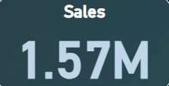
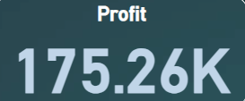
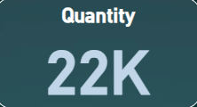
Key Metrics Overview (KPIs)
Content:
Sales: 1.57M
Profit: 175.26K
Quantity Sold: 22K
Insight: Business is doing well with over 1.5M in sales and strong profit margins. Quantity sold shows good customer engagement.

Slide 4
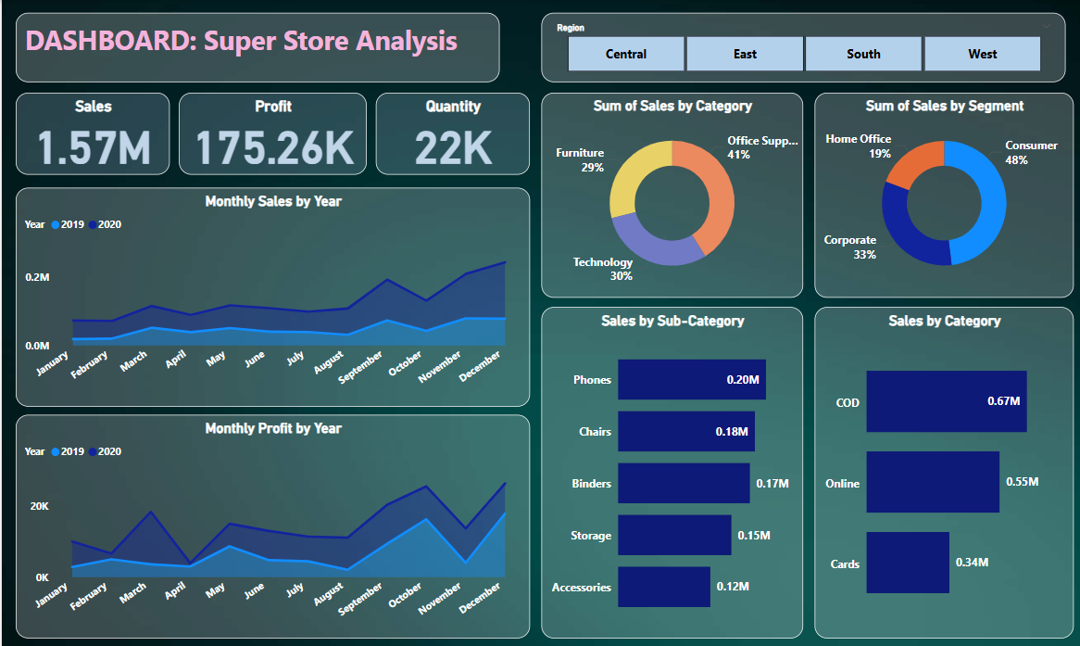
DASHBOARD

Slide 5
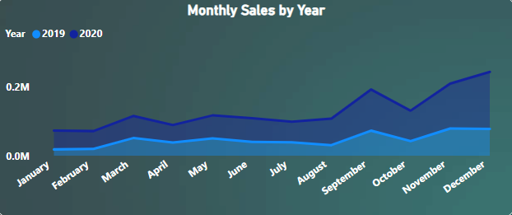
Monthly Sales Trend (2019 vs 2020)
Data: (Represented monthly over two years)
Peaks observed in October–December 2020
Overall upward trend in 2020 compared to 2019
Insight:
Sales in 2020 showed consistent growth, particularly in the final quarter, indicating a strong holiday season or year-end demand. The increase compared to 2019 reflects positive business growth and improved sales strategies.

Slide 6
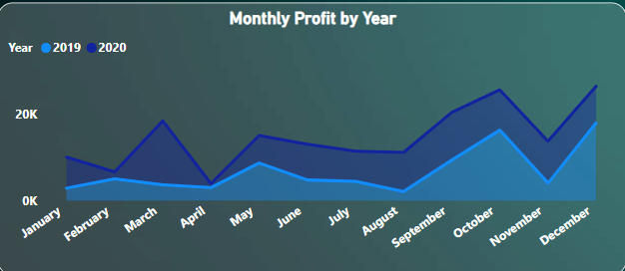
Monthly Profit Trend (2019 vs 2020)
Data: (Represented monthly over two years)
Profit spikes in March, October, and December 2020
2020 outperforms 2019 in most months
Insight:
In 2020, profits consistently outperformed 2019, especially in March, October, and December. These months showed noticeable spikes, indicating high sales or better cost efficiency. Overall, 2020 reflects a strong upward profit trend, suggesting improved business performance over the previous year.

Slide 7
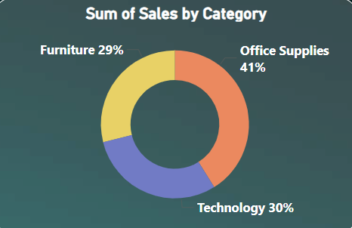
Sales Distribution by Product Category
Data:
Office Supplies: 41%
Technology: 30%
Furniture: 29%
Insight:
Office Supplies contribute the highest to total sales at 41%, indicating strong demand in this category. However, Technology (30%) and Furniture (29%) follow closely, showing a relatively even distribution and diverse customer purchasing behavior across departments.

Slide 8
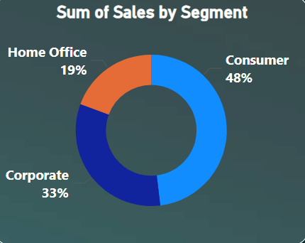
Sales Distribution by Customer Segment
Data:
Consumer: 48%
Corporate: 33%
Home Office: 19%
Insight:
The Consumer segment is the dominant buyer group with 48% of total sales, highlighting the importance of individual buyers. Corporate clients contribute significantly at 33%, while Home Office accounts for a smaller share, suggesting potential for targeted marketing in this segment.

Slide 9
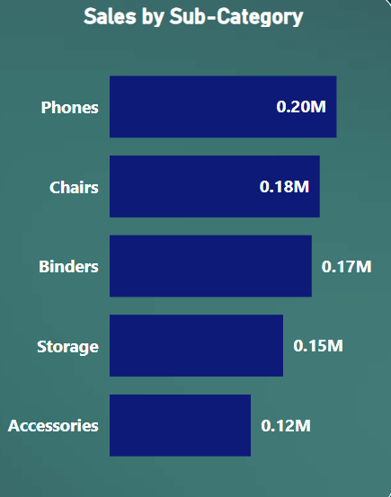
Sales by Sub-Category
Data:
Phones: 0.20M
Chairs: 0.18M
Binders: 0.17M
Storage: 0.15M
Accessories: 0.12M
Insight:
Phones and Chairs are the top-performing sub-categories, signaling a strong market for communication devices and office seating. Accessories and Storage, while lower, still show promising demand and could be improved with focused campaigns.

Slide 10
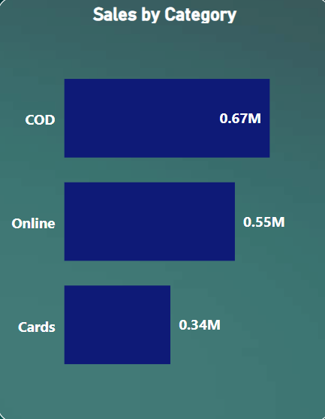
Sales by Payment Mode
Data:
Cash on Delivery (COD): 0.67M
Online: 0.55M
Cards: 0.34M
Insight:
Cash on Delivery remains the most preferred payment method, possibly due to customer trust or convenience. However, Online and Card payments also show substantial adoption, hinting at digital growth and the importance of multiple payment options.

Slide 11
Summary
This Power BI Dashboard provides a comprehensive analysis of Super Store sales data, uncovering key insights across product categories, customer segments, and regions. With interactive visualizations like line graphs, bar charts, and donut charts, the dashboard highlights performance trends in monthly sales, profits, and order quantities.
Key observations include:
Office Supplies led in sales, but Technology and Furniture were close competitors.
Consumer segment contributed the highest sales, followed by Corporate.
COD was the most preferred payment mode, while Phones and Chairs were top-selling sub-categories.
Monthly sales and profit showed a consistent growth trend in 2020.
This dashboard enables data-driven decision-making by helping stakeholders identify high-performing areas, seasonal patterns, and sales drivers effectively.

Slide 12
THANK YOU

