Slide 1
Object Oriented Programming and Design
Project – II
Harshal Dev
MT20086
Anjali
MT20082

Slide 2
Problem Statement
An Institute wants to computerize its admission process from receipt of applications to printing of admission letter. The received application is checked for completeness. A test is administered and a merit list of students is prepared. Shortlisted candidates are invited for an interview and a list of selected candidates is prepared along with a wait list of 50% of seats available. Candidates are asked to pay fees and register for the program.

Slide 3
Identification of Object in Problem Domain
Candidate
Administration
Application Portal
Application Form
Testing Portal
Admit Card
Question Paper
Selection Portal
Fee Portal
Fee Payment Method
Registration Portal
Admission Letter

Slide 4
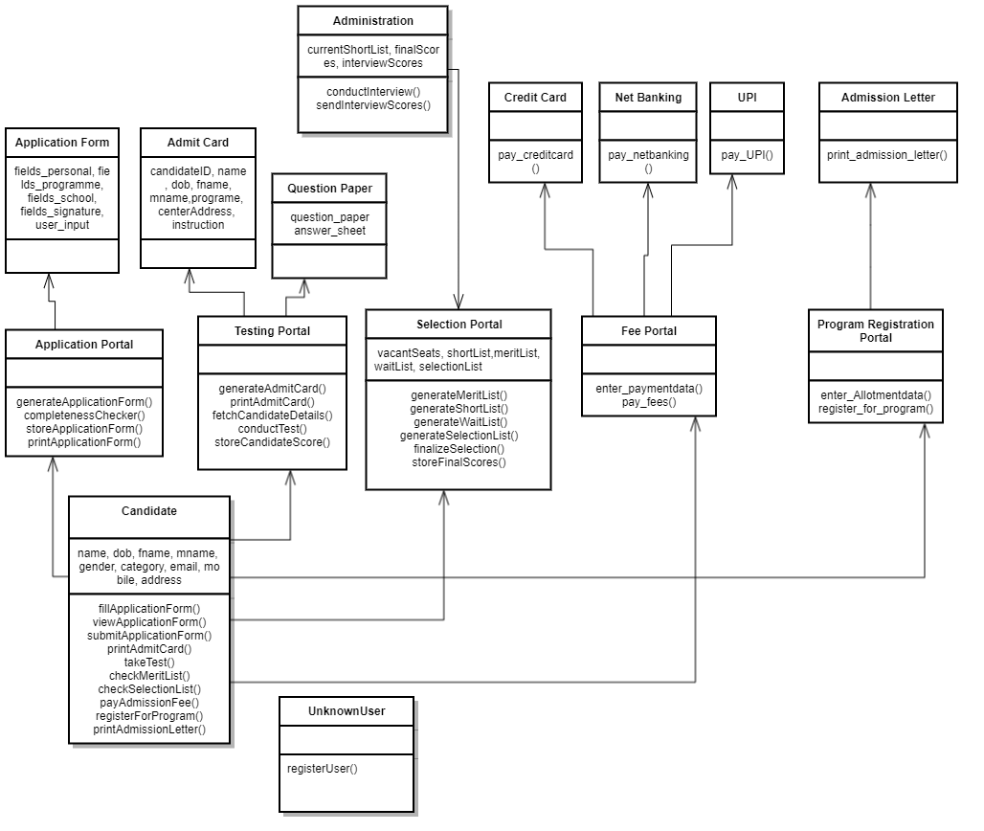
Design of Object Oriented System

Slide 5
Interaction of Objects
1. The Candidate object first interacts with the Application Portal, to fill out an application form.
2. The Candidate object interacts with the Testing Portal to print Admit Card.
3. The Candidate object further interacts with the Testing Portal object to take the Entrance Test.
4. The Candidate object interacts with the Selection Portal object to view the Merit List and Short List.
5. The Administration Object interacts with the Selection Portal object to obtain the Short List and conduct an Interview.

Slide 6
Interaction of Objects
6. The Candidate object interacts with the Selection Portal object to view the Selection List and Wait List.
7. The Candidate Object interacts with Fee Portal object to pay the admission fee.
8. The Candidate Object interacts with the Registration Portal to register for course and print Admission letter.

Slide 7
Features Implemented
1. Application Portal
This class receives application from students interested in getting admission.
a) Fill Application - Fills the Application and holds the details of the applicant in the storage system.
b) Completeness Checker - Completion check is implemented to check the completion of the form submitted by the applicant.

Slide 8
Features Implemented
2. Testing system
This class is to arrange test for the candidates who submitted application and print their admit card.
a) Admit Card Generation- Generates the admit card corresponding to the application number.
b) Test Managing- Take test of the applicants.
c) Test Evaluation - Evaluate the marks of the candidates and stores them in the storage system.

Slide 9
Features Implemented
3. Selection Portal
a) Merit List Generation-Generate merit list based on the cut off set and available seats in the institution.
b) Shortlist Generation-Generate the list of first set of candidates according to the merit list system who will be invited for interview.
c) Waiting List Generation-Generate the wait list of 50 % of the total seats available after the first round of the interview.
d) Selection List Generation –Generate the selection list of the students selected in interview in the storage system.

Slide 10
Features Implemented
4. Fee Payment
This class is for the selected students to pay their fee.
a) Payment Portal- Give student various options (card or online or UPI) through which they can pay fees.
b) Receipt generation-Generate receipt after the fees is paid.

Slide 11
Features Implemented
This class is for the program registration of students.
a) Program Choice Filling-Give the option to students for the program they want to register for.
b) Program Allotter- Allot the program to students.
c) Admission letter Generation- Print the admission letter

Slide 12
Single Responsibility Principle
“The SRP requires that a class should have only a single responsibility.”
The design of our objects in the problem domain follows the SRP principle.
No object in the problem domain has multiple sources of change that might result in unnecessary changes to a class as and when the requirements of one object interacting with it change.

Slide 13
Open-Closed Principle
“The OCP requires that each class should be open for extension, but closed for modification.”
The design of our objects in the problem domain follows the OCP principle.
This can be seen with the Fee Portal Payment method classes, whenever a new fee payment method needs to be added, a new class can be created, without requiring any modifications to the Fee Portal class.

Slide 14
Liskov Substitution Principle
“The LSP requires that objects in a program should be replaceable with instances of their subclasses without altering the correctness of that program.”
Since our design doesn’t (yet) include any subclasses, LSP is satisfied by default.

Slide 15
Team-wise Contribution
Classes implemented by Harshal
Candidate
Administration
Application Portal
Application Form
Testing Portal
Admit Card
Question Paper
Selection Portal

Slide 16
Team-wise Contribution
Classes implemented by Anjali
Fee Portal
UPI
Net Banking
Credit Card
Registration Portal
Admission Letter

Slide 17
Thank You

