Slide 1
Assignment 2
DES
Aditi Sharma Anjali
MT20100 MT20082

Slide 2
CODE INFORMATION :
Language used – Python
Number of code files – 1
DES.py

Slide 3
FUNCTIONS USED IN THE IMPLEMENTATION:
1. Binary to hex: It takes an input as string, checks the 4 characters at a time and assigns the corresponding hex code.
2. Binary to decimal: It takes a binary number and gives the corresponding decimal number.
3. Decimal to Binary: It takes a decimal number and gives the corresponding binary representation.
4. left_circularshift: It takes a string and do a circular left shift of n bits from the string
5. xor: This function returns the xor of two input strings
6. permute: This function permutes the string in accordance with the given table

Slide 4
7. sbox_subs: This function performs the sbox operation of converting a 48 bit string to 32 bit using tables of sboxes
8. keygen: This function generates 16 subkeys for each round using parity drop permutation and key compression permutation
9. encrypt: It encrypts the plain text to cipher text as follows:
Plain text in hex is converted to binary
Initial permutation is applied on plain text using IP table
Plain text is divided into left and right part
Then 16 rounds are applied as follows:
- The right part of plain text is permuted according to the expansion table
- Then xor is obtained on right part and key of the round
- The result is then sent to 8 sboxes to get 32 bit string
- Final permutation is applied to result string
- Then xor is obtained on left part and result string to give final part
- The final part and right part are swapped

Slide 5
Final part and right part are concatenated to form cipher text
10. decrypt: It calls encrypt on cipher text and the reverse of keys used in encrypt
11. DES: This is the main function which takes plain text and key and call encrypt and decrypt

Slide 6

INPUT GIVEN :

Slide 7
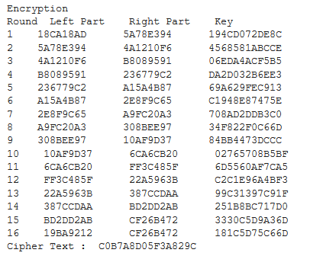
OUTPUT OBTAINED :
ENCRYPTION:

Slide 8
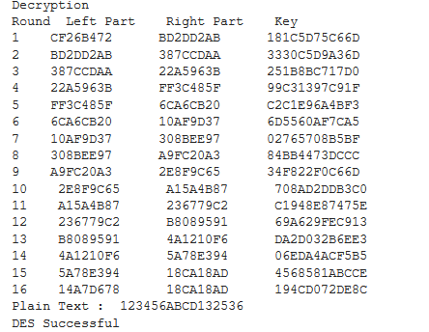
DECRYPTION:

