Slide 1
Assignment1 (0100+0082)mod 3=2 Project 2: 1. Encryption 2. Decryption 3. Brute Force attack On Transposition Cipher
Aditi Sharma
MT20100
Anjali
MT20082

Slide 2
Meta Data of Assignment
Language used- Python
Number of code files -2
EncryptDecrypt.py
BruteForceDecrypt.py
Input data to Encrypt function:
Key=45132
Plaintext- Wearediscoveredsaveyourself
Output of Encrypt function(which is input to Decrypt function):
encrypted message or ciphertext-
asrvr8047724eodyefb6a95*rcees1ff7f1aWdvsol7d9ed3eieauf7378d1
Output of Decrypt function:
Wearediscoveredsaveyourself

Slide 3
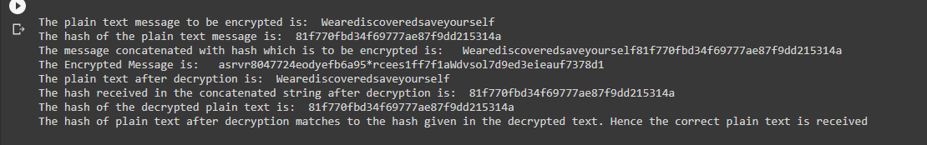
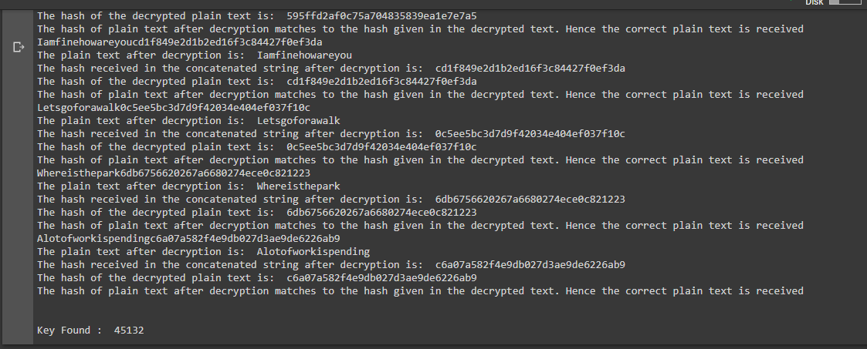
Screenshots
Output of Encrypt and Decrypt
Output of BruteForceDecrypt

Slide 4
We build 3 functionalities: 1. Encryption using encryptMessage 2. Decryption using decryptMessage 3. Brute Force Attack using BruteForceDecrypt
The user sends a plain text message T
The key assumed to be composed of digits with allowable digits given as [1 … Length(key)]
The key is known to both functionalities - encryptMessage and decryptMessage
Let the key be 2134 for illustration purposes.

Slide 5
Encryption using encryptMessage
A plain text T is received.
The MD5 hash, say H(T), of the plain text T is calculated using a pre-built python library function.
The hash H(T) is concatenated with the plain text T such that the new text ,
T´ = T || H(T)
The T´ is then encrypted using transposition cipher method as follows:
A matrix is formed in which the rows and columns are filled corresponding to the order of elements of key(using two nested for loops in the code):
2 | 1 | 3 | 4
C 1 | C 2 | C 3 | C 4
... | … | … | …
1 | 2 | 3 | 4
C 2 | C 1 | C 3 | C 4
... | … | … | …
The no of rows of matrix = Cols = Length(key)
Here, the … represents more rows as given by the formula
The C 1, C 2 … represents the characters of the plain text

Slide 6
1 | 2 | 3 | 4
C 2 | C 1 | C 3 | C 4
... | … | … | …
The matrix is prefilled by * character , in case the Length(T´) < Rows * Cols
We get the cipher text after the matrix is read row by row, column by column(using two nested for loops in the code) i.e.
first row first column, first row second column ...
second row first column, second row second column ...
and so on
This encrypted text E is sent to decryptMessage to perform decryption.

Slide 7
Decryption using decryptMessage
We receive the cipher text E
We make a matrix and fill it with characters from E, column by column
1 | 2 | 3 | 4
E 1 | E 2 | E 3 | E 4
... | … | … | …
The number of rows of matrix = Cols = Length(key)
Here, since No of rows = Rows * Cols , so no need for padding
The matrix also contains the special character * we used for padding during encryption
We read the matrix in the order given by elements of key i.e.
key = 2134 (Assumed initially), then, first the column 2 of matrix is read for each row,
then column 1 is read for each row and so on
We read all characters excluding *
The resultant text Tʺ is the text T´ = T || H(T). We get the plain text T from this using the length of original text T sent by the user.

Slide 8
We verify that the plain text Tʺ we got matches the plain text T sent by the user using method, say MV, as follows:
We find the MD5 hash of Tʺ i.e. H(Tʺ) and compare it with the H(T) we received after the decryption.
If H(Tʺ) = H(T) , decryption yielded the correct original text T

Slide 9
Brute Force Attack using BruteForceDecrypt
We do the brute force attack as follows:
We take some n number of <plain text T, cipher text E> pairs
We generate all possible permutations of key with length i where initially
i = 2, key = 12
For each generated key K, we decrypt the cipher text.
If any of the cipher text decryption results in incorrect match with the plain text, as given by the method MV we used previously, then the key is discarded and next generated key is checked.
The above procedure on completion, gives the key that decrypts all cipher texts correctly.

