Slide 1
Z- INDEX
Presented By
Anjali Krishnan

Slide 2
Z-Index
Introduction
Implementation of Z-index through an Example
Different Z-index values
Applying z-index using 3 boxes
Advanced concepts of z index
Conclusion

Slide 3
IntRODUCTION
Z-index property in CSS is used to control the stacking order of positioned elements.
Here stacking refers to the visual management and layering of components on top of one another on a website.
An element can have a positive or negative stack order
It is applied to positioned elements, which means elements that have a position value of absolute, relative, fixed, or sticky.

Slide 4
How z-index is applied using html & css
Through Example

Slide 5
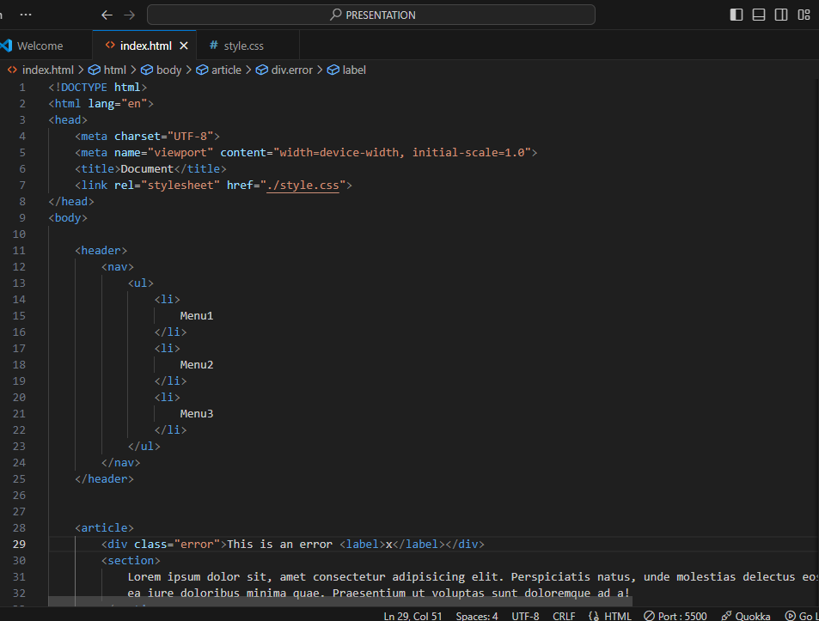
Example html part

Slide 6
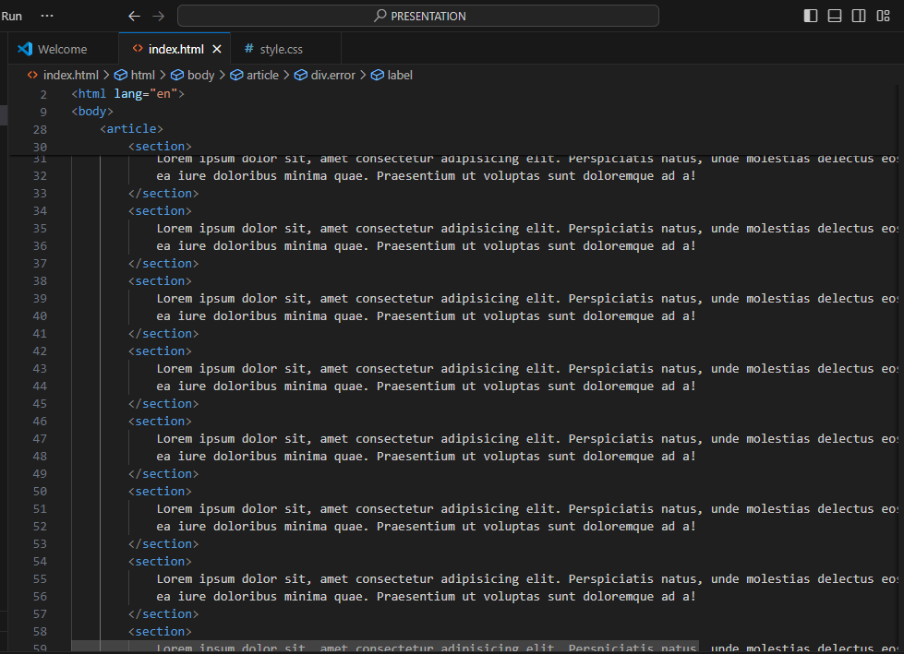
Example html part

Slide 7
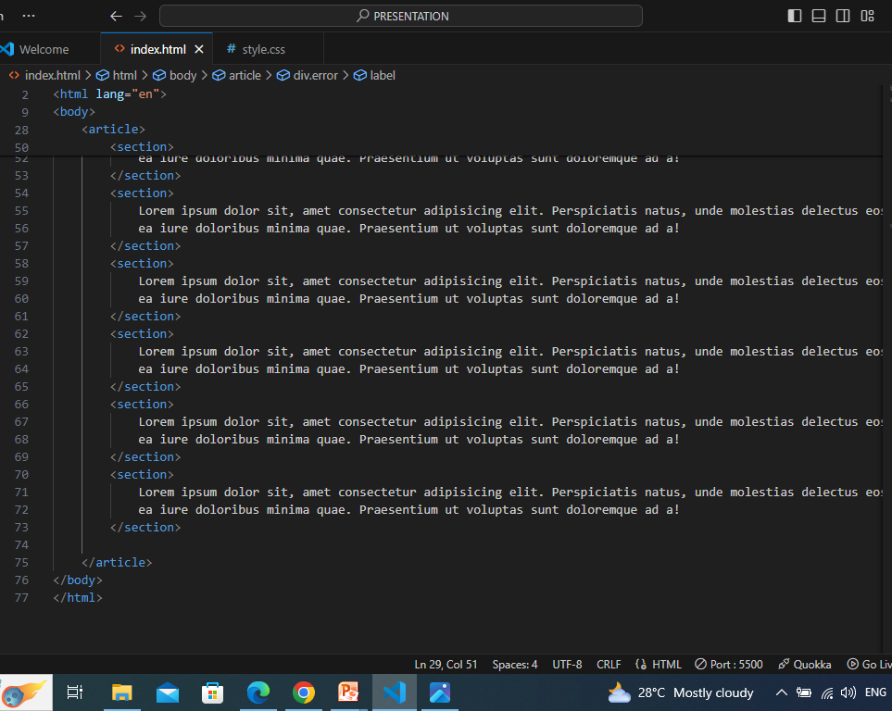
Example html part

Slide 8
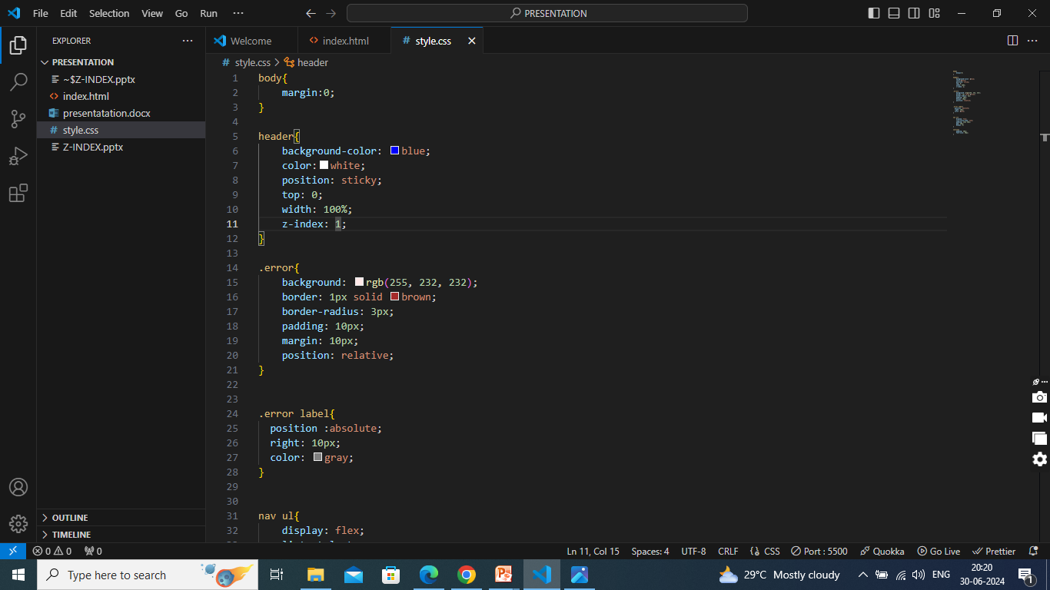
Example css part

Slide 9
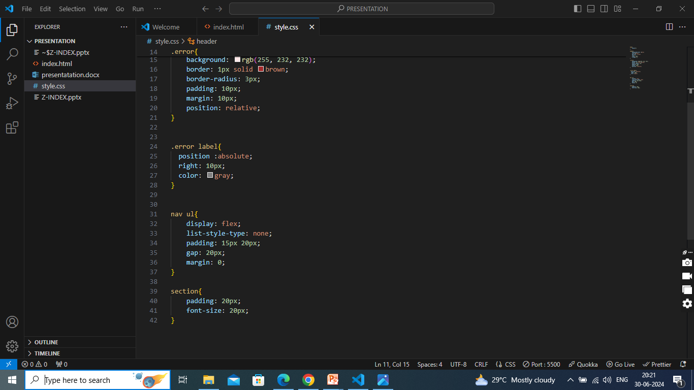
Example css part

Slide 10
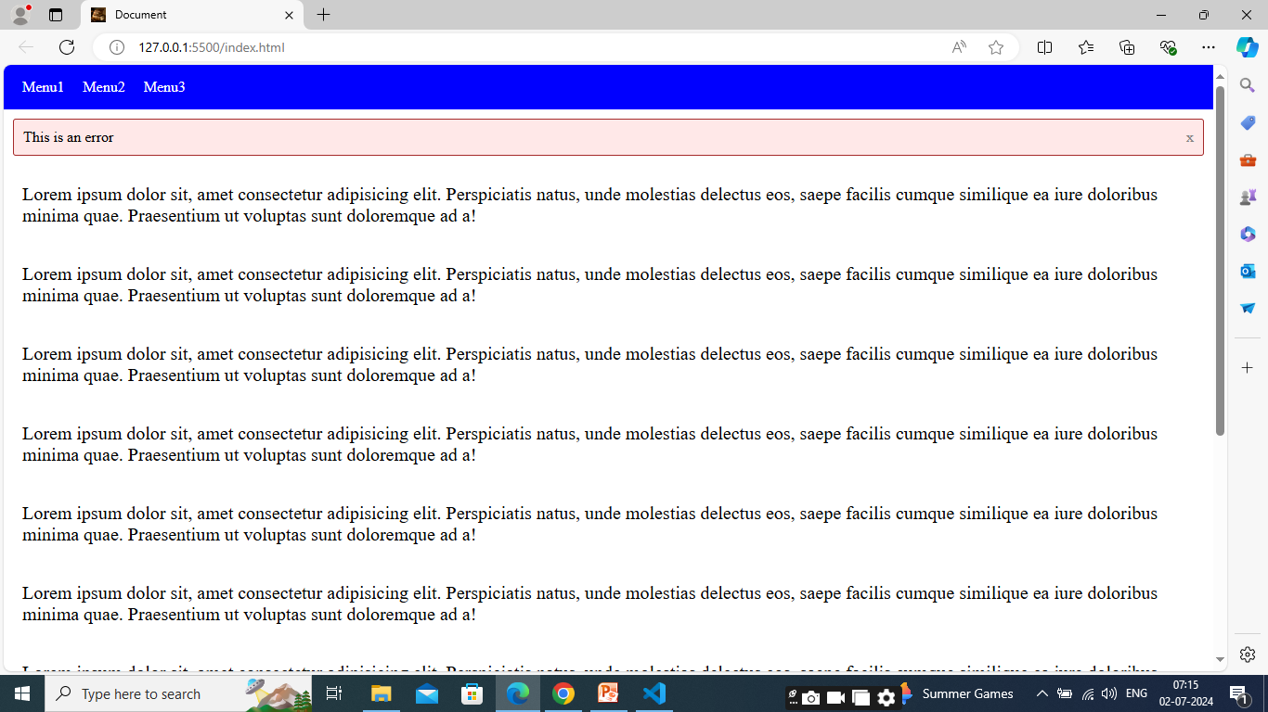
Output

Slide 11
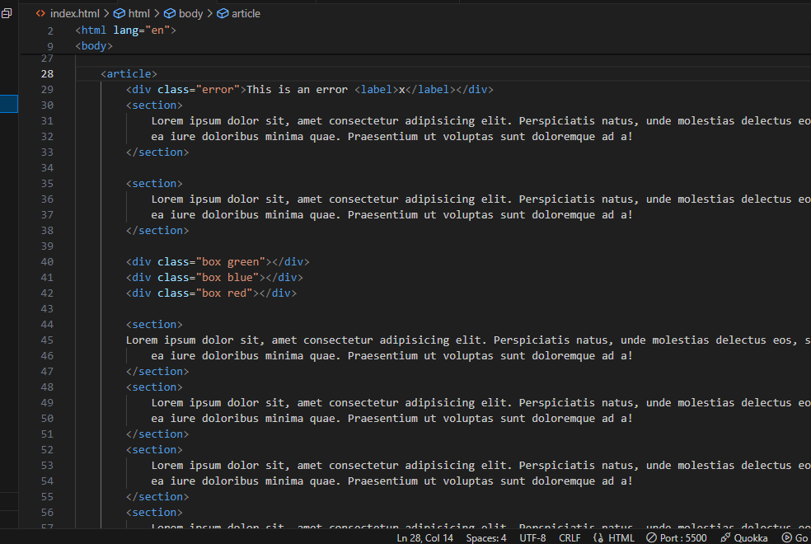
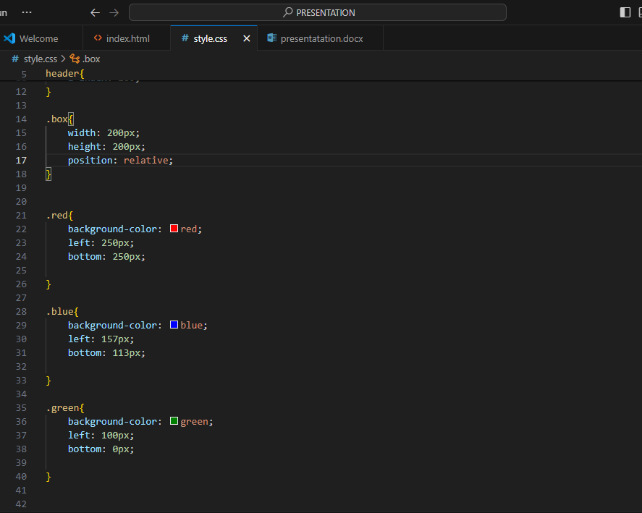
Apply z –index using 3 boxes

Slide 12
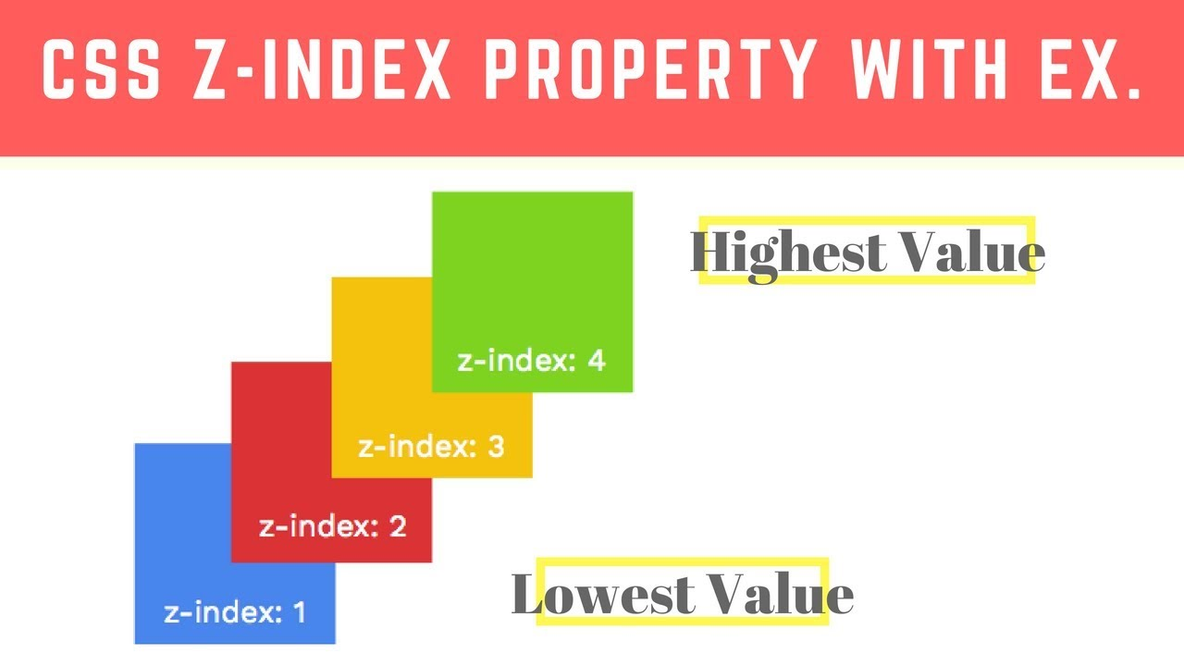
Different z-index values

Slide 13
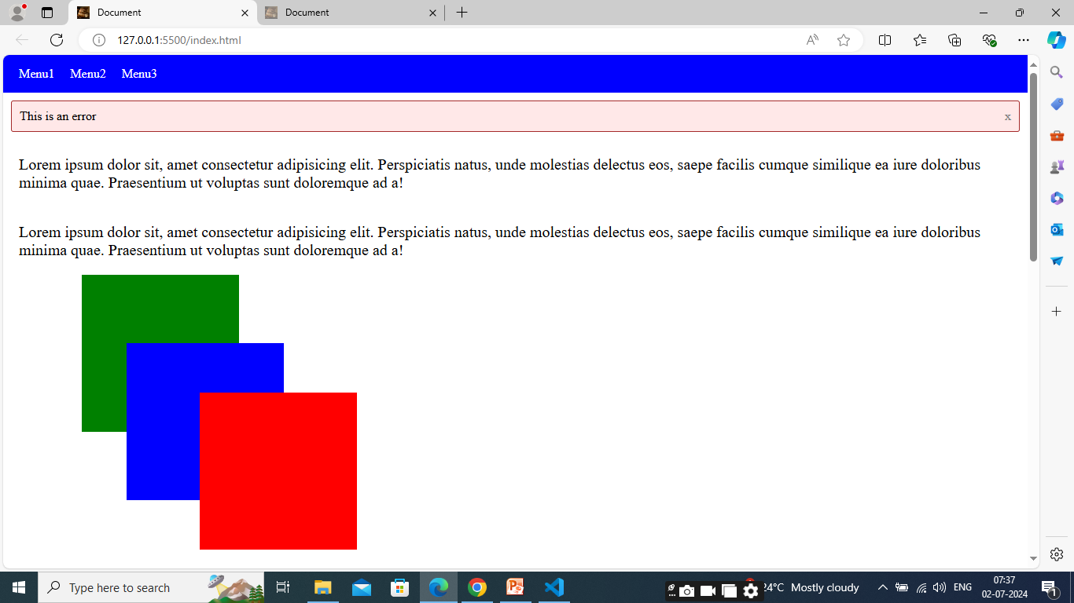
output

Slide 14
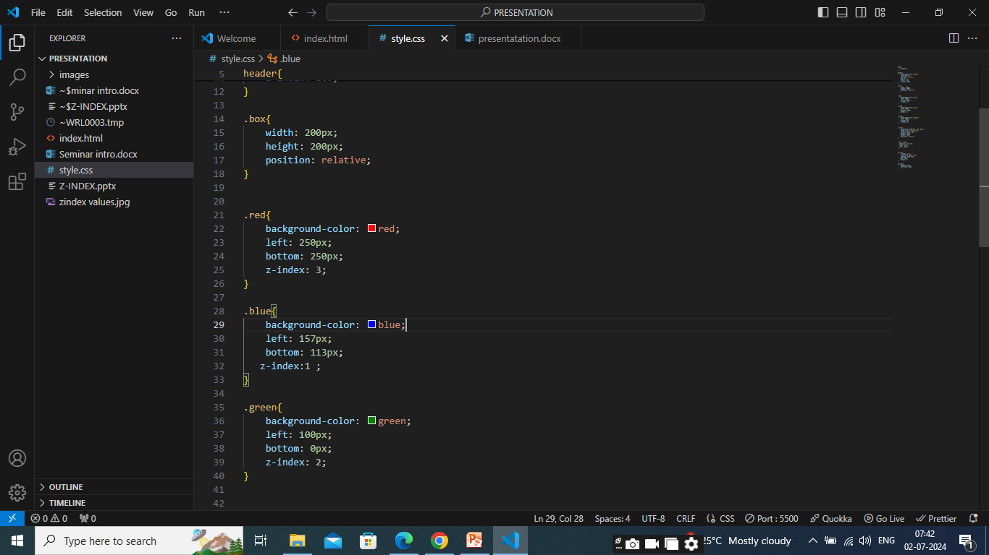
Applying z-iindex

Slide 15
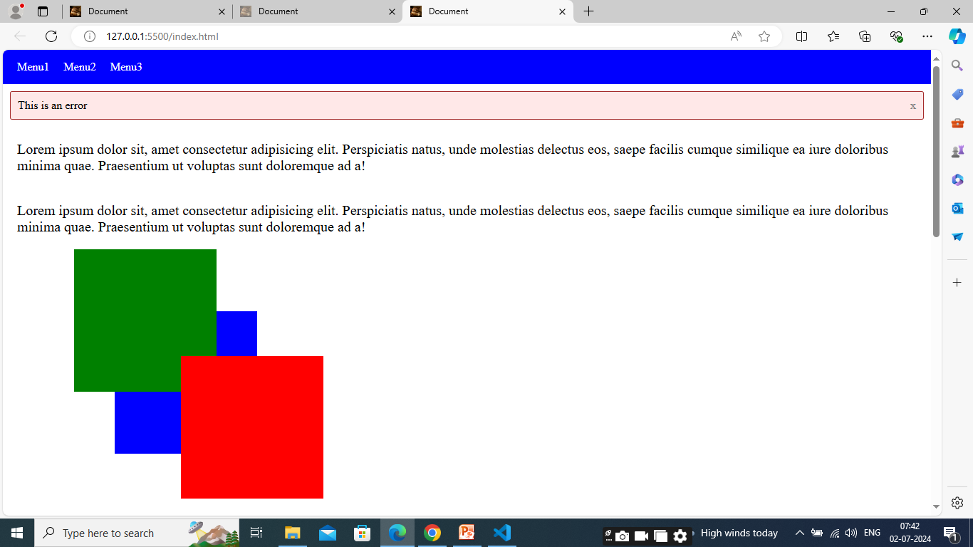
output

Slide 16
Advanced Concepts of Z Index
Stacking Contexts: When an element is positioned with a `z-index` value, it creates a stacking context. Each stacking context is an independent layer, and elements within a stacking context are only compared to each other when determining their stacking order.
Stacking Order: Stacking orders determine how elements are layered within a stacking context. Three factors determine the stacking order:
The stacking context with a higher `z-index` value is placed on top of a stacking context with a lower value.
The element that occurs later in the HTML structure is shown on top if two elements have the same stacking context.
If two elements have the same 'z-index' value and a similar stacking context, their stacking order is determined by the order in which they appear in the HTML structure.

Slide 17
Advanced concepts of z index
Negative z-index: The default stacking order or items with a negative "z-index" value are placed below those with a positive value.
Positioning Contexts: Elements with different positioning types (`position: static`, `relative`, `absolute`, or `fixed`) create their own stacking contexts. For example, an element with `position: relative` and a `z-index` value will be layered within its stacking context, independent of other stacking contexts.
Sticky Positioning: Elements with `position: sticky` are positioned according to their normal position in the document flow until a specified threshold is reached. Sticky elements are treated as if they were `position: relative` until the threshold is met, and then they become `position: fixed`. Elements with `position: sticky` can have a `z-index` value to control their stacking order within their stacking context.

Slide 18
Advanced concepts of z-index
Parent-Child Relationship: The stacking context of a parent element determines the 'z-index' value of a child element. The stacking order of the child element inside that context may change if the parent element has a greater "z-index" value.
Transparency and Stacking Order: Elements with transparent backgrounds or opacity values less than 1 can affect the stacking order of overlapping elements. The transparent or semi-transparent areas are treated as empty, allowing elements behind them to be visible and potentially affecting the stacking order.

Slide 19
Conclusion
Z-index is a crucial property for controlling the stacking order of elements on a webpage
By assigning different z-index values to positioned elements, developers can control their visual hierarchy and ensure elements appear in the desired order on the z-axis.

Slide 20


Slide 21


