Slide 1
Selectors, BOX model

Slide 2
CSS Selectors
A CSS selector selects the HTML element(s) you want to style.
We can divide CSS selectors into five categories:
1.Simple selectors (select elements based on name, id, class)
2.Combinator selectors (select elements based on a specific relationship between them)
3.Pseudo-class selectors (select elements based on a certain state)
4.Pseudo-elements selectors (select and style a part of an element)
5.Attribute selectors (select elements based on an attribute or attribute value)

Slide 3
Tag selector
When HTML tags are used to specifically identify which section of web pages in CSS, they are called selectors.
Eg: body {
background: # FC9;
font-family: Tahoma;
colour: # F60;
}

Slide 4
id Selector
The id selector uses the id attribute of an HTML element to select a specific element.
The id of an element is unique within a page, so the id selector is used to select one unique element!
To select an element with a specific id, write a hash (#) character, followed by the id of the element.
eg
#para1 {
text-align: center;
color: red;
}

Slide 5
class Selector
The class selector selects HTML elements with a specific class attribute.
To select elements with a specific class, write a period (.) character, followed by the class name.
eg:
.center {
text-align: center;
color: red;
}

Slide 6
Universal Selector
The universal selector (*) selects all HTML elements on the page
Eg:* {
text-align: center;
color: blue;
}

Slide 7
Grouping Selector
The grouping selector selects all the HTML elements with the same style definitions.
It will be better to group the selectors, to minimize the code.
To group selectors, separate each selector with a comma.
eg :
h1, h2, p {
text-align: center; color: red;
}

Slide 8
Pseudo Class Selector
button:hover{
font-weight:800;
}

Slide 9
Pseudo Element Selector
p::first-line{
color:blue;
}
It only select first line of p tag

Slide 10
CSS SPACING PROPERTIES - Box Model
CSS - Margin, Border and Padding
Using CSS we can wrap the content, we can set the distance between the content and the border, and the space with other elements on the page. For that, the following CSS attributes will be used
margin - The distance with other elements on page or page.
border - a line that surrounds the element
padding - the distance between the border and the content itself
content - the content can be whatever you like, for example text, image, div, span, etc

Slide 11
Border
Border will just draw a simple border around the HTML element.
Border-style
border-width
Border color
Border-radius

Slide 12
Border-style
The border-style attribute is the one that is used to change the border look. These are the values that can be used with border-style.
Eg: None, Solid, Dotted, Dashed, Double, Groove, ridge, inset, outset

Slide 13
Border-width
The border-width property is used to set the border's width. It is set in pixels.
You can also use the one of the three pre-defined values, thin, medium or thick to set the width of the border.
Eg: border-width: 5px;

Slide 14
Border color
There are three methods to set the color of the border.
Name: It specifies the color name. For example: "red".
RGB: It specifies the RGB value of the color. For example: "rgb(255,0,0)".
Hex: It specifies the hex value of the color. For example: "#ff0000".
There is also a border color named "transparent". If the border color is not set it is inherited from the color property of the element.

Slide 15
Border-radius
This CSS property sets the rounded borders and provides the rounded corners around an element, tags, or div. It defines the radius of the corners of an element.
It is shorthand for border top-left-radius, border-top-right-radius, border-bottom-right-radius and border-bottom-left-radius.
It gives the rounded shape to the corners of the border of an element.
We can specify the border for all four corners of the box in a single declaration using the border-radius. The values of this property can be defined in percentage or length units.
Eg: border-radius: 30px;
border-radius: 20% 10% ;(top-left and bottom-right )
border-radius: 10% 30% 20% 40%;
(first value will be the radius of top-left, the second value will be used for the top-right, the third value will be applied on bottom-right, and the fourth value is used for bottom-left.)

Slide 16
Margin
The margin is basically just space around the box and it will be transparent.
To define the space around our box model we will set the margin for all four sides of the element: TOP, RIGHT, BOTTOM, LEFT.
margin: 30px 20px 30px 50px; /* up, right, bottom, left */
margin: 30px 20px 50px; /* up, right and left, bottom */
margin: 30px 20px; /* up and bottom, right and left */
margin: 30px; /* up, bottom, right, left - This will just set a 30ps width margin around the element. */

Slide 17
Padding
Padding refers to the region between the content and the border. We will set this region, same way as the margin attribute.
padding-top:10px;
padding-bottom:10px;
padding-right:20px;
padding-left:20px;

Slide 18
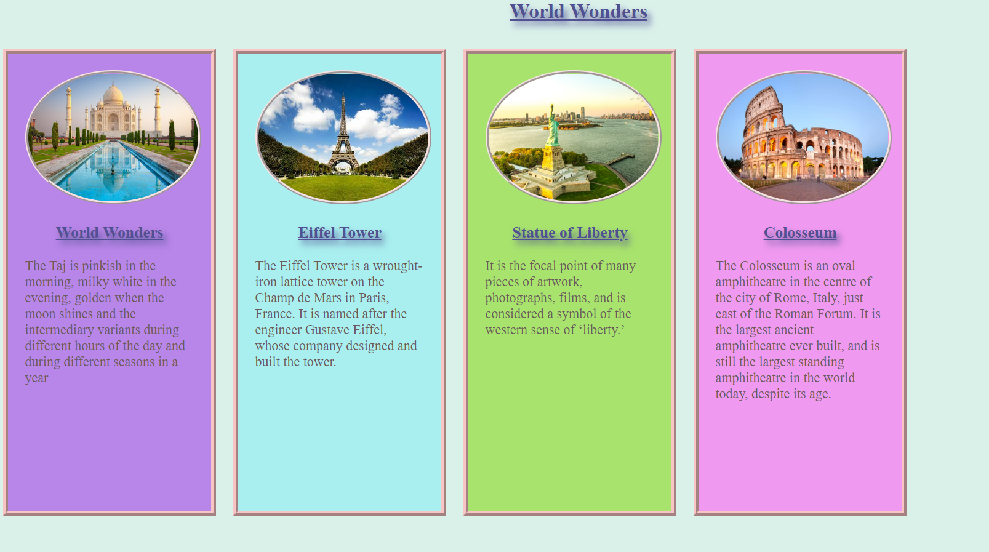
TASK
World wonder site

Slide 19
Task
Write a note on given css selectors
Descendant Selector
Child Selector (>)
Adjacent Sibling Selector (+)

