Slide 1
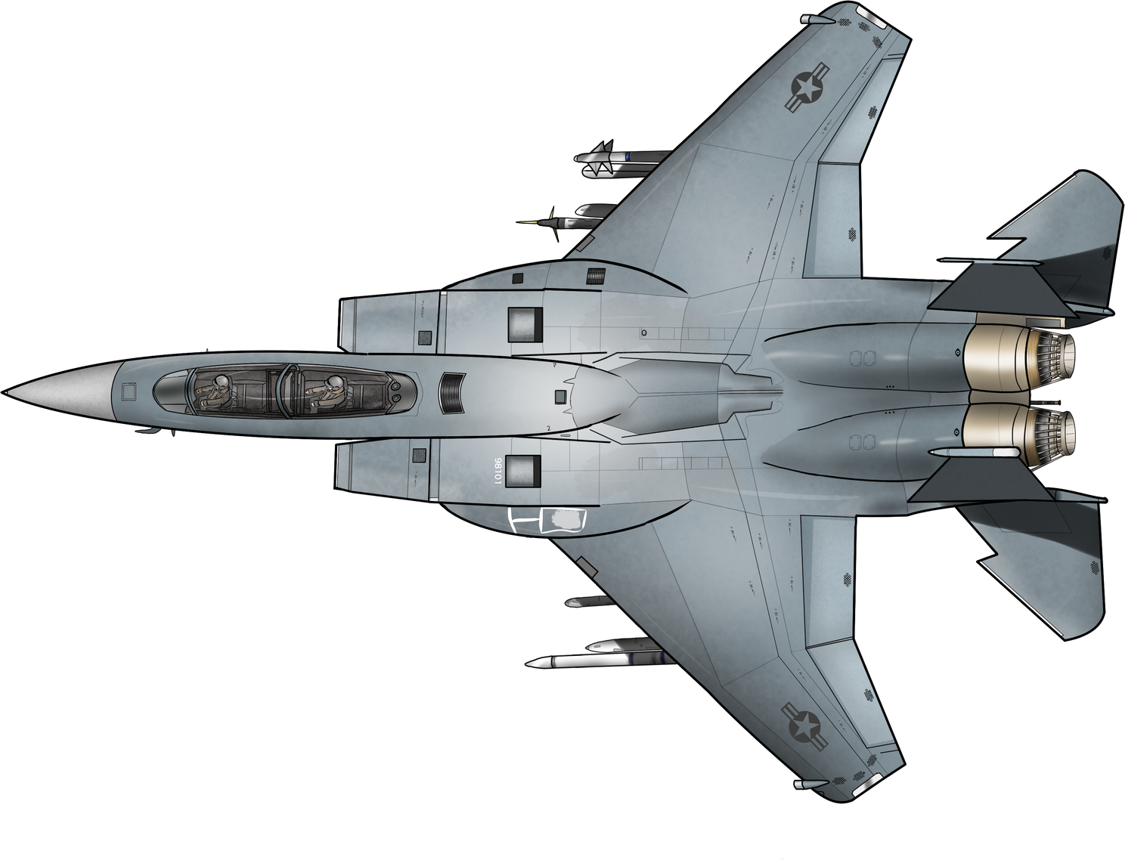
INTERACTIVE RADAR TUTORIAL WEBSITE

Slide 2
INTERACTIVE
RADAR TUTORIAL FOR AIRCRAFTS
TEAM MEMBERS:
ANJALI SHARMA
VANSHITA JAIN
KHUSHI JANGID
GUIDE:
MR. ARVIND SHARMA
ASSISTANT PROFESSOR
(CSE DEPARTMENT)

Slide 3
ABSTRACT
In the ever-evolving field of aerospace defense, understanding the intricacies of radar technology and its application in enemy detection systems is crucial. This tutorial website offers a comprehensive and interactive learning experience focused on radar systems used in aircraft for enemy detection.
Through engaging tutorials and theoretical knowledge with practical, hands-on simulations, these tutorials aim to enhance the learning experience and provide a deeper understanding of how radar systems contribute to national security.

Slide 4
DESCRIPTION
Provides a comprehensive understanding of radar technology and its critical role in enemy detection for aircraft.
Through detailed explanations and interactive simulations
Users will learn how radar systems identify, track, and differentiate between various airborne targets.
Practical insights into the strategic use of radar in enhancing aircraft security and situational awareness.

Slide 5
WHAT MAKES IT DIFFERENT?

Slide 6
INTERACTIVE RADAR VISUALIZER TOOL

Slide 7
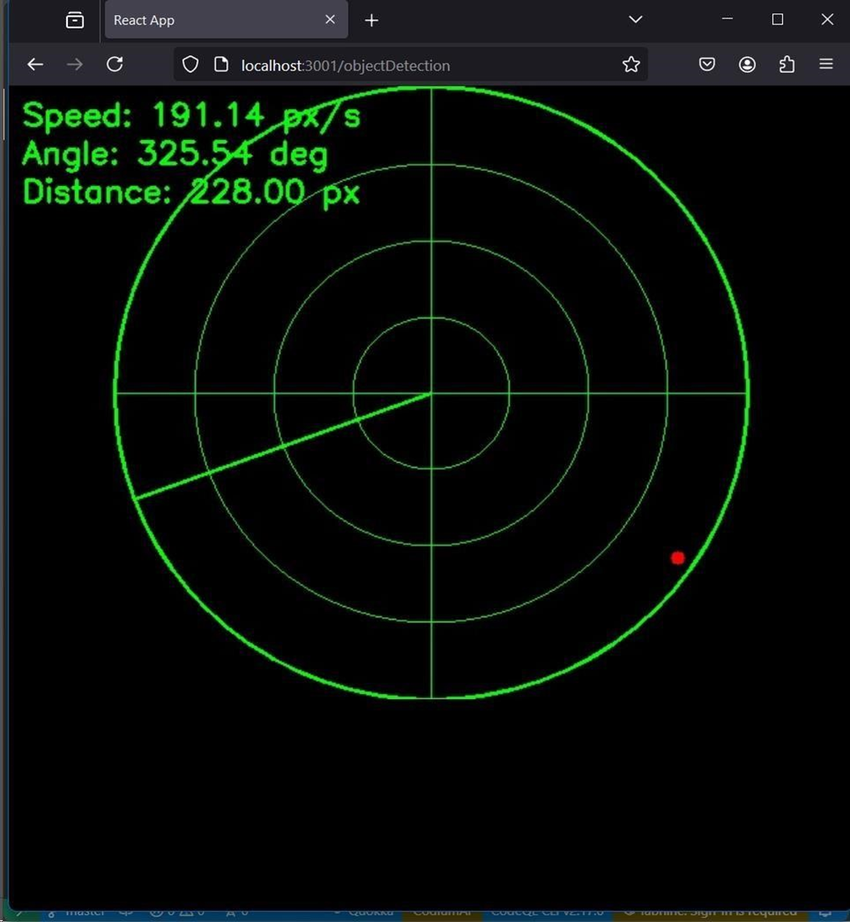
INTERACTIVE RADAR VISUALIZER TOOL
The user can use a yellow coloured object to simulate an enemy.
As she moves the object in front of the camera, she can see a red coloured dot on the screen.
The tool provides information such as the speed, angle and distance.

Slide 8







TECH STACK

Slide 9

TECH STACK

Slide 10
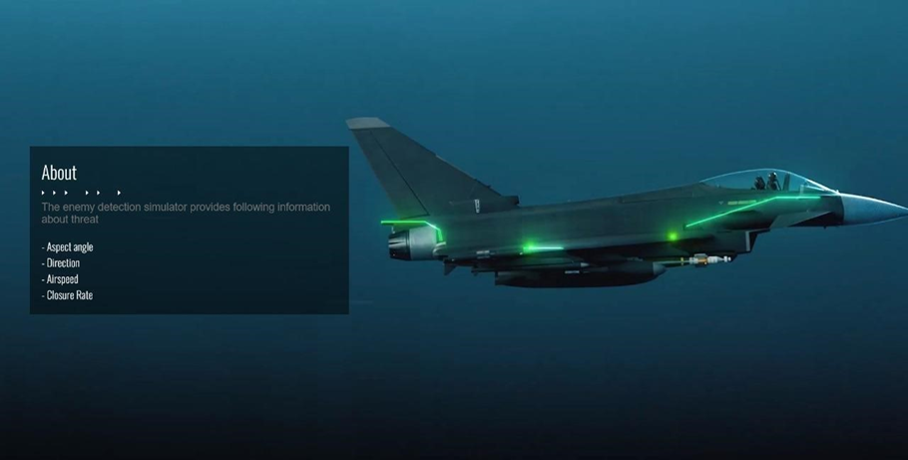

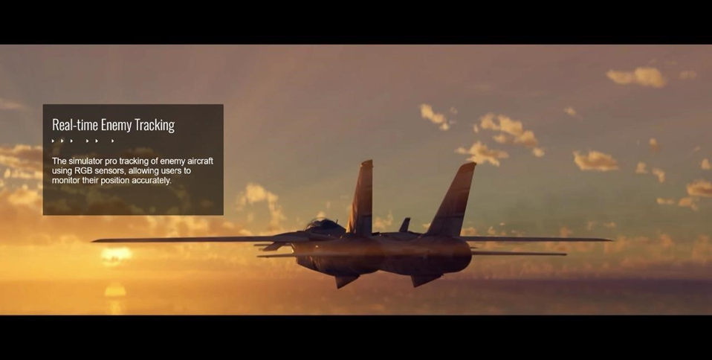
OUTPUT SCREEN

Slide 11
CONCLUSION
Radar technology continues to evolve, with advancements in signal processing, antenna design, and integration with other sensor technologies. It remains a critical tool for both military and civilian applications, enabling safer and more efficient operations across various industries. Radar technology continues to evolve, driven by advancements in electronics, signal processing, and materials science. Its applications span across defense, aviation, weather monitoring, and beyond, making it an indispensable tool in modern technology. As research and development progress, radar systems are expected to become more accurate, versatile, and integrated with other technologies, further enhancing their utility in diverse operational environments.

Slide 12

FUTURE SCOPE
• Infrared sensors: To get an idea of the depth in frames, the visualization tool can enhance the learning experience even further.
• Multidimensional system: Right now our tool is limited to the horizontal axis and doesn’t cover the vertical axis.
• Improving the characteristics of the enemy
objects with the help of machine learning. Which can detect
fighter jets, drones and other aerial vehicles, instead of a specific color.

Slide 13
FUTURE SCOPE
• Infrared sensors: To get an idea of the depth in frames, the visualization tool can enhance the learning experience even further.
• Multidimensional system: Right now our tool is limited to the horizontal axis and doesn’t cover the vertical axis.
• Improving the characteristics of the enemy
objects with the help of machine learning. Which can detect
fighter jets, drones and other aerial vehicles, instead of a specific color.

Slide 14
REFERENCES
https://migflug.com
https://www.iiss.org
https://www.eurofighter.com/
https://docs.opencv.org

Slide 15
THANK YOU!

