Slide 1
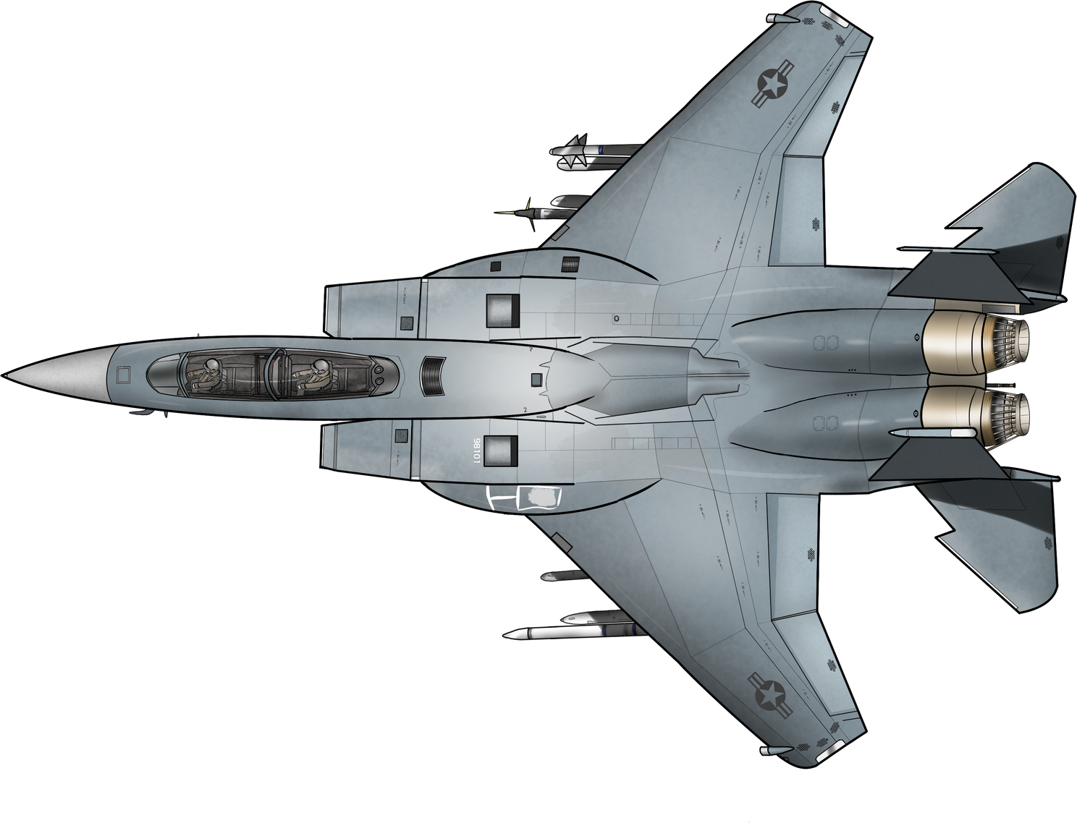
ENEMY
AIRCRAFT
DETECTOR

Slide 2
ENEMY
AIRCRAFT
DETECTOR
TEAM MEMBERS:
ANJALI SHARMA
VANSHITA JAIN
KHUSHI JANGID

Slide 3
ABSTRACT
The Enemy Detection System for Aircrafts uses RGB Sensor
Employs color-based motion detection to identify potential threats within the aircraft's vicinity.
Sensor captures real-time environmental data, and through image processing techniques, specific characteristics indicative of potential enemy aircraft are isolated.
Triggers a response mechanism, alerting the aircraft’s pilot to the potential threat.
The response can include visual indicators, alarms or tailored notifications.

Slide 4
The enemy detection system will work in 2 modes:
Search Mode: The system will run an object detection algorithm to locate the enemy.
Track Mode: The system provides more information target:
Air Speed
Direction
Aspect angle
Closure rate
Concepts used:
Vector algebra
Trigonometry
Object detection, tracking algorithms
Animations to make user interface interactive, intuitive appealing
DESCRIPTION

Slide 5






TECH STACK

Slide 6
TECH STACK

Slide 7

FUTURE UPDATES
• Infrared sensors: To get an idea of the depth in frames.
• Multidimensional system: Right now our project is limited to the horizontal axis and doesn’t cover the vertical axis.
• Improving the characteristics of the enemy
objects with the help of machine learning. Which can detect
fighter jets, drones and other aerial vehicles, instead of a specific color.

Slide 8
FUTURE UPDATES
• Infrared sensors: To get an idea of the depth in frames.
• Multidimensional system: Right now our project is limited to the horizontal axis and doesn’t cover the vertical axis.
• Improving the characteristics of the enemy objects with the help of machine learning. Which can detect fighter jets, drones and other aerial vehicles, instead of a specific color.

Slide 9
REFERENCES
https://migflug.com
https://www.iiss.org
https://www.eurofighter.com/
https://docs.opencv.org

Slide 10
THANK YOU!

