Slide 1
IMDb movie analysis
Anjali prajapati

Slide 2
Project description:
IMDB is a series or movie rating site.
Data set contains movie name, director names, imdb rating, language etc.
We are required to do,
Framing the problem.
Defining a problem that we want to shed some light on.
Cleaning the data as necessary, and using the data analysis skills to explore the data set and derive insights.

Slide 3
Approach:
Firstly, understanding the data.
Cleaning the data by deleting unnecessary columns, deleting duplicate values/cells and by removing null vales.
Checking if any outlier is present in the given set.
Then by using different excel functions, charts we will analysis the dataset.
Then we will conclude the results.

Slide 4



tech-stack used:
Microsoft excel
PowerPoint
Google sheets

Slide 5
Cleaning the data:
Drop the unnecessary columns.
(Because we don’t need these columns for the analysis.)
color
director_facebook_likes
actor_3_facebook_likes
actor_2_name
actor_1_facebook_likes
cast_total_facebook_likes
actor_3_name
facenumber_in_poster
plot_keywords
movie_imdb_link
content_rating
actor_2_facebook_likes
aspect_ratio
movie_facebook_likes
Remove the black values or cells.
Remove the duplicate values.
Click here -
Cleaned_data

Slide 6
Outlier:
-2127109510
-12213298588
-2499804112
-2397701809
-4199788333
(These are the outliers of our data set i.e. the extreme values.)

Slide 7
Movies with highest profit:
The movies with highest profit are AVATAR followed by JURASSIC WORLD then TITANIC and so on.

Slide 8
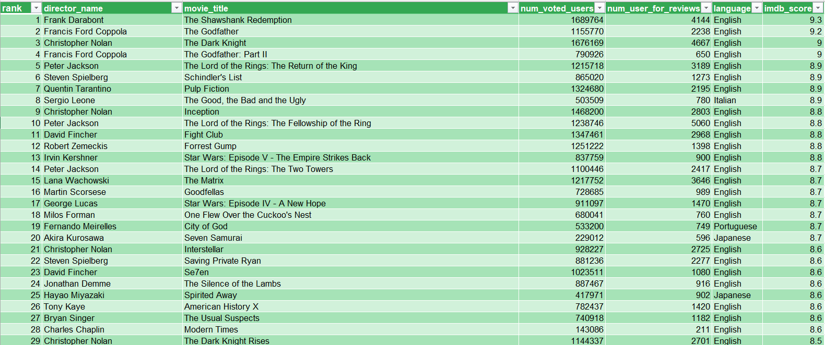
IMDB Top 250:
Click here -
top_250_movies

Slide 9
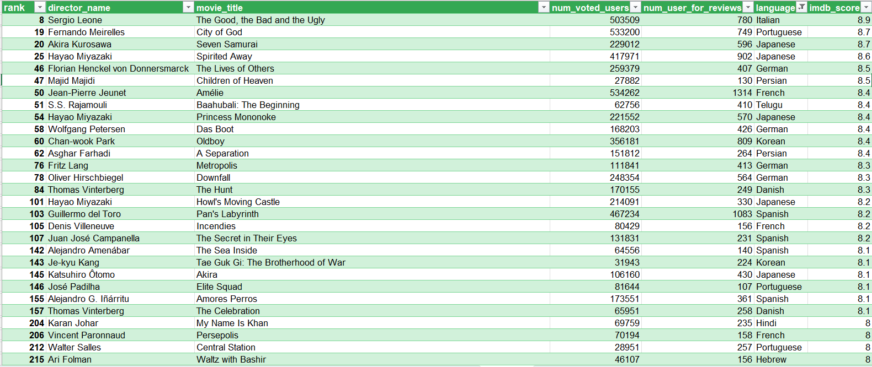
Top foreign language film:
Click here -
top_foreign_language_movies

Slide 10
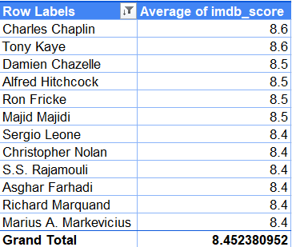
best directors:
Top_directors with average of imdb_score:
Charles Chaplin and Tony Kaye are the top directors with average imdb_score 8.6

Slide 11
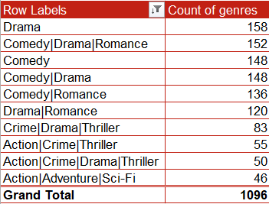
popular genres:
Drama is the most popular genres.

Slide 12
the critic-favorite and audience-favorite actors:
Leonardo DiCaprio is the CRITIC-FAVOURITE and the AUDIENCE-FAVOURITE actor.

Slide 13
Decade:
After 1980’s we can see increase in the number till 2000’s after that the number is declining.

Slide 14

Thank you☺

