Slide 1

Autonomous ML Model Monitoring & Drift Management Platform
MLOps | Cloud AI | ML Systems
ANJALI KUMARI
VAISHNAVI PANDEY
ABHAY TARKAR

Slide 2
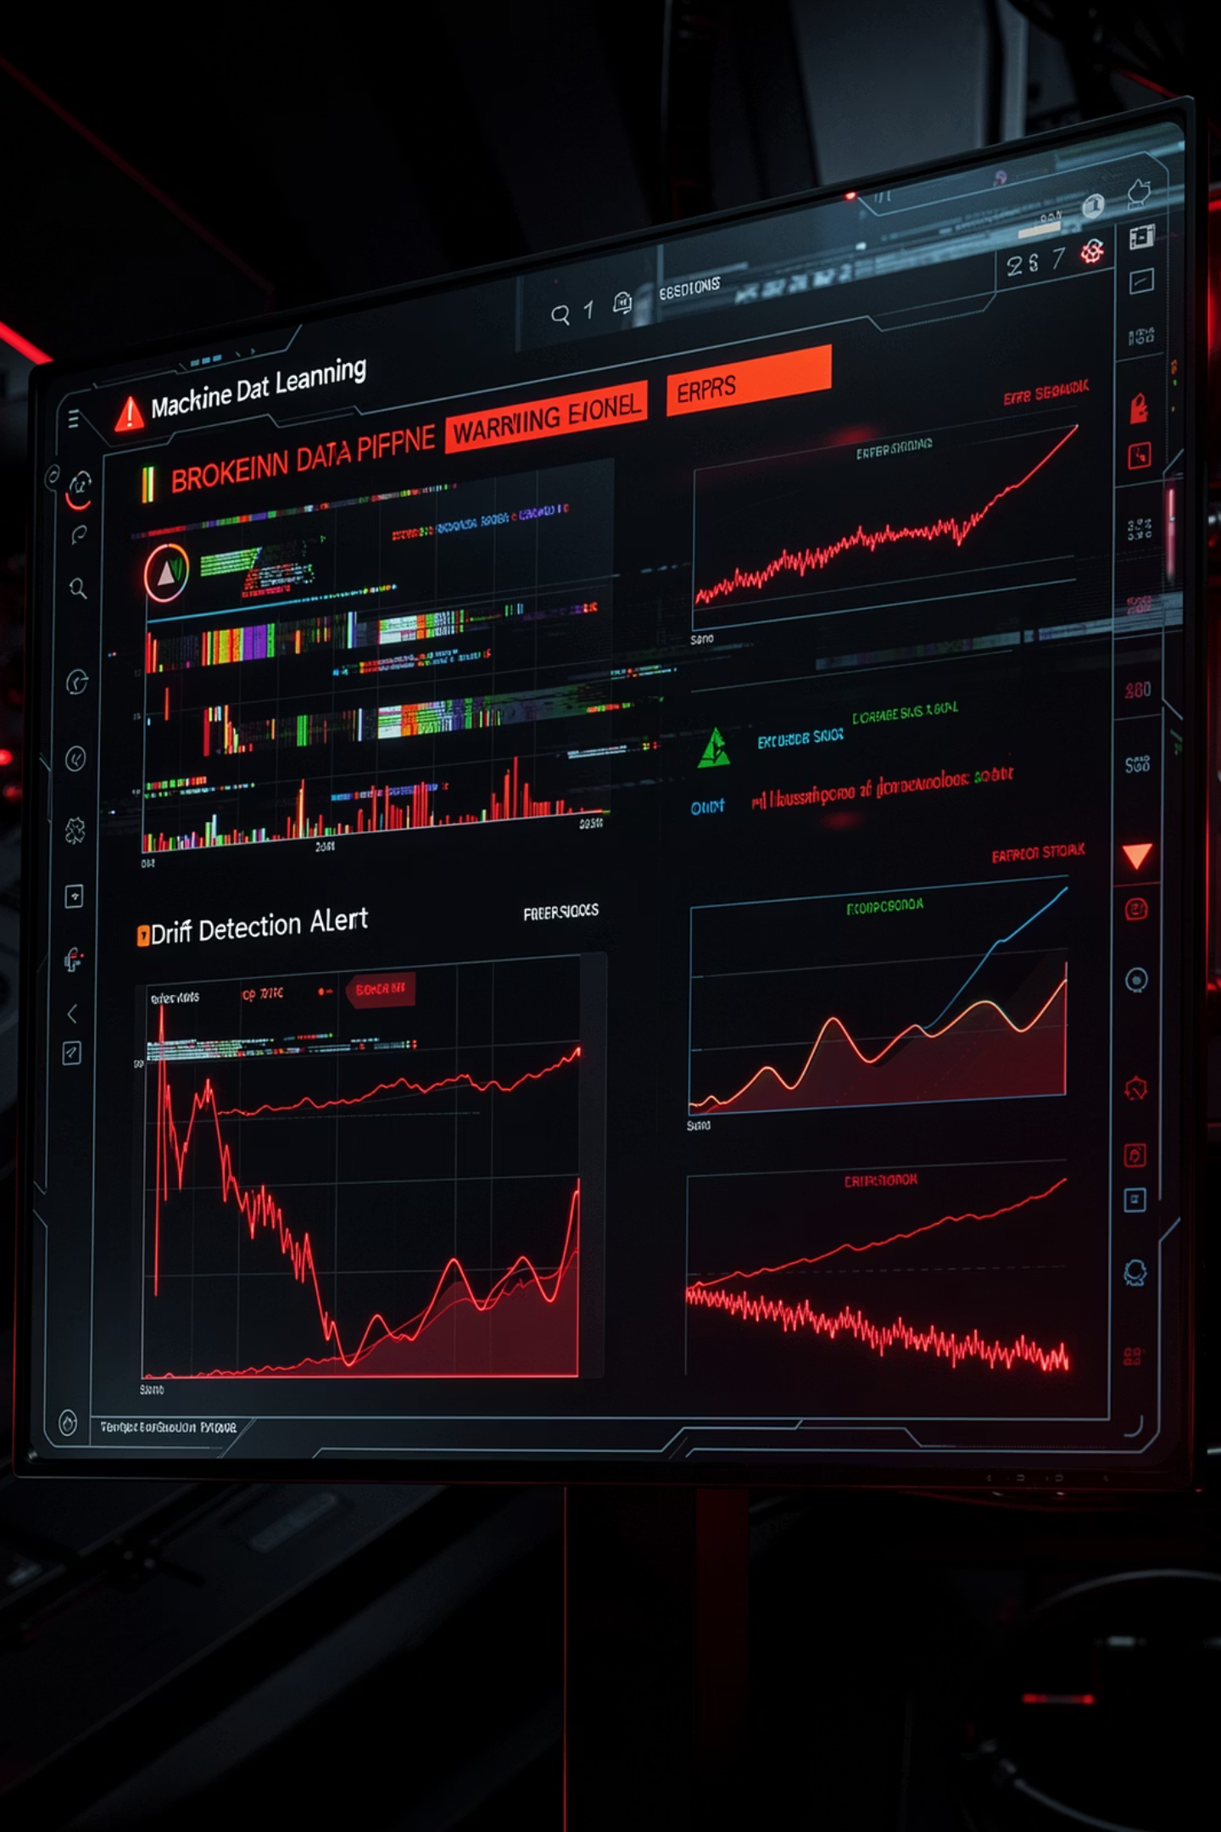
The Silent Crisis in Production ML
⚠ Silent Model Failure
📉 Data Drift
Models degrade undetected in production — no alerts, no visibility, no response.
Incoming data distributions shift over time, making trained models increasingly unreliable.
🕐 Late Detection
Issues surface only after significant business damage — costly and hard to reverse.

Slide 3
Why Existing Systems Fall Short
No Real-Time Visibility
Manual Retraining
Metrics are logged but never actively watched. Teams fly blind until failures cascade.
Engineers manually trigger retraining — slow, error-prone, and unscalable in production.
Poor Audit Logs
Delayed Alerting
No structured record of drift events, model versions, or retraining decisions. Compliance risk.
Threshold-based alerts fire too late — reactive, not proactive monitoring.

Slide 4
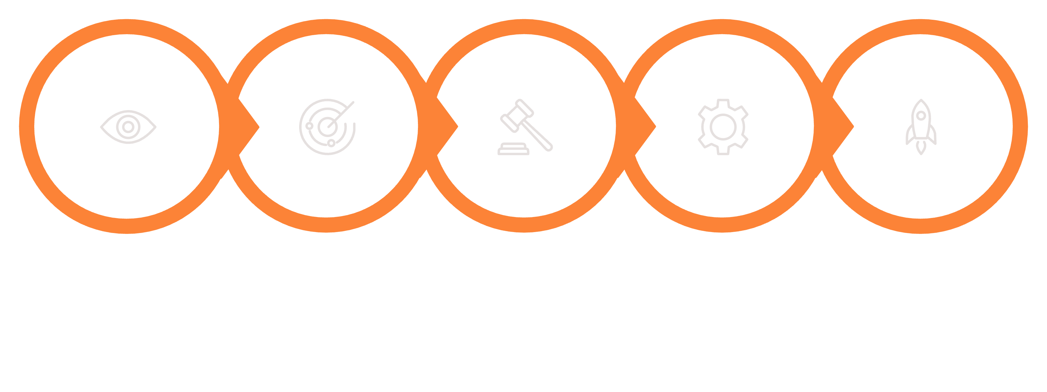
Our Solution: Close the Loop
A fully autonomous platform that detects, decides, and acts — without human intervention.
Monitor
Detect
Decide
Retrain
Deploy
Every stage is automated, logged, and observable — from drift signal to deployment.

Slide 5
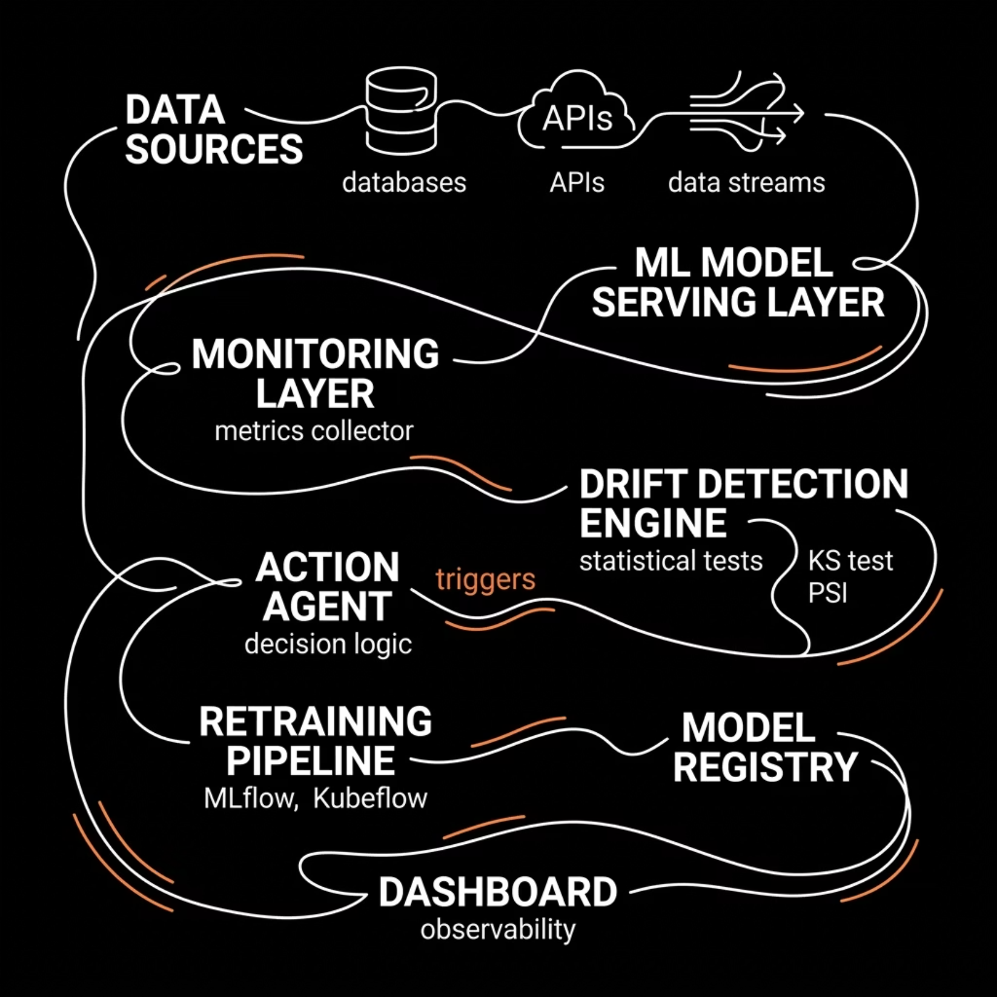

Platform Architecture
Key System Components
Data Ingestion
Drift Detection Engine
Streams, batch sources, feature stores
KS Test, PSI, MMD statistical methods
Action Agent
Retraining Pipeline
Rule-based + ML-driven decision logic
MLflow + Kubeflow orchestration
Observability Dashboard
Real-time metrics, alerts, model health

Slide 6
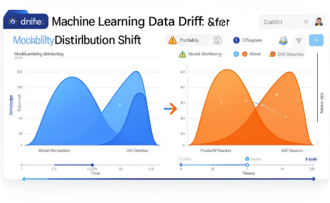
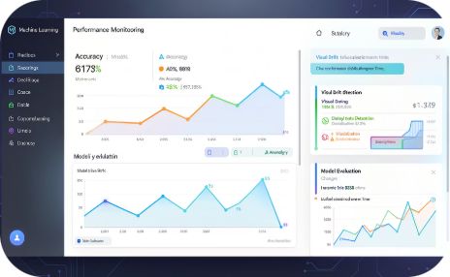
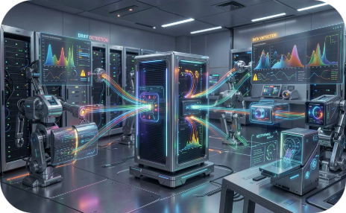
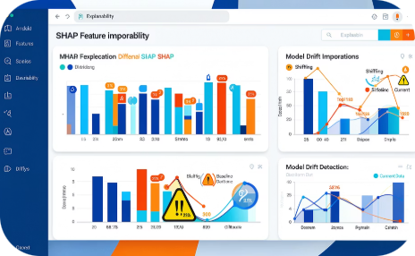
Core Platform Features
Drift Detection
Performance Monitoring
Auto Retraining
Explainability
Statistical tests (KS, PSI, MMD) detect covariate and concept drift in real time.
Automatically triggers retraining pipelines when drift severity exceeds defined thresholds.
SHAP-based feature attribution explains why drift occurred and which features shifted most.
Track accuracy, F1, latency, and custom KPIs continuously across all deployed models.

Slide 7
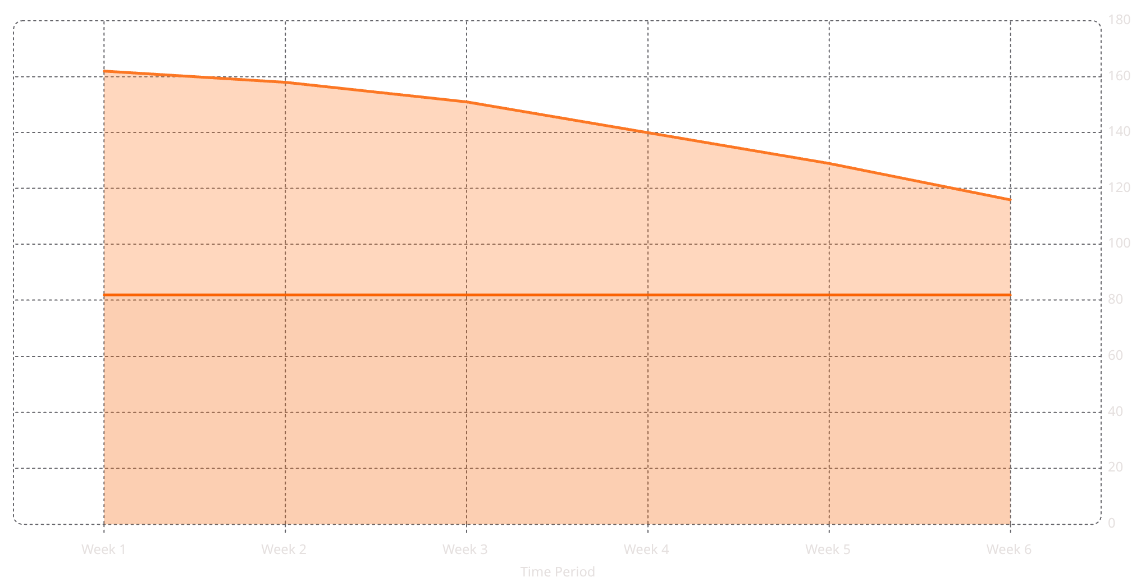

Drift Detection in Action
Live Data Distribution
Training Distribution
Two Types of Drift Detected
Data Drift
Input feature distributions shift — model receives data unlike what it was trained on.
Concept Drift
The relationship between inputs and outputs changes — ground truth evolves over time.
Drift detected at Week 4 — auto-retraining triggered automatically.

Slide 8

End-to-End Workflow Pipeline
Prediction
Retrain & Deploy
Monitoring
The entire pipeline executes autonomously — from live prediction to validated redeployment — with full audit trail at every step.

Slide 9
Platform Benefits
95%
10x
Uptime SLA
Faster Response
Model reliability maintained through continuous health checks
Automated detection vs. manual discovery of model failures
0
100%
Manual Triggers
Audit Coverage
Zero human intervention needed for routine retraining cycles
Every drift event, decision, and retrain fully logged and traceable

Slide 10

Not a model.
A system.
A production-ready MLOps platform that monitors, adapts, and evolves — keeping AI reliable long after deployment.
Self-Healing ML
Multi-Model Orchestration
Edge Deployment

