Slide 1
Lead Scoring Case Study
July 2021

Slide 2
Problem Statement
X Education sells online courses to industry professionals many interested professionals visit their website and browse for courses. The company generates leads through past referrals or visitors providing their contact details. Through the current sales process, only around 30% leads get converted. To improve this, ex education wishes to identify the most promising leads for the sales team.
The CEO, in particular, has given a ballpark of the target lead conversion rate to be around 80%.

Slide 3
Analysis Approach
Below are the steps followed for analysis of this case study:
1.Read the Leads dataset
Performed a non-graphical EDA
2. Data Cleaning
Missing Value Analysis – removed columns with more than 40% data missing
Imputed missing values using Central Tendency
Outlier Analysis
3. Checked data types
4. Grouped lower values of categorical variables
5. Checked the Target variable
6. Performed Univariate, Bivariate and Multivariate Analysis(one variable at a time) on Categorical and Numerical variables
7. Encoded categorical variables
8. Checked Correlations
9. Split data into train and test
10. Performed feature scaling
11. Performed feature selection using RFE
12. Model building using Statsmodels
13. Model evaluation by using metrics like Accuracy, Sensitivity, Specificity, False positive rate, Positive predictive value, Negative predictive value, Precision, Recall, ROC curve
14, Finding the optimum cut-off
15. Made predictions on the test set
16. Feature Importance
17. Conclusion
18. Recommendations

Slide 4
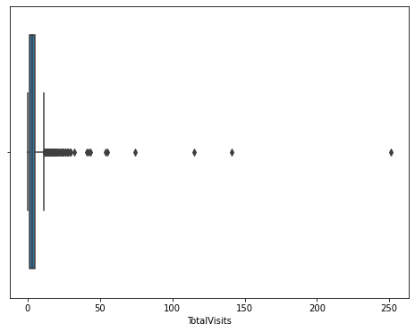
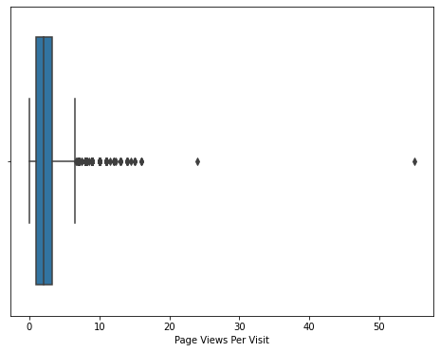
Outlier Treatment
Insights:
TotalVisits and page views per visit have outliers
Remove the rows which have values greater than 99th percentile for these columns

Slide 5
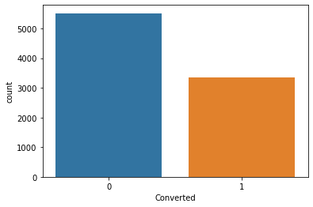
Checking the target variable
Insights:
Only 37% of the prospects have converted
We notice that the data is imbalanced

Slide 6
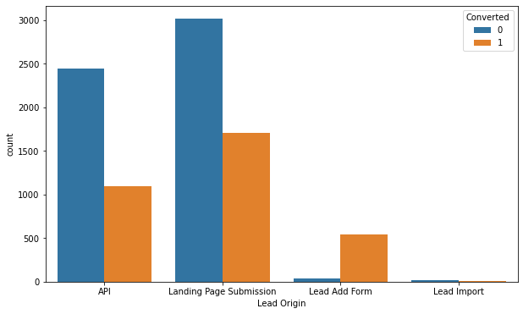
Comparing lead origin versus converted column
Insights:
More leads are coming through prospects submitting on the landing page

Slide 7
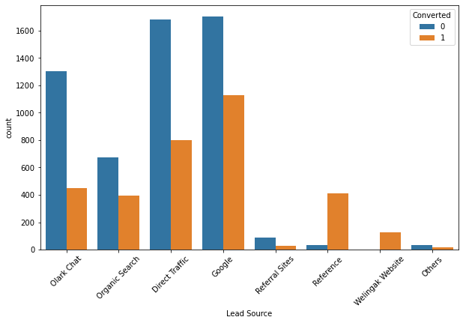
Comparing lead source versus converted column
Insights:
most leads are coming through Google and direct traffic

Slide 8
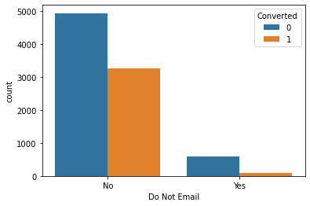
Comparing do not email versus converted column
Insights:
most customers do not want to be contacted through email about the course
This column has very low or no variability

Slide 9
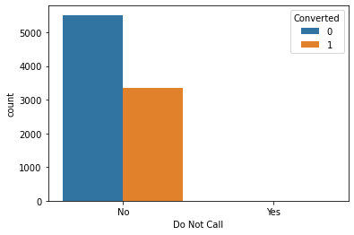
Comparing do not call versus converted column
Insights:
what most customers do not want to be called about the course
This column has very low or no variability

Slide 10
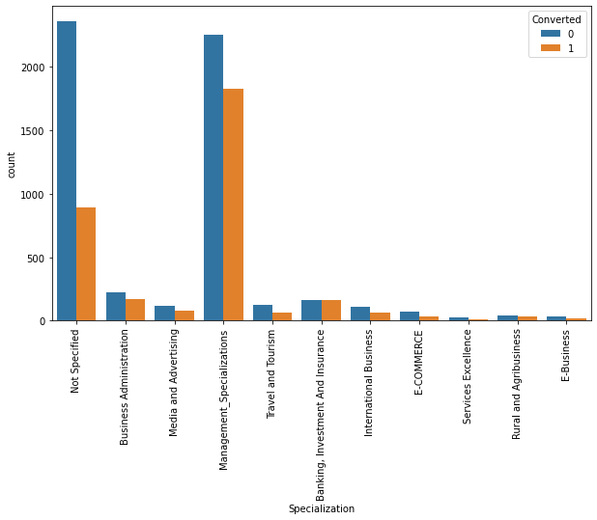
Comparing specialization versus converted column
Insights:
a sizable number of customers have either chosen not to provide their specialization or they are from management

Slide 11
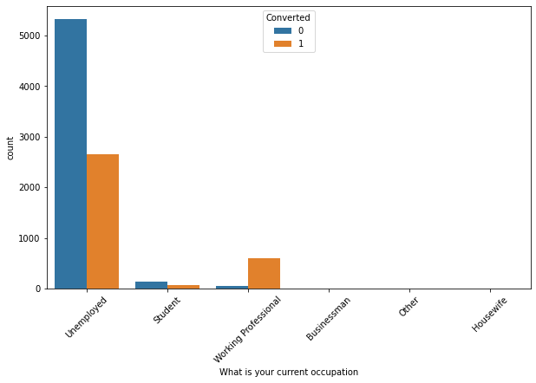
Comparing what is your current occupation versus converted column
Insights:
a clear majority of customers are unemployed

Slide 12
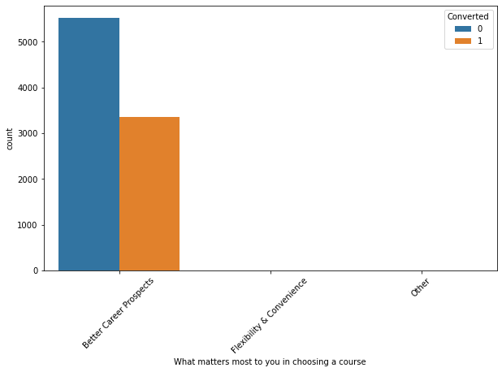
Comparing what matters most to you in choosing a course versus converted column
Insights:
most of the customer's main motive behind joining a course is to look for better career prospects
this column has very low or no variability

Slide 13

Comparing search versus converted column
Insights:
most of the customers have not seen the ad of X education
this column has very low or no variability

Slide 14
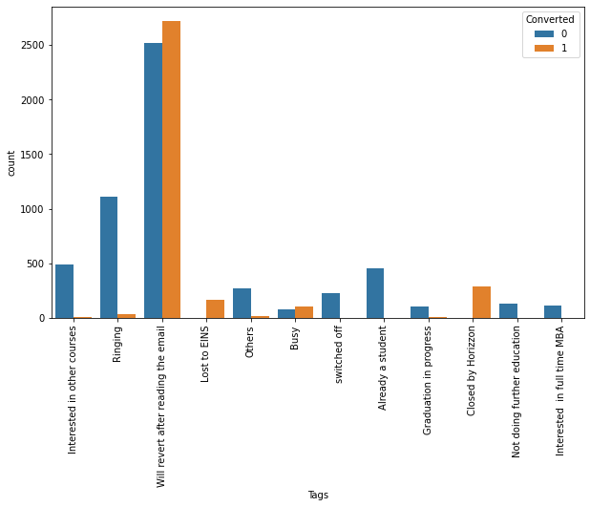
Comparing tags versus converted column
Insights:
the current status of most of the customers is that they will return after reading the email

Slide 15
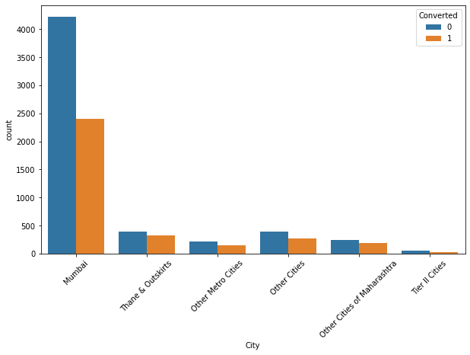
Comparing city versus converted column
Insights:
most customers are from Mumbai

Slide 16
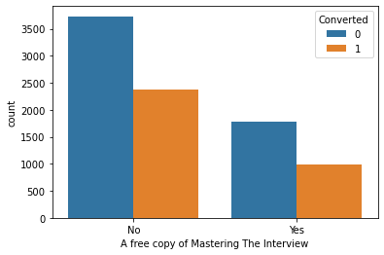
Comparing a free copy of mastering the interview versus converted column
Insights:
majority of customers do not want a free copy of the mastering the interview

Slide 17
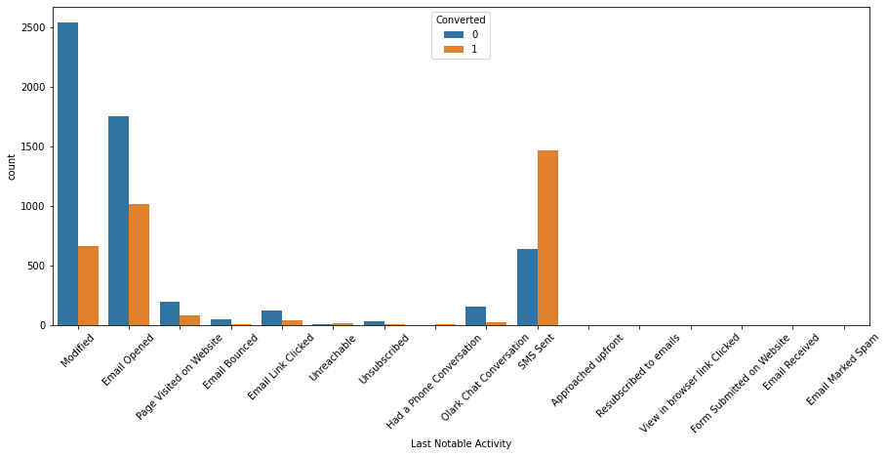
Comparing last notable activity versus converted column
Insights:
last notable activity of most of the students is either modified, email opened or SMS sent

Slide 18
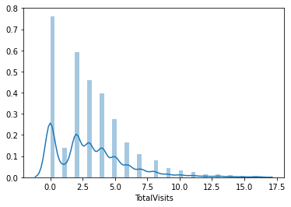
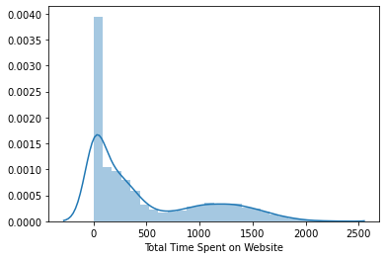
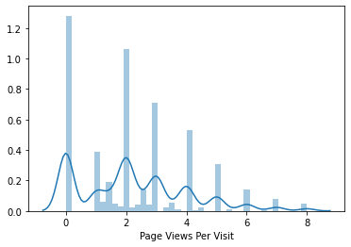
Visualizing the numerical distributions
Insights:
all three distributions are right skewed that is their mean is greater than mode

Slide 19
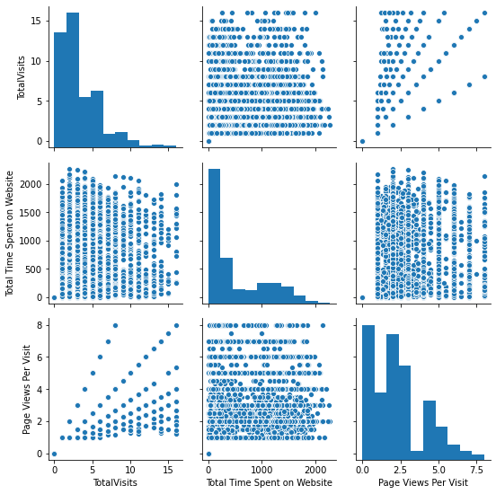
Visualizing the pair plots of numerical distributions
Insights:
there doesn't seem to be much direct linear relationship between these variables. But there seems to be some relationship between total visits and pageviews per visit

Slide 20
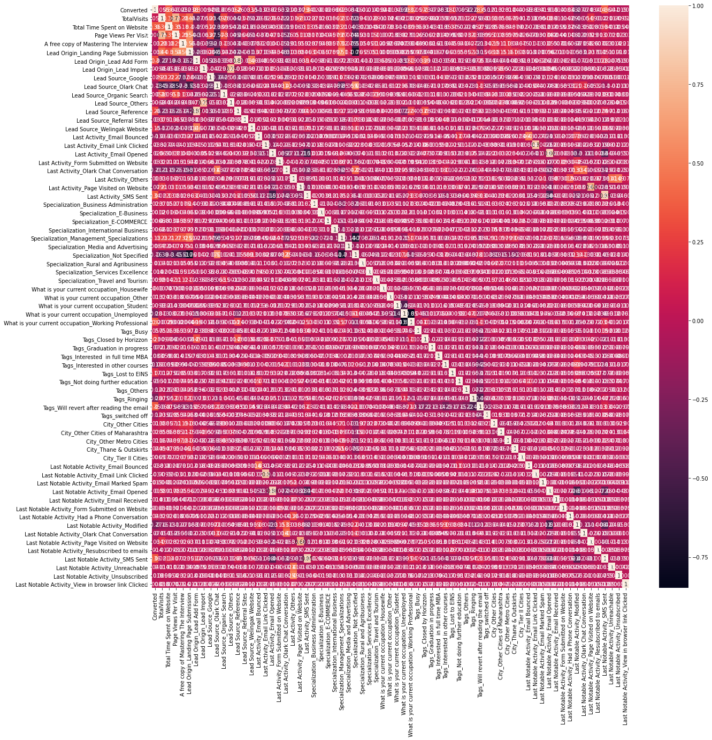
Visualizing the correlations using heatmap
Insights:
other than a few others only in the top left corner we see high correlations

Slide 21
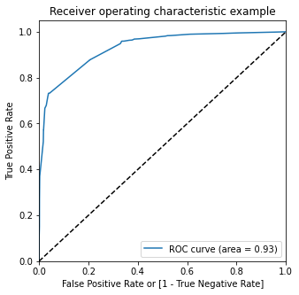
Visualizing the ROC to find the optimum cut off
Insights:
the AUC curve should have a value close to 1. We are getting a value of .93 indicating a good predictive model

Slide 22
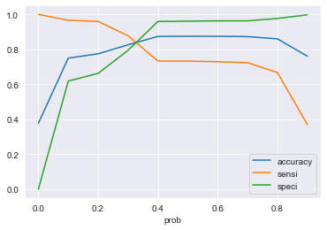
Noting accuracy, sensitivity and specificity for various probabilities
Insights:
cutoff of 0.3 is the optimum point such that we can maximize sensitivity without reducing specificity too much

Slide 23
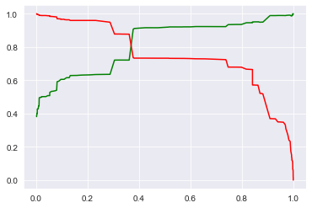
Plotting precision and recall for various probabilities
Insights:
a cut off closer to 0.4 would have given a balanced precision and recall. However, in our model we would want to increase recall as much as possible without compromising the precision too much. Hence a cut off of 0.3 seems to work fine.

Slide 24
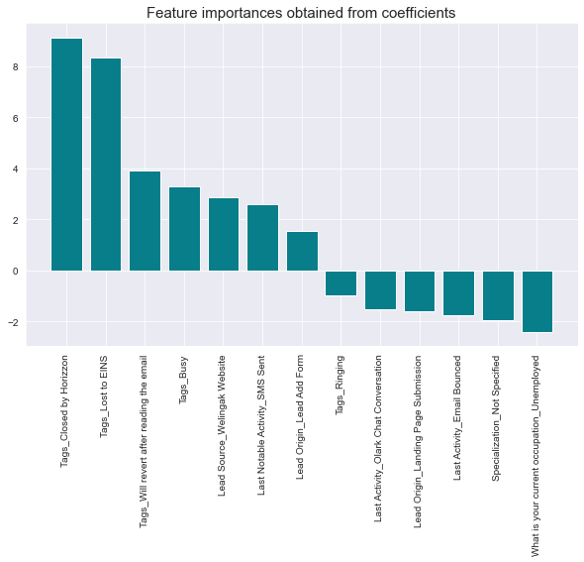
Feature Importance
Insights:
larger the coefficient, greater the impact on the prediction.
Positive coefficient means that the variable is impacting the prediction positively and vice versa for negative.
Zero coefficient means that the variable has no impact on the prediction.

Slide 25
Conclusion
Evaluation metrics for the Train Data:
Accuracy : 82.59%
Sensitivity : 87.78%
Specificity : 79.44%
False positive rate : 20.55%
Positive predictive value : 72.13%
Negative predictive value : 91.47%
Precision : 72.13%
Recall : 87.78%
Evaluation metrics for the Test Data:
Accuracy : 82.77%
Sensitivity : 87.22%
Specificity : 80.04%
False positive rate : 19.95%
Positive predictive value : 72.80%
Negative predictive value : 91.09%
Precision : 72.81%
Recall : 87.22%
We can see that the model performs reasonably well on the test set signifying that the model is generalizing well. It has a sensitivity value of 87.22%. This means out of all converted leads; model has correctly predicted 87.22% of them which is a very good measure. We have also assigned Lead scores to each customer in the range of 0-100 which can be used by X Education to target potential leads. A higher score means that the lead is hot, i.e., is most likely to convert whereas a lower score means that the lead is cold and will mostly not get converted.

Slide 26
Recommendations
Parameters positively impacting the lead conversion:
Tag assigned to a customer is any of the following
Closed by Horizzon
Lost to EINS
Will revert after reading the email
Busy
Lead Source is Welingak Website
Last Notable Activity performed by the student is SMS Sent
Lead Origin is Lead Add Form
This means that any customer with the above parameters is a very promising lead and is most likely to convert into paying customer. Hence, X Education should concentrate on such customers to increase the conversion rate of their leads.
Parameters negatively impacting the lead conversion:
Tags assigned to a customer is Ringing
Last Activity performed by the customer is any of the following
Olark Chat Conversation,
Email Bounced
Lead Origin is Landing Page Submission
Specialization is Not Specified by the customer
Customer is Unemployed
This means that any customer with the above parameters is less likely to convert into paying customer
In conclusion, X Education can look at the lead scores assigned to each customer, and along with the above parameters can focus their efforts on such a way as to maximize the lead conversion ratio.

Slide 27
Thank you

