Slide 1
Predicting Cardiovascular Risk using Electronic Health Records
UE24CS352A Machine Learning - Mini-Project
Madhumitha Dhondi, Anjali Arun

Slide 2
Problem statement
CVD is the leading cause of death globally - early identification of at-risk patients matters
Task: predict presence of cardiovascular disease from routine clinical measurements
Goal: compare interpretable regularised logistic regression vs gradient boosting (XGBoost)
Inspired by Nguyen (Stanford CS229) EHR-based CVD risk prediction; STRIDE data is private, so a public dataset is used

Slide 3
Dataset
Kaggle Cardiovascular Disease dataset: 70,000 records -> 67,941 after cleaning
Features: age, gender, height, weight, BP (systolic/diastolic), cholesterol, glucose, smoking, alcohol, activity
Engineered: BMI, pulse pressure
Target balanced-ish: 49.7% positive
Cleaning: implausible BP/height/weight removed, duplicates dropped
80/20 stratified train/test split; tuning with cross-validation on train only

Slide 4
Approach
Baselines: Logistic Regression with Ridge / Lasso / Elastic Net (standardised features)
Main model: XGBoost - sequential regularised decision trees, each correcting the previous errors
Hyperparameters tuned by 10-fold CV grid search on AUROC
Metrics: AUROC (primary), accuracy, sensitivity, specificity
Fairness check: AUROC by gender and age group

Slide 5
Implementation
src/data.py - load, clean, feature engineering
src/train.py - tuning, evaluation, plots, subgroup analysis
src/make_report.py / make_slides.py - build write-up and slides from results
Python: pandas, scikit-learn, XGBoost, matplotlib

Slide 6
Results
Model | CV AUROC | Test AUROC | Sensitivity | Specificity
LogReg (Ridge) | 0.793 | 0.783 | 0.666 | 0.773
LogReg (Lasso) | 0.793 | 0.784 | 0.668 | 0.773
LogReg (ElasticNet) | 0.793 | 0.784 | 0.668 | 0.773
XGBoost (GBM) | 0.802 | 0.796 | 0.693 | 0.764

Slide 7
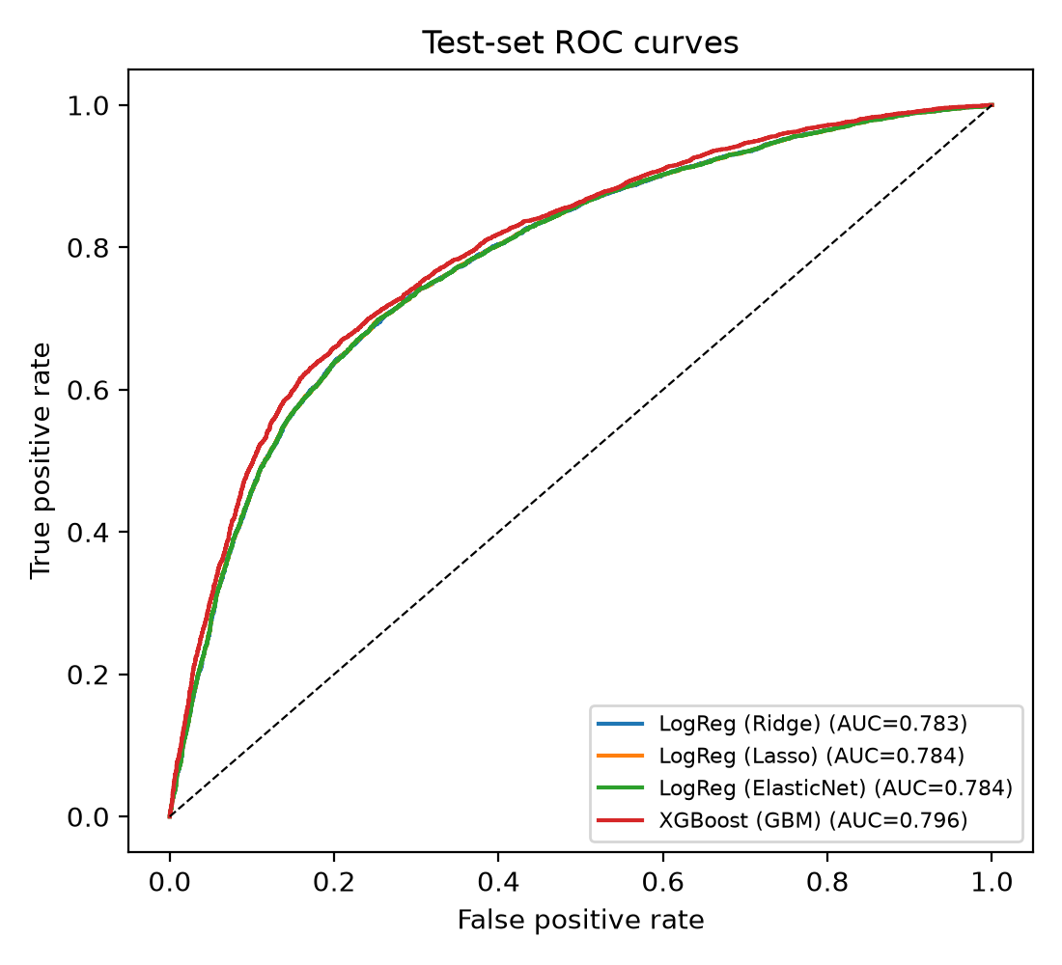
ROC curves (test set)

Slide 8
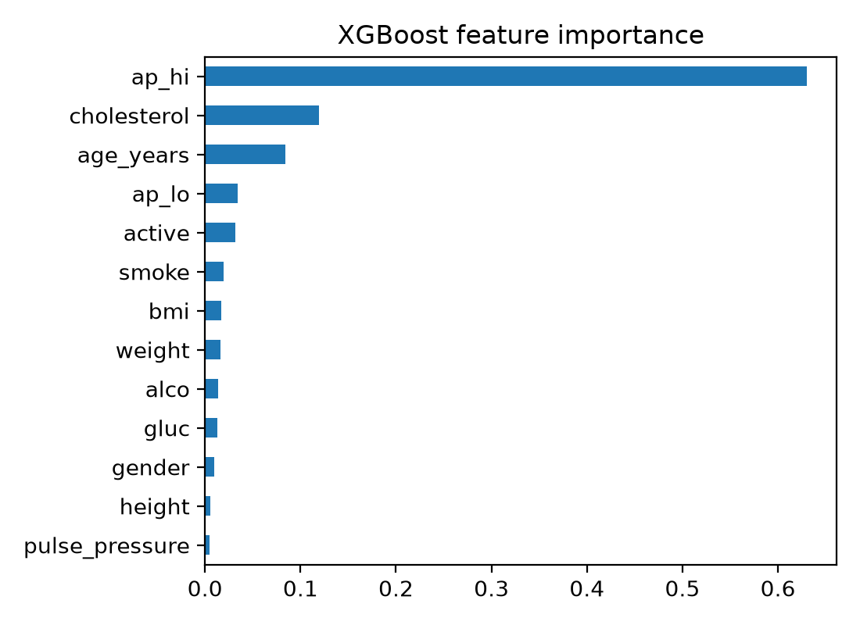
What drives the predictions?
XGBoost feature importance

Slide 9
Subgroup (fairness) check - XGBoost (GBM)
Female: AUROC 0.799 (n=8723)
Male: AUROC 0.792 (n=4866)
Age <50: AUROC 0.822 (n=4198)
Age 50-59: AUROC 0.764 (n=6874)
Age 60+: AUROC 0.729 (n=2517)
Performance is not identical across groups -> audit before clinical use

Slide 10
Conclusions & future work
Best model: XGBoost (GBM), test AUROC 0.796; small CV-test gap -> little over-fitting
Regularisation helps linear models; boosting captures non-linear effects
Limitations: prevalent (not incident) CVD, self-reported fields, no ethnicity data
Future: calibration, longitudinal EHR features, fairness-aware training

