Slide 1
Computer Lab Network Management System
Segmented, secure lab network using VLANs, inter-VLAN routing, DHCP, DNS and ACLs
Pankti Akhaja
Anjali Bhalala

Slide 2
Problem
One flat network for student PCs, faculty machines and servers
Students can reach faculty and admin systems
One broadcast domain slows the network as it grows
IP addresses assigned by hand: errors and conflicts
No control over which devices connect
Goal: a segmented, automatic and secure lab network

Slide 3
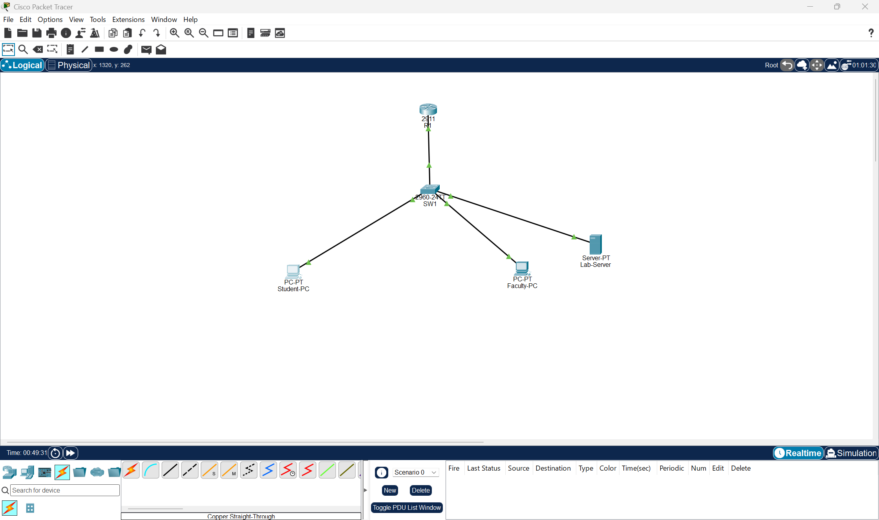
Design
Student-PC (VLAN 10), Faculty-PC (VLAN 20), Lab-Server (VLAN 30) ─ SW1 ═ trunk ═ R1
VLAN | Name | Hosts | Subnet | Gateway
10 | STUDENTS | 50 (/26) | 192.168.10.0/26 | .1
20 | FACULTY | 20 (/27) | 192.168.10.64/27 | .65
30 | SERVERS | 10 (/28) | 192.168.10.96/28 | .97
6 devices: R1 (2911), SW1 (2960), Lab-Server, 2 PCs. VLSM, largest first: 2⁶−2 = 62 for 50 hosts.

Slide 4
Implementation
SW1: VLANs 10/20/30, access ports, 802.1Q trunk to R1
R1: router-on-a-stick sub-interfaces gi0/0.10, .20, .30
R1: DHCP pools per VLAN, with gateway, DNS and excluded addresses
Lab-Server: DNS (portal.lab.local) and HTTP portal page
Verified with ping, browser and show commands

Slide 5
Innovation
Extended ACL
Port security
SSH v2
STUDENT-IN blocks students from faculty; server and portal still work
Sticky MAC, max 1, violation shutdown: rogue PC makes port err-disabled
Local user, RSA keys, SSH only on VTY lines: Telnet refused

Slide 6
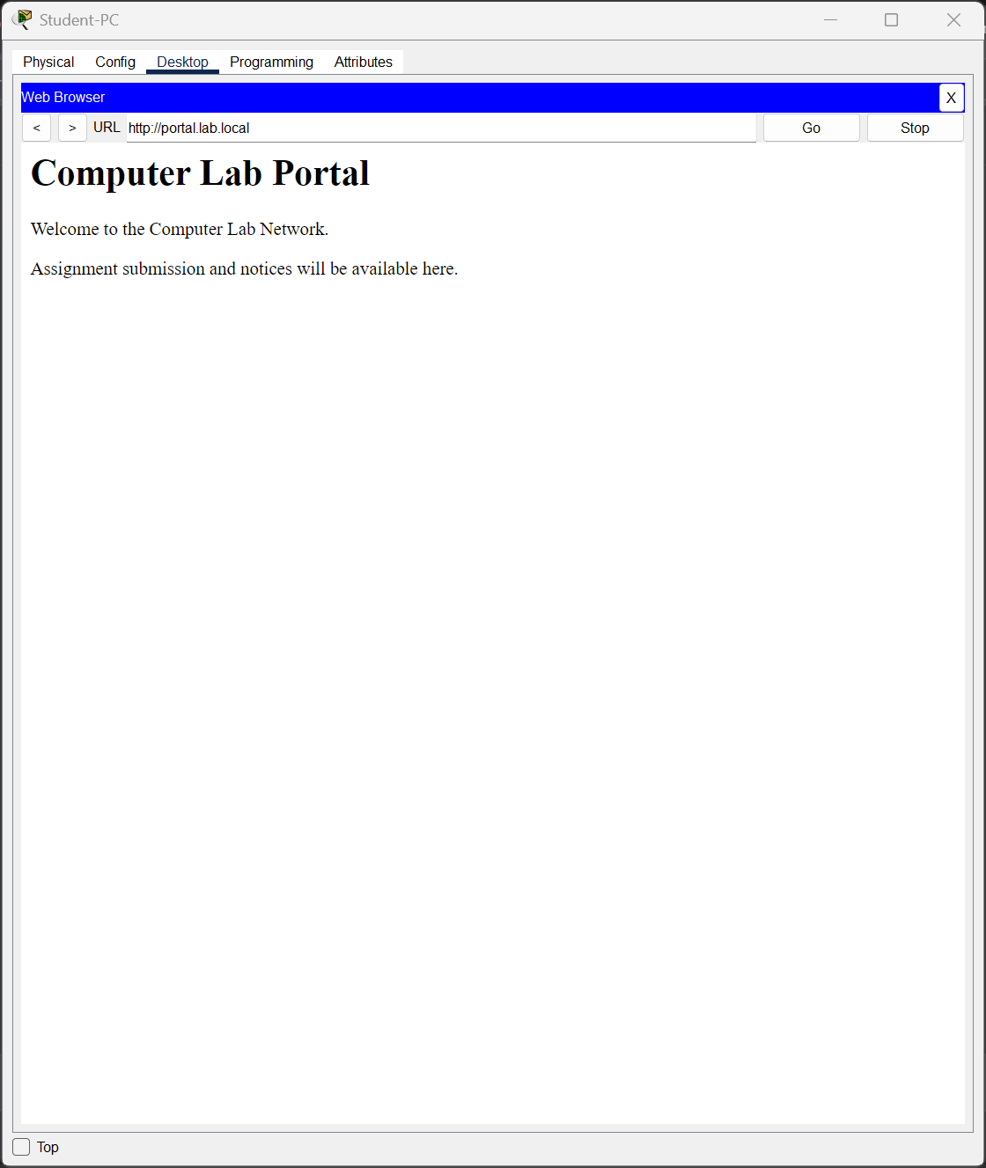
Testing results
Test | Expected | Result
PCs get DHCP addresses | Correct subnet and gateway | Pass
Student pings Faculty gateway (no ACL) | Success | Pass
Faculty-PC pings server | Success | Pass
Student opens portal.lab.local | Page loads | Pass
Student pings Faculty-PC (ACL) | Blocked | Pass
Rogue PC on Fa0/2 | Port err-disabled | Pass
SSH to R1 | Login success | Pass
Troubleshooting demo: wrong VLAN on Fa0/2, found with show vlan brief, fixed.

Slide 7
Limitations, future work and conclusion
Limitations
Future work
Single router and switch: no redundancy
Router-on-a-stick link can bottleneck
No internet, Wi-Fi or logging
Multilayer switch with SVIs
NAT/PAT, Guest Wi-Fi, FTP
Syslog/NTP, DHCP snooping, EtherChannel
Result: a segmented, automatic and secure lab network, with permitted traffic working and restricted traffic blocked.

Slide 8
THANK YOU!!

