Slide 1
WeatherWise
Temperature Prediction Using LSTM
Deep Learning Mini Project | B.Tech 5 CSE A
Submitted by:
Pankti Akhaja
Krishna Patel
Anjali Bhalala
Diya Chande

Slide 2
Introduction & Objectives
Short-term temperature forecasts help agriculture, energy planning and daily decisions
Weather is a time series: each reading depends on earlier ones
LSTM networks remember long-range patterns using gated memory cells
Problem: predict the next hour’s temperature from the previous 24 hourly readings
Objectives: preprocess data, train an LSTM, evaluate with MAE and RMSE, deploy with Streamlit
2

Slide 3
Dataset: Jena Climate
420,551
2009–2016
14
rows (10-minute readings)
Max Planck Institute, Jena
weather features
Features include pressure, temperature, humidity, dew point, wind speed and direction
Only T (degC), air temperature, is used as input and target (univariate)
3

Slide 4
Methodology
1. Load data
2. Hourly resample
3. Interpolate
4. 70/15/15 split
5. Min-Max scale
6. 24h windows
7. Train LSTM
8. Evaluate & deploy
Split is chronological (no shuffling); the scaler is fitted on training data only to avoid leakage.
4

Slide 5
Data Preprocessing
10-minute readings converted to hourly means with resample("1h"): roughly 70,000 points
Missing values filled by linear interpolation; saved as processed_temperature.csv
Split in time order: train 70%, validation 15%, test 15%
MinMaxScaler to [0, 1]; saved as scaler.pkl for the web app
Sliding window: input = 24 hours, shape (samples, 24, 1); target = next hour
5

Slide 6
Model Architecture
LSTM (50 units)
10,400 params
Dropout (0.2)
0 params
Dense (1)
51 params
Total: 10,451 trainable parameters (about 40.8 KB)
Optimiser: Adam | Loss: MSE | Metric: MAE
10 epochs, batch size 32, 1,534 steps per epoch
6

Slide 7
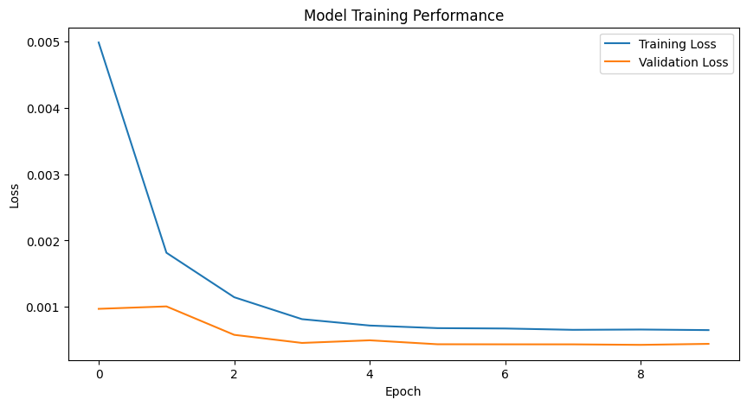
Training Results
0.637 °C
Test MAE
1.186 °C
Test RMSE
Training and validation loss fall quickly then flatten, close together: no sign of overfitting. Final val MSE (scaled): 0.00044.
7

Slide 8
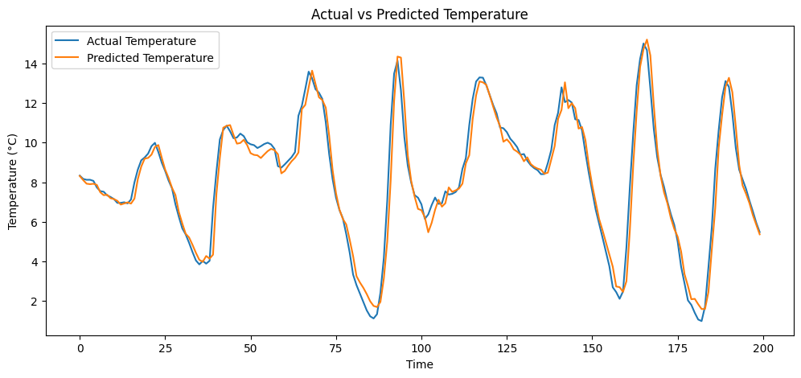
Actual vs Predicted Temperature
The prediction tracks the daily temperature cycle closely; the largest errors occur at sudden changes.
8

Slide 9
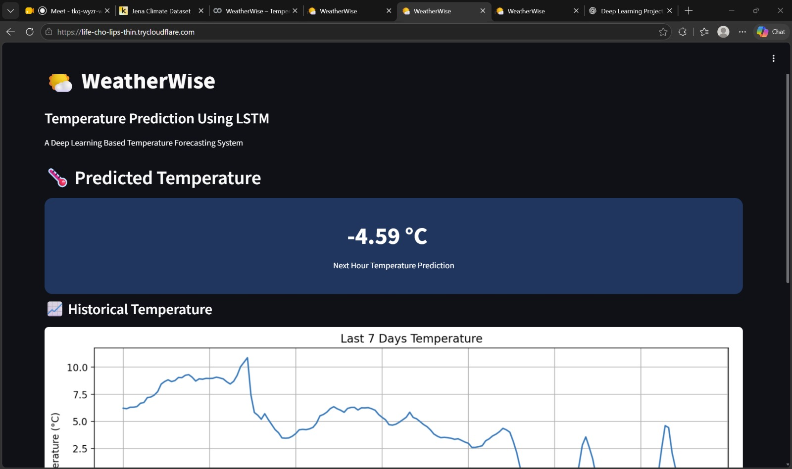
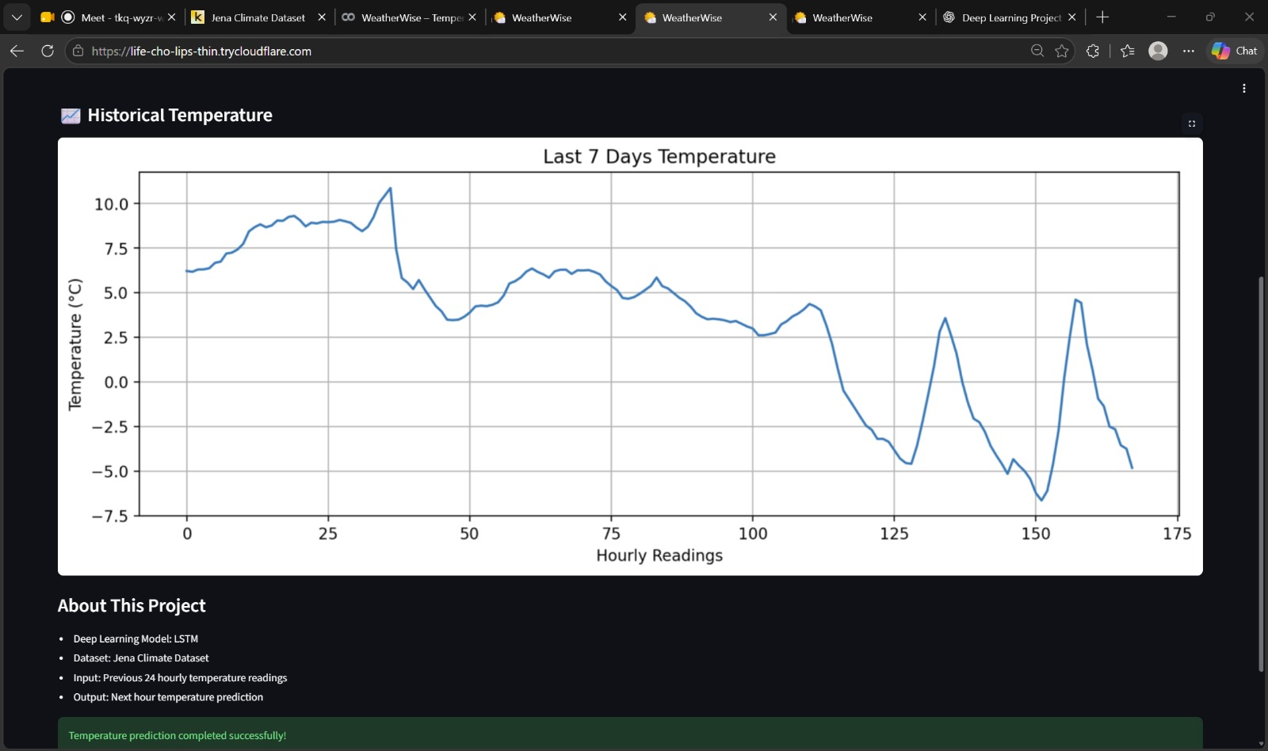
WeatherWise Web App (Streamlit)
Loads the saved model and scaler, takes the last 24 hourly readings, shows the prediction (−4.59 °C) and a last-7-days graph
Served on port 8501 and shared through a Cloudflare tunnel
9

Slide 10
Limitations, Future Scope & Conclusion
Limitations
Future Scope
Temperature only (univariate)
One-hour-ahead forecast
Single location, only 10 epochs
Uses stored data, not live weather
Use all 14 features
Multi-step forecasts
Compare GRU, ARIMA, Transformers
Live weather API, permanent hosting
Conclusion: a compact LSTM (10,451 parameters) predicts next-hour temperature with MAE 0.637 °C and RMSE 1.186 °C, and is deployed as an interactive web app.
10

Slide 11
THANK YOU!

