Slide 1

CapStone Project
Steganography
Secure Communication Through Image Embedding
Secure Communication Through Image Embedding
Presented by:
Anjali Boina Anil Neerukonda Institute of technology and Sciences
Department of Information Technology

Slide 2
Outline
Problem Statement
Technology Used
Wow Factor
End Users
Result
Conclusion
GitHub Link
Future Scope

Slide 3
Problem Statement:
"The need for secure and discreet data communication persists. Traditional data transfer methods are susceptible to interception. This project aims to develop a user-friendly tool to conceal sensitive text information within image files using Least Significant Bit (LSB) steganography, providing a method for covert data exchange."

Slide 4
Technology Used
Python: The programming language used to develop the application.
Tkinter: The Python standard GUI toolkit used for creating the graphical user interface.
Pillow (PIL - Python Imaging Library): The image processing library used for manipulating and working with image files.

Slide 5
Wow Factor
Practical Application of Steganography: It's not just a theoretical concept; it's a functional tool with a real-world application for discreet communication.
User-Friendly GUI: The Tkinter interface makes steganography accessible to users without deep technical knowledge, democratizing a powerful security technique.
Real-time Feedback: The "Encoding successful!" message provides immediate confirmation, enhancing the user experience.
Visual Demonstration: The screenshot itself showcases the tool in action, making its capabilities clear.
Robust Decoding: The use of null-character termination (mentioned in previous responses) to avoid garbled output is a significant improvement over basic LSB implementations.
Cross-Platform Potential: Python and Tkinter offer potential for cross-platform compatibility, increasing the tool's reach.

Slide 6
End Users
Individuals concerned with privacy: People who want to share messages discreetly, avoiding detection by third parties.
Journalists and whistleblowers: Those needing to protect sensitive information or sources.
Security enthusiasts: Individuals interested in exploring and experimenting with steganography techniques.
Hobbyists and programmers: Those looking to learn about image manipulation and data hiding.
Potentially, in a controlled environment, law enforcement or intelligence agencies: For covert communication purposes.

Slide 7
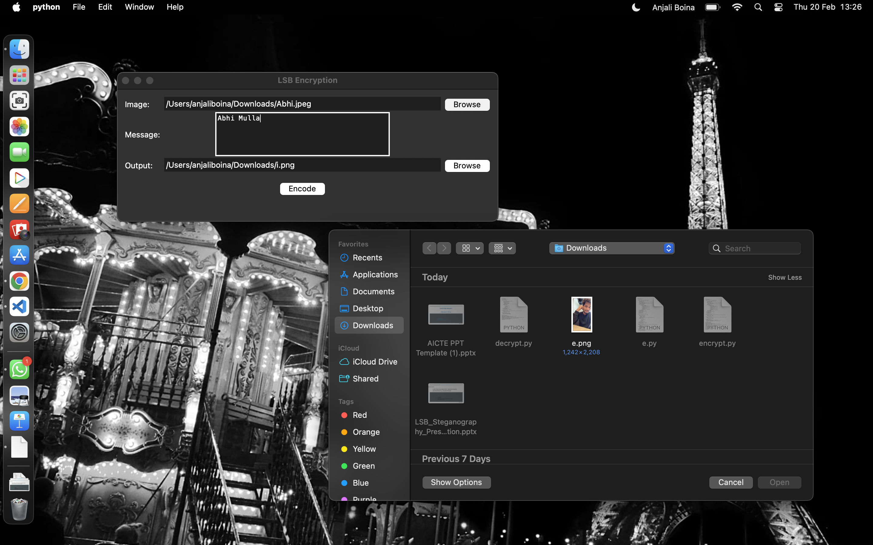
Results

Slide 8
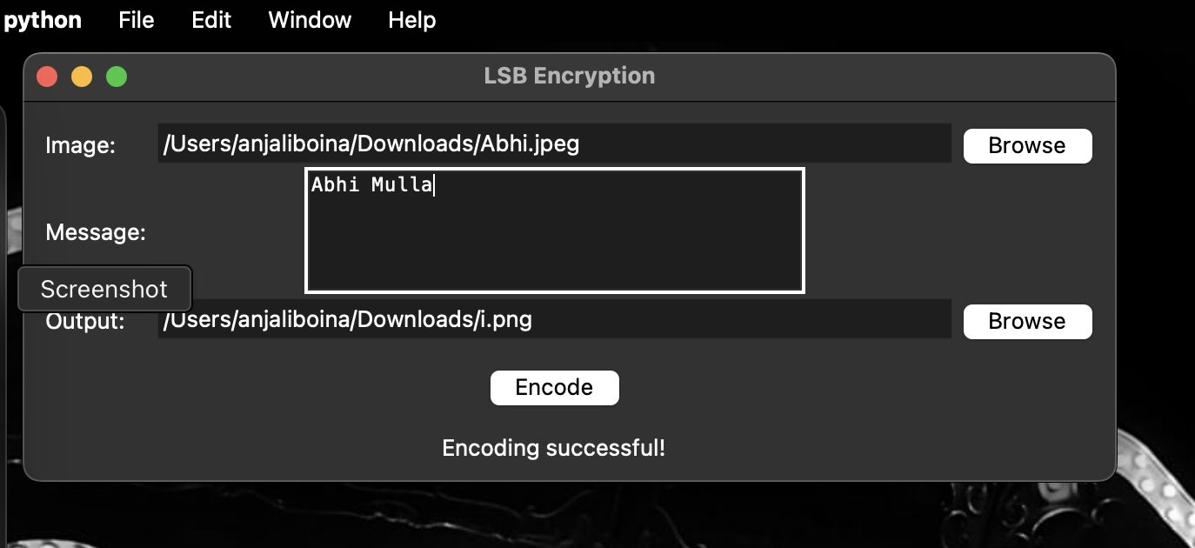
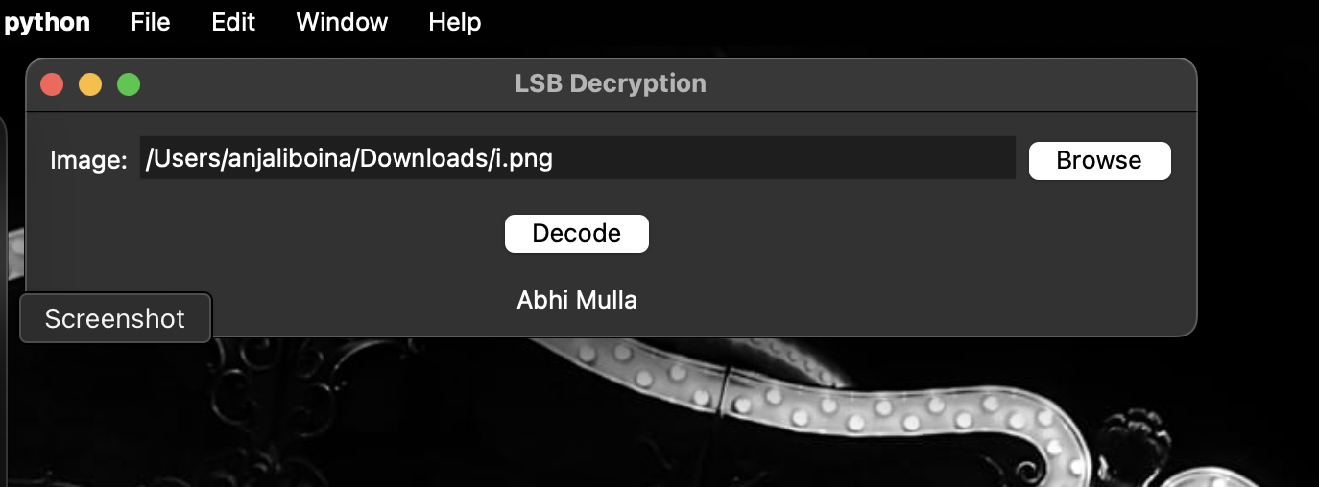
Encryption —>
Decryption —>

Slide 9
Conclusion
This project successfully developed a functional and user-friendly LSB steganography tool. By utilizing Python's Tkinter and Pillow libraries, the application provides a straightforward interface for encoding and decoding text messages within image files. The implementation of null character termination ensures improved accuracy in message extraction. This tool demonstrates the practical application of steganography for discreet communication, highlighting the potential for secure data exchange in various contexts.

Slide 10
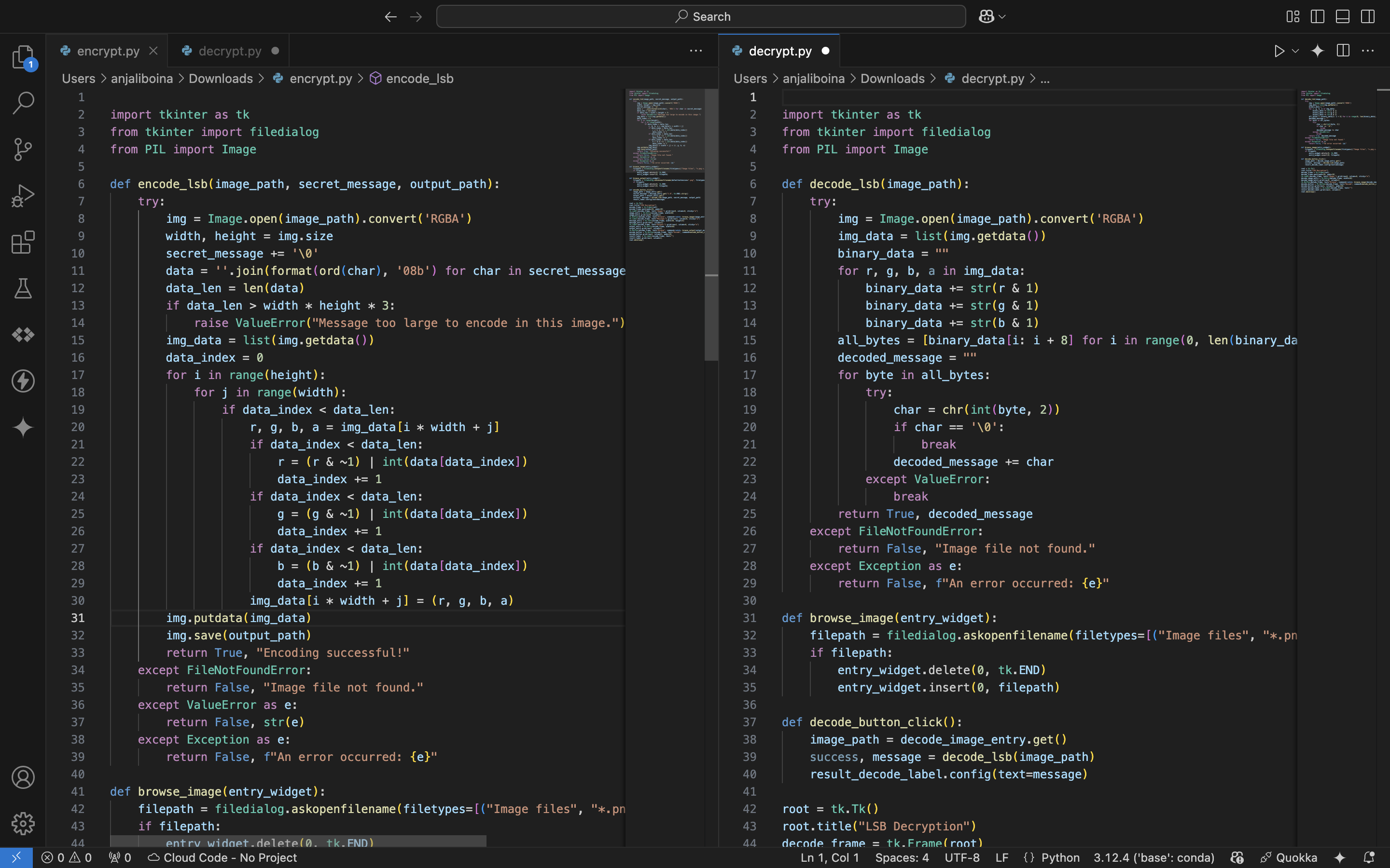
GitHub Link
Click here for link
<

Slide 11
Future scope
Expanded File Type Support: Implement the ability to hide data within other image formats (e.g., GIFs, TIFFs) or even within audio and video files.
Encryption Integration: Incorporate encryption algorithms (e.g., AES) before embedding the message, adding a layer of security.
Steganalysis Countermeasures: Develop techniques to make the hidden data more resistant to detection by steganalysis tools.
Improved Capacity Management: Implement a system to provide users with feedback on the maximum message size that can be embedded in a given image.
Advanced GUI Features: Add features like a message preview, a visual representation of the LSB modifications, and progress indicators for large files.
Network Steganography: Explore methods for embedding data within network packets for covert communication.
Mobile Application Development: Create a mobile app version for convenient steganography on smartphones and tablets.

Slide 12
Thank You

