Slide 1
CEPEC7032 NATURAL LANGUAGE PROCESSING B.Tech. VII
MSE Question Paper Pattern
MSE Syllabus
Practice and Revision

Slide 2
Question Paper Pattern for MSE
MSE (30 Marks)
Question 1 [08 Marks] [4 out of 5] [2 Marks each] : Mapped to CO – 1,2,3
Question 2 [12 Marks] [3 out of 4] [4 Marks each]: Mapped to CO - 3
Question 3 [10 Marks] [2 out of 3] [5 Marks each]: Mapped to CO - 2

Slide 3
MSE: SYLLABUS
Module 1: Introduction to NLP
1.1 NLP Pipeline and Levels of Analysis: Stages in NLP processing-text preprocessing, morphological, syntactic, semantic, pragmatic, and application-level stages.
1.2 Ambiguity and Challenges in NLP (English and Indian Languages)
1.3 Applications of NLP
1.4 Tools and Resources: NLTK, SpaCy, Hugging Face
Module 2: Text Processing and Word-Level Analysis
2.1 Lexical Analysis: Basics of lexical processing and word representation.
2.2 Empirical Laws on Raw Text 2.3 Preprocessing tasks: Sentence segmentation, tokenization, normalization, stop-word removal, stemming, lemmatization
2.4 Morphological Analysis: Inflectional and derivational morphology
2.5 Regular Relations and Finite-State Morphology: Regular expressions, finite-state automata, and transducers for morphological analysis.
2.6 Stemming and Lemmatization: Porter and Snowball algorithms; dictionary- and rule-based lemmatization.
2.7 Statistical Models:2.7.1 N-gram Models: unigram, bigram, trigram, and their evaluation.

Slide 4
MSE: SYLLABUS
Module 2: Text Processing and Word-Level Analysis
2.7.2 Smoothing Techniques: Laplace, Good–Turing
2.7.3 Evaluation Metrics: Perplexity
2.8 Word Representation Models: Bag of Words and TF-IDF features for statistical text representation.
Module 3: Syntax Analysis and Sequence Modeling
3.1 Part-of-Speech (POS) Tagging: Stochastic based approach; POS tagging using Hidden Markov Model (HMM) and Viterbi algorithm; challenges in POS tagging.
3.2 Discriminative Models for Sequence Labeling: Maximum Entropy Markov Model (MEMM) and Conditional Random Field (CRF),BiLSTM-CRF for neural sequence labeling.
3.3 Grammar Formalisms: Context-Free Grammar (CFG) and Probabilistic Context-Free Grammar (PCFG); modelling syntactic structure and constituency.
3.4 Parsing Techniques: 3.4.1 Top-Down Parsers: Predictive and Early Parser; 3.4.2 Bottom-Up Parsers: Shift-Reduce and CKY algorithm; 3.4.3 Introduction to Dependency and Constituency Parsing.

Slide 5
Practice
Compute the Type-Token Ratio (TTR) and interpret whether the passage has high or low lexical diversity.
Regular exercise improves physical fitness. Daily exercise helps people maintain fitness, build strength, and stay active.

Slide 6
Practice
Compute the measure m of the following words with respect to the Porter Stemmer:
Complexity, Typography, Psychology, Organization

Slide 7
Question Paper Pattern
Practice: Ambiguity
“The manager told the employee that he had reviewed the report on the file.”

Slide 8
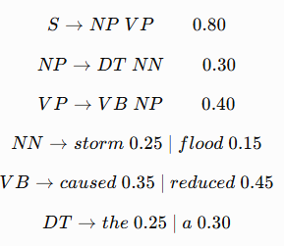
Practice Compute the probability of the parse tree of the input string: “The storm caused a flood”
Given the following partial PCFG:

Slide 9
Practice
In a corpus, the number of meanings associated with the words “bat” and “pitch” are 9 and 18, respectively. Estimate the ratio:
RANK(bat):RANK(pitch)

Slide 10
Question Paper Pattern
Identify the morphological operation for given data
Classify into inflectional and derivational

Slide 11
Practice
Consider the following corpus: • <s> The doctor treats patients </s> • <s> A nurse checks records </s> • <s> The nurse treats patients </s> • <s> A doctor checks records </s>
Given the POS tags, DT: Determiner, NN: Noun, VB: Verb
Apply a bigram HMM to compute emission and transition probabilities.

Slide 12
Practice HMM table

Slide 13
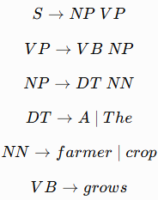
Practice Consider the following CFG
Input: A farmer grows the crop
Construct a CKY-based parsing table and parse tree.

Slide 14
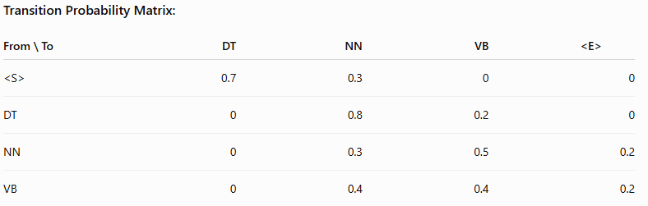
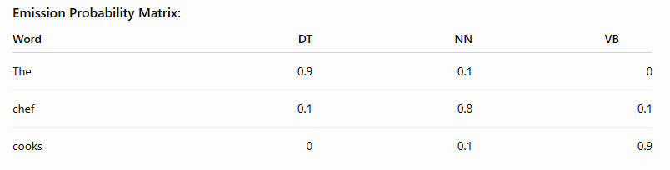
Practice The transition and emission probability matrices are given below.
Apply the Viterbi algorithm to determine the most probable POS-tag sequence for the observation sequence “The chef cooks”.

Slide 15
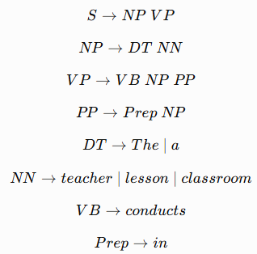
Practice Consider the following CFG and the sentence given below. Apply the leftmost derivation and construct the corresponding parse tree .
Sentence: The teacher conducts a lesson in the classroom.

Slide 16
Practice
Compute the perplexity of “The storm causes heavy damage” by considering the bigram model from the following text.
The storm causes damage. The storm brings heavy rain. Heavy rain causes damage. The storm causes heavy damage. The rain causes flooding. The flooding causes damage.

Slide 17
Practice
Using Add-1 (Laplace) smoothing, calculate the smoothed probability of the given test sentence: Musicians perform live concerts
Consider the following training corpus: Musicians perform concerts nightly. Musicians practice new songs. Live concerts attract audiences. New songs help musicians perform better.

Slide 18
Practice
Consider the following documents: D₁: Pilots monitor flight systems. D₂: Pilots monitor navigation systems. D₃: Engineers repair flight systems.
TF-IDF

