Slide 1
DSA-2 Miniproject Linux command GREP Anjali Dofe MIS 111903137 SY Comp Div 2
(grep stands for globally search for regular expression and print out)
grep — searches a file for a pattern
(Prints lines matching a pattern)
The Boyer–Moore algorithm is also used in GNU’s GREP

Slide 2
Some options available in GREP
-i : Ignores case for matching.
-w : Matches the whole word.(Case sensitive)
-q : Quiet; do not write anything to standard output. Exit immediately with zero status.
-n : Display matched lines with their line numbers.
-f file : Takes pattern from file, one per line.
-o : only matching
-m : Stops the searching of files after num number of lines are searched.
--help : Print a usage message briefly summarizing these command-line options and the bug-reporting address, then exit.

Slide 3

DATA STRUCTURE USED

Slide 4
ADT used typedef struct node{ char a[2]; struct node *prev; struct node *next; }node; typedef struct line{ node *head; node *tail; }line;

Slide 5
A line has been represented using linked list data structure Functions in ll.h/ll.c Init //to initialize line Append //to append the line Display //to display the line destroy //to destroy the line

Slide 6
Functions
lower_case(); //to lower the case of string
match_pattern(); //checking for pattern in line
These two are the basic functions used with slight modifications to make all other functions used in the project such as non-matching of pattern and whole word matching or case insensitive matching and so on.

Slide 7
Basic Algo followed for match_pattern(line l, char* pattern);
Copy the pattern into a string (char array)
Initializing new line l1 and copying l data into it
Then we check for matching patterns comparing line and string character by character (while loop):
if one-character matches of line and string increment i and also point to next character of line
if the line character does not match pattern
reset i to 0 as we need to check from beginning of pattern
incase i = 0 when the first character itself did not match just point to next character of line
when it comes out of while loop and it is last character of line
if last letter of line also matches i++
only if the entire pattern has matched then it would reach '\0' character return 1
else incase pattern has not matched return 0

Slide 8
Functions in file.c (header.h)
int openfile(char *filename, int option, char *pattern, int flag, int num, int option1);
//flag used for –h –H option..
//num used for –m option
int types(char type, int option);
void filename(int option, char *pattern, char *name); // for -l and -r uses <dirent.h>
void listFiles(const char *path); //recursively to list all files in working directory

Slide 9
OPTIONS/Flags in PROJECT
-h
-H
-v
-i
-w
-c
-m NUMBER
-r
-l
-n
-e
--help
-version
& few Combinations of these

Slide 10
The details on how to use these options are given in USAGE.txt file along with various combinations possible which has been tested and verified.

Slide 11
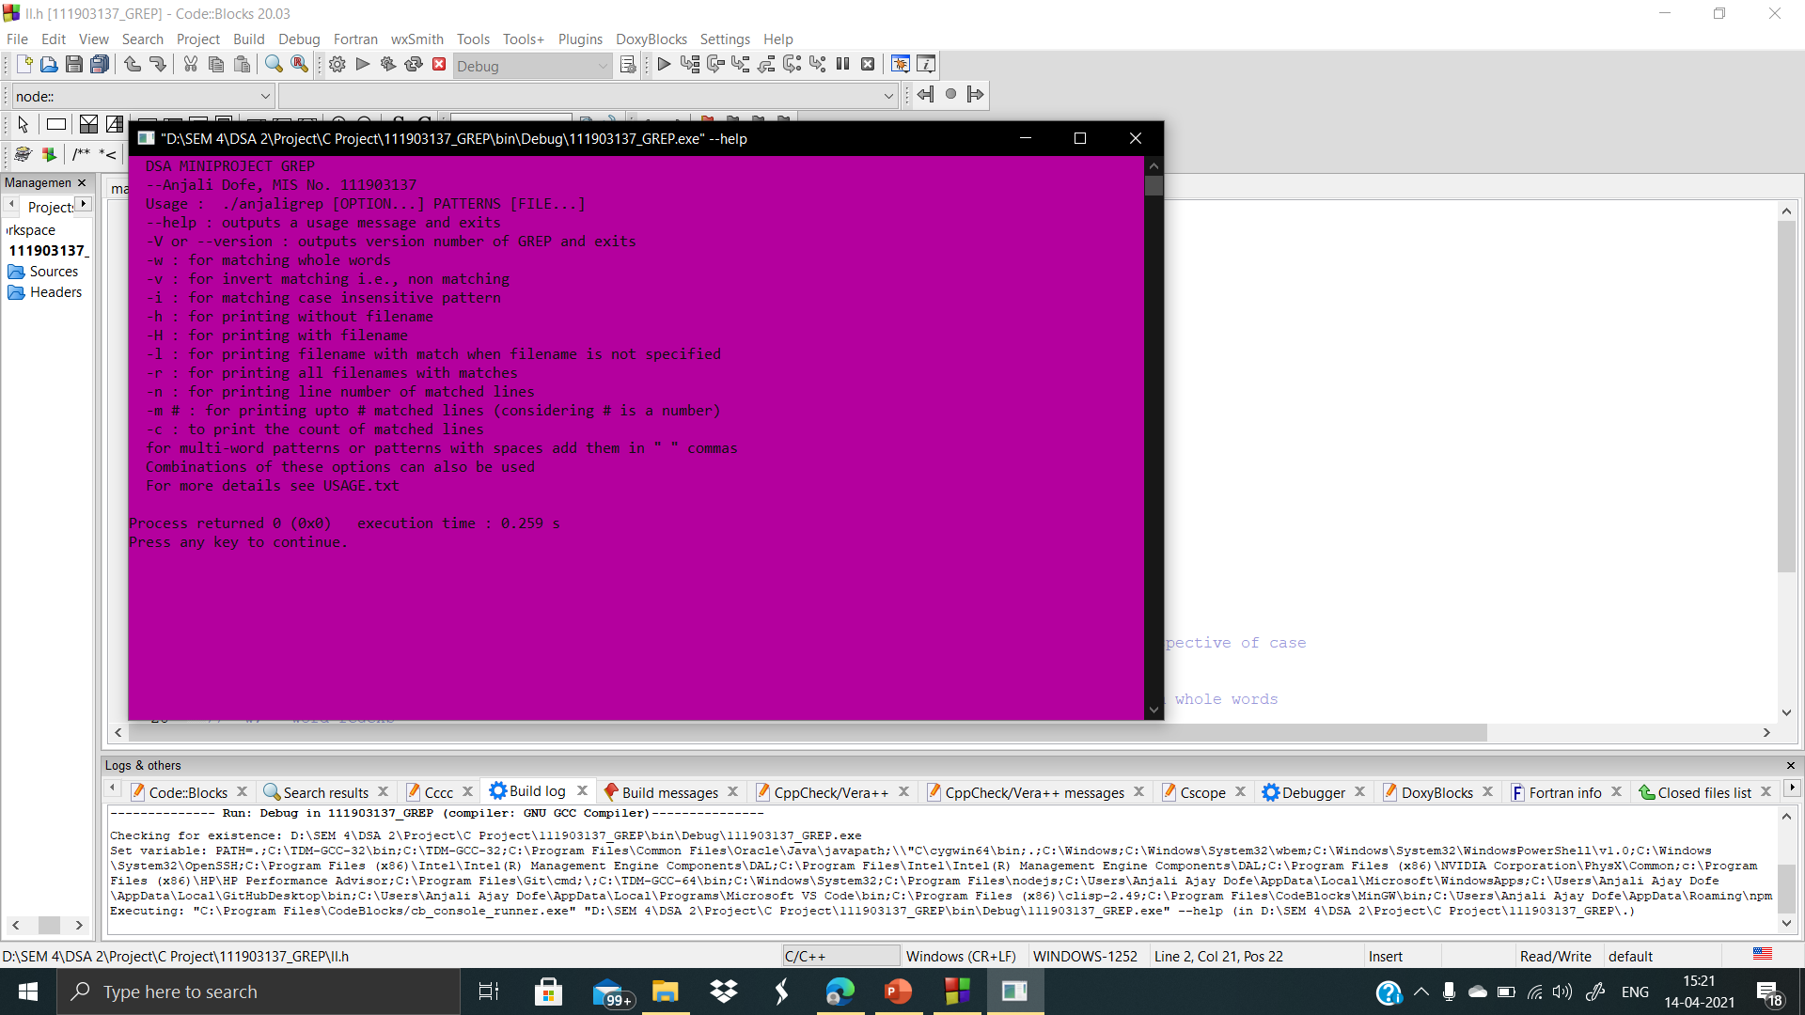

Slide 12
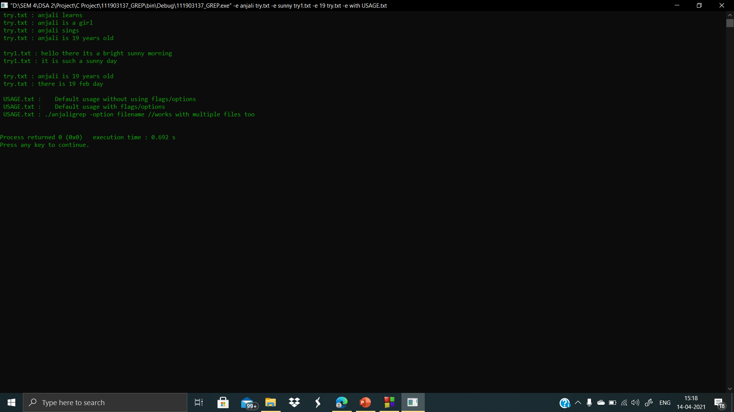
Sample Output for
-e anjali try.txt –e sunny try1.txt –e 19 try.txt –e with USAGE.txt

Slide 13
References
https://linuxcommand.org/lc3_man_pages/grep1.html
https://man7.org/linux/man-pages/man1/grep.1p.htm
dirent.h(0p) - Linux manual page (man7.org)
How to print Colored text in C++ - GeeksforGeeks

