Slide 1
🚦 REAL-TIME TRAFFIC CONGESTION PREDICTION
& RISK INTELLIGENCE SYSTEM
- Anjali Gupta

Slide 2
THE URBAN TRAFFIC CRISIS
❌ EXISTING SYSTEMS:
• Only display current traffic speed
• No intelligent prediction capability
• No risk evaluation or advisory
• Reactive rather than proactive
📍 INDIAN CONTEXT:
• Major cities face 40-50% congestion daily
• Loss of ₹1.5 lakh crore annually due to traffic
• No smart decision support for commuters
💡 OPPORTUNITY:
Convert raw traffic data into INTELLIGENT ROUTE DECISIONS`

Slide 3
🎯 PROJECT OBJECTIVES
🔄 LIVE DATA FETCHING
• Real-time traffic via TomTom API
🤖 ML PREDICTION & CLASSIFICATION
• Random Forest Classifier (High/Medium/Low)
⚠️ RISK SCORING ENGINE
• Calculate Route Risk Score (0-100)
🧠 SMART TRAVEL ADVISORY
• Generate real-time travel recommendations
🏙️ MULTI-CITY COMPARISON
• Compare multiple cities simultaneously

Slide 4
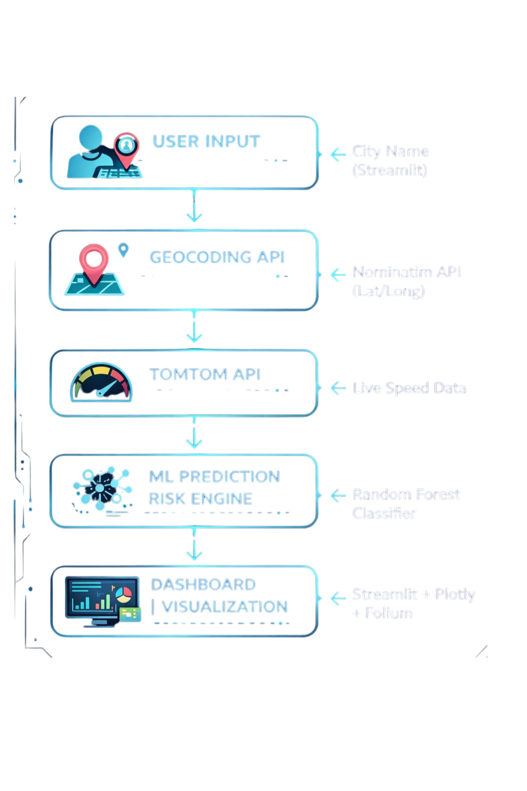
🏗️ SYSTEM ARCHITECTURE

Slide 5
🛠️ TECHNOLOGY STACK
PROGRAMMING: 🐍 Python (Core Logic)
DASHBOARD: 🌐 Streamlit (Interactive Web UI)
MAPS: 🗺️ Folium (Interactive Maps)
VISUALIZATION: 📊 Plotly (Charts & Gauge Meter)
MACHINE LEARNING: 🤖 Scikit-learn (Random Forest)
DATA HANDLING: 🐼 Pandas
API CALLS: 🌐 Requests
EXTERNAL APIs:
TomTom Traffic API (Real-time data)
TomTom Geocoding API (Location)

Slide 6
⚡ KEY FEATURES - I
🚦 LIVE TRAFFIC DATA FETCHING
• Real-time speed & free flow speed monitoring
• 30-second auto-refresh capability
🤖 ML-BASED CONGESTION PREDICTION
• Algorithm: Random Forest Classifier
• Input: Speed ratio + Time features
• Output: High / Medium / Low classification
📊 CONGESTION GAUGE METER
• Visual 0-100% congestion display
• 🟢 0-40% (Low) | 🟡 40-70% (Medium) | 🔴 70-100% (High)
• Real-time animated needle

Slide 7
⚡ KEY FEATURES - II
⏰ PEAK HOUR DETECTION :
• Morning Rush: 8:00 AM - 11:00 AM
• Evening Rush: 5:00 PM - 9:00 PM
• Auto-adjusts risk weightage
🚨 ROUTE RISK SCORE ENGINE (0-100) :
Formula: Congestion% + Peak Penalty + Speed Penalty
• >70: AVOID | 40-70: CAUTION | <40: SAFE
🏙️ MULTI-CITY COMPARISON :
• Compare multiple cities simultaneously
• Risk ranking with medals 🥇🥈🥉
• Smart recommendation engine

Slide 8
🤖 MACHINE LEARNING MODEL
ALGORITHM: Random Forest Classifier
WHY RANDOM FOREST?
✅ Handles non-linear traffic patterns
✅ Reduces overfitting (ensemble learning)
✅ Excellent for classification problems
TRAINING FEATURES:
• Current Speed (km/h) | Free Flow Speed (km/h)
• Hour of Day (0-23) | Speed Ratio (Current/Free)
OUTPUT CLASSES:
🟢 Low Congestion | 🟡 Medium Congestion | 🔴 High Congestion
PERFORMANCE: ~85-90% Accuracy | <100ms Prediction Time

Slide 9
🧮 RISK SCORE CALCULATION
FORMULA:
RISK SCORE = Base Congestion %
+ Peak Hour Penalty (+10)
+ Speed Ratio Penalty (+10)
FINAL RANGE: 0 (Safe) — 100 (Avoid)
EXAMPLE:
Current Speed: 25 km/h | Free Flow: 50 km/h
Congestion: 50% | Peak Hour: YES | Speed Ratio: 0.5
Calculation: 50% + 10 + 10 = 70 RISK SCORE
RESULT: 🟡 CAUTION - Heavy Traffic Expected

Slide 10
🧠 SMART TRAVEL ADVISORY
ML Prediction | Peak Hour | System Advisory
🔴 HIGH | YES | ❌ AVOID THIS ROUTE
🔴 HIGH | NO | ⚠️ HEAVY TRAFFIC
🟡 MEDIUM | YES | 🚗 TRAVEL CAREFULLY
🟢 LOW | ANY | ✅ SAFE TO TRAVEL

Slide 11
🏙️ MULTI-CITY COMPARISON
LIVE COMPARISON DASHBOARD:
🥇 Mumbai Speed: 22 km/h Risk: 85 [🔴 HIGH]
🥈 Delhi Speed: 35 km/h Risk: 60 [🟡 MED]
🥉 Bangalore Speed: 42 km/h Risk: 45 [🟡 MED]
4️⃣ Pune Speed: 50 km/h Risk: 30 [🟢 LOW]
RISK SUMMARY: High: 1 | Medium: 2 | Low: 1
SMART RECOMMENDATION:
❌ "Avoid Mumbai - Highest congestion detected"
✅ "Safest choice: Pune - Low traffic risk"
📊 Visual: Risk comparison bar chart (Plotly)

Slide 12
🚀 FUTURE SCOPE
ENHANCEMENTS ROADMAP:
🗺️ INDIA TRAFFIC HEATMAP
• Visual heatmap of congestion across cities
🤖 DEEP LEARNING (LSTM)
• Time-series prediction for traffic forecasting
☁️ CLOUD DEPLOYMENT
• AWS/GCP hosting for 24/7 availability
📱 MOBILE APPLICATION
• iOS/Android app for on-the-go access
🔔 PUSH NOTIFICATIONS
• Alerts for high-risk routes before travel

Slide 13
THANK YOU 😊
QUESTIONS & ANSWERS..!!

