Slide 1
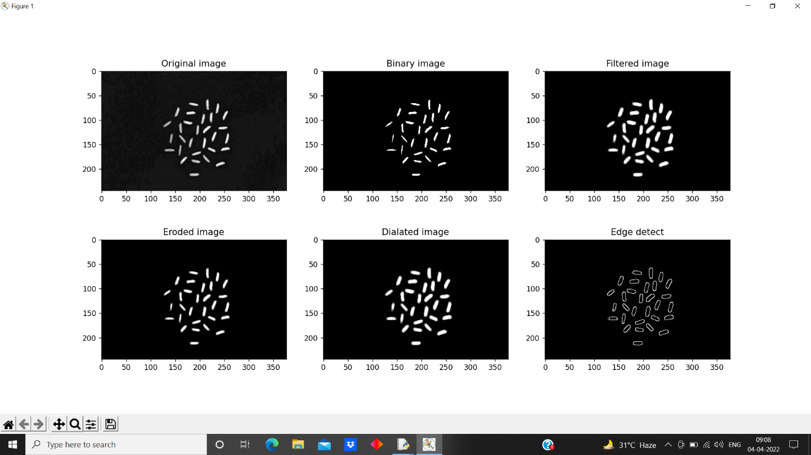
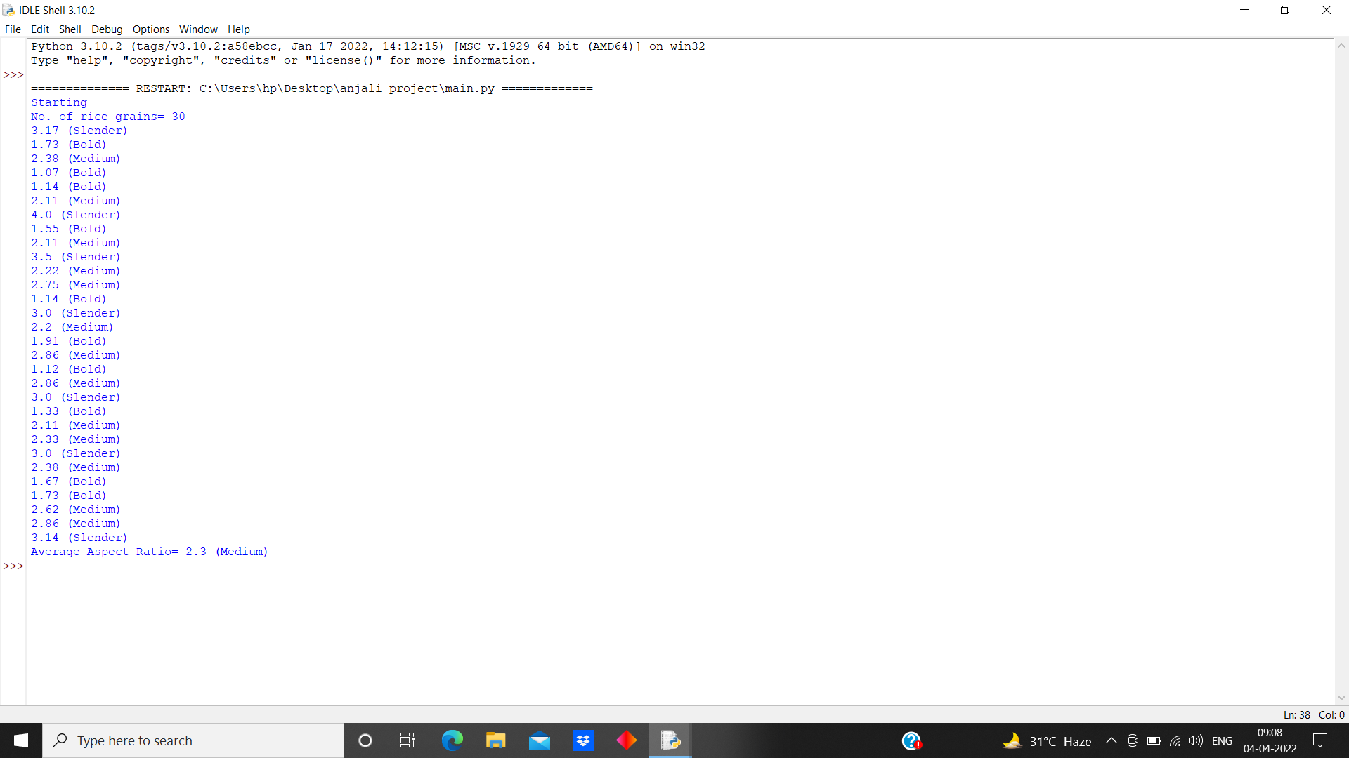
Analysing Rice Seed Quality Using Machine Learning
Anjali C. Hadke* and Dr. Mrs. Anupama D. Sakhre
*anjalihadke20@gmail.com
Abstract The proposed System is a solution of grading and evaluation of rice grains on the basis of rice grain size and shape using Image processing techniques. Edge detection algorithm is used to find out the region of boundaries of each grain quality. In the proposed work, we are measuring the length and breadth of rice by using Image processing. The Image processing method requires less time, low cost and better result as compare with manual result.
Keywords: Image Processing, Agriculture Business, Machine Learning, Rice Seed, Rice Seed Quality.
Experimental work Result
Conclusion Rice grain samples were captured using a camera. The input image processed using Edge detection algorithm to extract the grains' physical characteristics. The proposed system process rice grains image analyse rice quality in a short period of time than manual inspection with good accuracy result. Furthermore, rice seed analyse method provides a solution to measure 2D area of rice grains to identify rice quality and broken grains.
Saliens Features
Farmers can get quality analysed
Seed testing laboratory
Check seed quality at home
Determine the quality for planting
Image Acquisition
Pre-processing
Edge Detection
Grading
Object Measurement
(a) (b)
Fig 2 (a) (b) : Screenshot of results
Fig 1 : Steps Of Image Processing
Scope of Future work
In future, it can be used to classify various rice grain by developing an automated system using image analysis. Also we can calculate various parameters for quality analysis and classify them into normal, small & long rice seed.
SYNERGY-2022 Department of Electronics And Computer Science, RTM Nagpur University, Nagpur-440033

