Slide 1
Problem Identification
Big Mountain Resort is a premium ski resort that has around 350,000 visitors each year. The resort’s pricing strategy has been to charge above the average price of resorts in its market segment, and wants to make a change that will cut costs without undermining the ticket price.
Goals:
Better capitalize on facilities
Cut costs without undermining the ticket price
Find value in increasing the ticket price
The focus is capitalizing on facilities before making any changes to ticket prices.

Slide 2
Key Findings
Strong positive correlation between ticket price and the Vertical Drop, Fast Quads, Runs, and Total Chairs
Vertical Drop is the biggest positive feature
Big Mountain Resort could close down up to 5 runs with negligible losses
Adding a run, increasing the vertical drop by 150 feet, and installing an additional chair lift would increase support for ticket price by $1.24

Slide 3
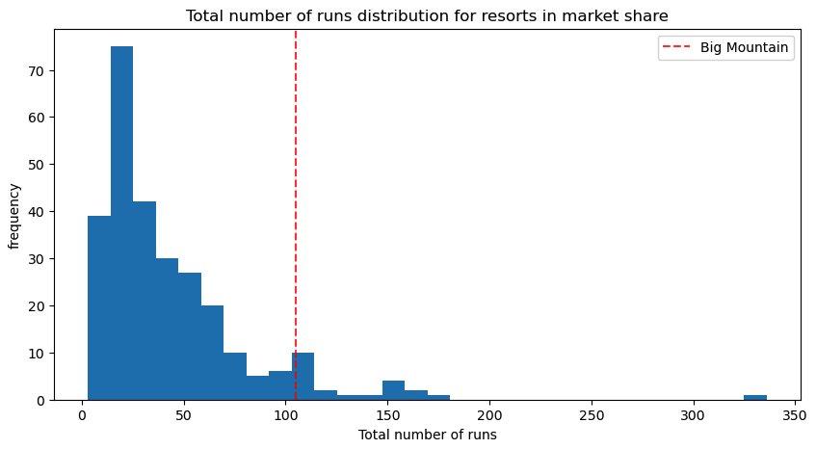
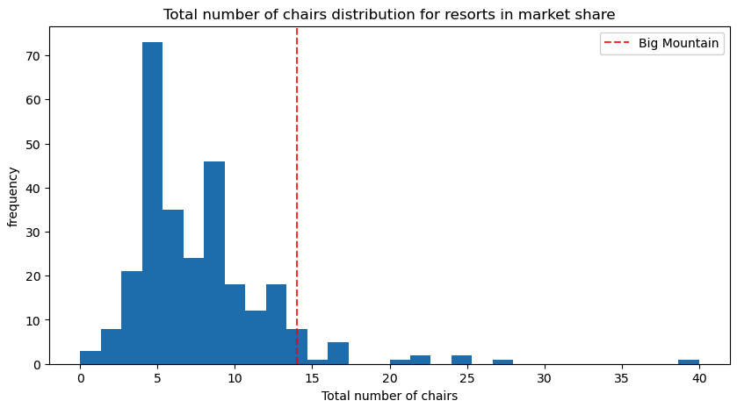
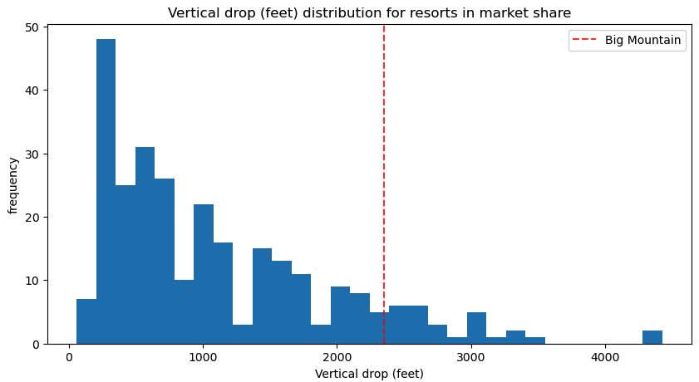
Modeling - Market Context
The modelled price is price is $92.19, suggesting room for a price increase.
Big Mountain Resort compares well in runs and chair distribution.
There are a quite a few resorts with higher vertical drops, and Vertical Drop is our biggest positive feature.

Slide 4
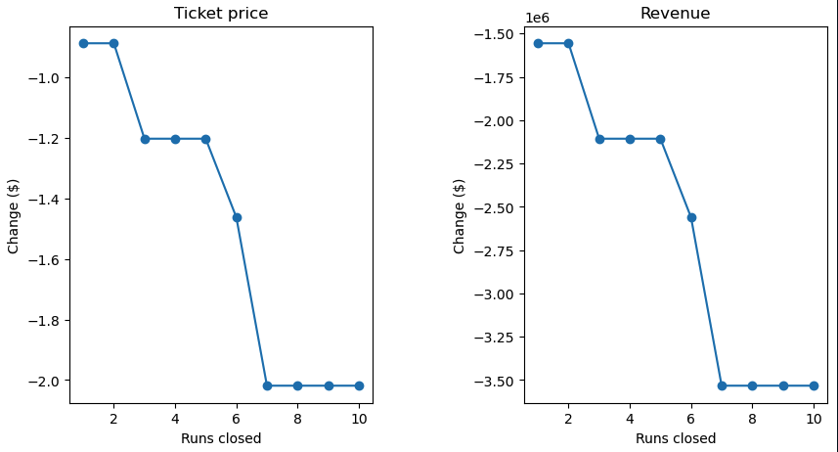
Modeling - Option One
I tested closing up to 10 of the least used runs.
The model indicates:
closing one run makes no difference
Closing 2-3 runs reduce support for ticket price
Closing 3 runs has the same impact as closing 4-5 runs.
Closing 6+ runs leads to a large drop in value
Big Mountain Resort can close 3-5 runs without undermining the ticket price.

Slide 5
Modeling - Option Two
I tested adding a run, increasing the vertical drop by 150 feet, and installing an additional chair lift.
Adding snowmaking and run length to did scenario did not result in an increase in value.
This scenario increases support for ticket price by $1.24
Over the season, this could be expected to amount to $2,171,296

Slide 6
Summary
I have determined two ways to make a change that will cut costs without undermining the ticket price:
Cut costs by removing 3-5 runs and keep ticket price the same.
Add a run, increasing the vertical drop by 150 feet, and install an additional chair lift to increase ticket price by $1.24, resulting in an approximated $2,171,296 annually.

