Slide 1

Benchmark Pruning
Presented by:
Anjali Kaushik

Slide 2
The Problem
Full Benchmark Cost
The Goal
Every item requires a forward pass
315 coding + 100 long-context items per model
Costs scale linearly with benchmark size
Re-run every time a new model is assessed
Multi-hour evaluation cycles per candidate
Preserve model rankings
Preserve go/no-go decisions
Preserve difficulty distribution
Generalize to unseen models
Difficulty-calibrated AND content-diverse

Slide 3
Spectral-IRT Stratified Pruner
Stratify
Cluster
Select
Embed items using a sentence transformer embedding model (all-MiniLM-L6-v2, 384-dim).
Run spectral clustering with Gaussian kernel.
One item per cluster.
Medium: highest IRT score - best separates the models
Easy/Hard: centroid-closest item
Build binary score matrix.
Partition by ‘pass-rate’ into Easy, Medium and Hard.
Allocate budget proportionally to preserve difficulty distribution.

Slide 4
Spectral-IRT Stratified Pruner
IRT
Spectral Clustering
The information function, IRT score = a²×P×(1−P), peaking at P=0.5 directly acts as the discriminator.
It concentrates the limited medium-stratum budget on the items where models actually disagree
Handles non-linear structure k-means misses.
Benchmark items in embedding space form irregular, non-convex topic regions. Spectral clustering operates on pairwise similarities and handles this geometry correctly.
Target Size Calculation
n_min = ceil( ceil(√S_hard) × N_total / S_hard )
Where: N_total = total items in the full benchmark, S_hard = size of the hard stratum, ceil(√S_hard) = minimum spectral clusters required in the hard stratum (square-root rule for cluster stability)

Slide 5
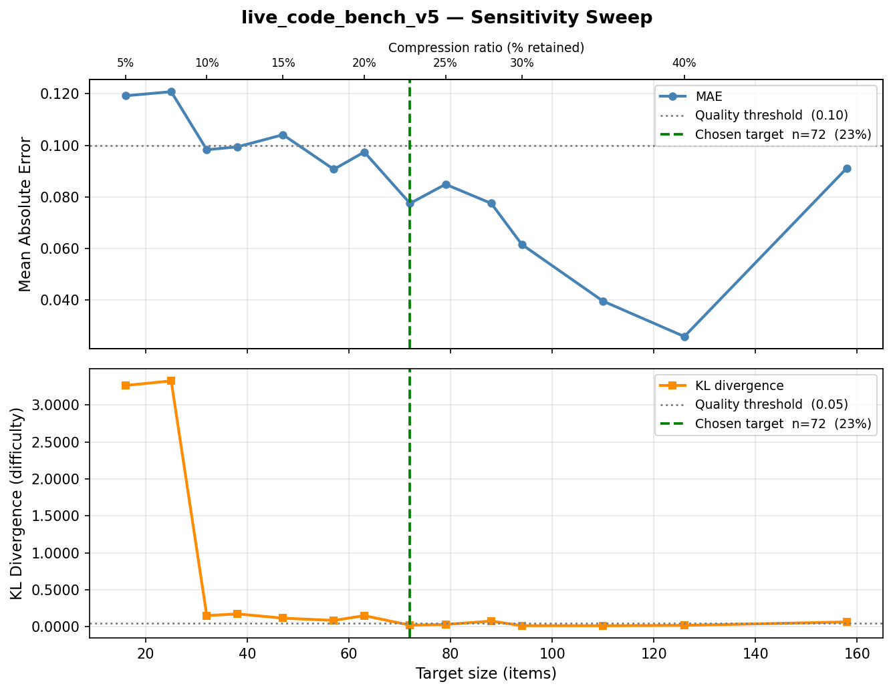
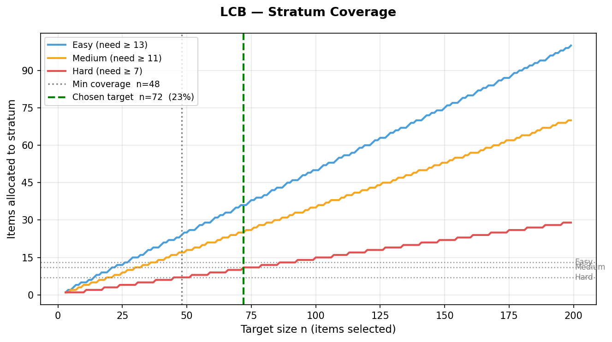
LiveCodeBench
Full: 315 items -> pruned: 72 items (22.9% retained, 4.4x compression)
MAE: 0.078, KL divergence: 0.021
Validation: Spearman ρ: 1.0, Go/No-Go: 100%, LOMO MAE: 3.4pp
Target size (n) = 72

Slide 6
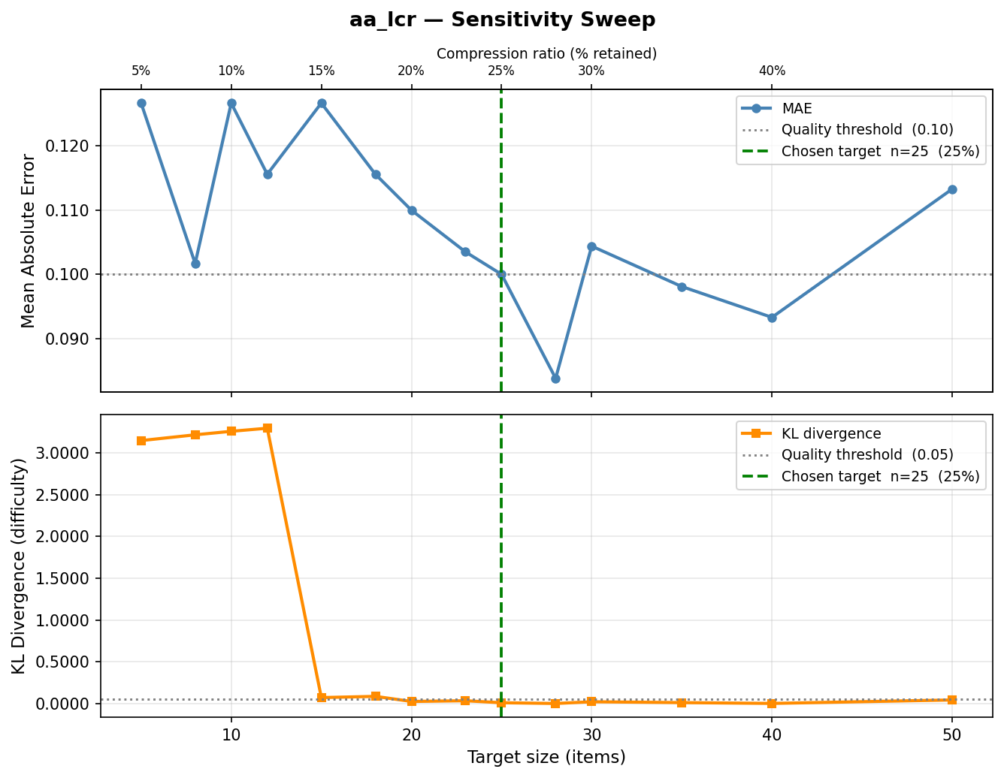
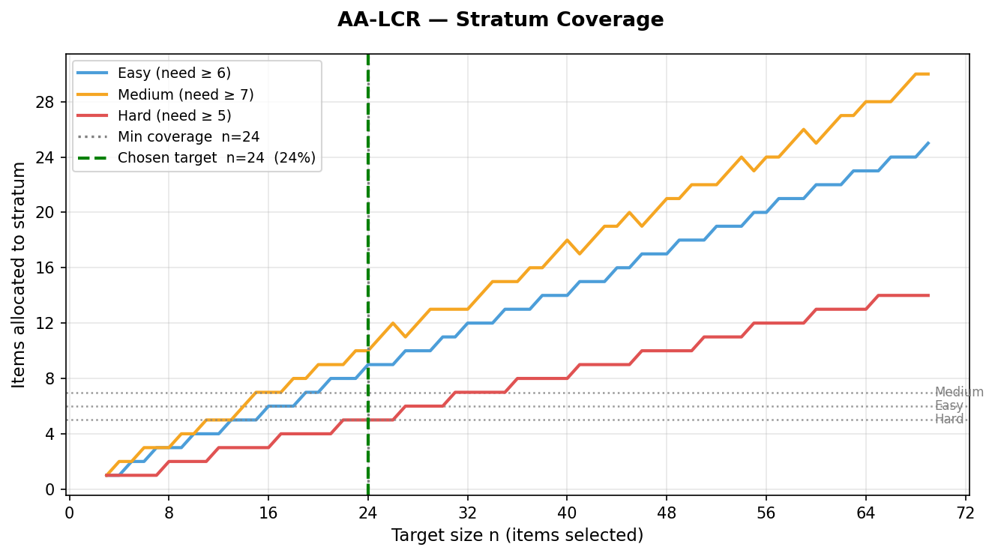
AA-LCR
Full: 100 items -> pruned: 24 items (24.0% retained, 4.2x compression)
MAE: 0.102, KL divergence: 0.034
Validation: Spearman ρ: 1.0, Go/No-Go: 100%, LOMO MAE: 2.8pp
Target size (n) = 24

Slide 7
MMMU Modifications
Stratification from Labels
Centrality Selection
With one model no ‘Medium’ stratum can be derived.
‘Topic_difficulty’ labels from the benchmark are used for stratification.
Without inter-model variance, IRT scores cannot be calculated.
All three strata use centrality to maximize representativeness without a discrimination signal.

Slide 8
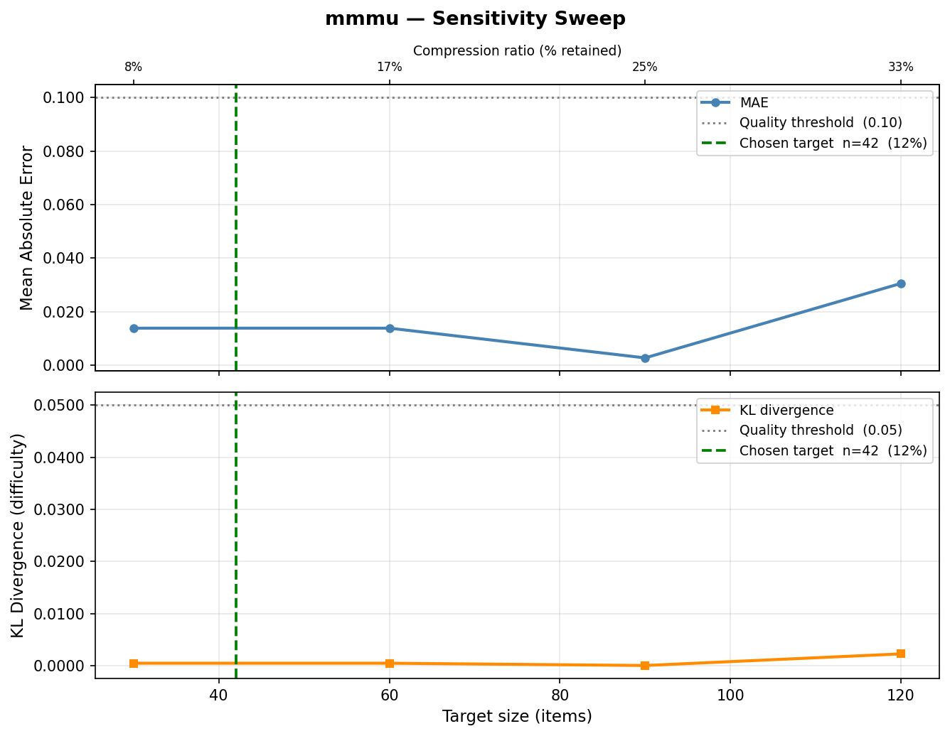
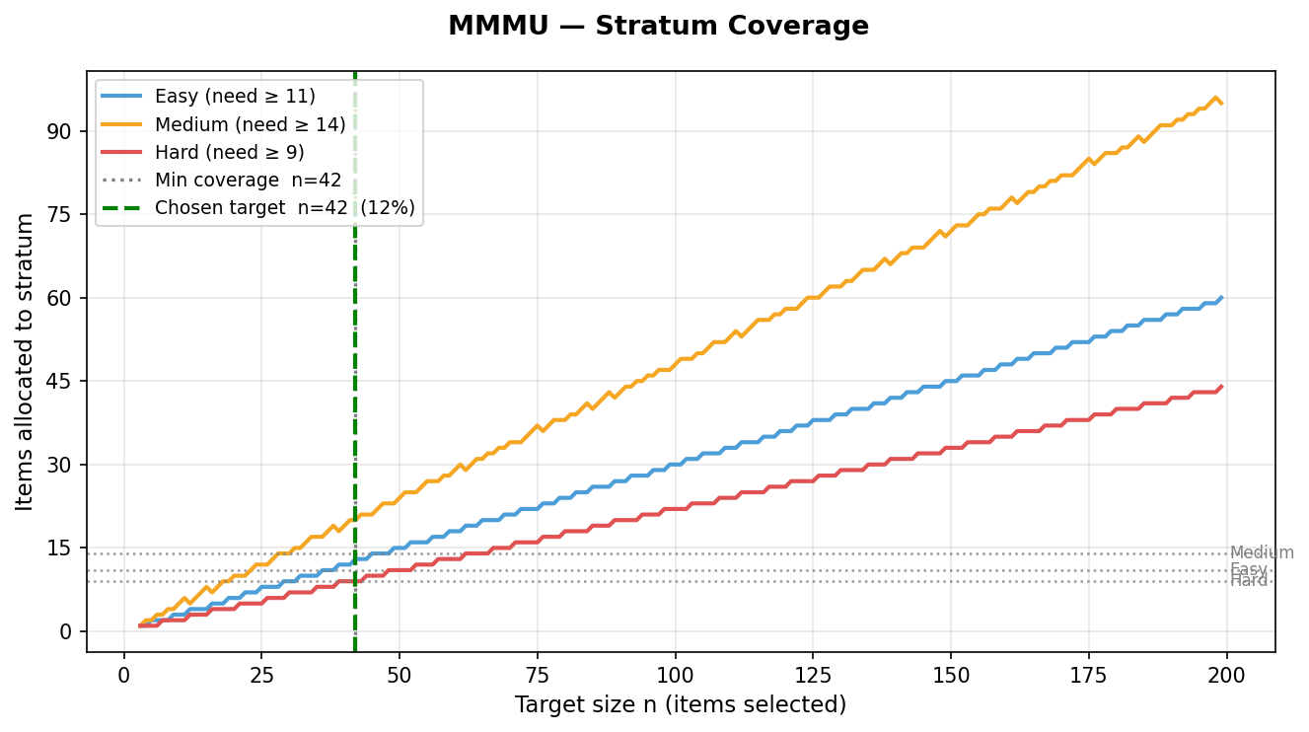
MMMU
Full: 360 items -> pruned: 42 items (11.7% retained, 8.6x compression)
MAE: 0.004, KL divergence ~ 0.001
Validation: Go/No-Go: 100%
Target size (n) = 42

Slide 9
Thank you

