Slide 1


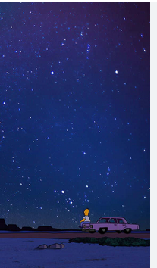

LIFE
“LIVING TRUE?”
NAME :ANJALI KUMARI
AFFLIMATION :CHANDIGARH UNIVERSITY
SUBMITTED TO : DR SIMRAN MAM

Slide 2


what does ‘life’ really mean to?
LIFE = Learning + Integrity + Faith + Effort.
L – Learning: Helps us grow and gain knowledge .
I – Integrity: Guides our actions with honesty and values
F – Faith: Gives strength, hope, and belief in ourselves
E – Effort: Drives us forward toward goals and success
Life is a journey built on Learning, Integrity, Faith, and Effort. Each part plays an important role.

Slide 3
People see life in different ways:
Some view it through a scientific lens, focusing on facts, growth, and understanding the world. Others see life spiritually, looking for meaning, purpose, and inner peace. Both perspectives show how life can be experienced in unique and valuable ways.
01
02
scientific aspect:
Spritiual aspect:

Slide 4

How life evolves.

Slide 5
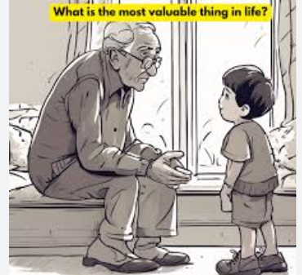

purpose
value

Slide 6
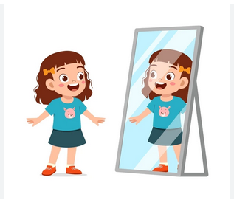
conclusion
Life is a continuous process of evolution and growth.
Every stage of life presents challenges and struggles that shape our character.
Failures serve as learning experiences that lead to personal and professional development.
Hard work and perseverance transform challenges into success.
Purpose and values give meaning to our efforts and decisions.
Understanding life’s journey helps us grow into responsible, confident, and value-driven individuals.
THANK YOU ......!

