Slide 1
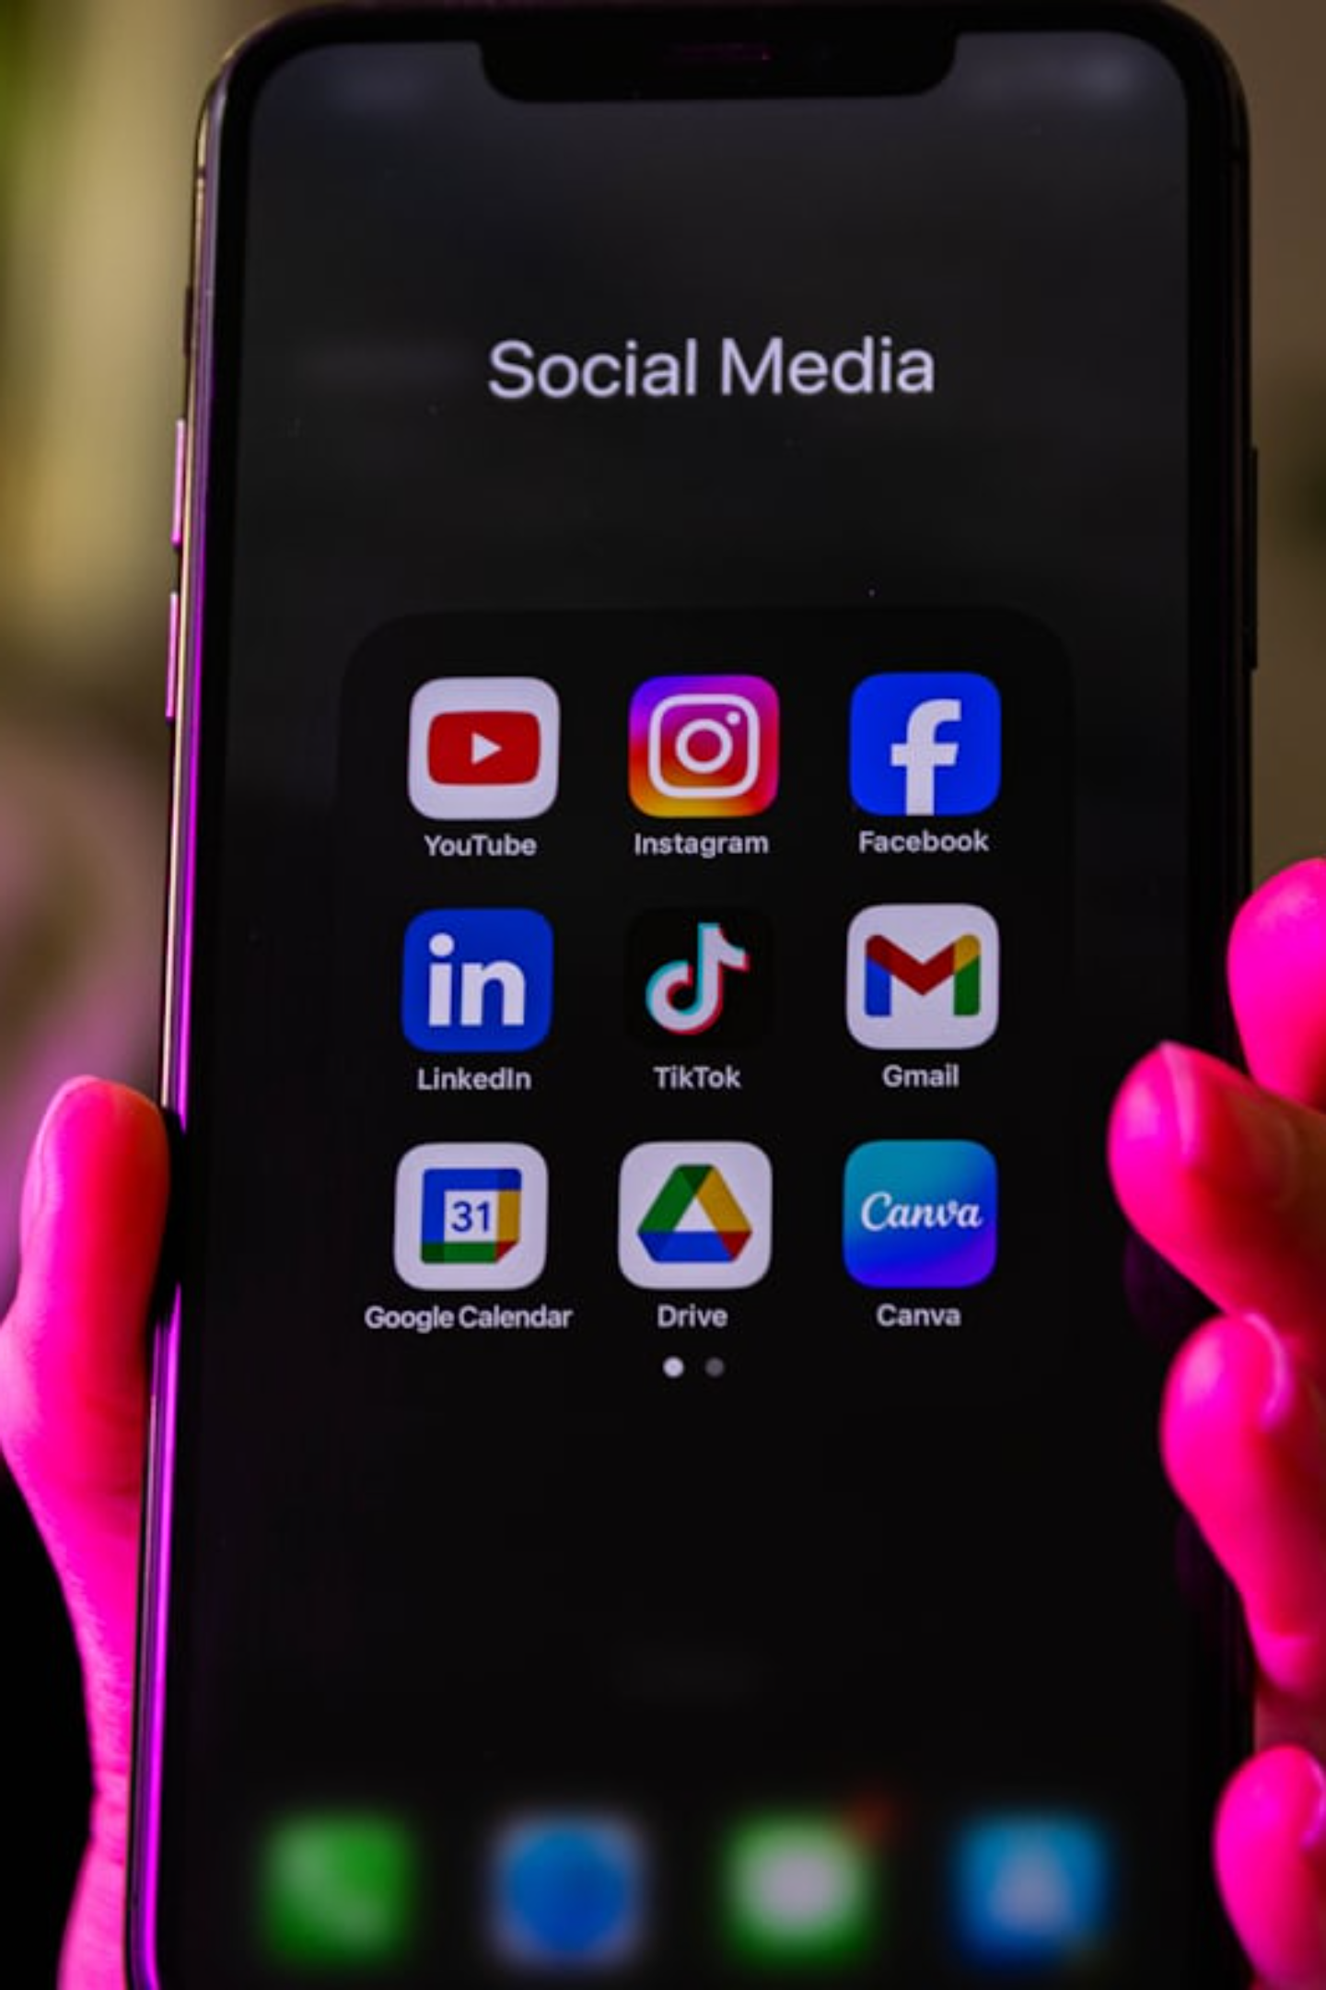
Social Media Awareness & Digital Behavior Analysis
A comprehensive study examining usage patterns, cyber safety awareness, and productivity impact across a diverse sample of social media users — offering data-driven insights for educators, researchers, and digital wellbeing advocates.
RESEARCH STUDY
DIGITAL WELLBEING

Slide 2

Introduction
Why This Study Matters
What We Examined
Social media has become inseparable from modern daily life — shaping how we communicate, consume information, and spend our time. Understanding these patterns is essential for fostering healthier digital habits.
How individuals engage with social media platforms on a daily basis
Awareness levels around cyber safety and responsible digital behavior
The relationship between screen time and personal productivity
Behavioral differences across student and working populations

Slide 3
Study Objectives
This research was designed with four core goals to provide a structured understanding of social media's influence on users' lives.
1
2
Analyze Usage Behavior
Study Cyber Safety Awareness
Identify which platforms are most used and how frequently users engage with them throughout the day.
Assess how informed users are about online risks, privacy settings, and safe digital practices.
3
4
Measure Screen Time Impact
Understand Productivity Changes
Quantify daily screen time across user groups and identify patterns tied to age and platform preference.
Explore how varying levels of social media use correlate with self-reported productivity outcomes.

Slide 4
Methodology
Research Design
50
4
This study utilized a structured survey methodology, collecting responses from a sample of 50 participants spanning student and working professional demographics. Data was captured across key behavioral and demographic variables, then analyzed using Microsoft Excel for descriptive statistics and visual pattern identification.
Total survey responses collected
Major platforms analyzed
2
Excel
Variables Collected
User groups: students & professionals
Tool used for data analysis
Demographics: Age group and gender
Platform preference: Primary social media platform used
Usage frequency: Daily hours spent on social media
Awareness ratings: Self-assessed cyber safety knowledge
Productivity ratings: Self-reported impact on work or study

Slide 5
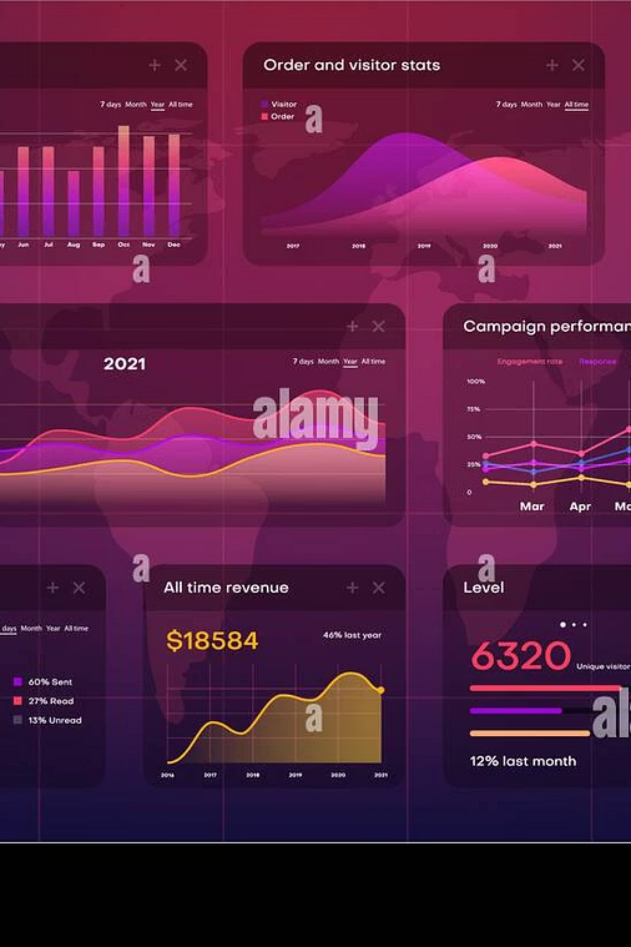
Data Overview
50
Total Responses
Collected across student and working adult populations
4
Platforms Analyzed
Instagram, YouTube, WhatsApp, and Facebook
2
User Groups
Students and working professionals
5
Key Variables
Age, gender, platform, usage hours, awareness & productivity ratings

Slide 6
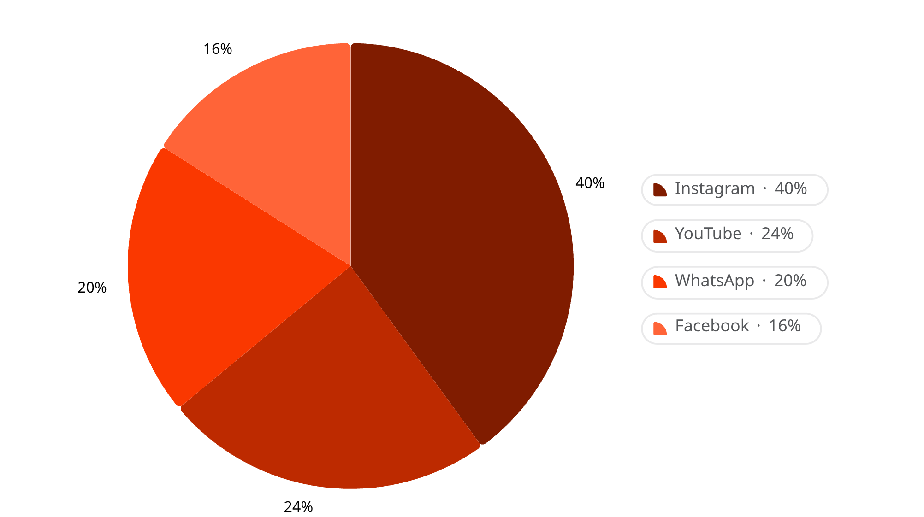

Platform Usage Distribution
Key Findings
Instagram leads as the most popular platform, used by 40% of respondents — reflecting its strong appeal among younger audiences through visual content and short-form media.
YouTube follows as the second-most used platform, favored for long-form video content and educational material. WhatsApp remains dominant for direct messaging, while Facebook sees relatively lower engagement in this sample.
Instagram's dominance aligns with broader national and global trends of visual-first social media consumption, particularly among users aged 18–30.

Slide 7
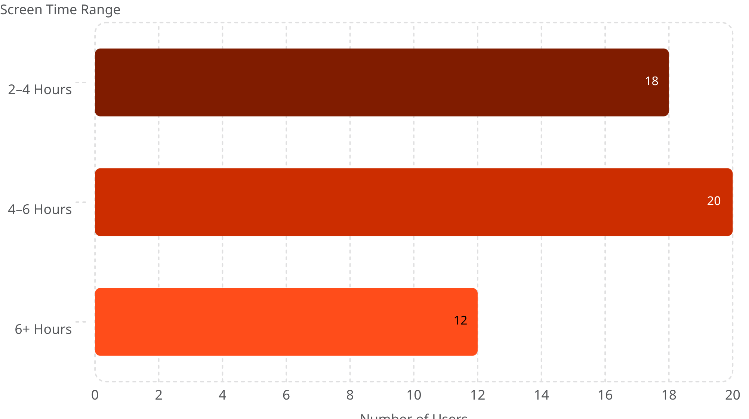

Daily Screen Time Analysis
Interpretation
The majority of respondents — 40% — report spending 4 to 6 hours per day on social media. This level of usage significantly exceeds most health and digital wellness guidelines, which recommend no more than 2 hours of recreational screen time daily.
A notable 24% of users exceed 6 hours per day, raising important concerns about the potential for addictive behavior and its downstream effects on sleep, focus, and productivity.
Extended daily screen time is associated with reduced sleep quality and increased stress levels among regular users.

Slide 8
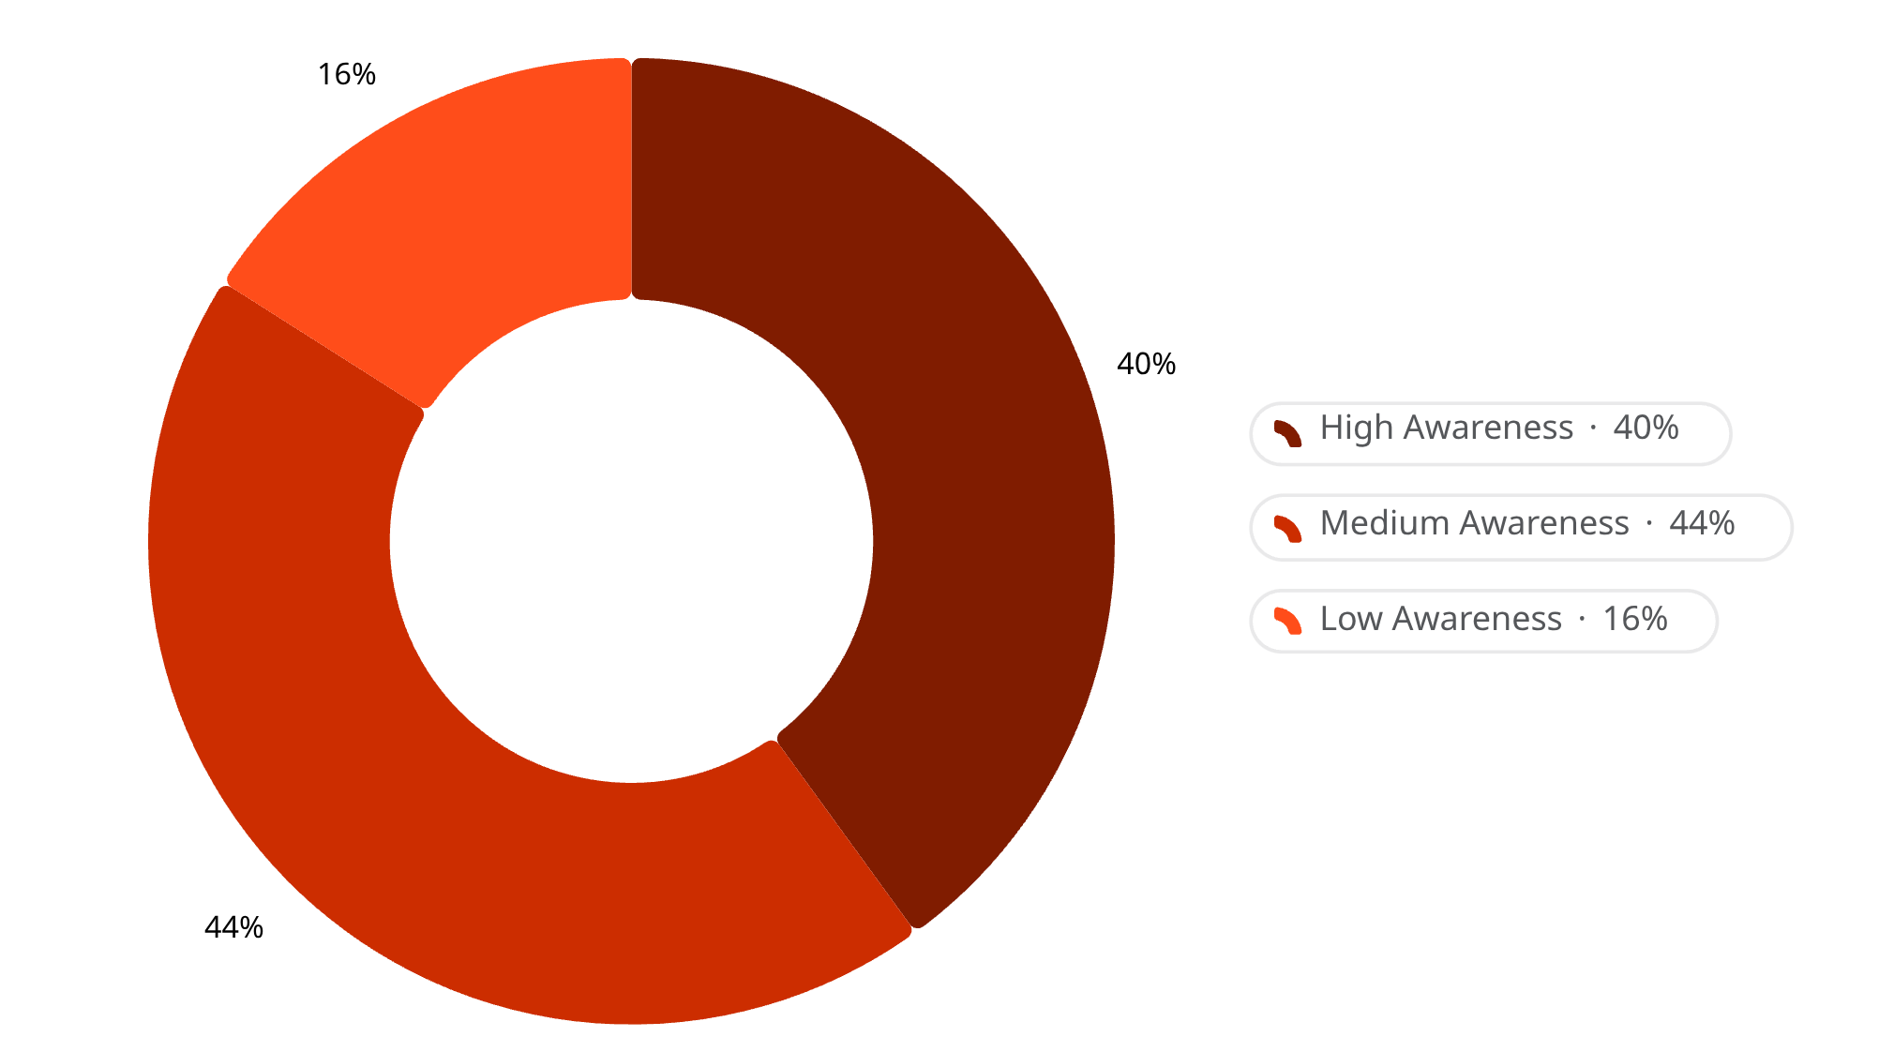

Cyber Safety Awareness
Awareness Breakdown
While 64% of respondents report high or medium cyber safety awareness, a closer look reveals that only 40% demonstrate a high level of informed digital behavior. This means the majority of users fall in a vulnerable middle ground — partially aware but not fully equipped to protect themselves online.
32 users report actively following cyber safety practices, while 18 users acknowledge gaps in their awareness — a group particularly at risk for phishing, data privacy violations, and online harassment.
Low-awareness users are significantly more susceptible to online scams, identity theft, and harmful digital interactions.

Slide 9
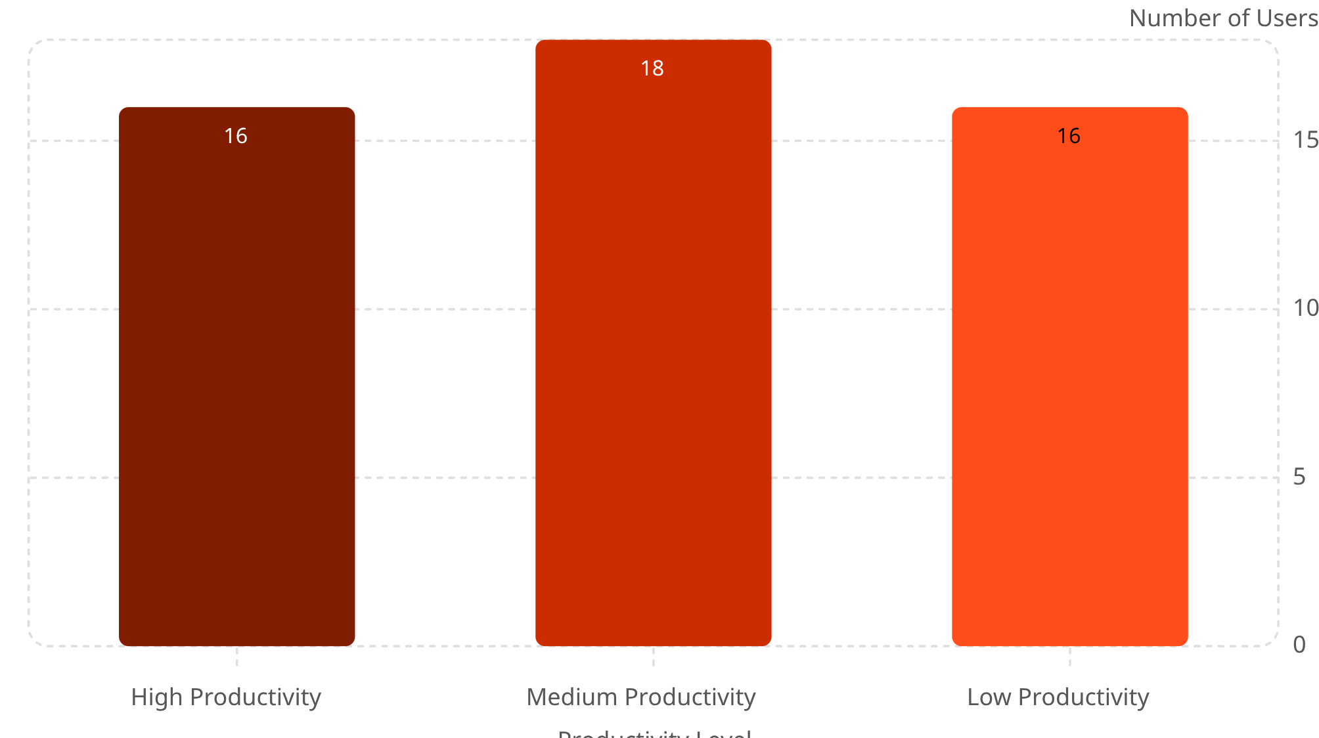

Productivity Impact of Social Media
What the Data Reveals
Productivity levels are almost evenly distributed across high, medium, and low categories — yet cross-referencing with screen time data reveals a clear pattern: users who spend 6 or more hours on social media are significantly more likely to report low productivity.
The near-equal split between high and low productivity suggests that while social media is not inherently harmful, unmanaged and excessive use is a strong predictor of reduced output in academic and professional settings.
Users who set intentional screen time boundaries report higher productivity and greater satisfaction with their digital habits.

Slide 10

Conclusions & Recommendations
Key Findings
Recommendations
High platform engagement: Instagram dominates usage, with most users spending 4–6 hours daily on social media.
🛡️ Strengthen Cyber Safety Education
Moderate awareness gap: A significant portion of users lack sufficient cyber safety knowledge, leaving them at risk.
Integrate digital literacy and cyber safety training into educational curricula and workplace onboarding programs.
Productivity at risk: Excessive screen time is directly linked to reduced productivity across student and working groups.
⏱️ Reduce Recreational Screen Time
Encourage users to adopt screen time management tools and set daily usage limits to protect focus and wellbeing.
📈 Promote Productive Digital Use
Guide users toward purposeful, goal-oriented social media engagement that supports learning and professional growth.

