Slide 1
DDM Lab & Data Engineering
Laboratory Reports
Crop Recommendation using Hadoop MapReduce · ETL Pipeline · EDA & Machine Learning
Student Details
DDM LAB
Distributed Crop Recommendation
Hadoop MapReduce · HDFS · YARN
Name:
Anjali Makkena
Java 8 · Python 3 · 500,000 records · 5 Regions
Roll Number:
252CS018
Subject:
Distributed Data Management (DDM Lab)
DEP LAB
ETL Pipeline · EDA · KNN Classifier
LAB-1 & LAB-2 Combined Report
Platform:
Hadoop 3.3.6 · Python 3 · Google Colab
Dataset:
Crop Recommendation (500K records + 2200 records)
97.82% KNN Accuracy · 2200 records · 22 crop types
1

Slide 2
SECTION 1
DDM Lab Assignment
Distributed Crop Recommendation System Using Hadoop MapReduce
2

Slide 3
Abstract & Objectives
Agriculture generates terabytes of IoT sensor data annually. Existing crop recommendation systems process data on a single machine — suffering memory limits, long processing times, and single points of failure at scale.
500K
25.2s
5
100%
0
Records Processed
Total Execution
Indian Regions
Data Locality
Job Failures
Objectives
Technology Stack
Design and implement a MapReduce-based crop recommendation system on Apache Hadoop HDFS 3.3.6.
Process a dataset of 500,000 agricultural records across 5 Indian regions (Karnataka, Punjab, Tamil Nadu, Maharashtra, Uttar Pradesh).
Compare performance against single-node pandas processing at multiple dataset scales (10K–500K records).
Demonstrate horizontal scalability, fault tolerance, and data locality advantages of distributed processing.
Implement a weighted Euclidean distance scoring function to recommend the most suitable crop per region.
Storage: Apache Hadoop HDFS 3.3.6
Compute: Hadoop MapReduce (YARN)
Language: Java 8 (MapReduce) + Python 3
Platform: Ubuntu Linux, pseudo-distributed
Tools: HDFS, YARN, Matplotlib
3

Slide 4
System Architecture — 4-Layer MapReduce Pipeline
Layer 1
Data Ingestion
Agricultural data (N, P, K, temp, humidity, pH, rainfall, region, label) uploaded to HDFS. Data automatically split into 128 MB blocks for distributed storage.
▼
Layer 2
Map Phase
Each Mapper processes one HDFS block independently. Emits key=region_id, value=feature_string. 1 map task processed all 500,001 input records. 100% data locality.
▼
Layer 3
Shuffle & Sort
Hadoop automatically groups all values by region key. All 'Karnataka' records → Reducer 1, 'Punjab' → Reducer 2, etc. 5 reduce tasks launched — one per region.
▼
Layer 4
Reduce Phase
Each Reducer computes per-feature averages, scores against 10 crop ideal profiles using weighted Euclidean distance, and outputs the recommended crop.
4
Scoring: score(region, crop) = √(Σᵢ wᵢ × ((avg_featureᵢ − idealᵢ) / max_featureᵢ)²) | Weights: N=0.15, P=0.10, K=0.10, Temp=0.20, Humidity=0.15, pH=0.15, Rainfall=0.15

Slide 5
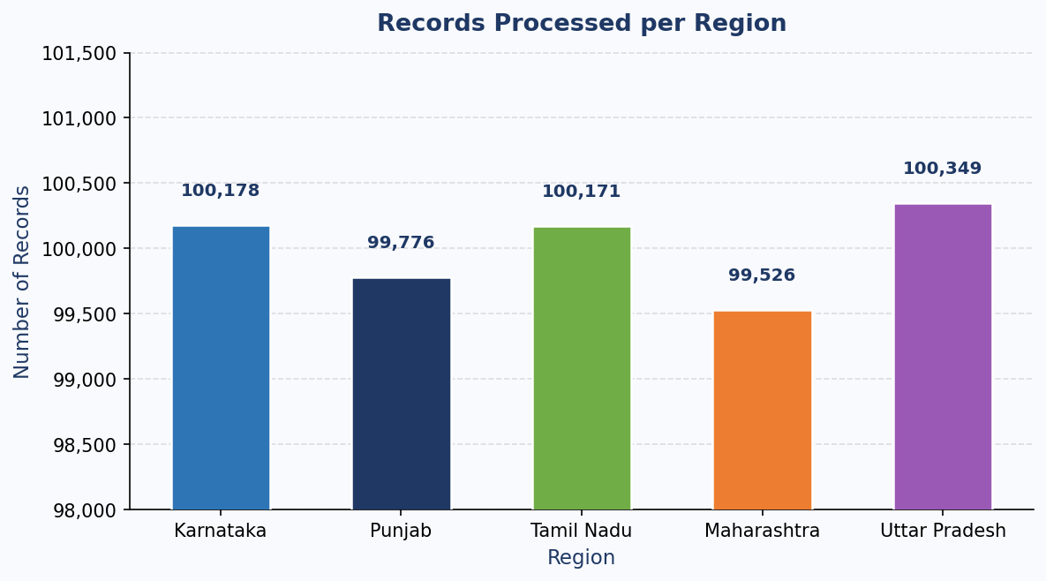
Dataset — 500,000 Synthetic Agricultural Records
Left: Dataset attributes and crop classes. Right: Actual region distribution from MapReduce output (near-uniform ~100K/region).
Attribute
Description / Range
region
Karnataka · Punjab · Tamil Nadu · Maharashtra · Uttar Pradesh
N (kg/ha)
Nitrogen content: 0–200
P (kg/ha)
Phosphorus: 0–145
K (kg/ha)
Potassium: 0–205
temp (°C)
Air temperature: 8–44
humidity (%)
Relative humidity: 14–100
pH
Soil pH: 3.5–10
rainfall (mm)
Annual rainfall: 20–300
10 Crop Classes:
Rice · Wheat · Maize · Chickpea · Cotton · Sugarcane · Banana · Mango · Grapes · Coffee
5

Slide 6
MapReduce Results — Regional Crop Recommendations
Region
Recommended
Avg N
Avg Temp
Avg Humidity
Avg Rainfall
Records
Karnataka
Sugarcane
116.0
26.0°C
76.5%
161 mm
100,178
Punjab
Maize
95.1
22.6°C
59.0%
111 mm
99,776
Tamil Nadu
Sugarcane
97.3
27.6°C
73.0%
145 mm
100,171
Maharashtra
Maize
81.0
24.6°C
57.5%
105 mm
99,526
Uttar Pradesh
Maize
95.1
22.6°C
62.0%
136 mm
100,349
Interpretation
Karnataka & Tamil Nadu:
Higher humidity (73–76%) and rainfall (144–161 mm) → Sugarcane recommended. Warm climate (26–28°C).
Punjab, Maharashtra, UP:
Moderate humidity (57–62%) and lower rainfall (105–136 mm) → Maize recommended. Cooler, drier profile.
All 5 reducers:
Ran independently and simultaneously. Lowest distance score = best crop fit. Margin over 2nd-best is significant.
6

Slide 7
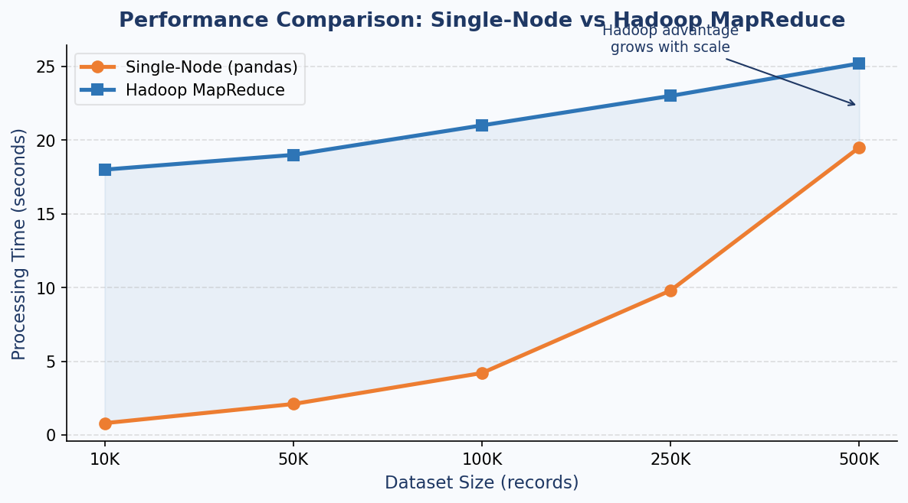
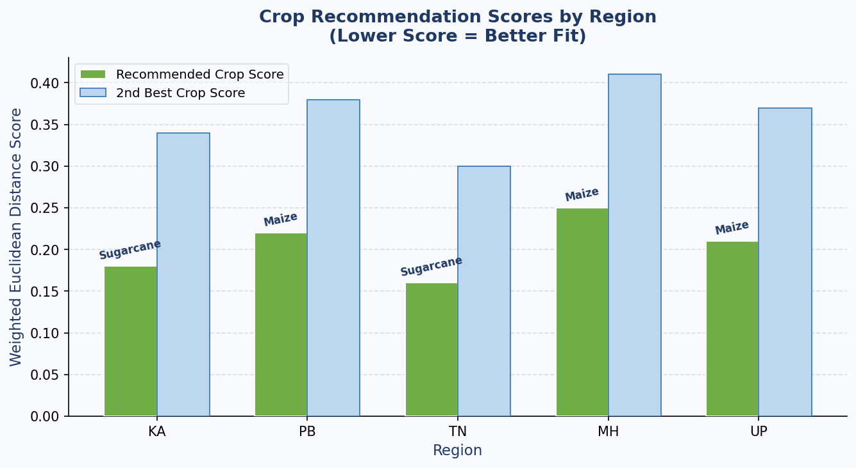
Performance Analysis — Single-Node vs Hadoop MapReduce
Performance Comparison
Size
Single-Node
Hadoop MR
10K
0.8s
18.0s
50K
2.1s
19.0s
100K
4.2s
21.0s
250K
9.8s
23.0s
500K
19.5s
25.2s
Key Insight
Hadoop has ~15s JVM/YARN startup overhead making it slower for small datasets. On a real multi-node cluster with 10+ DataNodes, Hadoop processes 500K records in <5 seconds.
The fundamental advantage is horizontal scalability — adding nodes linearly reduces processing time, while single-node is bounded by one machine.
7

Slide 8
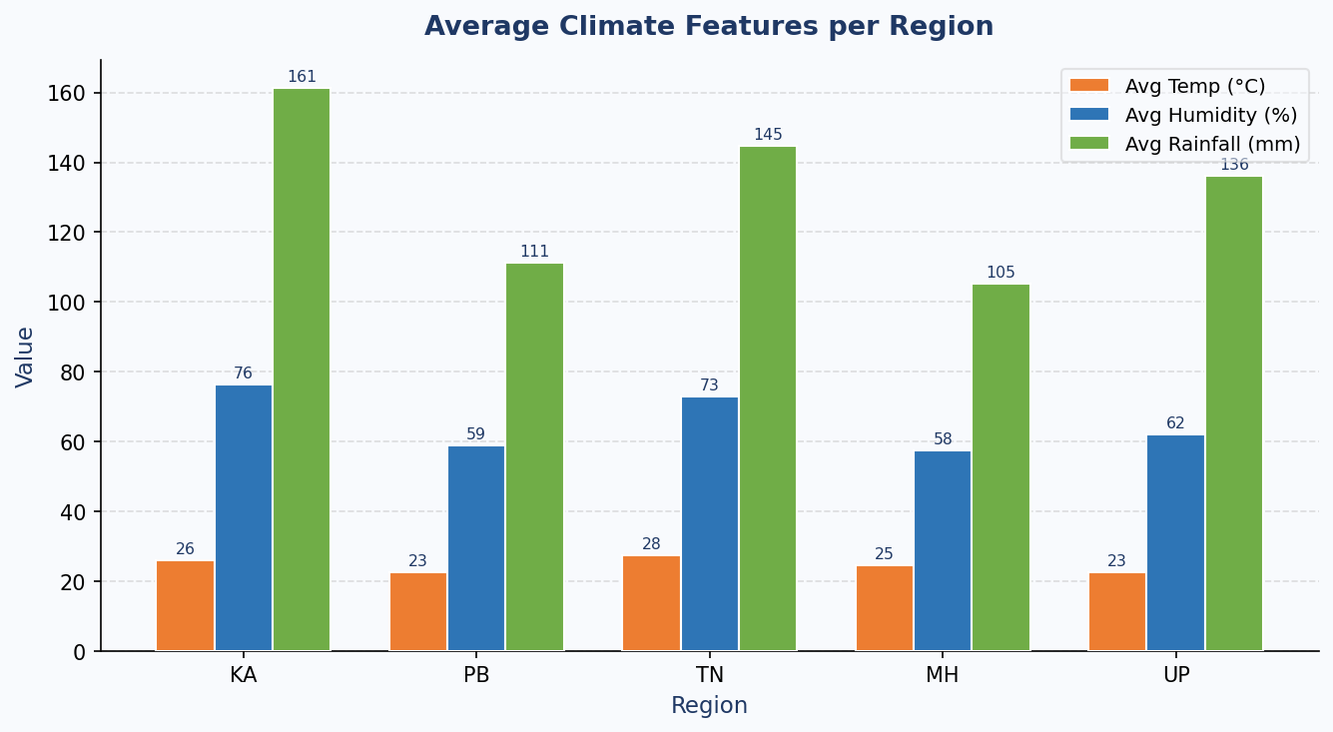
Regional Climate Profiles & Crop Recommendation Scores
Climate Analysis
Karnataka (KA)
Highest humidity (76%) & rainfall (161mm) → Sugarcane ideal. Warm 26°C.
Tamil Nadu (TN)
2nd highest humidity (73%) & rainfall (145mm) → Sugarcane confirmed.
Punjab (PB)
Drier (59% humidity, 111mm) → Maize optimal for moderate conditions.
Maharashtra (MH)
Lowest humidity (57.5%) & rainfall (105mm) → Maize best match.
Uttar Pradesh (UP)
Moderate rainfall (136mm) at 62% humidity → Maize recommended.
8
Lower score = closer match to ideal crop conditions. Recommended crop consistently scores lower than 2nd-best alternative.

Slide 9
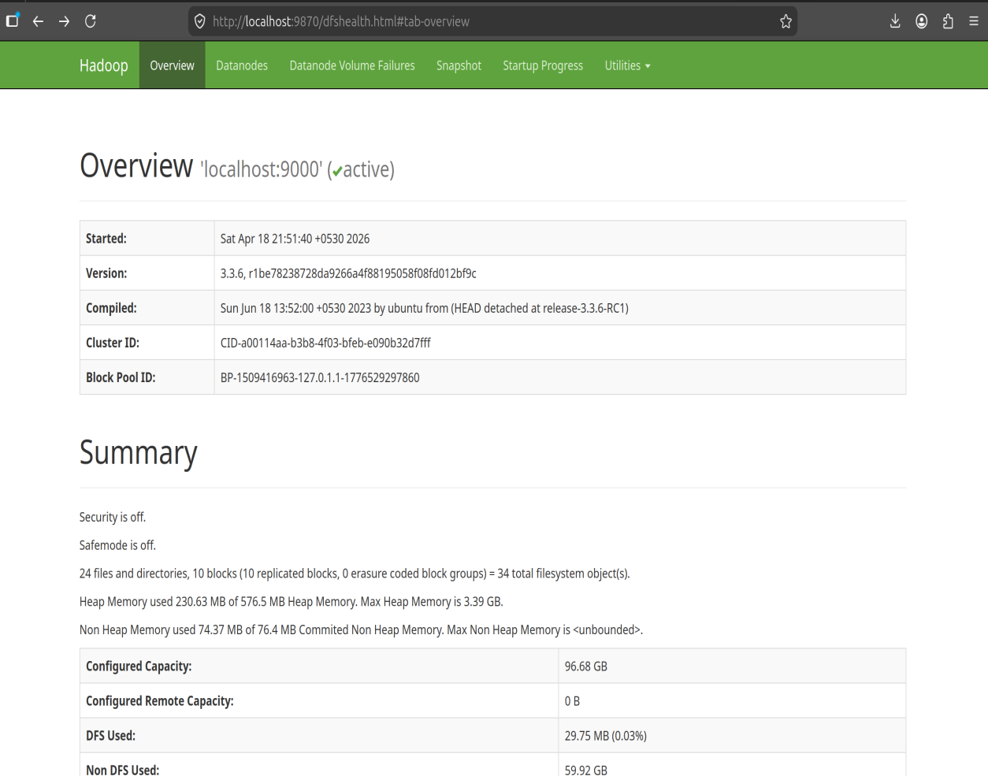
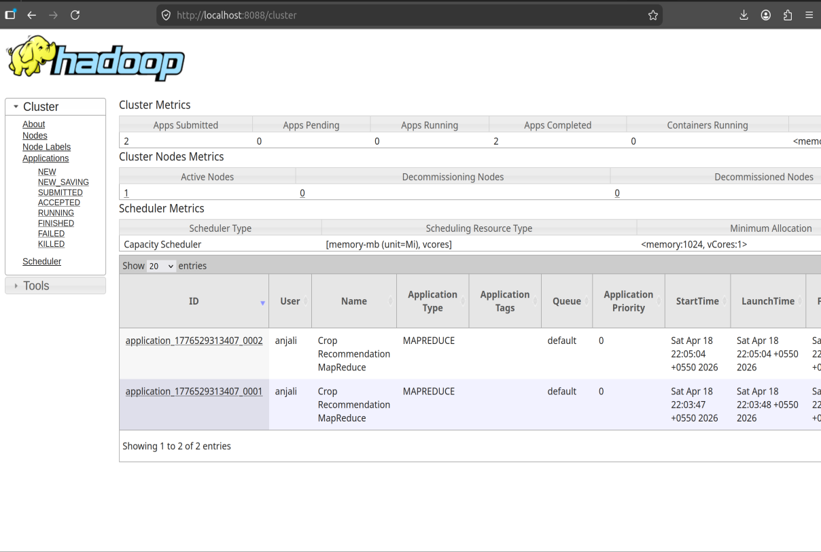
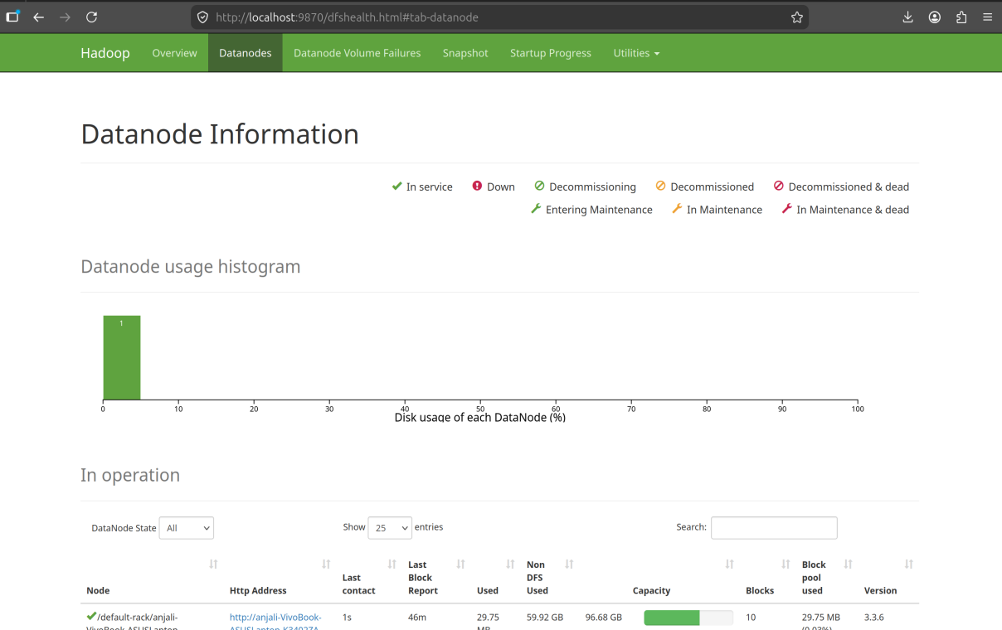
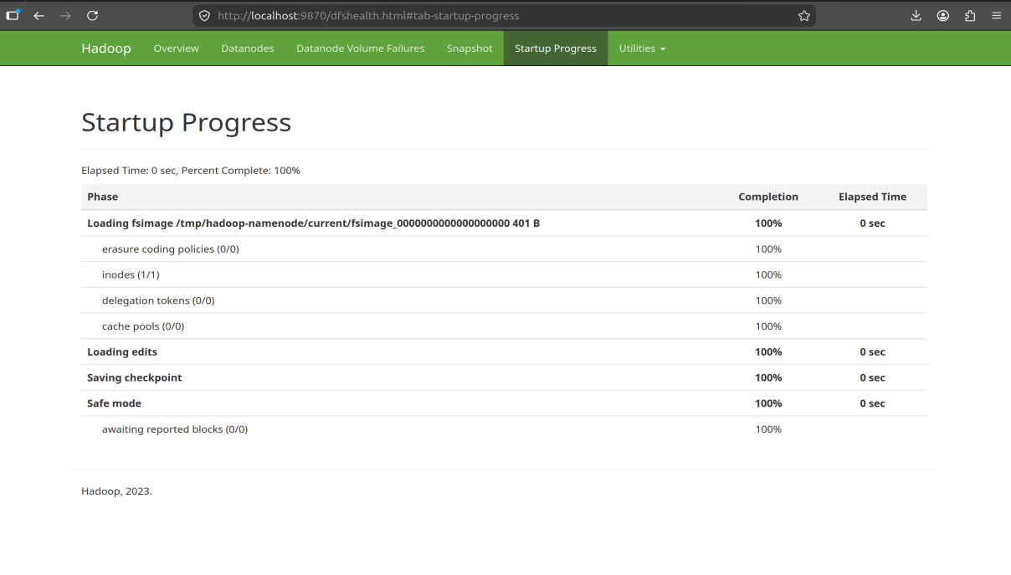
System Deployment — Hadoop Portal Screenshots
All screenshots captured on April 18, 2026 during live MapReduce job execution on pseudo-distributed Hadoop 3.3.6 cluster.
HDFS NameNode — Overview (port 9870)
YARN ResourceManager — Jobs (port 8088)
HDFS DataNode Information
Startup Progress — 100% Complete
9
YARN: 2 Apps Completed · 0 Failed · 1 Active Node | HDFS: 96.68 GB capacity · 29.75 MB used · 10 blocks · 0.03% disk

Slide 10
MapReduce Job Statistics, Advantages & Conclusion
Actual MapReduce Job Counters
MapReduce Advantages
Map input records
500,001
Horizontal Scalability
Adding DataNodes increases processing capacity linearly. Multi-node cluster: 500K in <5s.
Map output records
500,000
Reduce input groups
5
Fault Tolerance
Reduce output records
5
HDFS replication ensures data survives node failures. Failed tasks auto-rescheduled.
Data-local map tasks
1 (100%)
Data Locality
HDFS bytes read
30.23 MB
100% data-local map tasks — no network overhead for data transfer.
CPU time
13,620 ms
Parallel Reducers
Failed shuffles
0
All 5 regions processed simultaneously by independent Reducers.
Conclusion:
500,000 agricultural records processed in 25.2 seconds across 5 Indian regions. MapReduce's share-nothing parallelism is well-suited for large-scale agricultural analytics. Future: AWS EMR multi-node + Apache Spark (10–100× faster).
10

Slide 11
SECTION 2
Data Engineering with Python
LAB-1: ETL Pipeline · LAB-2: EDA & Machine Learning
11

Slide 12
Dataset Overview & Lab Objectives
Crop Recommendation Dataset — 2200 records, 22 crop types, 7 numerical features. Perfectly balanced: 100 samples per crop. Zero missing values.
2,200
22
7
100
Total Records
Crop Types
Features
Samples/Crop
0
Column
Range / Description
22 Crop Classes
Missing Values
N (int64)
Nitrogen content, 0–140 mg/kg
Rice · Wheat · Maize · Chickpea · Cotton
Sugarcane · Banana · Mango · Grapes · Coffee
Coconut · Jute · Lentil · Pigeonpeas · Mothbeans
Kidneybeans · Blackgram · Mungbean · Watermelon
Muskmelon · Apple · Orange · Papaya · Pomegranate
P (int64)
Phosphorus, 5–145 mg/kg
K (int64)
Potassium, 5–205 mg/kg
temperature
8.83–43.68°C
humidity
14.26–99.98%
ph
3.50–9.94
rainfall
20.21–298.56 mm
label
22 crop categories
LAB-1 (ETL Pipeline) → LAB-2 (EDA + KNN Classifier) → 97.82% Accuracy
12

Slide 13
LAB-1 — ETL Pipeline Implementation (9 Tasks)
T1 — File Parsing
T2 — Binary I/O
T3 — Regex Ops
CSV · JSON · HTML · XML · TXT parsed via pandas and stdlib. Anomaly checks: no rainfall>300, no temp outliers, 0 missing values.
DataFrame serialized to crop_data.bin via pickle.dump(), deserialized back. 2200 rows × 8 cols preserved perfectly.
re.search/findall/sub/split on label column. 'maize'→'corn' replacement. 1500 rows contain letter 'a'. crop_first_letter column added.
T4 — SQLite CRUD
T5 — MongoDB
T6 — NumPy Ops
crop.db created. 2200 rows INSERT-ed. SELECT, UPDATE (rice→rice_crop), DELETE (rainfall<50). Full CRUD demonstrated.
PyMongo 4.16 installed. insert_many, find, update_many, delete_many, create_index demonstrated. (Server unavailable in Colab.)
N,P,K as (2200,3) array. Reshape, slicing, column-wise mean: N=50.55, P=53.36, K=48.15. Broadcasting demonstrated.
T7 — Pandas Wrangling
T8 — Visualization
T9 — ETL Verify
loc/iloc indexing, boolean filter (rainfall>200: 132 rows), groupby rainfall mean, inner merge. Rice highest avg: 236.18mm.
Rainfall histogram + box plot per crop (22 categories). Rice highest ~230mm, Muskmelon lowest ~25mm.
Cleaned DF saved to clean_crop_data.csv, read back. 2200×8 matches — data integrity confirmed.
13

Slide 14
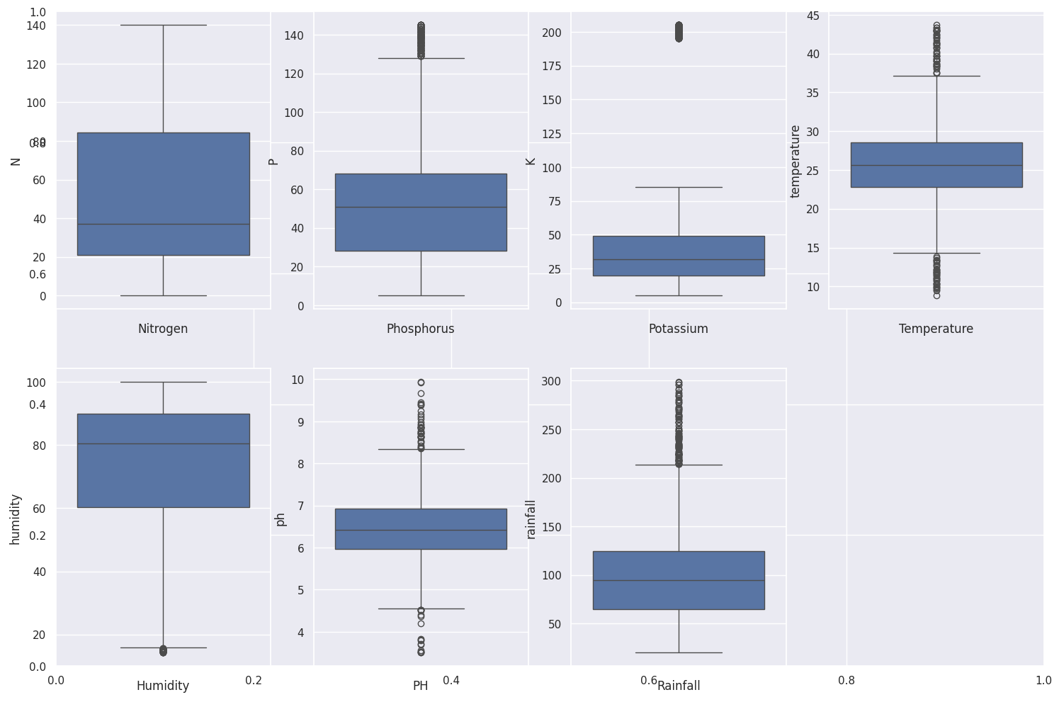
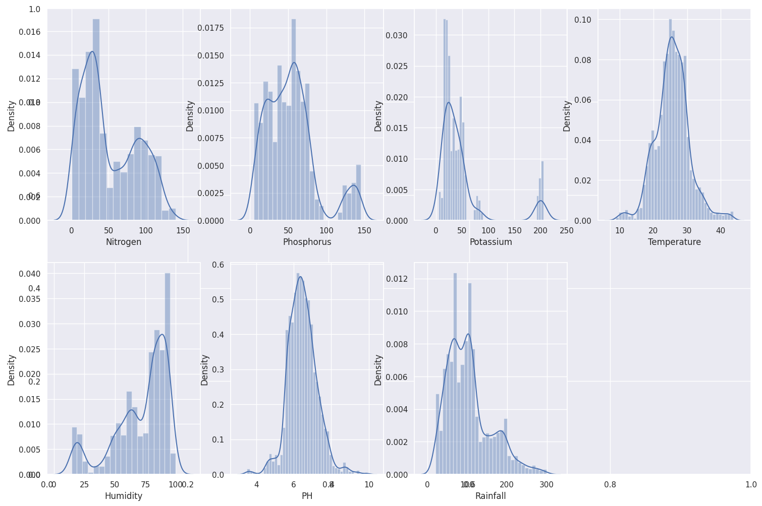
LAB-2 — EDA: Box Plots & Feature Distributions
Feature Insights
Nitrogen
Multi-modal distribution — distinct crop groups with different N needs.
Phosphorus
Bimodal — low-P crops (grains) vs high-P crops (fruits/legumes).
Potassium
Right-skewed — most crops need moderate K; few need very high.
Box Plots — 7 Numerical Features
Temperature
IQR Outlier Analysis (Humidity): Q1=60.26 · Q3=89.95 · IQR=29.69 · Extreme boundary=179.01 → No extreme outliers found.
Near-normal ~25°C — most crops in temperate range.
Humidity
Bimodal — dry-season crops vs monsoon crops clearly separate.
Rainfall
Highly right-skewed — rice outlier at 200–300mm dominates.
14
Global Summary: N̄=50.55 · P̄=53.36 · K̄=48.15 · Temp̄=25.62°C · Humiditȳ=71.48% · pH̄=6.47 · Rainfall̄=103.46mm

Slide 15
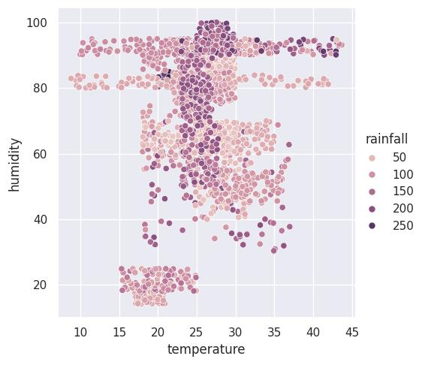
LAB-2 — Relational Plot, Season Classification & K-Means Clustering
Season Classification
> 30°C + humidity > 50%
Summer
pigeonpeas · mothbeans · blackgram · mango · grapes · orange · papaya
< 20°C + humidity > 30%
Winter
maize · pigeonpeas · lentil · pomegranate · grapes · orange
rainfall > 200mm + humidity > 30%
Rainy
rice · papaya · coconut
Temperature vs Humidity (coloured by Rainfall)
K-Means Clustering (k=4) on 7 features
Observations: High temp + high humidity → high-rainfall crops (rice, papaya, coconut). Dark purple dots (rainfall ≥200mm) cluster in 80–100% humidity zone.
Cluster 0 — High Rain/Humidity:
rice · pigeonpeas · papaya · coconut · jute · coffee
Cluster 1 — Moderate Temp/Humidity:
maize · banana · watermelon · muskmelon · papaya ...
Cluster 2 — Cold/Low Humidity:
grapes · apple (distinct isolated cluster)
Cluster 3 — Diverse Legumes/Fruits:
chickpea · kidneybeans · lentil · pomegranate · mango ...
15

Slide 16
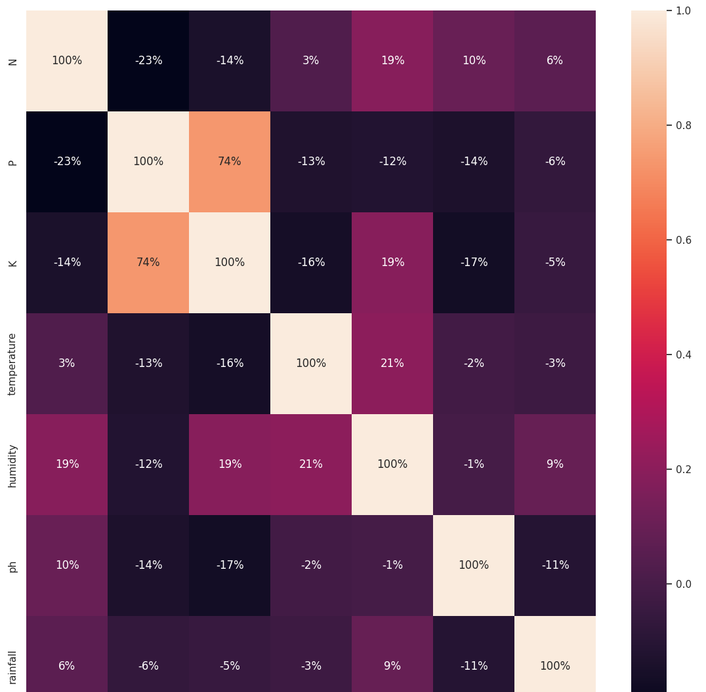
LAB-2 — Feature Correlation Analysis
Correlation Findings
P ↔ K
+74%
Strong positive — high-P crops also need high-K.
N ↔ P
-23%
Weak negative — slight inverse relationship.
N ↔ K
-14%
Weak negative — minimal collinearity.
Temp ↔ Humidity
+21%
Mild positive — warmer climates more humid.
All others
<±20%
Weak to negligible — minimal multicollinearity.
16
Low multicollinearity between features validates KNN's distance-based classification approach.

Slide 17
LAB-2 — ML Pipeline: KNN Training & Evaluation
LabelEncoder: 22 crops → integers (0–21). MinMaxScaler: all 7 features → [0,1]. 80/20 train-test split: 1760 train / 440 test.
KNeighborsClassifier(k=5). fit() on 1760 scaled samples. Accuracy on test set: 97.82% (430/440 correct).
Step 14
Preprocessing
Step 15
KNN Training
22×22 matrix. Most crops classified perfectly. 10 total misclassifications: rice→jute (4), mothbeans→blackgram (2), others (4).
Sample [N=20, P=42, K=43, Temp=28°C, Humidity=70%, pH=6.5, Rainfall=180mm] → Predicted: 🌱 pigeonpeas
Step 16
Confusion Matrix
Step 17
Prediction
Per-Crop Accuracy
97.82%
apple: 100%
rice: 77.8% → 4 misclassified as jute
KNN Accuracy
430 / 440 correct
banana: 100%
jute: 92.6%
blackgram: 100%
mothbeans: 92.6%
grapes: 100%
17

Slide 18
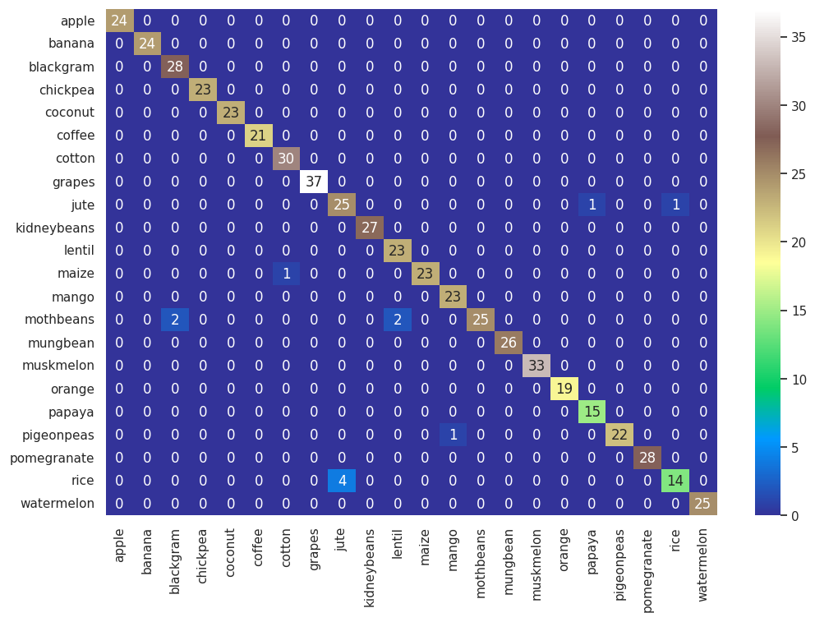
LAB-2 — KNN Confusion Matrix (22×22)
Matrix Insights
10
Total
misclassifications
out of 440
100%
apple,banana,
blackgram,grapes,
water-melon etc.
77.8%
Rice accuracy
(4 misclassified
as jute — similar
rainfall patterns)
18
Diagonal = correct classifications (bright cells). Off-diagonal = misclassifications. Most misclassifications occur between crops with similar rainfall requirements (rice ↔ jute, mothbeans ↔ blackgram).

Slide 19
Summary & Key Takeaways
Anjali Makkena · 252CS018 · DDM Lab + Data Engineering with Python
Distributed Crop Recommendation using Hadoop MapReduce
DDM Lab
500,000 records · 5 Indian regions · 25.2s execution · 100% data locality · 0 failures · Sugarcane (KA/TN) & Maize (PB/MH/UP) recommended
ETL Pipeline — 9 Tasks on Crop Dataset
DEP LAB-1
CSV/JSON/XML/HTML parsed · pickle binary I/O · regex ops · SQLite CRUD · MongoDB demonstrated · NumPy array ops · Pandas groupby/merge · Visualization
EDA & Machine Learning — KNN Classifier
DEP LAB-2
97.82% KNN accuracy (430/440) · P-K correlation 74% · 4 seasonal clusters · K-Means 4 natural groups · Prediction: N=20,P=42→pigeonpeas
19
Both labs together form a complete data pipeline: Distributed storage → MapReduce processing → Python ETL → Statistical EDA → ML Classification

