Slide 1




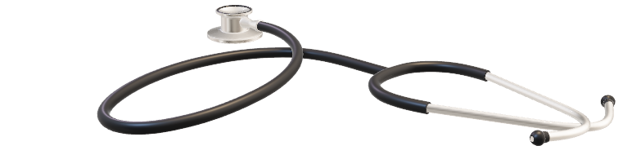



Welcome
Anjali Maria V

Slide 2

Breast Cancer Prediction

Slide 3
Introduction
According to the world health organization (WHO) Breast cancer is the most frequent cancer among women ,impacting 2.1 million women each year, and also causes the greatest number of cancer-related deaths among women.
Here we are using the Logistic Regression, K – Nearest Neighbor Classifier,Random Forest Classifier and XGBoost Classifier algorithm for detecting the model and predicting.
The model with the best results will be used and then classify the cancer as malignant or benign.

Slide 4
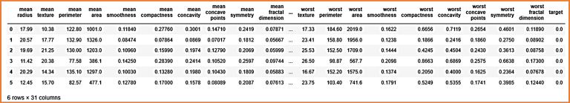
Data Set
It was created by Dr. William H. Wolberg, physician at the University Of Wisconsin Hospital at Madison, Wisconsin, USA.
The dataset used in this story is publicly available, http://archive.ics.uci.edu/ml/datasets/breast+cancer+wisconsin+%28diagnostic

Slide 5
Data Visualization
Pairplot
Heatmap
Correlation Barplot

Slide 6
Model Building
Logistic Regression: with accuracy .97
K – Nearest Neighbor Classifier:with accuracy .93
Random Forest Classifier:with accuracy .97
XGBoost Classifier:with accuracy.98

Slide 7
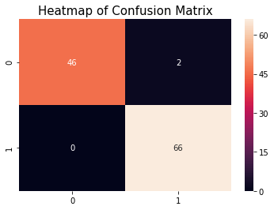
Confusion Matrix

Slide 8
Conclusion
From heatmap of confusion matrix we get, the model is giving 0% type II error and it is best.
To get more accuracy, we trained all supervised classification algorithms but you can try out a few of them which are always popular. After training all algorithms, we found that Logistic Regression, Random Forest and XGBoost classifiers are given high accuracy than remaining but we have chosen XGBoost.
We used Xgboost model because it gives 98% accuracy and the prediction is done on this model.

Slide 9
FUTURE SCOPE
In this project in python, we learned to build a breast cancer tumour predictor on the dataset and created graphs and results for the same. It has been observed that a good dataset provides better accuracy. Selection of appropriate algorithms with good home dataset will lead to the development of prediction systems. These systems can assist in proper treatment methods for a patient diagnosed with breast cancer. There are many treatments for a patient based on breast cancer stage; data mining and machine learning can be a very good help in deciding the line of treatment to be followed by extracting knowledge from such suitable databases.

Slide 10
Thank You

