Slide 1
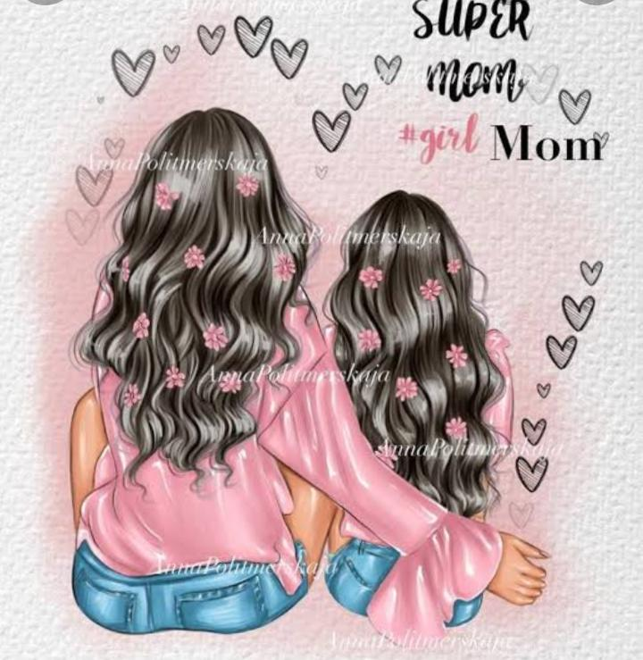
Role model ☺️

Slide 2
My mother 💗
IF THERE IS ANY
. BEAUTIFUL PERSON IN
THE WORLD 🌎 THEN
SHE IS THE
“MOTHER” 💗🌎🤗

Slide 3
My world 🌎🤗
MY MOTHER IS MY ROLE MODEL ☺️ SHE IS INSPIRES & MOTIVATES ME TO GROW
WITHOUT ANY BARRIERS 😙A MOTHER CAN DO ANYTHING FOR THE SUCCESS
•mother is the only person who carries you for 9 months in her 💖
Belly,3 years in her arms,and forever in her heart.
• THERE IS NO DIFFERENCE BETWEEN GOD AND “MOTHER” BOTH ARE ALWAYS
WITH US.
• SHE IS VERY LOVING AND HARD WORKING .
•SHE TEACHES ME GOOD MANNERS & MORAL VALUES
I love u so much mummy 💗
I miss u a lot mummy🥺

Slide 4
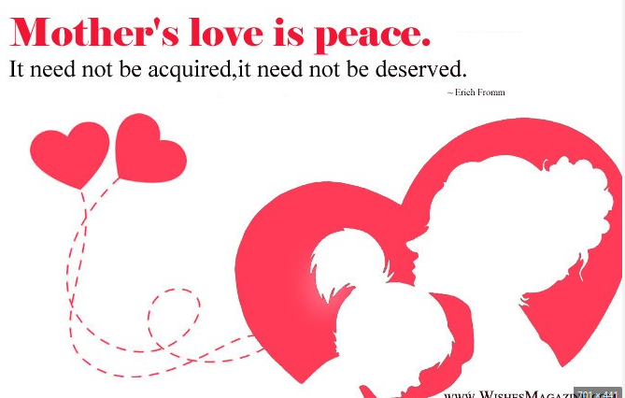
Mom 🌍💝
am who am I today You are the peanut butter
Because of You mom. To jelly
You are my inspiration. A carry a part of U with
Role model , best friend ❣️. Me where ever i go
And so many more other
Things in my life You’ve showed Me how to
see things through your
I can’t “Thank you” eyes and for that
Enough for the all love 💕 I love u 😚💓
And joy you have
Showered over
Our family 🌎

Slide 5
Conclusion
Thank u mom for
everything 🌎
I’m so thankful That God
. Made you mom 😊
Like in my life every story start with my mom
And ends with my mom only ............💓
Thank u for being A wonderful mom
And my best friend to🤗💓

Slide 6


