Slide 1
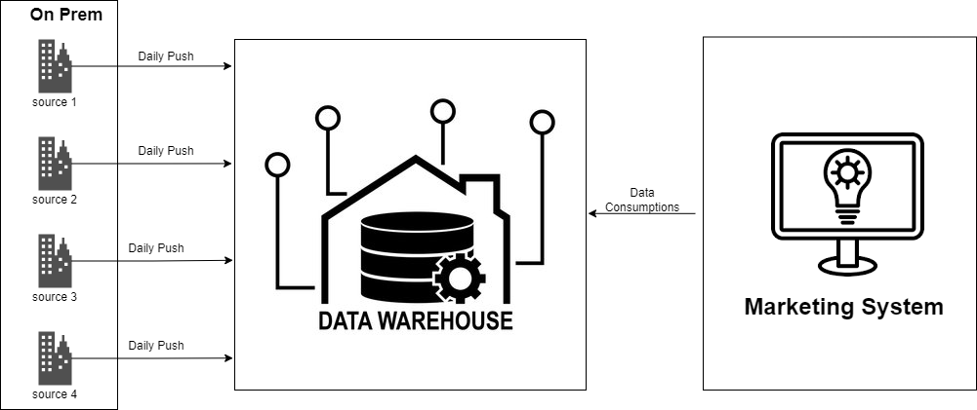
OLD DESIGN

Slide 2
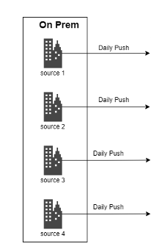

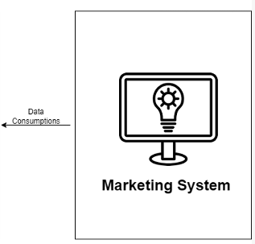

PROPOSED DESIGN
ADF
TRANSFORM
Daily Push
Centrailized
Azure Datalake Storage
Marketing System-
Azure Datalake Storage Account
ADF
Databricks

Slide 3
Assumptions
The Marketing system dashboards are capable of reading the data from storage account without any performance issue (if not, It is better to have the transformed data loaded to Azure SQL DB)
Data Processing Steps
Data Ingestion from all sources to Centralized ADLS: Daily Incremental Data ingestion to centralized ADLS from various on-prem systems and other sources through ADF pipelines
Data transformation and data load to Azure storage account:
Read the incremental data from centralized ADLS datasets from Databricks notebook
Tranform the data as per the business requirements of Marketing system team. The data cleansing and transformations are to be performed in databricks notebook
Load the final data to the designated AZ-storage account of Marketing system
Orchestrate this activity through ADF
The ADF pipeline shall be scheduled to run daily after the centralized ADLS data load has been completed
Data consumption by marketing system: Marketing sytem will consume the data for reporting/dashboarding purposes from their designated Marketing system AZ- storage account

