Slide 1
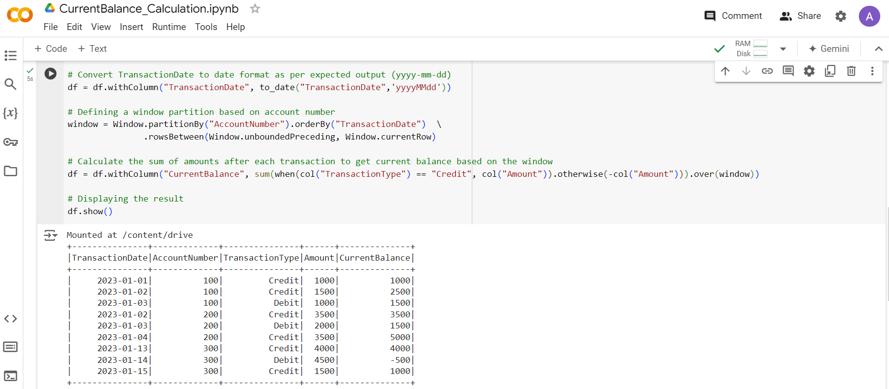
Steps Involved
Used Google Colab for coding purposes
Uploaded the input file to a Google drive location
Relevant comments have been added to the script
Captured the output below

