Slide 1
CMP304 Introduction to Web Designing and PHP
Anjali Patel(23000183)
SYBCA –C
LARAVEL CERTIFICATION COURSE

Slide 2
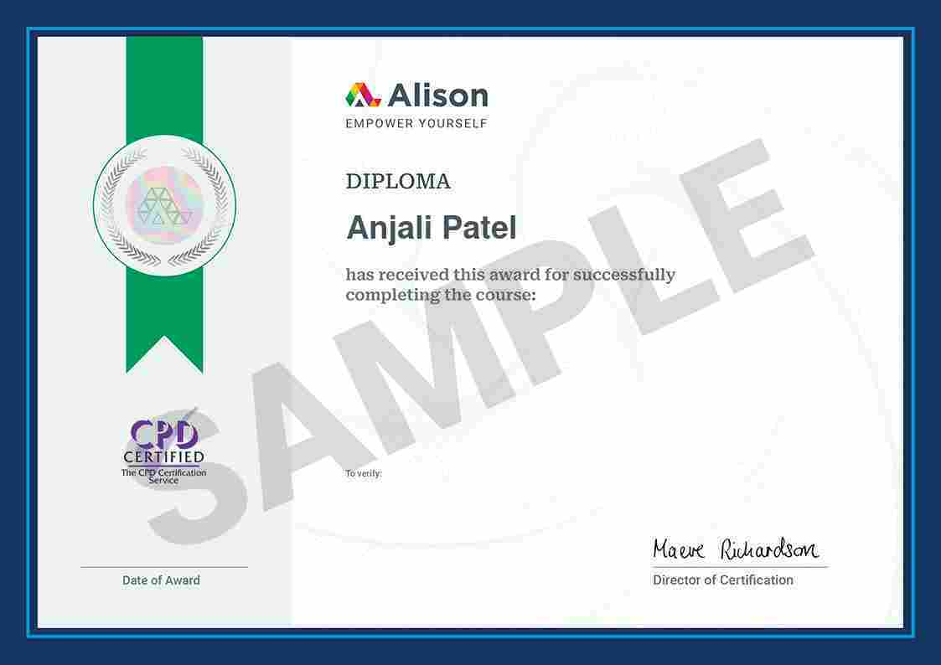

Slide 3
MODULE-1 WHAT IS LARAVEL PURPOSE?
Laravel simplifies web development with a clean, expressive syntax and a range of pre-built tools, making routine tasks more manageable. It offers many ready-to-use features, like routing, authentication, caching, and session management, which help developers avoid starting from scratch. This rich library of components acts as a foundation, allowing developers to focus more on the unique, creative parts of their applications rather than repetitive code.
By reducing the time spent on standard tasks, Laravel fosters innovation and speeds up development, supporting developers in creating robust, feature-rich applications. Its design reflects a commitment to an efficient workflow, making it an ideal framework for crafting complex, modern web applications with ease.

Slide 4
ADVANTAGES
Scalability and Maintainability:- Laravel follows the MVC (Model-View-Controller) architectural pattern, promoting code organization and separation of concerns. This structure facilitates scalability as the application grows and ensures maintainability by keeping code modules distinct and manageable.
Extensive Ecosystem:- It boasts a vast ecosystem of extensions, known as Laravel Packages or Bundles, that extend its functionalities. These packages cover diverse needs, ranging from simple authentication solutions to complex API integrations, allowing developers to leverage existing solutions easily.
Community Support and Documentation:- It has a vibrant community with active forums, documentation, tutorials, and online resources. This strong community support ensures that developers can find solutions to their queries and stay updated with the latest best practices and trends.
Modern Tooling and Features:- Laravel integrates modern PHP features and tools, including Eloquent ORM for database interaction, Blade templating engine for intuitive views, Artisan CLI for automated tasks, and robust testing utilities, enhancing the development experience.

Slide 5
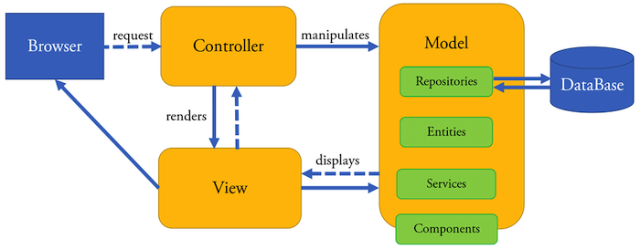
MVC ARCHITECTURE
The Model-View-Controller (MVC) architecture is a software design pattern used in web development to separate an application into three interconnected components: Model, View, and Controller. In Laravel, the MVC architecture is pivotal in structuring and organizing code. Here's an overview of each element and its significance within Laravel:

Slide 6
Model (M) Purpose: The Model represents the data and business logic of the application. It interacts with the database, encapsulating data access, manipulation, and validation.
Significance in Laravel: In Laravel, Models are PHP classes that typically correspond to database tables. They define relationships, perform CRUD (Create, Read, Update, Delete) operations, and encapsulate business rules.
View (V)Purpose: The View is responsible for presenting the data to the users. It comprises the user interface elements, such as HTML, CSS, and sometimes JavaScript, that users interact with.
Significance in Laravel: Views in Laravel are created using Blade templating engine or plain PHP. They allow for the creation of dynamic, reusable templates that render data retrieved from Controllers.
Controller (C)Purpose: The Controller acts as an intermediary between the Model and View. It handles user requests, processes input, interacts with the Model to retrieve data, and passes the data to the View for presentation.
Significance in Laravel: Controllers in Laravel are PHP classes responsible for handling HTTP requests. They contain methods (actions) corresponding to different user interactions. Controllers retrieve data from Models, manipulate it as needed, and pass it to the appropriate View for rendering.

Slide 7
Significance of MVC in LARAVEL
Separation of Concerns:- MVC promotes a clear separation of concerns. Models handle data manipulation, Views handle presentation logic, and Controllers manage the application flow. This separation enhances code organization, readability, and maintainability.
Code Reusability:- Each component in MVC can be developed independently. Views can be reused with different Controllers, and Models can be used across various application parts. This reusability reduces duplication and enhances efficiency.
Scalability and Maintainability:- By separating components based on their roles, MVC makes applications easier to maintain and scale.
Supports Testing:- The separation of concerns facilitates unit testing. Developers can independently test Models, Views, and Controllers, ensuring each component functions correctly.

Slide 8
MODULE-2 ACTIVE RECORD INTRODUCION
Active Record is a design pattern that provides an object-oriented interface for accessing and manipulating data stored in a database. This pattern encapsulates the business logic of an application within the model, allowing developers to interact with the database using a simple and intuitive API. Laravel's Eloquent ORM (Object-Relational Mapping) is an implementation of the Active Record pattern.
key concepts and features related to the Active Record pattern:
Model Representation:- In Active Record, a model class represents a table in the database. Each instance of the model class corresponds to a record in the table.
CRUD Operations:- Active Record simplifies database interactions by providing methods for Create, Read, Update, and Delete operations. Models typically have methods like create, find, update, and delete for these operations.
Relationships:- Active Record simplifies handling relationships between tables. Eloquent models define relationships such as one-to-one, one-to-many, and many-to-many using methods like hasOne, hasMany, belongsTo, etc.
Validation:- Active Record models often include validation rules. Laravel's Eloquent allows you to define validation rules for model attributes.

Slide 9
MIGRATION IN LARAVEL
In Laravel, migrations are a powerful and efficient way to manage database schema changes and version control for your application. Migrations allow you to define the structure of your database tables and easily modify them over time. To create a new migration, you can use the make: migration Artisan command.
For example:> php artisan make:migration create_users_table.
This command generates a new migration file in the database/Migration directory.

Slide 10
Migration file contains two methods
Up:-The up method defines the changes to be made to the database
Down:- The down method specifies how to reverse those changes.

Slide 11
ELOQUENT IN LARAVEL
In the Laravel, Eloquent Models stand as the backbone of database interaction, providing an elegant and expressive way to interact with databases.
Eloquent Models serve as an abstraction layer between your application and the database. They represent tables in your database, allowing you to interact with the data in a highly intuitive and object-oriented manner.
To create a new model using Artisan, you van run the following command:
>php artisan make:model yourmodel
This command will create a new Eloquent Model file named YourModel.php in the app directory by default.

Slide 12
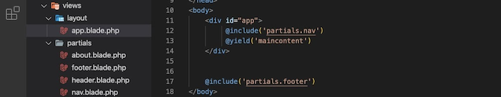
VIEW INTRODUCTION
Views in Laravel serve as the user interface components of your web application. They allow you to organize and display information to the user. Blade, Laravel's templating engine, makes the process of creating these views both efficient and clear.
Blade files typically have a .blade.php extension, and they are stored in the resources/views directory. The template can be used in the controller by view helper.
If we create app.blade.php template, then we can use it in the controller's action: ... $name = 'John Doe'; return view('app', compact('name'));

Slide 13
CONTROLLER INTRODUCTION
In the context of the Laravel PHP framework, a controller is a class that handles the incoming HTTP requests and manages the application's logic to produce an appropriate HTTP response.
Controllers act as an intermediary between the model (which represents the data and business logic) and the view (which displays the user interface).
They play a crucial role in enforcing the separation of concerns in the MVC (Model-View-Controller) architectural pattern.
Key purposes of Laravel controllers include:-
Handling HTTP Requests
Application Logic
Routing and Actions
Response Generation

Slide 14
ROUTING INTRODUCTION
In Laravel, routes are defined in the routes/web.php file for web routes and routes/api.php for API routes.
The basic syntax for defining a route looks like this:
Route::get('/example', function () { return 'Hello, this is an example route!'; });
This example defines a route for the HTTP GET method that maps to the /example URI, and when accessed, it returns a simple string.
USING NAMED ROUTE:-
We can use name() method for adding a particular name for our route.
Route::get('/users', 'UsersController@list')->name('users');
Then, we can use the defined name to refer to this route from different places.

