Slide 1
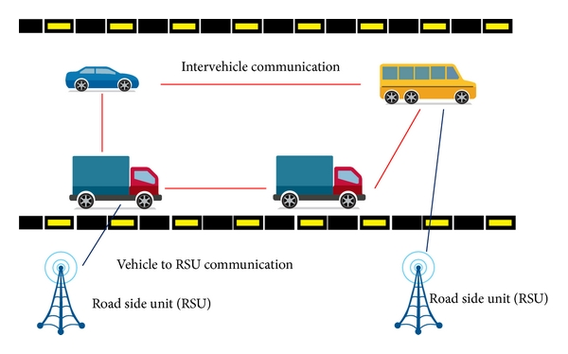
Privacy preserving mechanism using, Biometric block chain of each mobile node in VANET for Smart Traffic Management.
By- Anjali Pathak
UNI Roll No-2018006
Sachin Badoni
UNI Roll No-2014448
GUIDED BY: Priya Kholi

Slide 2
OUTLINE
Introduction
About Vanet
Authentication and Privacy
Model
OTP Verification
Fingerprint Verification
Hybrid Algorithm
Mobile Nodes connected by Blockchain.
Conclusion
References

Slide 3
INTRODUCTION
VANET aims to ensure safe driving by improving the traffic flow and therefore significantly reducing car accidents. This is possible by providing appropriate information to the driver or to the vehicle.
Due to the difficulties of using a real time execution due to authentication and privacy issues, several majors are taken to provide the wireless network for smart trafficking to minimise the causes of accidents .

Slide 4
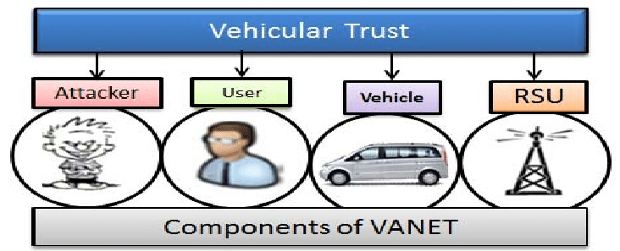
About VANET
VANETs can increase road safety by sharing information about both vehicles (e.g., position, speed and direction) and traffic conditions (e.g., accidents, jams, aquaplaning) as beacons.
Safety messages, in this case, are the key information to avoid accidents. However, collisions can occur when safety messages and transmission of packets are improperly broadcast from multiple vehicles
Many threats for VANET.

Slide 5
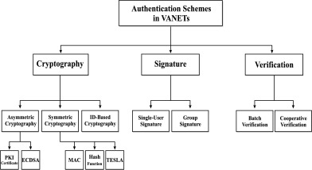
Authentication and Privacy
Although the excitement surrounding the potential benefits of VANETs is growing, the dynamic nature of VANETs (vehicles can join and leave at will) along with a multitude of system and application related requirements make it very challenging to design efficient methods for ensuring privacy of vehicles.

Slide 6
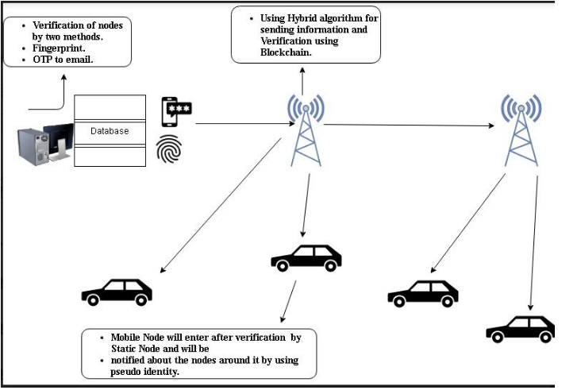
MODEL
The implementation of the Model starts with the verification of the data provided by the user such as the details like phone number, address, car number,personal details of the users is all first verified then stored in the database .All this data is provided or accessible -only to the Trusted Authority . In the whole process only this section is the only one where we are providing the details of the User.

Slide 7
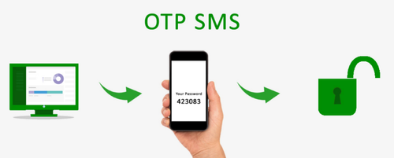
OTP Verification
OTP is a "One-Time Password" which is randomly generated and sent to your registered mobile number and registered email address for validation of your transaction.

Slide 8
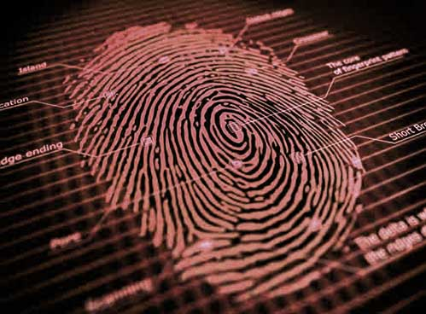
Biometric Verification FingerPrint
A fingerprint-based biometric system is essentially a pattern recognition system that recognizes a person by determining the authenticity of his/her fingerprint.

Slide 9
Hybrid Algorithm
The algorithm for privacy is RSA with Digital Signature.
We used this to overcome following problems:
Avoid some threats using Digital Signature
Many threats for VANET.

Slide 10
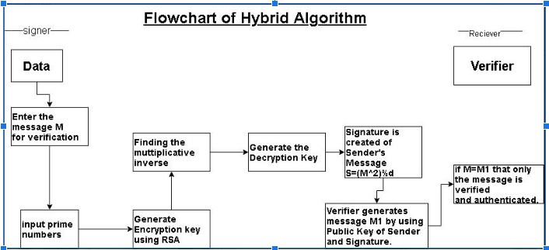
Flow of the Algorithm

Slide 11
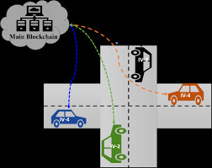
Mobile Nodes Connected by Blockchain
Mobile Nodes are the Vehicles that are used to communicate with each other by sending the message of the Nodes near or around them. This is done by the use of Blockchain where each node is connected with the hash value message of the previous nodes.

Slide 12
Conclusion
In this Model Privacy is taken care of at each step –
First the Information of Personal detail are verified
Then to connect from Trusted authority to Static Node Hybrid Algorithm is used.
Then message of traffic is shared between the cars by use of Hash Functions in Blockchain.

Slide 13
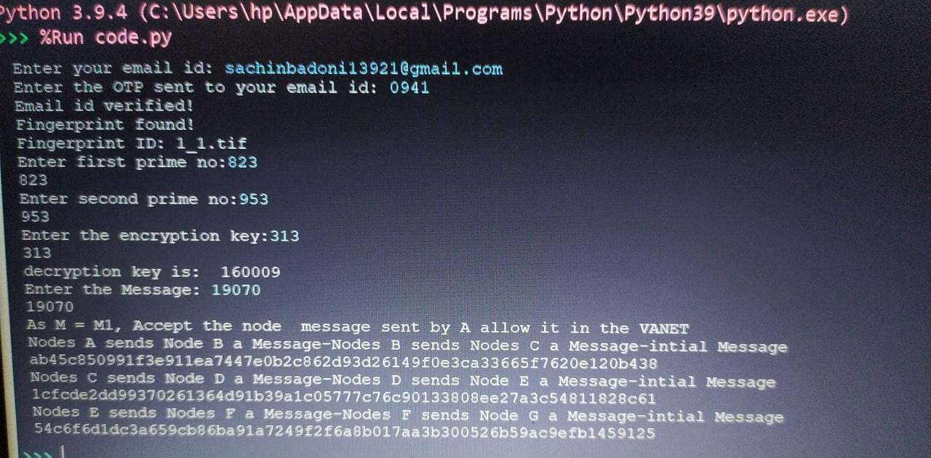
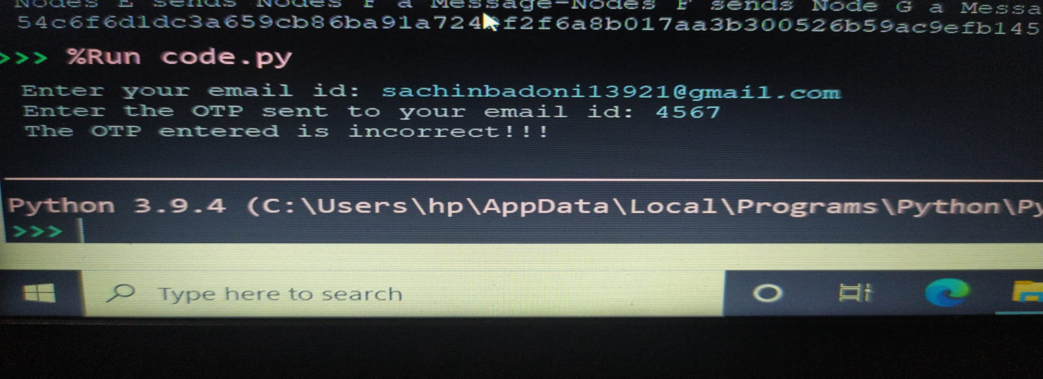
Output

Slide 14
References:
https://www.researchgate.net/publication/327366416_A_Research_Paper_on_Vehicular_Ad-Hoc_Network
https://journal-bcs.springeropen.com/articles/10.1186/s13173-021-00113-x
https://link.springer.com/chapter/10.1007/978-3-642-22543-7_34
https://www.sciencedirect.com/science/article/pii/S2352864818303092
https://www.geeksforgeeks.org/rsa-algorithm-cryptography
https://www.geeksforgeeks.org/dsa-algorithm-cryptography
www.wikipedia.com
https://www.tutorialsteacher.com/python/random-module#:~:text=The%20random%20module%20is%20a,%2C%20shuffle%20elements%20randomly%2C%20etc.
https://link.springer.com/content/pdf/bbm%3A978-3-662-50497-0%2F1.pdf

Slide 15
THANK YOU!!

