Slide 1
IBM University Engagement Project Submission
“Exploring the Power of Agentic AI with IBM Granite and LangFlow”

Slide 2
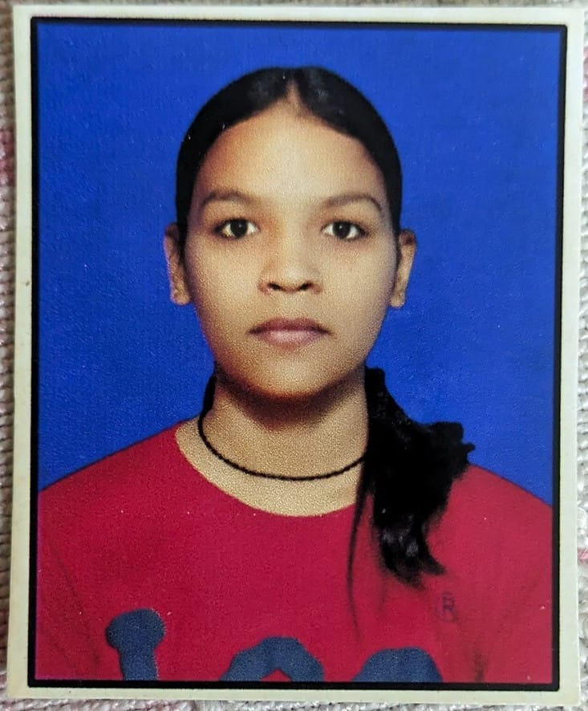
Project Tile – [Smart Farming Agent]
Domain of Project – [ Agriculture]
Student Name | Recent Passport Photo | Email ID | Mobile number [WhatsApp]
Anjali Patwal |  | anjalipatwal817@gmail.com | 9368148046

Slide 3
Problem Statement -
Problem Statement : AI Agent for Smart Farming Advice
The Challenge
Small-scale farmers lack access to expert agricultural guidance
No real-time data on weather, soil conditions, or market prices
Language barrier — most tools are English-only
Knowledge gap leads to poor crop yield and income loss
Pest & disease identification is difficult without experts
.
The Objective
Build KisanAI — an AI agent for smart farming advice
Use RAG to retrieve trusted data from farming knowledge base
Integrate live weather & mandi (market) prices
Support Hindi & English for rural accessibility
Provide crop, soil, pest & fertilizer guidance
Powered by IBM Watsonx AI & Granite Models

Slide 4
Technology Used
Tech Stack
I used:
IBM Watsonx AI,
IBM Granite LLM,
RAG Pipeline,
OpenWeather API,
DuckDuckGo Search,
Python + Flask,
ChromaDB + HuggingFace

Slide 5
Proposed Solution -
Proposed Solution:KisanAI
KisanAI is a full-stack AI agent that combines IBM Watsonx AI, RAG pipeline, live APIs, and a React chat interface to deliver real-time, localized farming guidance to small-scale Indian farmers in Hindi and English.
.
AI Chat Interface: Farmers ask questions in Hindi or English. IBM Granite LLM understands and responds naturally.
RAG Knowledge Base : LangChain retrieves relevant farming data from a vector database before generating answers — no hallucination.
Live Weather Data Real-time weather via OpenWeather API. Temperature, humidity & farming alerts for any Indian city.
Mandi Price Tracker : Live market prices via web search. Farmers know today's rates before going to the mandi.
Soil Health Checker: Identifies soil type (alluvial, black, red, sandy) and recommends the best crops for that soil.
Pest Guide: Identifies common pests and gives both chemical and organic solutions with affected crop details

Slide 6
Langflow component Used -
1FARMER (User)– Hindi / English query via React Chat UI
2) FLASK API BACKEND--REST endpoints: /chat /weather → Orchestrates all services
3) IBM WATSONX AI + GRANITE--meta-llama/llama-3-3-70b via Watsonx Runtime (eu-gb) — Generates intelligent farming answers
4) RAG PIPELINE--LangChain → ChromaDB → HuggingFace Embeddings → Farming Knowledge Base
5) LIVE DATA SOURCES -- OpenWeather API (weather) | DuckDuckGo Search (mandi prices) | farming_knowledge.txt

Slide 7
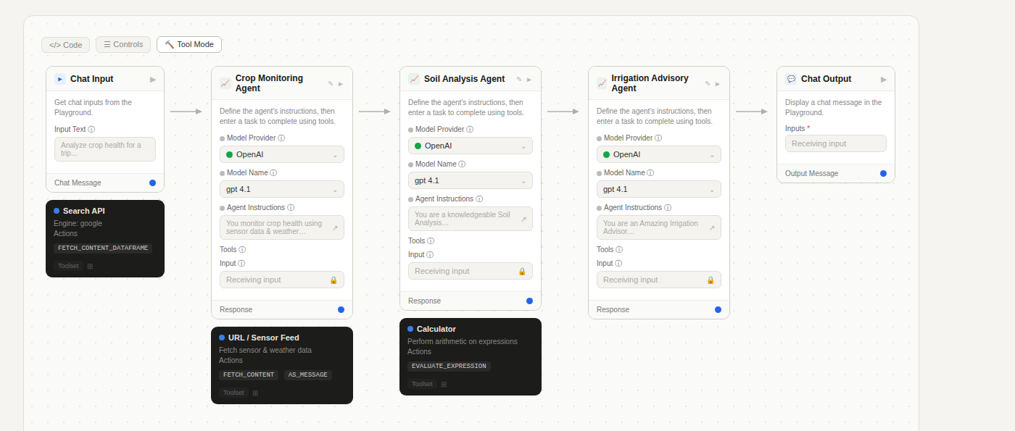
Langflow workflow -

Slide 8
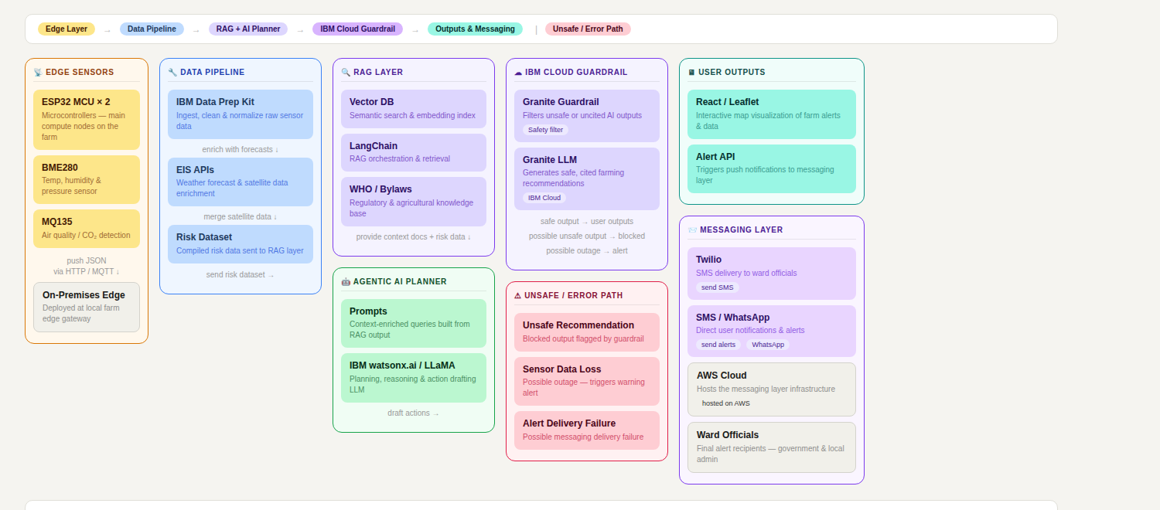
Architecture blueprint

Slide 9

Role of Agentic AI in the Smart Farming Agent
Agentic AI enables the Smart Farming Agent to function as an intelligent, autonomous system rather than a simple query-response tool. Using IBM watsonx.ai and IBM Granite models, it coordinates multiple specialized agents to deliver data-driven farming guidance and actionable insights to farmers.
Each agent performs a specific role — such as analyzing soil conditions, recommending suitable crops, predicting weather impacts, detecting plant diseases, and advising on irrigation or fertilizer usage — while working collaboratively as a unified system. This multi-agent approach ensures efficient task execution and highly accurate agricultural recommendations.
Agentic AI also brings context awareness, understanding farm-specific details like location, soil type, crop history, and seasonal patterns to generate tailored guidance. It supports real-time adaptation, continuously updating suggestions based on dynamic inputs such as live sensor data, weather changes, and crop growth stages.
Additionally, agents communicate with each other, enabling smarter decision-making — for example, combining soil moisture data with weather forecasts to optimize irrigation schedules automatically.
Overall, Agentic AI makes the Smart Farming Agent proactive, personalized, and goal-driven — acting like a smart digital farming assistant that empowers farmers to make better decisions, reduce crop losses, and improve yields sustainably.

Slide 10
Technology Used
React (v19.2.7) – For building the frontend user interface where farmers can interact with KisanAI through a chat-based web application.
Flask (Python) – For building the backend REST API that handles incoming chat requests, processes user messages, and returns AI-generated farming responses.
Flask-CORS – For enabling secure cross-origin communication between the React frontend and the Flask backend running on different ports.
IBM Granite Model (e.g. ibm-granite-3-2-8b) – For natural language understanding and reasoning, generating intelligent, context-aware farming advice in Hindi and other regional languages based on the farmer's query.
IBM Watsonx.ai – For model deployment and AI inference, providing the platform to access and run the IBM Granite model securely and at scale.
IBM Cloud – It provides the infrastructure to build, deploy, and scale KisanAI efficiently. IBM Cloud enables a reliable, secure, and scalable environment for running both the backend and AI models in production.
OpenWeatherMap API – For fetching real-time weather data based on the farmer's city, which is injected into the AI prompt to provide location-specific and season-aware farming recommendations.
Python-dotenv – For securely managing API keys and environment variables such as IBM Watsonx credentials and weather API tokens without hardcoding them in the source code.
npm / Create React App – For managing frontend dependencies, build tooling, and running the React development server efficiently.

Slide 11
Novelty and Uniqueness
The proposed KisanAI Smart Farming Agent stands out by combining Agentic AI, real-time weather intelligence, and multilingual personalization into a single intelligent farming assistant built specifically for Indian farmers.
Farmer-Centric Conversational AI – Instead of a generic chatbot, KisanAI is purpose-built for agriculture, understanding farming-specific queries in Hindi and regional languages, making it accessible to rural farmers who are not comfortable with English.
Weather-Aware Intelligent Responses – Uniquely integrates real-time weather data from the farmer's city directly into the AI prompt, ensuring every farming recommendation is location-specific, season-aware, and practically actionable.
Multilingual Support – Delivers AI-generated responses in Hindi and other regional languages, bridging the language barrier that prevents most farmers from benefiting from modern agricultural technology.
Greeting-Aware Context Management – Intelligently detects whether a message is a casual greeting or a farming query, avoiding unnecessary weather injection and ensuring natural, human-like conversations.
IBM Granite-Powered Reasoning – Leverages IBM Granite models via IBM Watsonx.ai for deep agricultural reasoning, providing reliable, governed, and enterprise-grade AI responses rather than unverified internet answers.
Modular & Scalable Architecture – Built with a clean separation of concerns — dedicated modules for AI (watsonx_client.py) and weather (weather_service.py) — making it easy to plug in new agents like crop disease detection, soil analysis, or market price tracking in the future.
Hyperlocal Focus for Indian Agriculture – Defaults to Indian cities (e.g., Meerut) and Hindi language, making it uniquely tailored for the needs of Indian farmers rather than being a generic global solution.

Slide 12
Git Hub Link
https://github.com/anjalipatwal26-ap/smart-farming-agent
·
·
·

Slide 13
Future Scope
Crop Disease Detection – Farmers can upload crop photos to get instant AI-based disease and pest diagnosis.
Soil Health Analysis – Personalized fertilizer and crop recommendations based on soil test inputs.
Market Price Intelligence – Real-time mandi price integration to help farmers sell at the right time and place.
Voice Assistant Support – Voice-based interaction in Hindi and regional languages for low-literacy farmers.
IoT Sensor Integration – Connect with smart sensors for automated irrigation and real-time field monitoring.
Personalized Crop Calendar – AI-generated reminders for sowing, fertilizing, and harvesting based on location and crop type.
Government Scheme Advisor – Guide farmers about relevant subsidies, loans, and insurance schemes based on their profile.
RAG-Based Knowledge Base – Implement RAG for more accurate, citation-backed farming responses.
Mobile App – A lightweight Android app optimized for rural farmers with low-end devices and slow internet.
Multi-Language Expansion – Support more regional languages like Tamil, Telugu, Marathi, and Punjabi to reach farmers pan-India.
·
·
·

Slide 14


