Slide 1

Federation of ontologies - Books
Anjali Prasad, Priya Ananthasankar, Pooja Bhandari, Nitish Mohan Shandilya
GROUP 5

Slide 2
Agenda
Background
Main goal
Ontology Design
Meta Ontology
Querying and Efficiency
Conclusion

Slide 3
Background
What is an Ontology
We know this!
Why do we need it?
To share common understanding of the structure of information
Semantic Web
Better Data Representation
Why do we need a federated ontology?
Better query exposure
Not keep track of individual ontology structure
Better data depiction

Slide 4
Main Goal
Amazon
Goodreads
Comics
Meta-Ontology
SPARQL queries
Diverse domains:
1. Goodreads – Social network
2. Amazon – Buyer/Seller marketplace
3. Comics – Characters and Cartoons

Slide 5
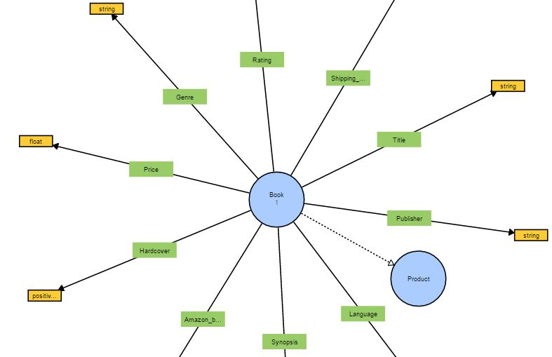
Ontology Depiction - Amazon

Slide 6
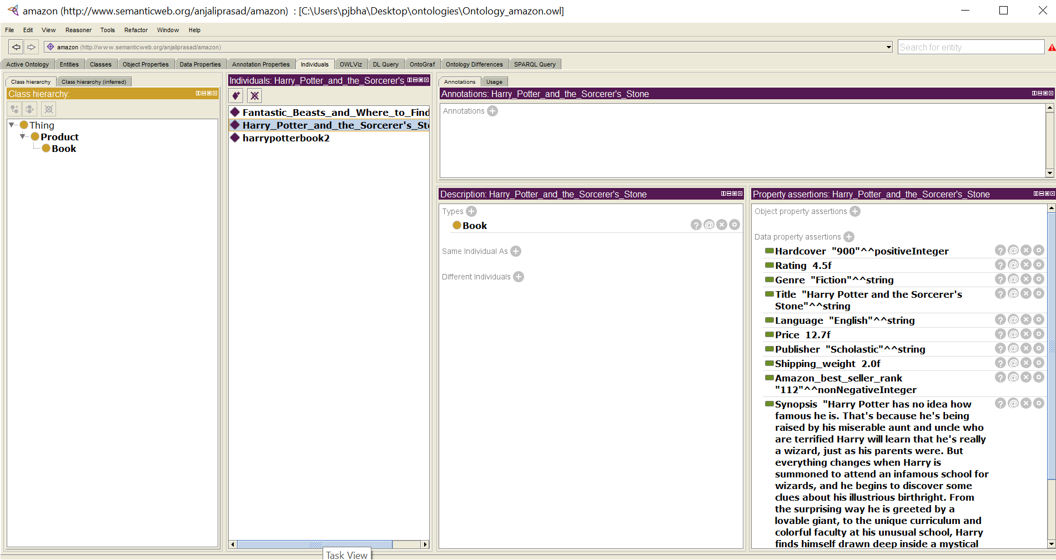
Ontology Design - Amazon

Slide 7
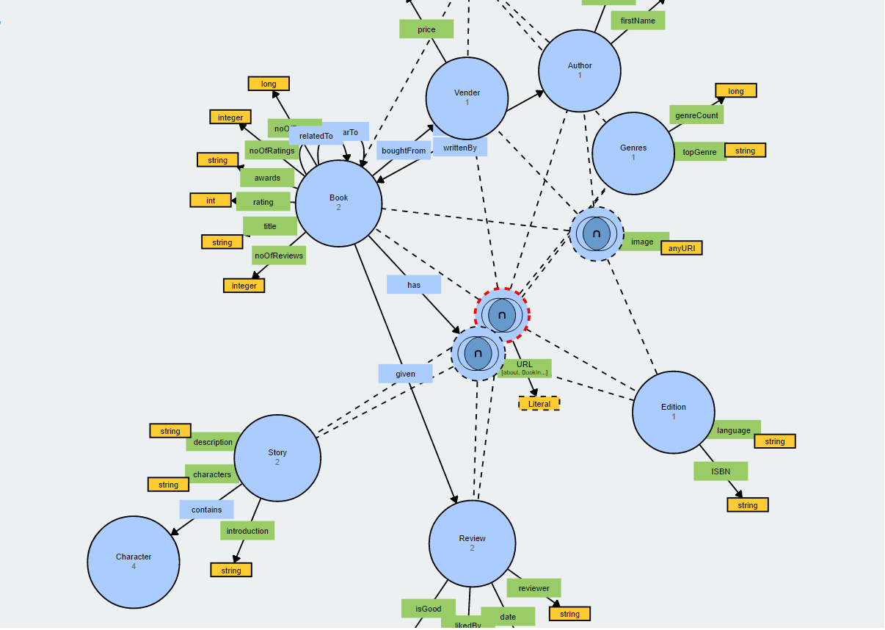
Ontology Depiction - Goodreads

Slide 8
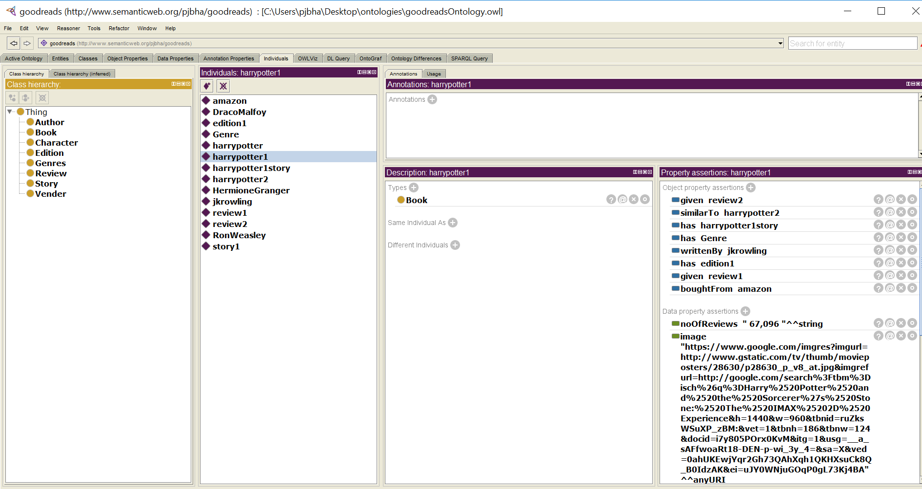
Ontology Design - Goodreads

Slide 9
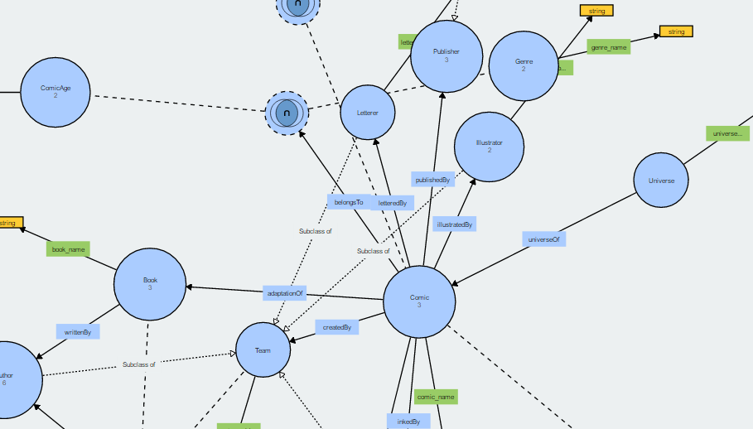
Ontology Depiction - Comics

Slide 10
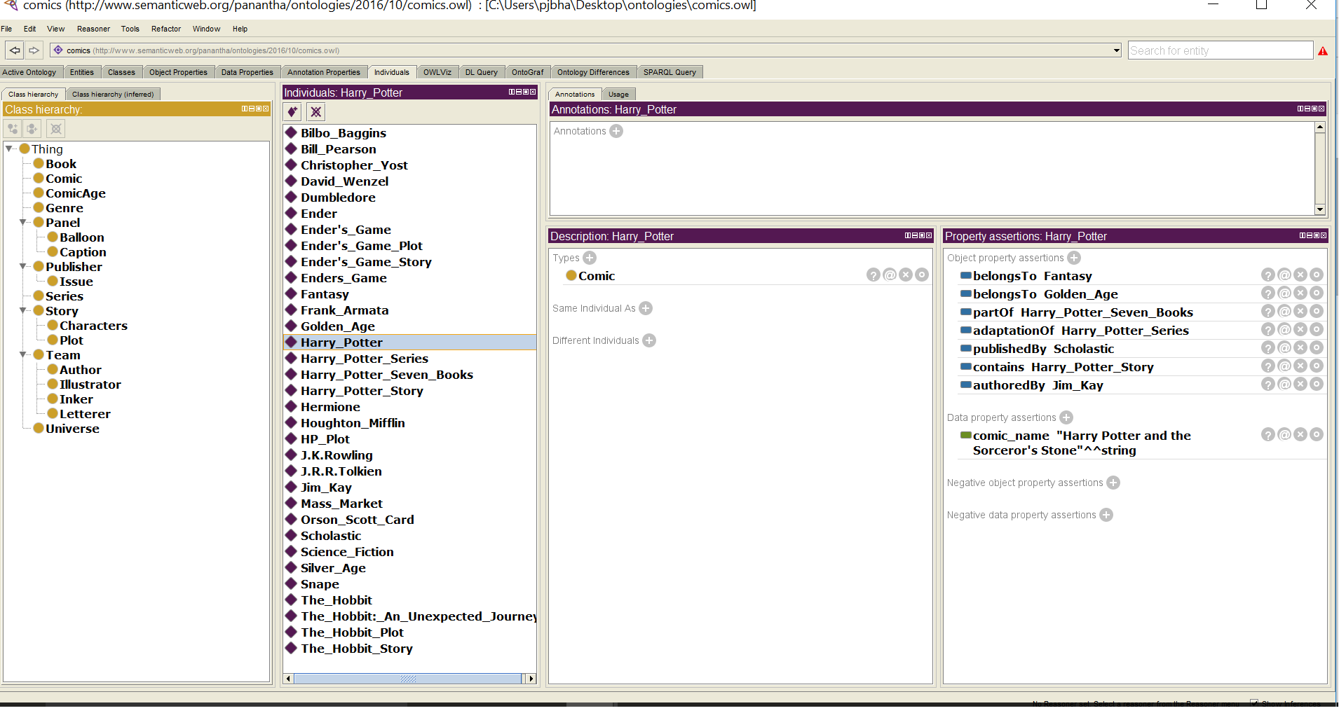
Ontology Design - Comics

Slide 11
Meta Ontology – Federation of ontologies
Problems with querying multiple ontologies:
Understand each ontology structure
Conflict in selection of literals
Difficult to match literals of different ontologies
Limited content exposure
Some queries cannot be answered
More complex queries
Therefore, we need a federated ontology

Slide 12
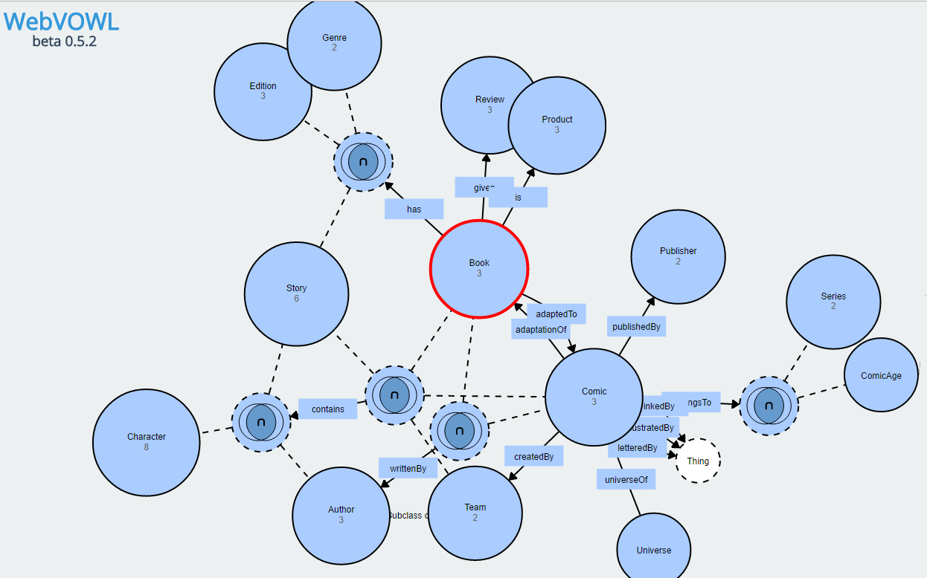
Meta Ontology – Depiction
Meta Ontology – Depiction

Slide 13
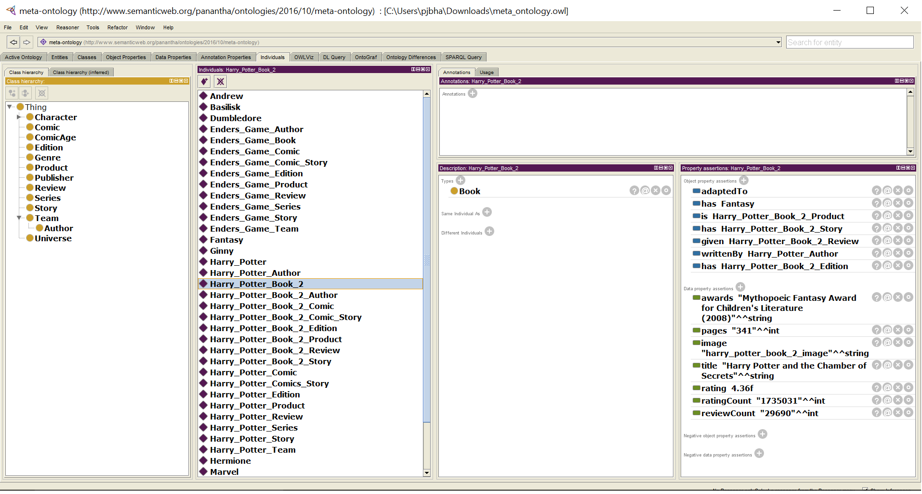
Meta Ontology – Design

Slide 14
Meta Ontology – Design
Design of federated (meta) ontology
Build common parent classes
Removed redundant classes and unified classes
Maintained distinction without falsely combining classes
Resolution of conflicts and ambiguities
Ex: (Has vs has, writtenBy vs Written_By)
Semantic resolution
Ex: (authoredBy vs writtenBy)
Richness of meta ontology
Can answer rich set of queries
Minimal operations compared to querying multiple ontologies
Comparison based on instances rather than literals

Slide 15
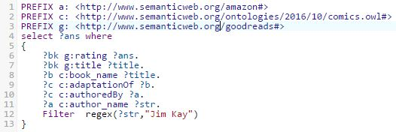
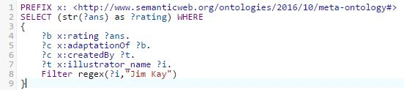
Querying – query 1
Ratings of books with comics written by Jim Kay
Edit Distance: 7
Meta ontology
Edit Distance: 5
Edit Distance: number of operations

Slide 16
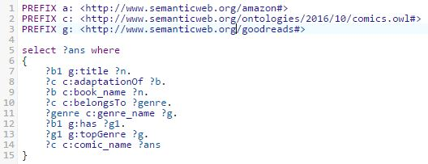
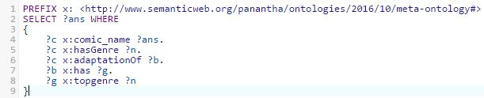
Querying – query 2
Comics with same genre as that of book
Meta ontology
Edit Distance is less despite preserving distinction

Slide 17
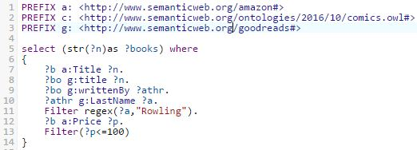
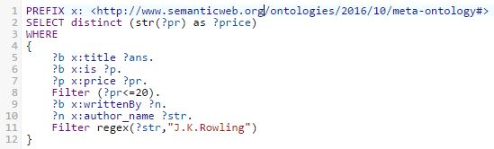
Querying – query 3
JK Rowling books available for less than 100$
Meta ontology
Edit Distance is same
But, better Content Exposure

Slide 18
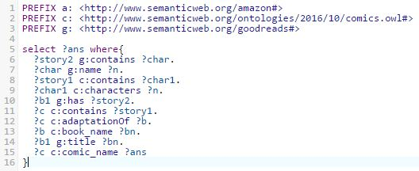
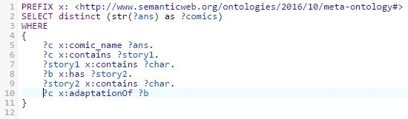
Querying – query 4
Comics having same characters as that of its book
Lesser edit distance because of instance match
Meta ontology

Slide 19
Conclusion
Federation of ontologies is better
We need a meta-ontology to answer diverse and richer set of queries
The federated ontology performs better in terms of edit-distance and ambiguity resolution
Federation provides maximum content exposure

Slide 20
Questions?
THANK YOU

