Slide 1

New Features for WhatApp
WhatsApp Messenger is a freeware, cross-platform messaging and Voice over IP (VoIP) service owned by Facebook. It allows users to send text messages and voice messages, make voice and video calls, and share images, documents, user locations, and other media.

Slide 2

Current features of WhatsApp
TEXTS
Group chats
voice and video calls
photos and videos
voice messages
DOCUMENTS

Slide 3
Texts
Simple, Reliable Messaging
Message your friends and family for free*. WhatsApp uses your phone's Internet connection to send messages so you can avoid SMS fees.

Slide 4
Group Chats
Groups to keep in touch
Keep in touch with the groups of people that matter the most, like your family or coworkers. With group chats, you can share messages, photos, and videos with up to 256 people at once. You can also name your group, mute or customize notifications, and more.

Slide 5
voice and video calls
Speak Freely
With voice calls, you can talk to your friends and family for free*, even if they're in another country. And with free* video calls, you can have face-to-face conversations for when voice or text just isn't enough. WhatsApp voice and video calls use your phone's Internet connection, instead of your cell plan's voice minutes, so you don't have to worry about expensive calling charges.

Slide 6
photos and videos
Share Moments that Matter
Send photos and videos on WhatsApp instantly. You can even capture the moments that matter to you most with a built-in camera. With WhatsApp, photos and videos send quickly even if you're on a slow connection.

Slide 7
voice messages
Say What's On Your Mind
Sometimes, your voice says it all. With just one tap you can record a Voice Message, perfect for a quick hello or a longer story.

Slide 8
Documents
Document Sharing Made Easy
Send PDFs, documents, spreadsheets, slideshows and more, without the hassle of email or file sharing apps. You can send documents up to 100 MB, so it's easy to get what you need over to who you want.

Slide 9


Competitors of WhatsApp
Telegram and Hike are the biggest competitors.

Slide 10
HIKE
Hike is an Indian freeware, cross-platform messaging and Voice over IP (VoIP) application. Hike was launched on 12 December 2012. On 16 August 2016, Hike raised $175 million in a new round of funding led by Tencent & Foxconn. After raising this round Hike reached the valuation of $1.4 Billion and became the youngest startup to reach unicorn status having achieved it in just 3.7 years after launch.

Slide 11
TELEGRAM
Telegram is a cloud-based instant messaging and voice over IP service. Telegram client apps are available for Android, iOS, Windows Phone, Windows NT, macOS and Linux. Users can send messages and exchange photos, videos, stickers, audio and files of any type.

Slide 12
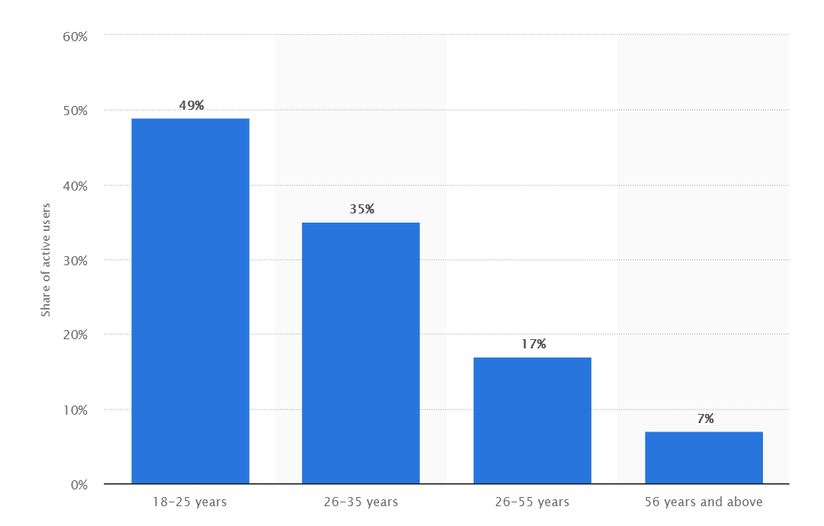
Target Audience
Target audience : 18-25years
Source-> https://www.statista.com/statistics/962654/india-active-whatsapp-users-share-by-age-group/

Slide 13
Opening Questions
Demographics:
1.What is your Name?
2.What is your Age?
3.What is your Profession?
4.What is your location?
How do you spend your day?
What applications do you use in your daily life?

Slide 14
FAQ
Task based
Is it easy to share images or documents on whatsapp ?
What is the first thing you do while using whatsapp ?
Need based
Why do you use whatsapp?
How often do you use whatsapp?
Value based
What are the Difficulties you faced while sharing images or documents?
Is there any way to improve on the whatsapp?
What is your experience while using whatsapp?

Slide 15

Bio
Aditya sharma is 20 year old. He is a C.S.E 3rd year student of chitkara university lives in zirakpur . He like to play football
Name : Aditya sharma
Age : 20 years
Location : zirakpur
Education : B.E.
Technolgy used:
Digital deivces laptop smart-phone
Apps used: whatsapp instagram uber zomato
Tasks:
Sending Documents
Changing profile picture
Opening any received image without opening chat.
Needs:
He wants to send 40 photos of class notes in serial order
He wants to change profile picture which is not a easy task
He wants to open a received image without opening chat.
Pain-points:
Cannot send more than 30 photos.
Due to lack of network connection photos were not in correct order.
There are lots of steps to change profile picture.
It is not possible in whatsapp to open image from notification bar.

