Slide 1

Excel Reassessment

Slide 2
Ques 1
Insights:
There are total 800 items that are returned that contribute to 8% of the total orders placed.
Because of returns, there will be 7.86% loss of total sales and 8.11% decrease in profit.
Inferences:
8% of the total orders are getting returned which led to decrease in revenue and profit with approximately 8%. Simplified, there is a perfect correlation between orders return and revenue and profit.

Slide 3
Ques 2
Insights:
It can be Interpreted that Standard Class has higher average delivery time, means it is the slowest and Same Day has least average delivery time, means it is the fastest mode of delivery.
Inferences:
It can be inferred that Same day deliver should be the preferred mode if customer wants the order to be delivered as early as possible.

Slide 4
Ques 3
Insights:
Customers can be grouped according to sales, it can be observed there are maximum number of orders placed in order value of 0-2000 and this the segment with highest profit as well.
Inferences:
It can be inferred that the orders of amount 0-2000 is valuable as it contributes to the most valuable customer segment.

Slide 5
Ques 4
Insights:
The Top selling category is Technology with respect to Sales and Sub-Category is Phones in Technology.
Inferences:
By average of profit and sales, it can be inferred that Technology category mainly contributes to the revenue and should always be in stock.
Furniture category somewhat contributes to the loss percentage and hence its stock should be managed properly.

Slide 6
Ques 5
Insights:
Region with highest Sales – West
Region with lowest Sales – South
Region with highest Profit – West
Region with lowest Profit – Central
Inferences:
It can be inferred that west region should be the top priority region for the company and trend can be seen with respect to profitability, east and west contributes most for the profit of the company.

Slide 7
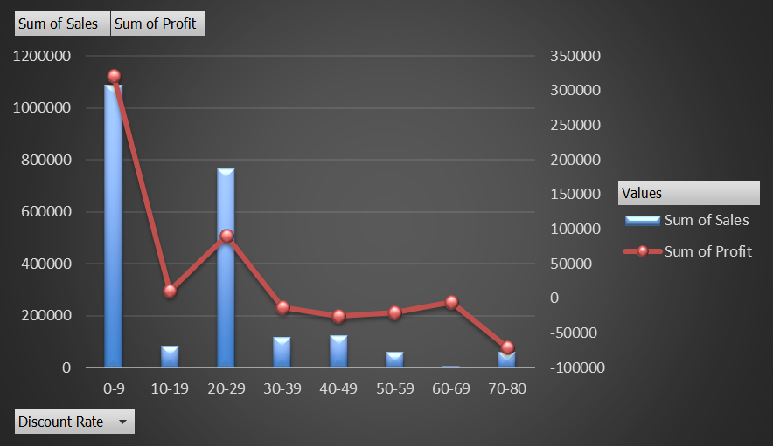
Ques 6
Insights: As the Discount rate increases, the profit decreases but not such big increase in the total sales.
Inference: It can be inferred that discount rate should not be that high as it can affect the profitability of business.

Slide 8
Ques 6
Insights:
There is negative correlation between Discount rates and Profits.
There is no such correlation between Discount rates and quantities.

Slide 9
Ques 7
Insights:
Market with high potential growth and low saturation is in West Region as it has highest sales as well as highest profit margin.
Inferences:
It can be inferred that market should be expanded in the region where sales and profit both should be highest.
Market can be expanded by making the delivery time less, offering small discounts.

Slide 10
Ques 8
Insights: Year by year the customer retention rate is increasing only.
Inference: 2017 retention rate is not incremented by the same rate as previous years.
By timely delivery and some small amounts of discounts can maintain the retention rate of customers.

Slide 11
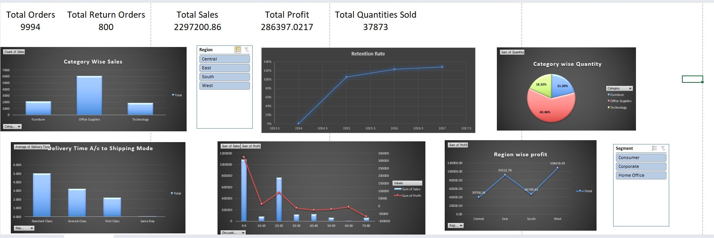
Ques 9

Slide 12
Ques 9
Dashboard shows:
The main Key Indicators like : Total Orders, Total sales, Total quantities sold and etc.
As this indicators allows us to have an overall view.
Then the sales, profit and quantity category wise, with region as a slicer or filter to analyse how different categories are contributing across different regions, so that the executive can take decision where to expand the market.
As well as it has to Segment wise, to know which segment is contributing in terms of sales and quantity.
Impact of discount is also described in the dashboard as it is impacting sales and discount.

Slide 13
Thank You

