Slide 1


The Fragility of Sparsity
Authors: Michal Kolesar, Ulrich K. Muller, Sebastian T. Roelsgaard
Seminar: Machine Learning in Econometrics
Presenter: Anjali Sarawgi
Date: July 12, 2024

Slide 2
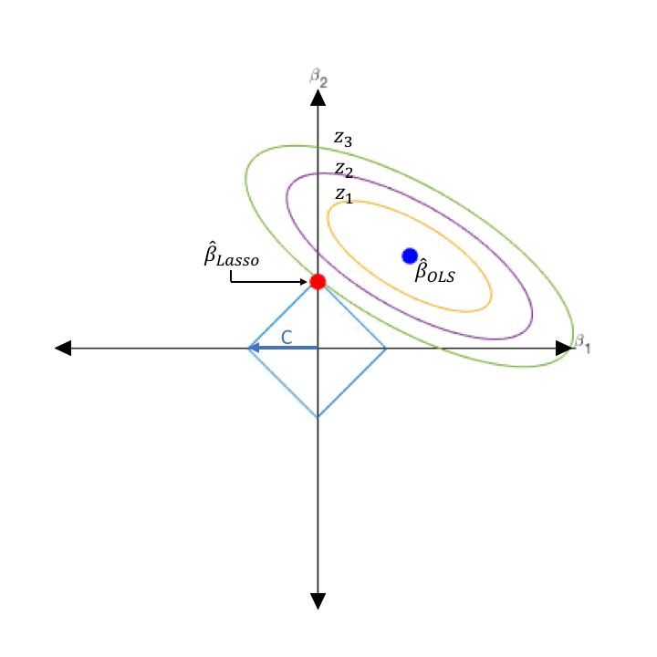
Main Idea of the paper
Fragility of SBEs: Sensitivity of estimates to the choice of regressor matrix; no effect on OLS
Two Tests for Sparsity Assumption : Developed methods to evaluate the sparsity assumption
Empirical Validation: Three applications - Abortion on crime, occupational upgrading by Black southerners, impact of moral values on voting.
Efficiency of OLS vs. SBEs : OLS yields more robust results unless the number of regressors is comparable to or exceeds the sample size
Fig: Lasso Regression
1
Seminar – ML in Econometrics

Slide 3
INTRODUCTION
ANALYSIS AND FINDINGS
i. Normalization of Control Matrix
ii. Efficiency Gains Under Sparsity
iii. Two Tests
III. CONCLUSION AND REMARKS
3
Seminar – ML in Econometrics

Slide 4
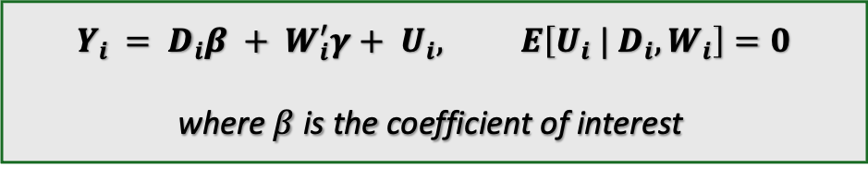
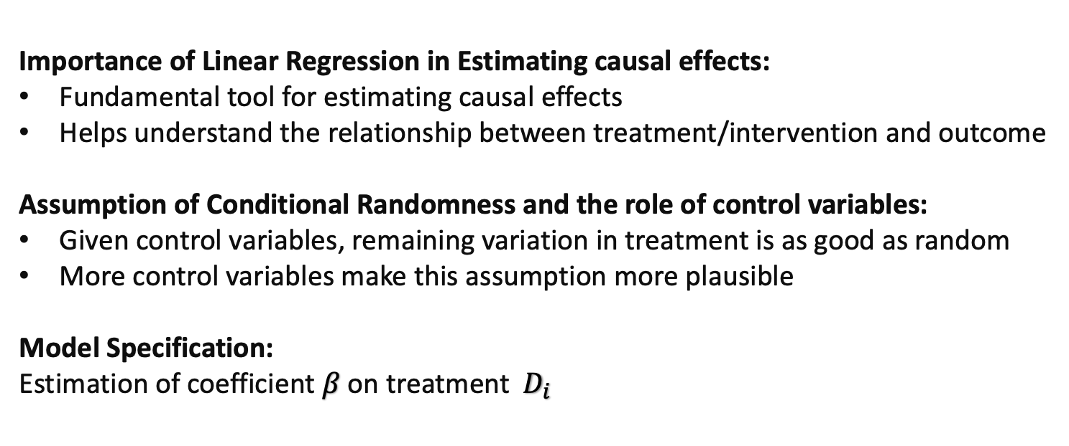
Introduction
Importance of Linear Regression in Estimating causal effects:
Fundamental tool for estimating causal effects
Helps understand the relationship between treatment/intervention and outcome
Assumption of Conditional Randomness and the role of control variables:
Given control variables, remaining variation in treatment is as good as random
More control variables make this assumption more plausible
Model Specification:
Estimation of coefficient $β$ on treatment ${ D}_{i}$
$$Y_{i }= D_{i}β + W_{i}^{′}γ+ U_{i}, E\left[U_{i} | D_{i}, W_{i}\right]=0$$
where $β$ is the coefficient of interest
Note: $D_{i}$ = treatment variable, $W_{i}$ = vector of control variables, $U_{i}$= error term, $γ$ = coefficients of control variables
4
Seminar – ML in Econometrics

Slide 5
Limitations of OLS and Development of SBEs
Limitations of OLS
Development of SBEs
Traditional OLS Limitation: OLS limits p<n
Overfitting Risk: When p approaches or exceeds n
Led to
Need of alternative methods : To address OLS limitations
Examples : Lasso, Debiased Lasso, Post double selection procedure
5
Seminar – ML in Econometrics

Slide 6
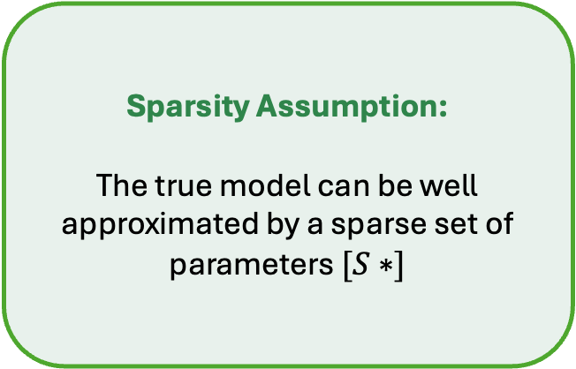
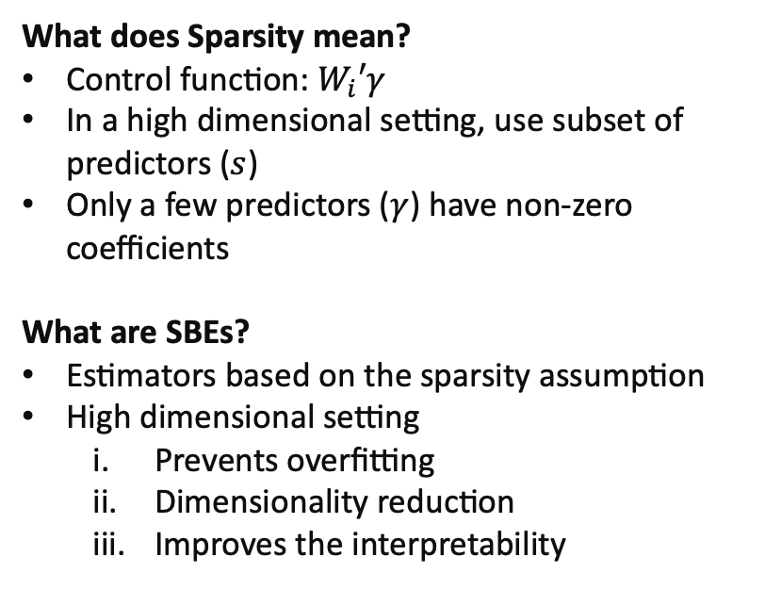
Understanding Sparsity and SBEs
What does Sparsity mean?
Control function: $W_{i}′γ$
In a high dimensional setting, use subset of predictors ($s$)
Only a few predictors ($γ$) have non-zero coefficients
What are SBEs?
Estimators based on the sparsity assumption
High dimensional setting
Prevents overfitting
Dimensionality reduction
Improves the interpretability
Sparsity Assumption:
The true model can be well approximated by a sparse set of parameters $[S∗]$
6
Seminar – ML in Econometrics

Slide 7
Credibility Concerns of SBEs
Sensitivity
Sensitive to choices in the initial setup:
How the control matrix is normalized:
Handling collinear columns
Change in baseline controls
Robustness
Stability of estimates across different scenarios:
Variability: different estimates with different normalizations
Less reliable: different estimates for different model specifications
(undermines the confidence of results)
Lack of theoretical foundations
~ in social sciences
Lack of theoretical reasoning
An unclear level of sparsity needed for the estimates
7
Seminar – ML in Econometrics

Slide 8

Assumptions and Methodology
Scenario:
p = number of predictors
n = number of observations
Considering p < n
Why? Allows us to use OLS benchmark
Assumptions:
a. Exact Sparsity vs Approximate Sparsity
c. Homoscedastic / Heteroscedastic considerations
SETUP:
Empirical Applications
Choose $p$
Normalize
Analysis / Test
8
Seminar – ML in Econometrics

Slide 9
INTRODUCTION
ANALYSIS AND FINDINGS
i. Normalization of Control Matrix
ii. Efficiency Gains Under Sparsity
iii. Two Tests
III. CONCLUSION AND REMARKS
9
Seminar – ML in Econometrics

Slide 10
Normalization of Control Matrix
(Impact of Choice of Control Matrix with empirical applications)
Efficiency Gains under Sparisty
(quantifying differences in standard errors)
III. Two Tests
(to test the sparsity assumption - with empirical applications)
10
Seminar – ML in Econometrics

Slide 11

Normalization Methods
Education Level (categorical variable) = High School, Bachelors, Masters, PhD
Age (continuous Variable) = {22, 45, 67, 43, ….12}
Normalizing baseline controls
Varying offset values
age – $λ$
$$where λ=\{40,41,42,43\}$$
age – mean | age - median
Grouping columns to resolve multicollinearity
Grouping categories together
(as subsets)
Drop “PhD” vs Drop “Bachelors”
Group {High School, Bachelors} as one subset
11
Seminar – ML in Econometrics

Slide 12
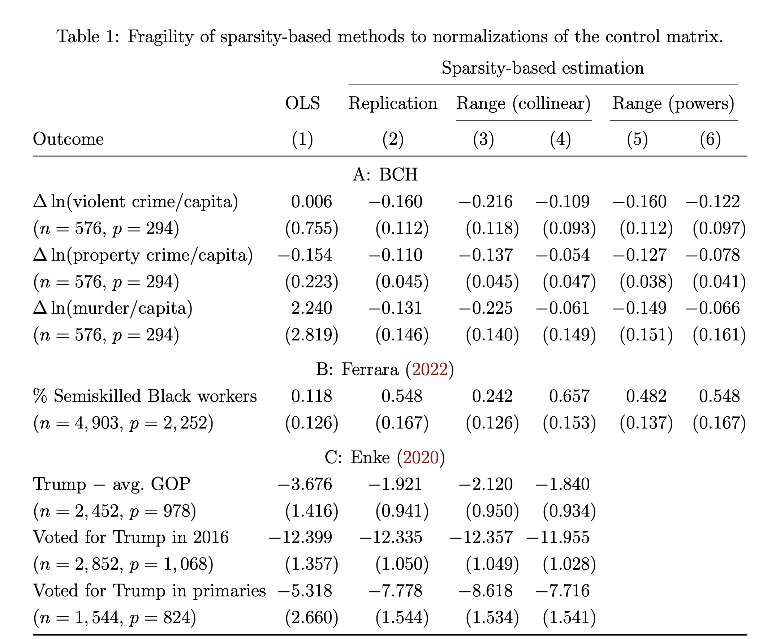
Empirical Applications and Results (1)
Empirical Applications:
The effect of abortion on crime
Study of occupational upgrading by black southerners.
Study on the effect of moral values and voting behavior.
Key findings:
OLS :
A) Higher standard errors
B) Sable
SBEs:
A) Lower standard errors
B) varying estimates for each normalization (fragile)
12
Seminar – ML in Econometrics

Slide 13
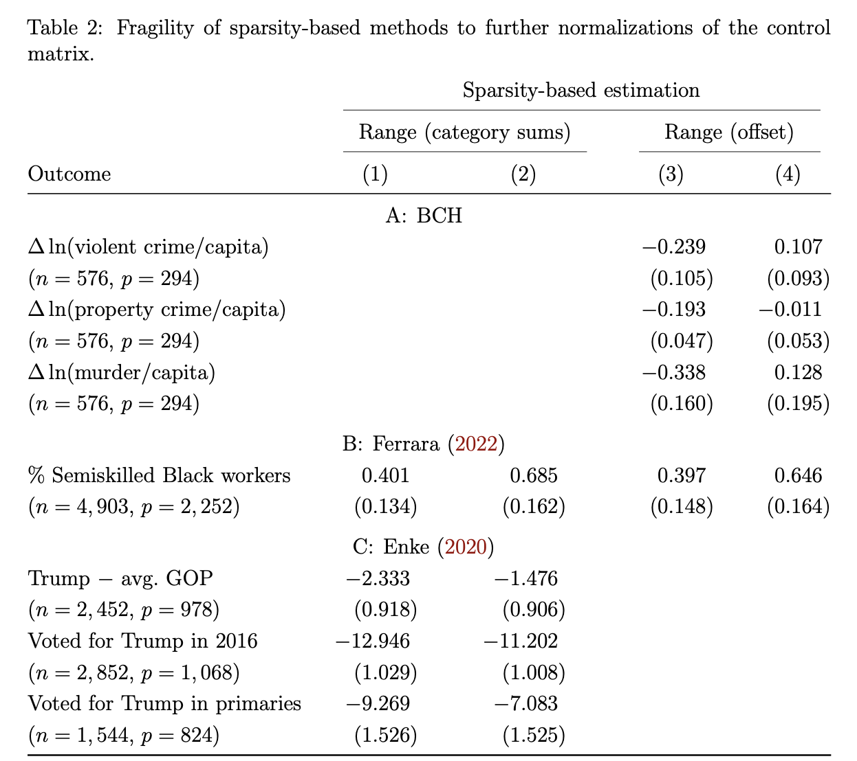
Empirical Applications and Results (2)
Key findings:
SBEs are sensitive
SBEs might be more efficient but fragile
Choosing a representation at random reduces the chances of achieving sparsity
Note: Normalization choices don’t affect OLS but affect SBEs
13
Seminar – ML in Econometrics

Slide 14
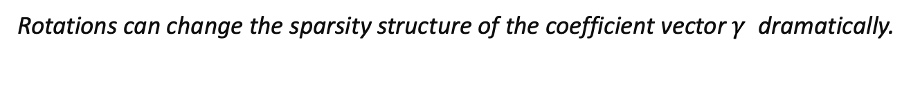
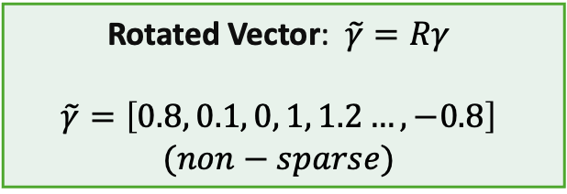
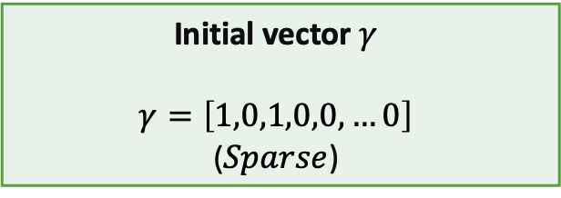
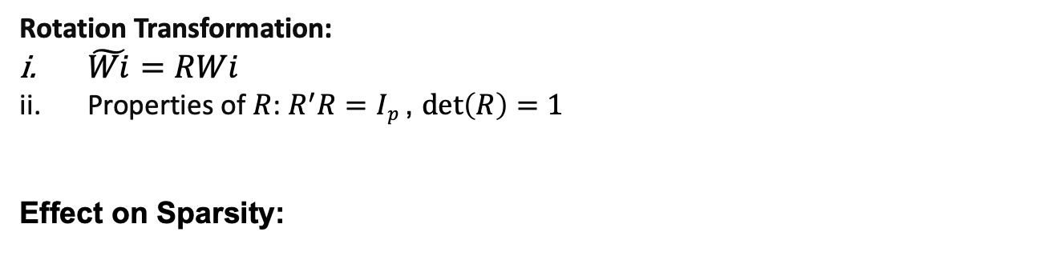
Theoretical Insights - Rotations
Rotation Transformation:
$\tilde{Wi}=RWi$
Properties of $R$: $R^{′}R=Ip$ , $\det\left(R\right)=1$
Effect on Sparsity:
Initial vector $γ$
$$γ=\left[1,0,1,0,0,…0\right]$$
($Sparse$)
Rotated Vector: $\tilde{γ}=Rγ$
$$\tilde{γ}=\left[0.8, 0.1, 0, 1, 1.2…,−0.8\right]$$
$$(non−sparse)$$
Random rotation
Rotations can change the sparsity structure of the coefficient vector $γ$ dramatically.
How likely it is to maintain sparsity here?
14
Seminar – ML in Econometrics

Slide 15
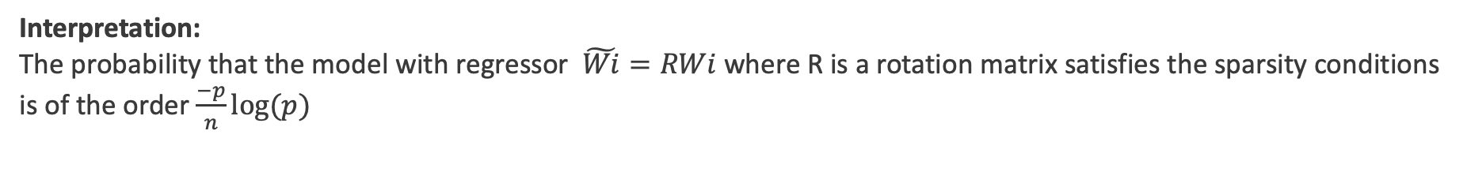
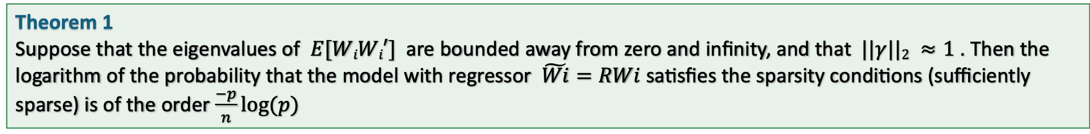
Theoretical Insights – Rotations (cont.)
Theorem 1
Suppose that the eigenvalues of $E[WiWi′]$are bounded away from zero and infinity, and that $||γ||2 ≈1$. Then the logarithm of the probability that the model with regressor $\tilde{Wi}=RWi$satisfies the sparsity conditions (sufficiently sparse) is of the order $\frac{−p}{n}log⁡(p)$
Interpretation:
The probability that the model with regressor $\tilde{Wi}=RWi$where R is a rotation matrix satisfies the sparsity conditions is of the order $\frac{−p}{n}log⁡(p)$
Key findings:
Rotation matrices mixes the weights
Probability of inducing sparsity is dramatically low for large p
c. Lack of robustness of SBEs to rotations
15
Seminar – ML in Econometrics

Slide 16
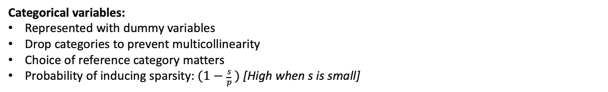
Theoretical Insights – Categorical Variables
Categorical variables:
Represented with dummy variables
Drop categories to prevent multicollinearity
Choice of reference category matters
Probability of inducing sparsity: $(1−\frac{s}{p} )$ [High when s is small]
Reference category: PHD
• High School: -$20,000 (indicating $20,000 less than PhD)
• Bachelor’s: -$10,000 (indicating $10,000 less than PhD)
• Master’s: -$5,000 (indicating $5,000 less than PhD)
Example:
Income (y)
Education(x) = High School, Bachelor’s, Master’s, and PhD
Reference category: High School
• Bachelor’s: +$10,000 (indicating $10,000 more than High School)
• Master’s: +$15,000 (indicating $15,000 more than High School)
• PhD: +$20,000 (indicating $20,000 more than High School)
16
Seminar – ML in Econometrics

Slide 17
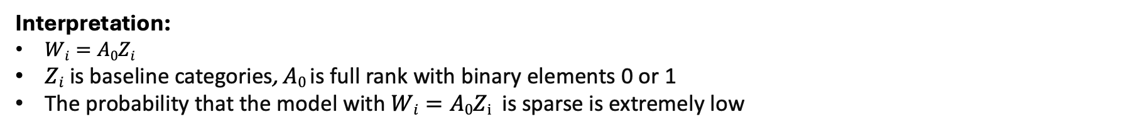
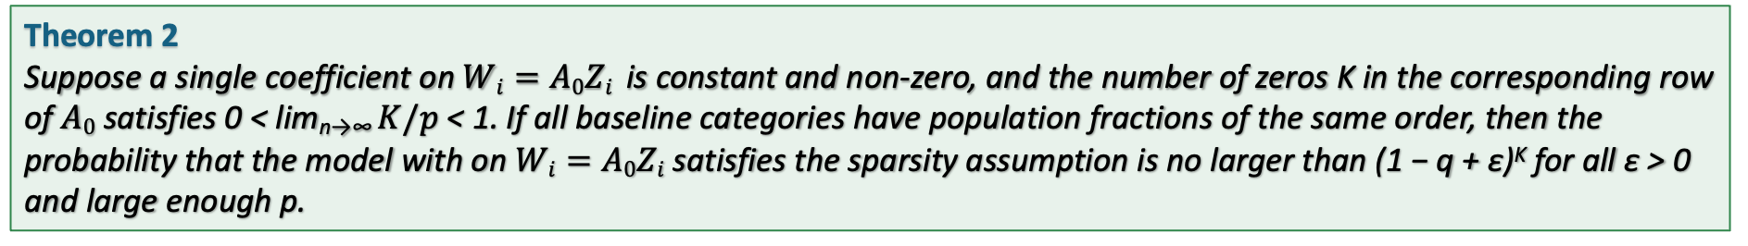
Theoretical Insights – Categorical Variables (cont.)
Theorem 2
Suppose a single coefficient on $Wi=A0Zi$ is constant and non-zero, and the number of zeros K in the corresponding row of $A0$ satisfies 0 < lim_{n→∞} $K/p$< 1. If all baseline categories have population fractions of the same order, then the probability that the model with on $Wi=A0Zi$ satisfies the sparsity assumption is no larger than (1 − q + ε)^{K} for all ε > 0 and large enough p.
Interpretation:
$Wi=A0Zi$
$Zi$ is baseline categories, $A0$is full rank with binary elements 0 or 1
The probability that the model with $Wi=A0Zi$is sparse is extremely low
Key Insights:
Random choice: It’s very unlikely that a random specification of categorical variables will maintain sparsity
Right choice: Model can be exactly sparse if the right reference category is chosen
17
Seminar – ML in Econometrics

Slide 18
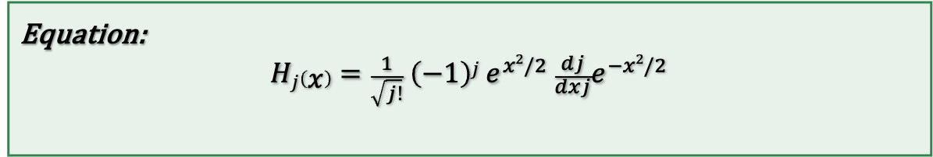
Theoretical Insights – Hermite Polynomials
Hermite Polynomials
Sequence of orthogonal polynomials to handle normal distribution
Creates basis functions (new variables) that capture non-linear relationships
Equation:
$$Hj\left(x\right)=\frac{1}{\sqrt{j!}} \left(−1\right)j e^{x2/2} \frac{dj}{dxj}e^{−x2/2}$$
18
Seminar – ML in Econometrics

Slide 19
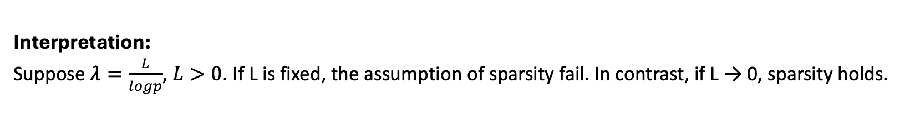
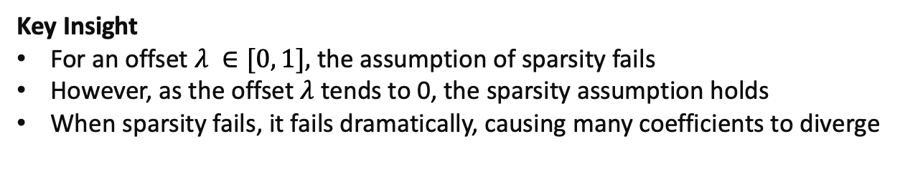
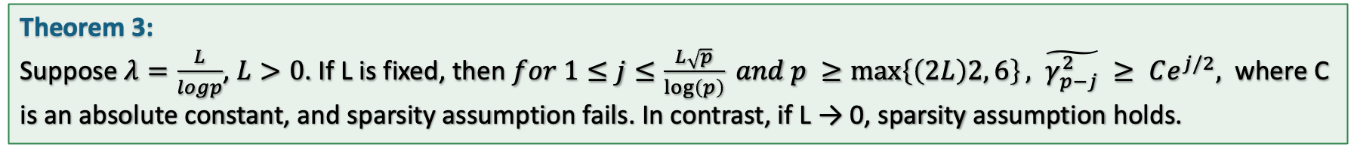
Theoretical Insights – Hermite Polynomials (cont.)
Theorem 3:
Suppose $λ=\frac{L}{logp}$, $L>0$. If L is fixed, then $for 1≤j≤\frac{L\sqrt{p}}{\log\left(p\right)} and p ≥\max\left\{\left(2L\right)2, 6\right\}, \tilde{γ_{p−j}^{2}} ≥ Ce^{j/2},$ where C is an absolute constant, and sparsity assumption fails. In contrast, if L → 0, sparsity assumption holds.
Interpretation:
Suppose $λ=\frac{L}{logp}$, $L>0$. If L is fixed, the assumption of sparsity fail. In contrast, if L → 0, sparsity holds.
Key Insight
For an offset $λ ∈[0, 1],$ the assumption of sparsity fails
However, as the offset $λ$ tends to 0, the sparsity assumption holds
When sparsity fails, it fails dramatically, causing many coefficients to diverge
19
Seminar – ML in Econometrics

Slide 20
Normalization of Control Matrix
(Impact of Choice of Control Matrix - with empirical applications)
Efficiency Gains under Sparsity
(quantifying differences in standard errors)
III. Two Tests
(to tests the sparsity assumption - with empirical applications)
20
Seminar – ML in Econometrics

Slide 21
Efficiency Gains under Sparsity (1)
For n = 100,
0
p = 20
100
p = 80
OLS: efficient, BLUE
OLS is better
OLS: noisy, multicollinear, overfits
SBE is better
Efficiency Gain:
It means estimates are more precise (lower variance)
Quantified by comparing standard errors of SBE and OLS
21
Seminar – ML in Econometrics

Slide 22
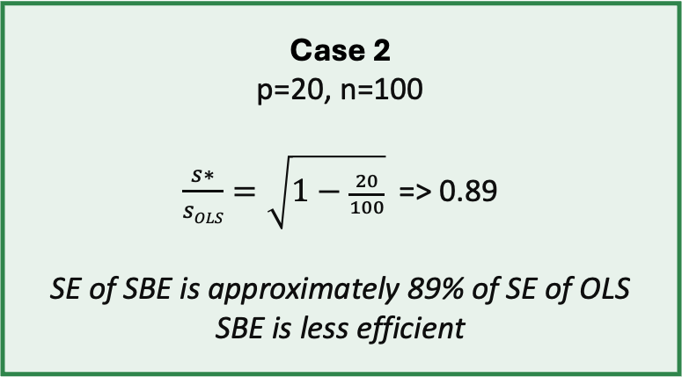
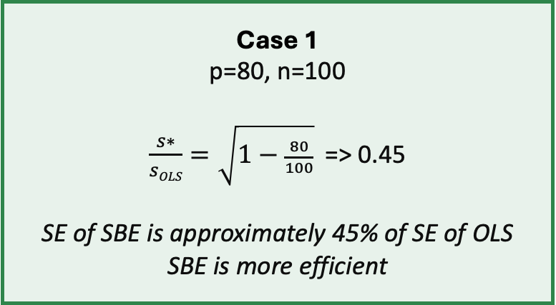
Efficiency Gains under Sparsity (2)
Efficiency Gain Formula: $\frac{s∗}{sOLS}=\sqrt{1−\frac{p}{n}}$
Case 1
p=80, n=100
$\frac{s∗}{sOLS}=\sqrt{1−\frac{80}{100}}$=> 0.45
SE of SBE is approximately 45% of SE of OLS
SBE is more efficient
Case 2
p=20, n=100
$\frac{s∗}{sOLS}=\sqrt{1−\frac{20}{100}}$=> 0.89
SE of SBE is approximately 89% of SE of OLS
SBE is less efficient
Limitation
SBE is capped; minimal gain when p/n is small
22
Seminar – ML in Econometrics

Slide 23
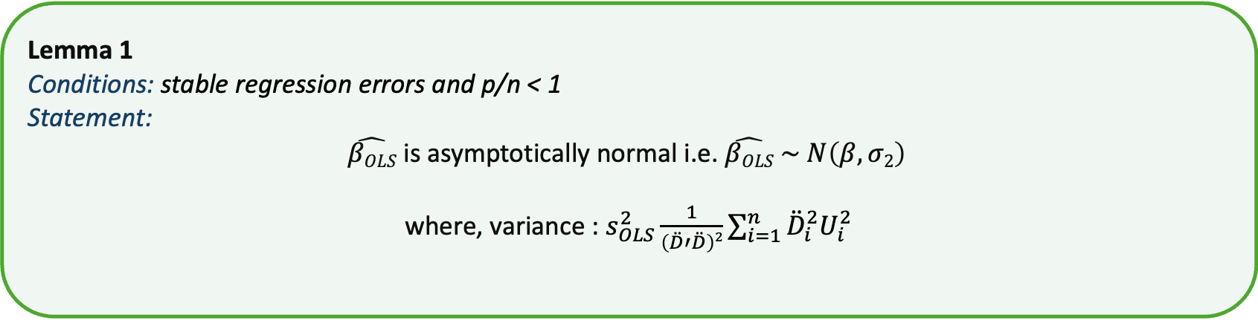
Efficiency Gains under Sparsity (3)
Lemma 1
Conditions: stable regression errors and p/n < 1
Statement:
$\hat{βOLS}$ is asymptotically normal i.e. $\hat{βOLS} \sim N\left(β, σ2\right)$
where, variance : $s_{OLS}^{2}\frac{1}{\left(\ddot{D}′\ddot{D}\right)2}\sum_{i=1}^{n}{{\ddot{D}}_{i}^{2}U_{i}^{2}}$
Key Insights:
Validity in High Dimensions: Confirms the reliability of OLS even when the number of predictors p is close to the sample size n
Reliability, Basis of comparison
23
Seminar – ML in Econometrics

Slide 24
Normalization of Control Matrix
(Impact of Choice of Control Matrix with empirical applications)
Efficiency Gains under Sparsity
(quantifying differences in standard errors)
III. Two Tests
(to test the spasity assumption - with empirical applications)
24
Seminar – ML in Econometrics

Slide 25
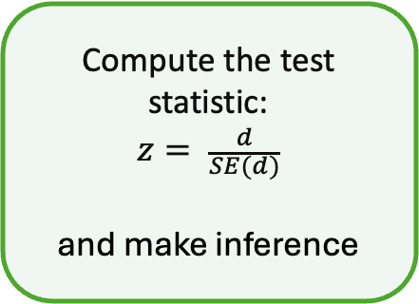
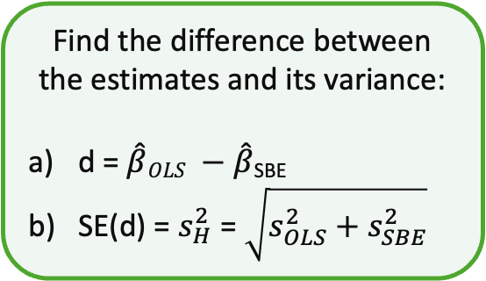
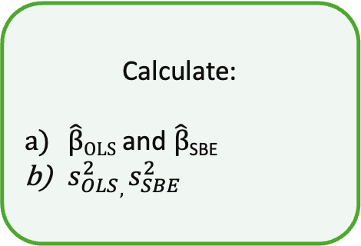
Hausman Test
Key Idea:
Compare OLS and SBE
If estimates are similar, assumptions hold.
Calculate:
$\hat{β}OLS$and $\hat{β}$_{SBE}
$s_{OLS}^{2},s_{SBE}^{2}$
Find the difference between the estimates and its variance:
d = $\hat{β}OLS −\hat{β}\text{SBE}$
SE(d) = $s_{H}^{2}$ = $\sqrt{s_{OLS}^{2}+s_{SBE}^{2}}$
Compute the test statistic:
$$z= \frac{d}{SE(d)}$$
and make inference
Relevance:
Hausman test acts as a robustness check
Significant difference questions the reliability of SBEs
H0: difference is not statistically Significant; H1: difference is statistically Significant
25
Seminar – ML in Econometrics

Slide 26
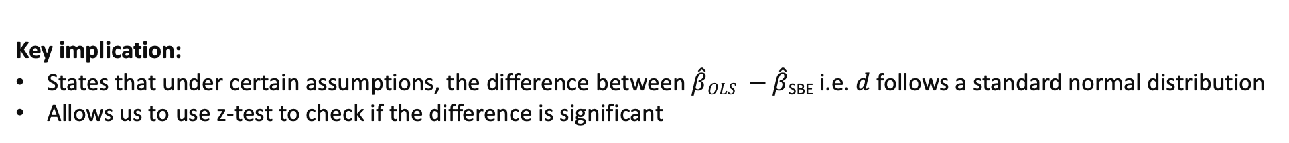
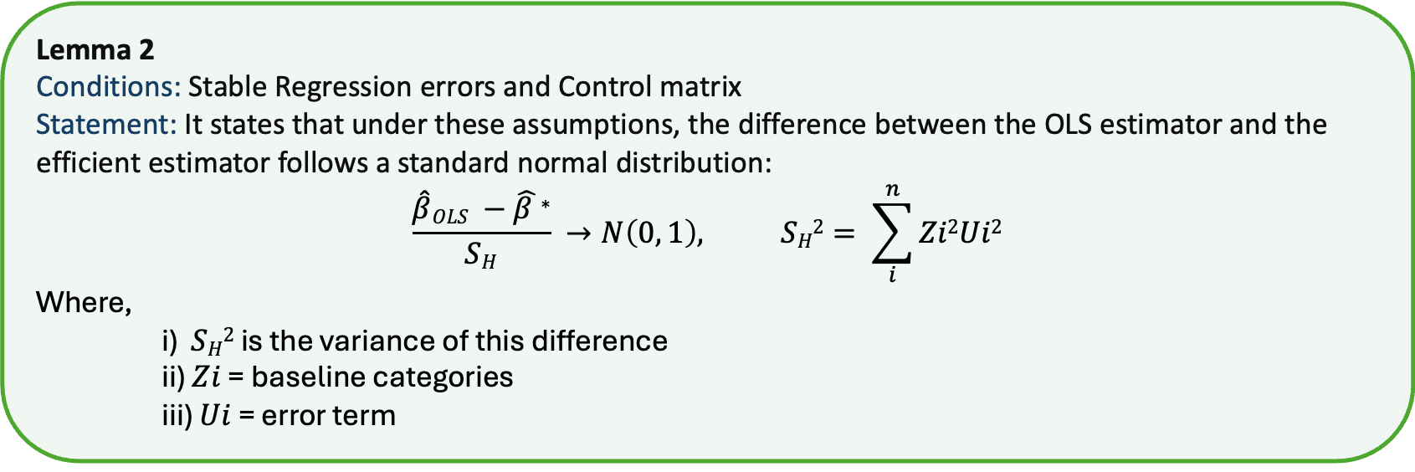
Hausman Test (cont.)
Lemma 2
Conditions: Stable Regression errors and Control matrix
Statement: It states that under these assumptions, the difference between the OLS estimator and the efficient estimator follows a standard normal distribution:
$$\frac{\hat{β}OLS −\hat{β }\text{∗}}{SH} →N\left(0, 1\right), SH2= \sum_{i}^{n}{Zi2Ui2}$$
Where,
i) $SH2$ is the variance of this difference
ii) $Zi$ = baseline categories
iii) $Ui$ = error term
Key implication:
States that under certain assumptions, the difference between $\hat{β}OLS −\hat{β}\text{SBE}$ i.e.$d$follows a standard normal distribution
Allows us to use z-test to check if the difference is significant
26
Seminar – ML in Econometrics

Slide 27
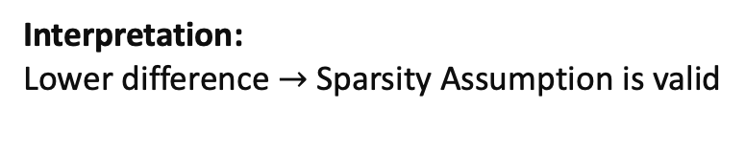
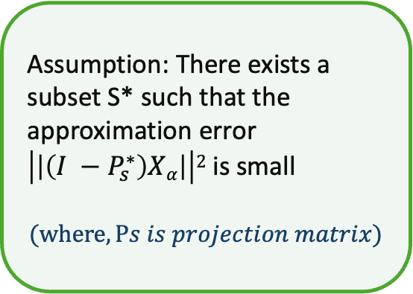
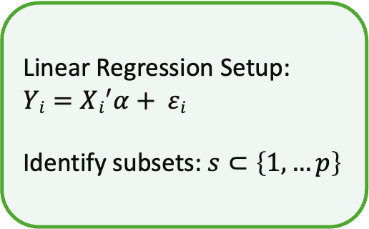
Residual Test
Key Idea:
Compare the residual sum of squares (RSS) from SBEs and OLS regressions
Use an F-statistic to determine if the difference is significant.
Assumption: There exists a subset S* such that the approximation error $\left|\left|\left(I −P_{s}^{∗}\right)Xα\right|\right|2$ is small
$$(where, Ps is projection matrix)$$
Compare RSS from SBE and OLS
Use the F-Statistic to check for significant differences
Linear Regression Setup: $Yi=Xi^{′}α+ εi$
Identify subsets: $s⊂\left\{1, …p\right\}$
Interpretation:
Lower difference $→$Sparsity Assumption is valid
H0: Differences are not significant; H1: Differences are significant
$F =Y^{′}\left(I−PS∗\right)Y−Y^{′}\left(I−P\right)Y$
27
Seminar – ML in Econometrics

Slide 28
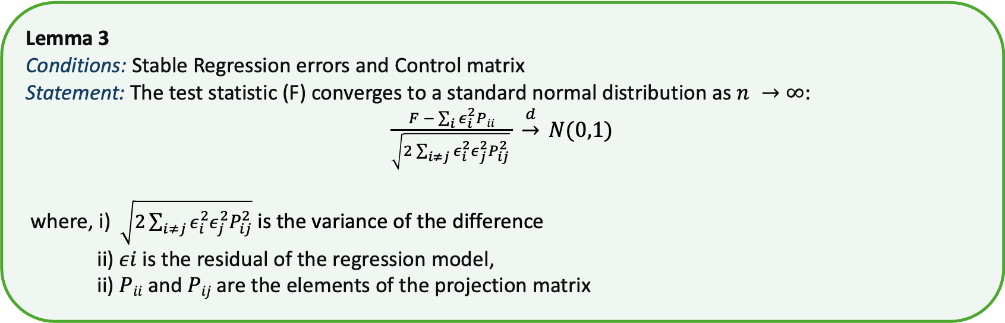
Residual Test (cont.)
Lemma 3
Conditions: Stable Regression errors and Control matrix
Statement: The test statistic (F) converges to a standard normal distribution as $n →∞$:
$\frac{F − \sum_{i}{ε_{i}^{2}Pii}}{\sqrt{2\sum_{i≠j}{ε_{i}^{2}ε_{j}^{2}P_{ij}^{2}}} } \underset{→}{d} N(0,1)$
where, i) $\sqrt{2\sum_{i≠j}{ε_{i}^{2}ε_{j}^{2}P_{ij}^{2}}}$ is the variance of the difference
ii) $εi$is the residual of the regression model,
ii) $Pii$ and $Pij$ are the elements of the projection matrix
Key implication:
The F statistic follows a standard normal distribution
Confirms residuals are accurate to apply the residual test effectively
Enabling the use of standard statistical inference techniques.
28
Seminar – ML in Econometrics

Slide 29
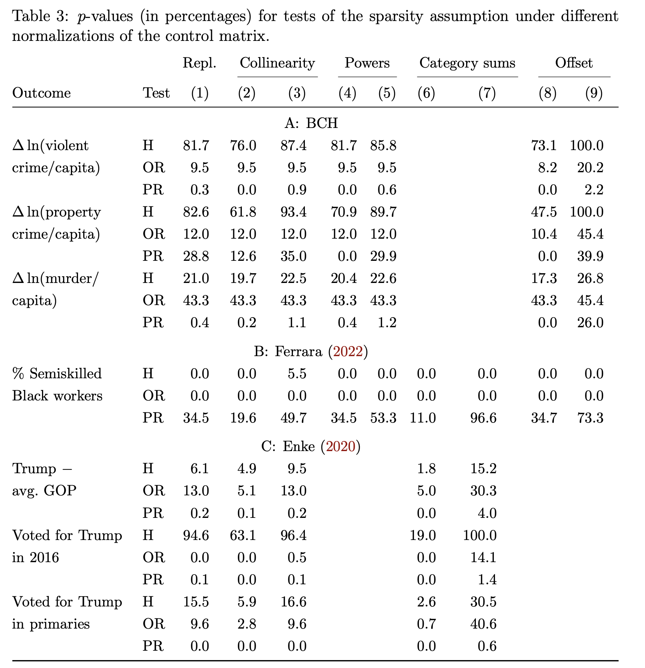
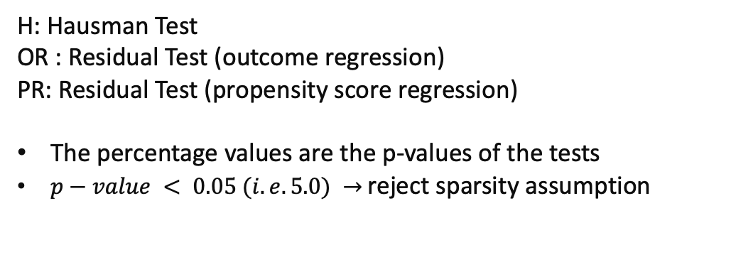
Empirical Applications and Result (3)
Understanding the Table
H: Hausman Test
OR : Residual Test (outcome regression)
PR: Residual Test (propensity score regression)
The percentage values are the p-values of the tests
$p−value < 0.05 (i.e. 5.0) →$reject sparsity assumption
Key implications / results
For 6 out of 7 outcomes, at least of test rejects the sparsity assumption
For most of the tests, no normalization was found which did not reject the sparsity assumption for all cases
29
Seminar – ML in Econometrics

Slide 30
INTRODUCTION
ANALYSIS AND FINDINGS
i. Normalization of Control Matrix
ii. Efficiency Gains Under Sparsity
iii. Two tests
III. CONCLUSION AND REMARKS
30
Seminar – ML in Econometrics

Slide 31
Conclusion and Remarks
Moreover,
SBEs are highly sensitive to how our control matrix is specified
For a large p:
OLS : Less efficient, More robust
SBE: More efficient, Less robust
Two possible reasons for sensitivity:
Dependence on specification even if sparsity assumption holds
No sparsity across normalization
Remarks
SBEs vs OLS should not be a robustness check
Requirement to justify the choice of control matrix
Broader implications: Machine Learning
31
Seminar – ML in Econometrics

Slide 32
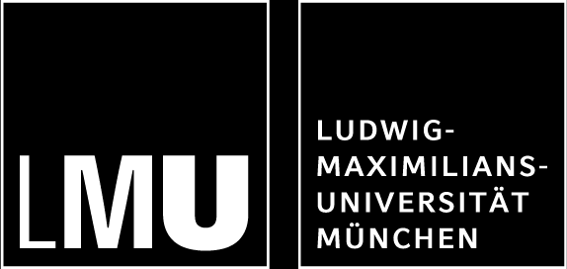
So, in conclusion, the next time someone tells you that sparsity-based estimates are robust, just remember – even a Jenga tower is more stable!
QUESTIONS?

