Slide 1
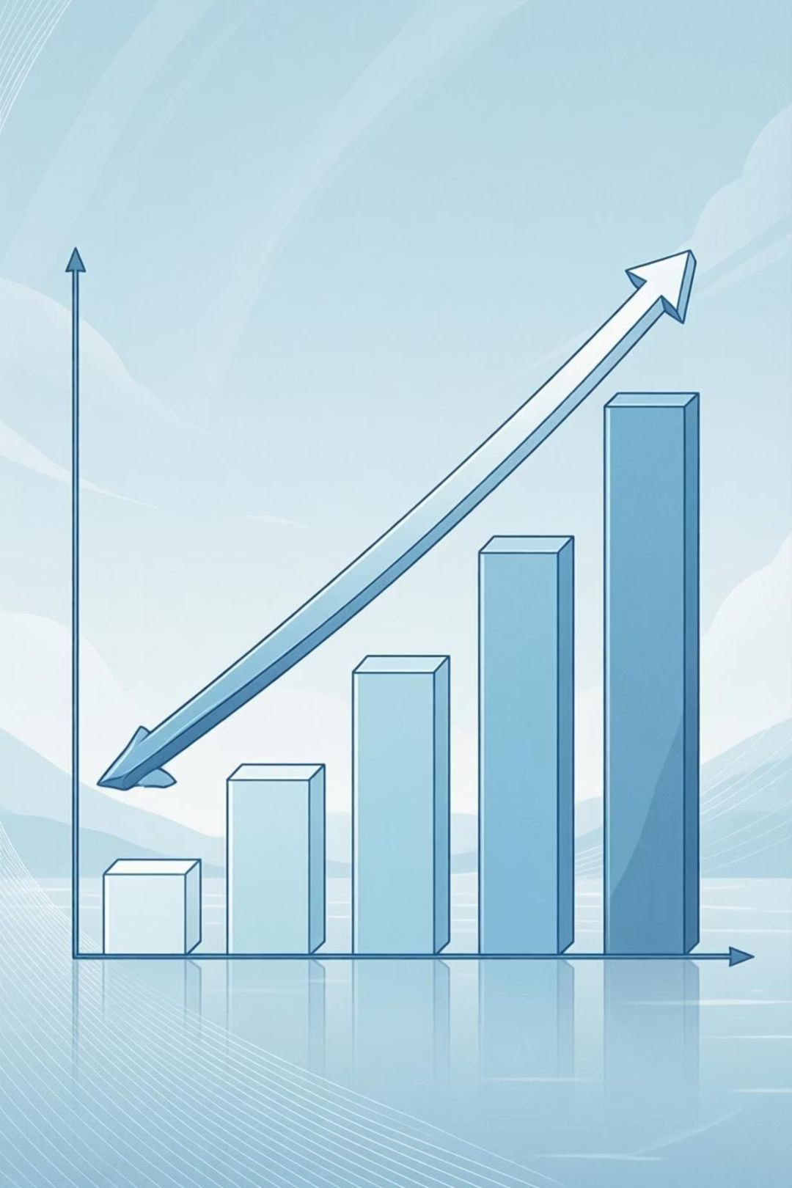
Student Performance Progression And Risk Analyzer

Slide 2

Why Student Performance Progression Matters
Identify Strengths & Needs
Data-Driven Decisions
Promotes informed decisions based on concrete data to continuously enhance learning outcomes.
Enables educators to pinpoint individual student strengths and areas requiring focused support.
Foster Transparency
Builds openness and strong collaboration among teachers, students, and parents, fostering a shared understanding of progress.

Slide 3





Understanding Performance Levels
We categorize student performance into four key levels, mirroring comprehensive assessment models like the Wisconsin Forward Exam:
Developing
Beginning to grasp concepts, needs significant support.
Approaching
Shows understanding but requires further practice and guidance.
Meeting
Demonstrates solid understanding and grade-level readiness.
Advanced
Exceeds expectations, shows mastery and independent application.
Our overarching goal is to effectively move all students towards the Meeting and Advanced levels, ensuring comprehensive grade-level readiness. This is achieved by combining multiple measures including test scores, classroom assessments, and active participation.

Slide 4
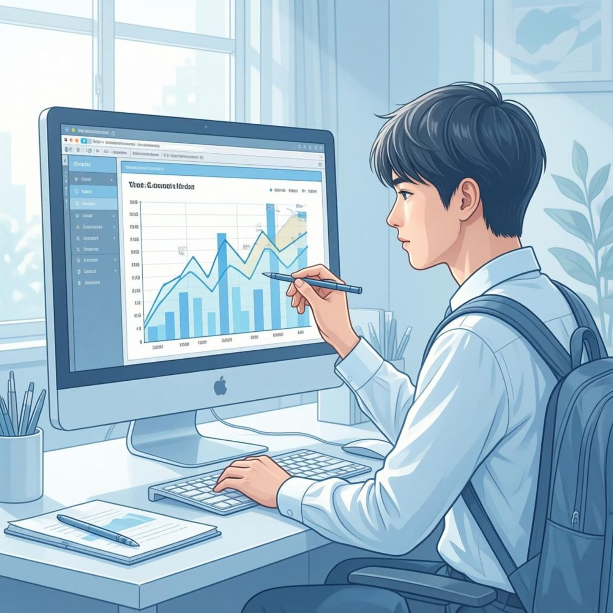
Methodology: Our Comprehensive Progress Monitoring
Continuous formative assessments track learning over time.
Visual tools like charts, graphs, and infographics for clear communication.
Incorporation of behavioral and attendance data for a holistic student view.
Regular feedback loops with students and parents to set achievable goals.

Slide 5
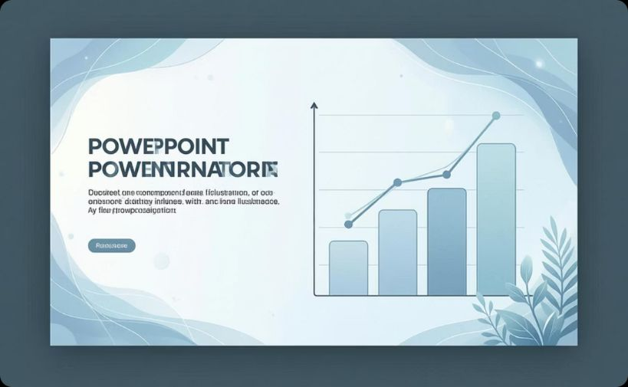

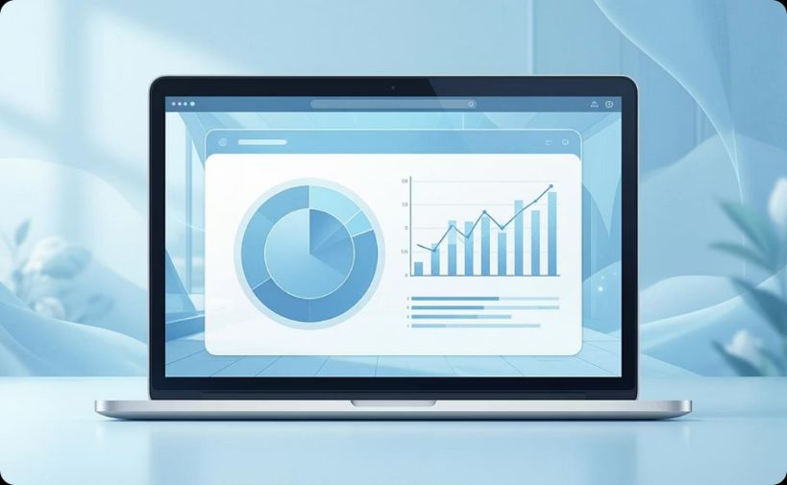
Tools and Techniques Employed
Dynamic Progress Reports
Multimedia Showcases
Tailored Infographics
PowerPoint-based reports with stair-step visuals to clearly illustrate growth milestones.
Integration of multimedia elements to highlight student projects and celebrate achievements.
Use of editable infographics allows for personalized and precise reporting tailored to individual student needs.

Slide 6

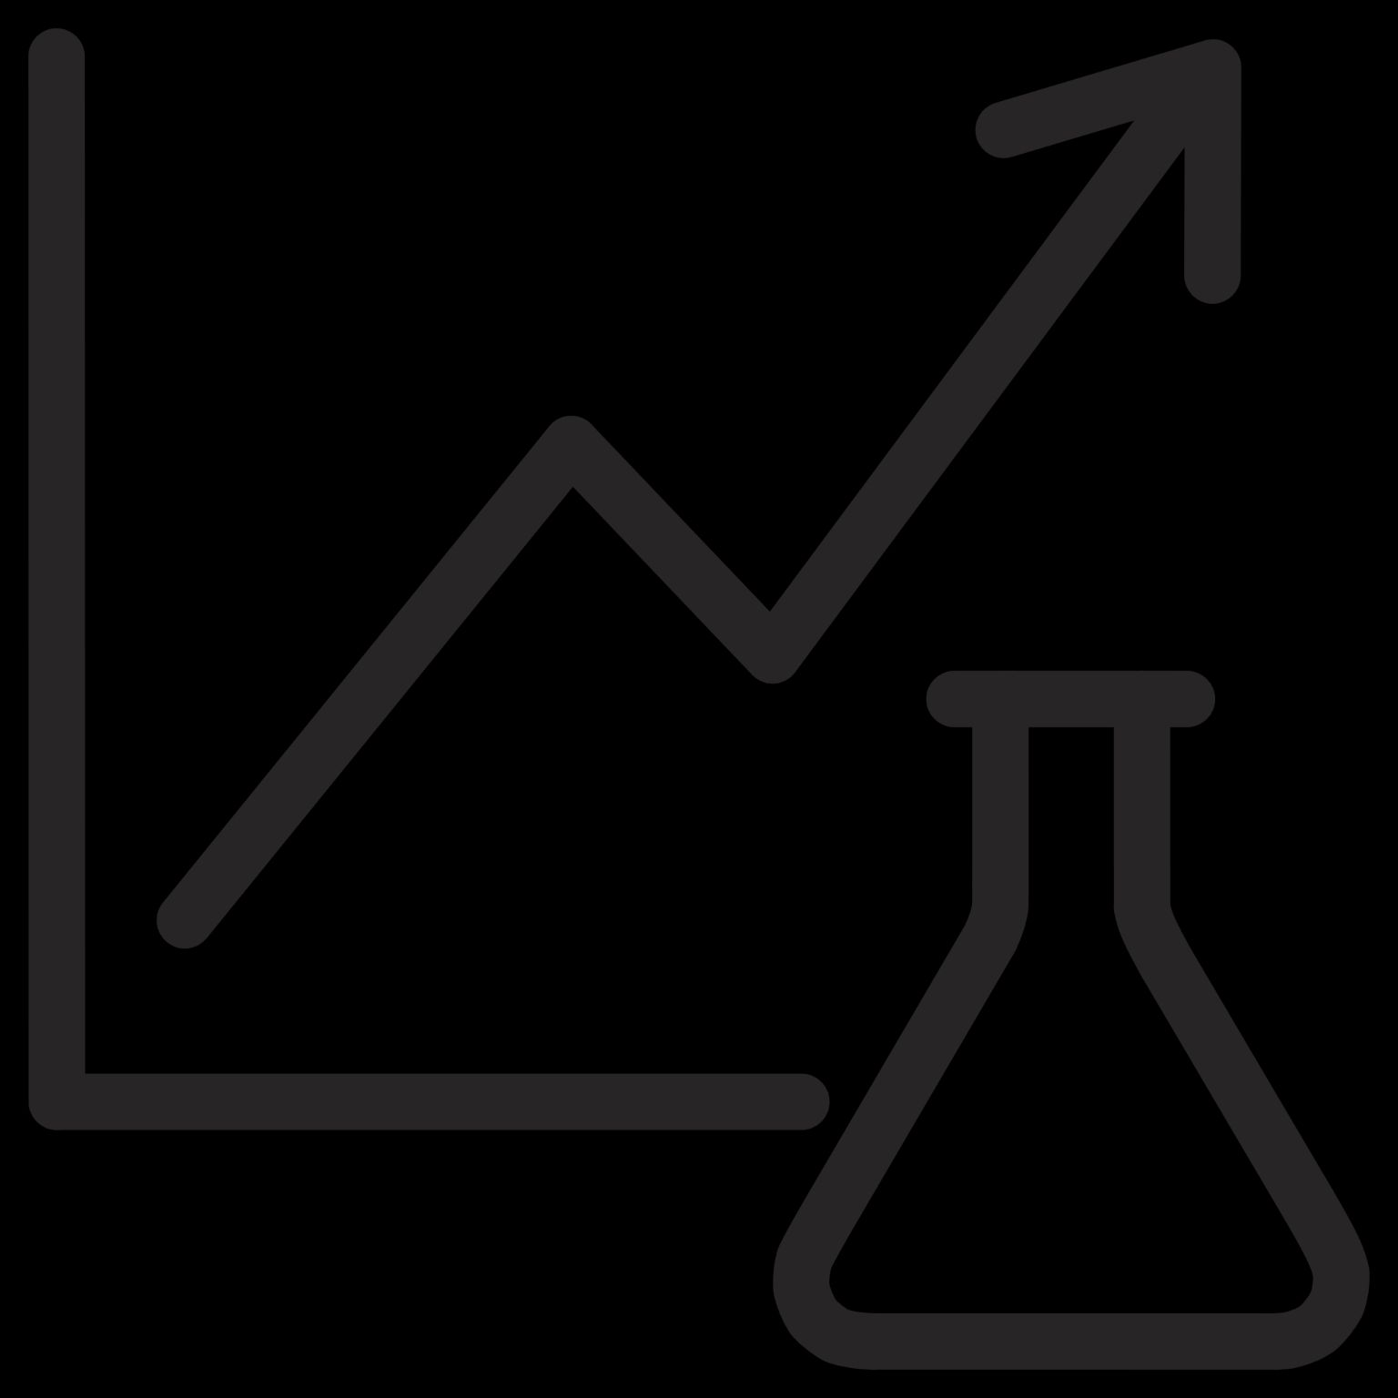
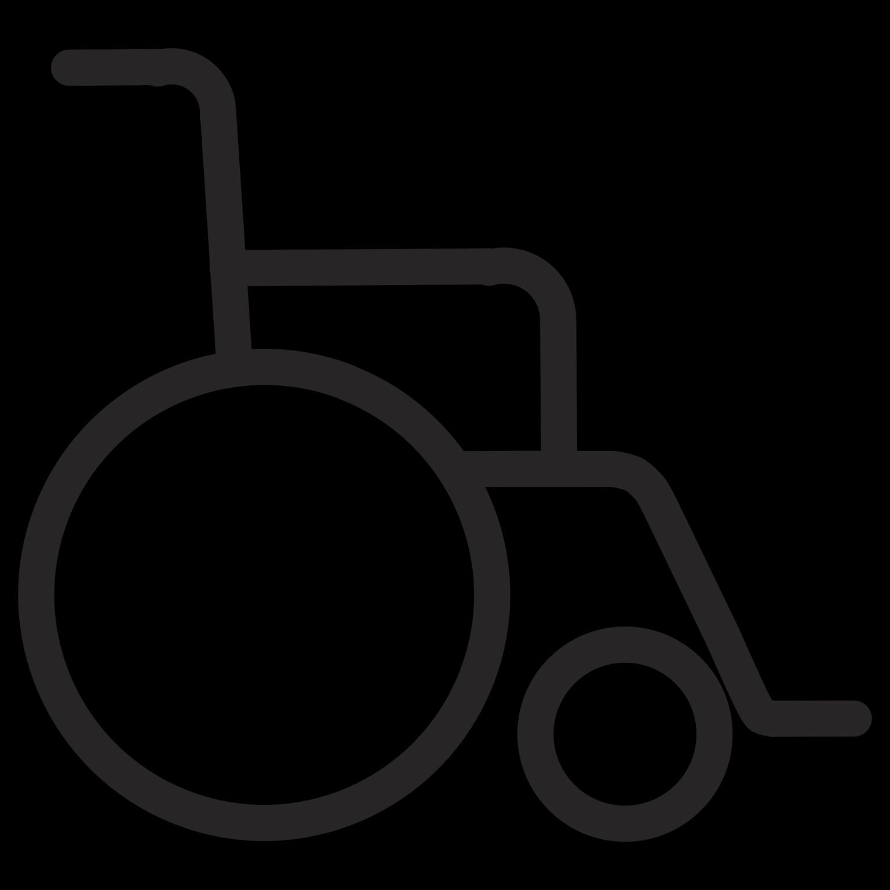

Future Scope: Expanding and Enhancing Progress Tracking
Predictive Data Analytics
Mobile-Friendly Dashboards
Implementing advanced data analytics for predictive insights into student performance, anticipating future needs.
Developing intuitive, mobile-friendly dashboards for real-time updates and on-the-go access to student progress.
Social-Emotional Learning (SEL)
Expanding metrics to include crucial social-emotional learning alongside academic achievements for a holistic view.

Slide 7
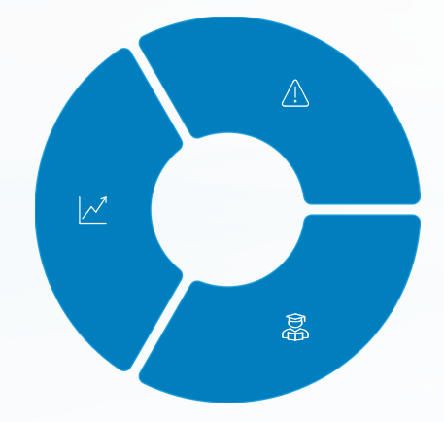

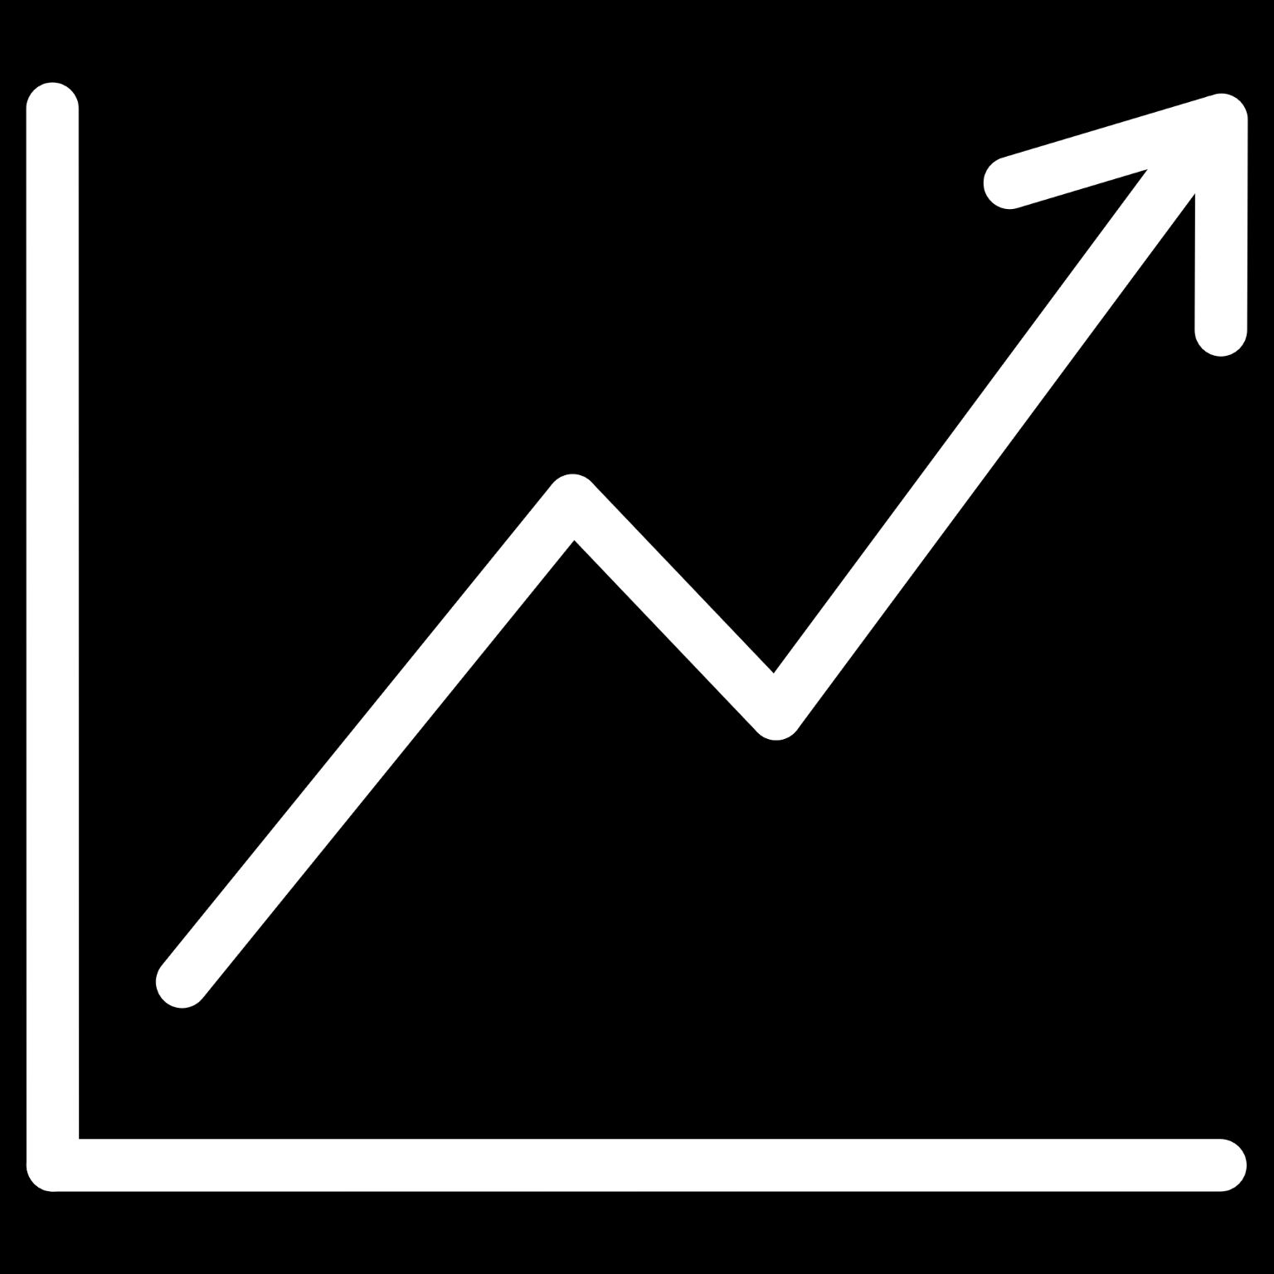

How Our Project Excels Beyond Traditional Extensions
Proactive Interventions
Fosters early identification of learning gaps, enabling immediate and targeted support.
Continuous Monitoring
Emphasizes ongoing, real-time monitoring rather than infrequent, periodic snapshots.
Student Empowerment
Encourages self-monitoring and goal-setting, fostering greater student ownership of their learning journey.

Slide 8
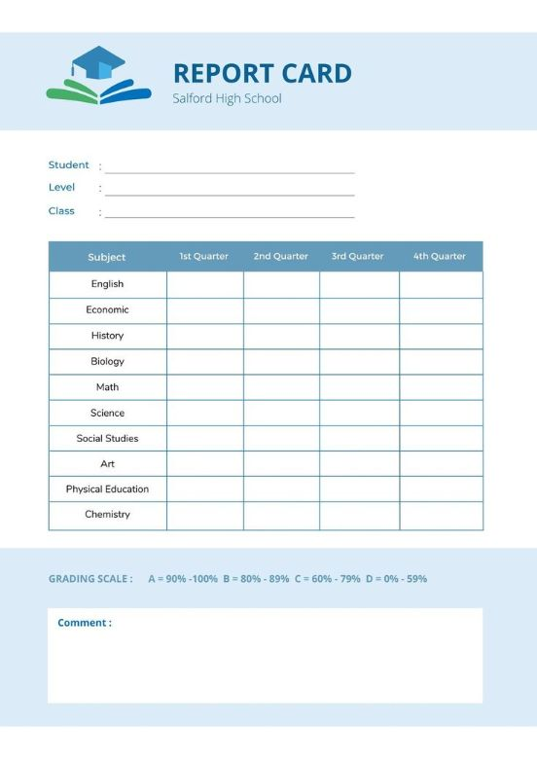
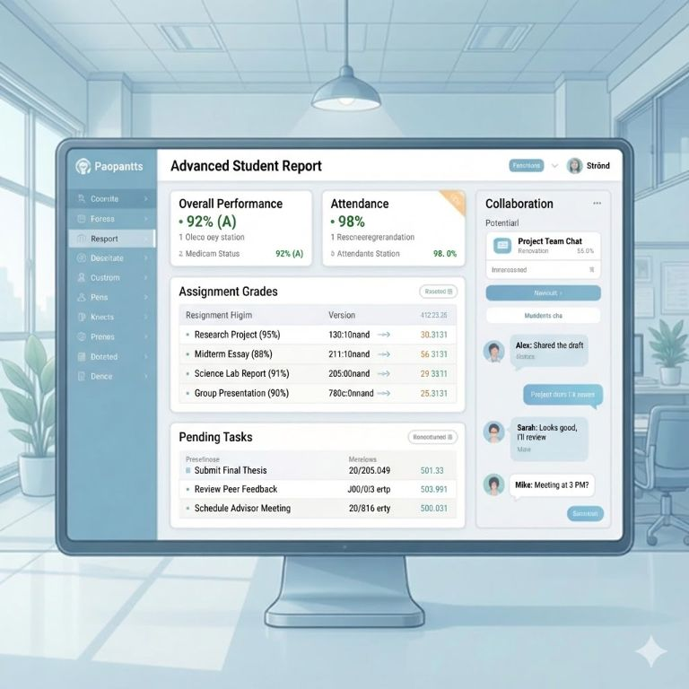
Visualizing Success: Before and After
Before
After
Limited and fragmented data.
Real-time, comprehensive insights.
Delayed and infrequent feedback.
Personalized and actionable feedback.
Generic, one-size-fits-all reports.
Engaging visuals, collaborative goal-setting.
The result: Improved student motivation, higher academic achievement, and stronger home-school partnerships.

Slide 9
Conclusion & Call to Action
Effective student performance progression is the key to unlocking every student's full potential.
Our project offers a transformative, data-driven approach to education, moving beyond traditional methods.
Let's commit to:
Smarter Monitoring: Utilizing advanced tools for precise tracking.
Clearer Communication: Ensuring all stakeholders are informed and engaged.
Better Outcomes: Achieving improved results for every learner.

