Slide 1

TRY AND BUY
MYNTRA
India’s Largest Online Fashion Store
BY-
Anjali Singh

Slide 2

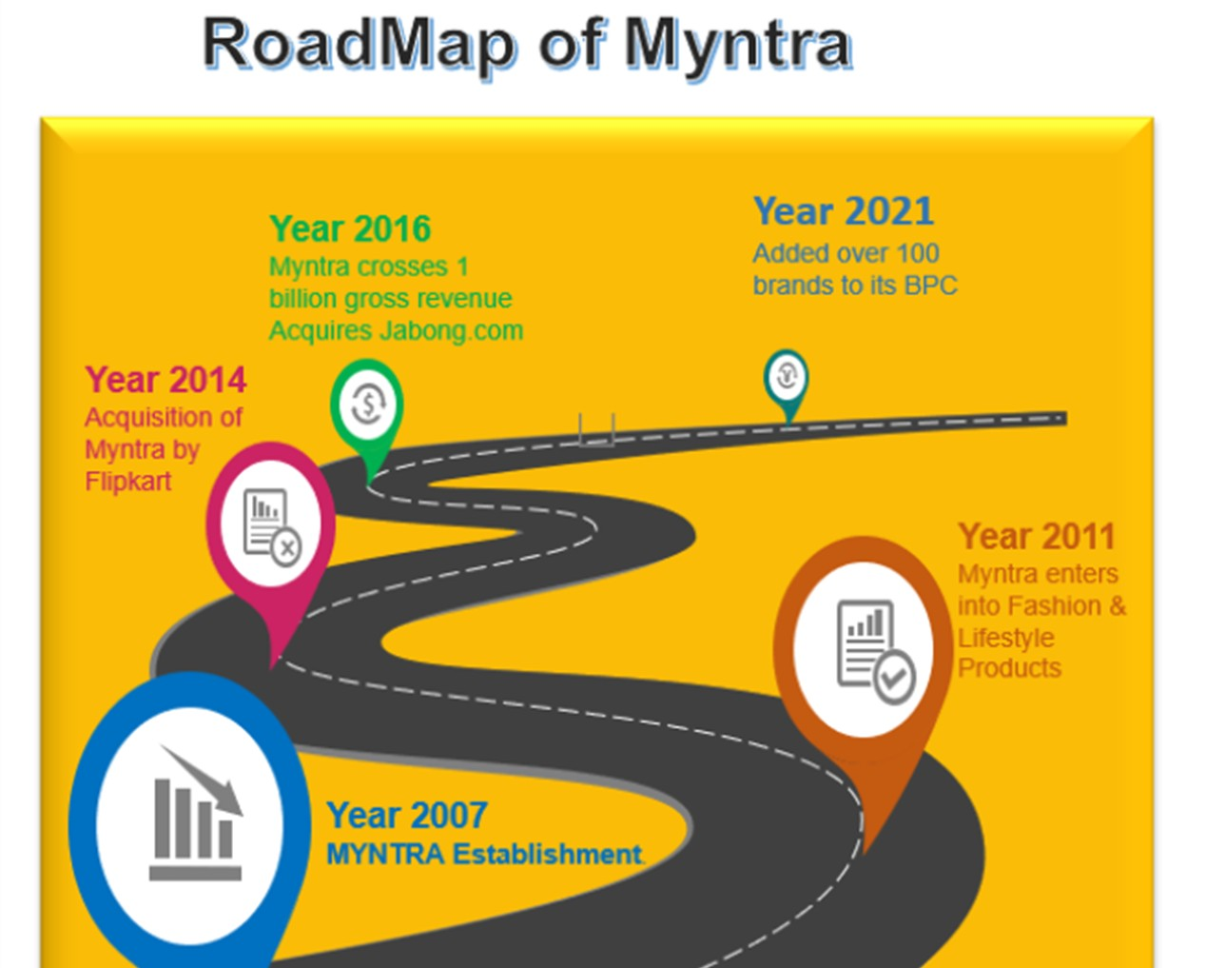
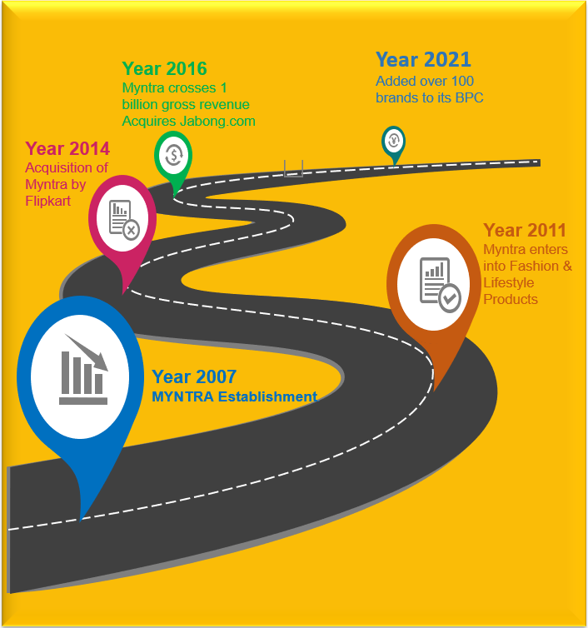
03

Slide 3

GOVERNMENT NORMS FOR MYNTRA:
05

Slide 4

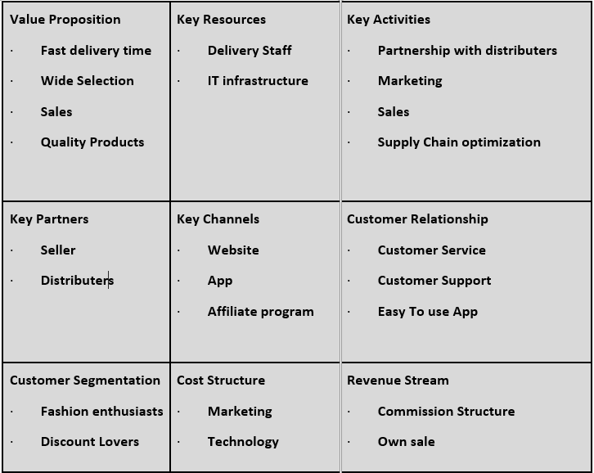
Busniess Model and Implication

Slide 5
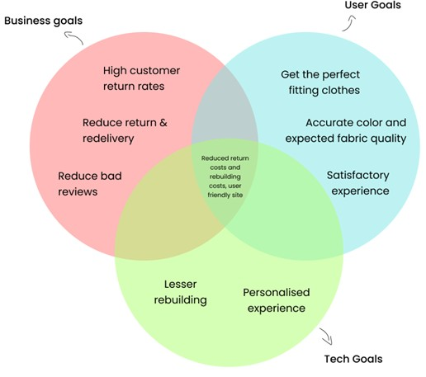

Competitive strategy

Slide 6
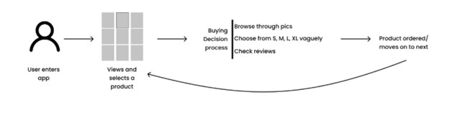
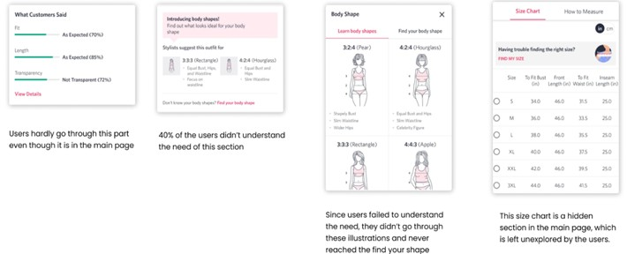
One of the Major Problem Faced by Myntra-Redelivery and Return:
Features missed by user :-
10

Slide 7
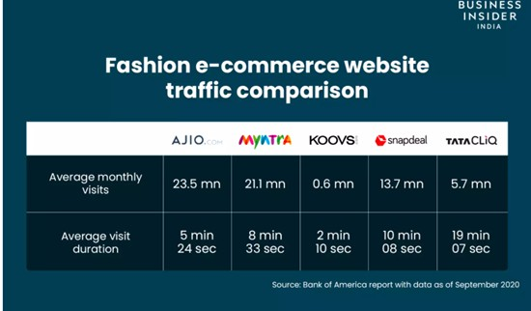
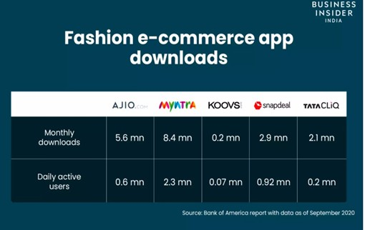
Competitors

Slide 8



THREE-FOLD INCREASE IN WAREHOUSE CAPACITY
Potential solution
INCREASE IN WORKFORCE
INCREASE IN PRIVATE LABELS PHYSICAL STORES
12

Slide 9

Future Business Prospects
Myntra on its journey towards digital transformation
Offline Expansion of Myntra Stores
Style Exchange : First of its kind in E-commerce:

Slide 10

Thank you
15

