Slide 1


Namma Yatri
---TECHNICAL METHODOLOGY REPORT --
Presented By : Anjali Singh

Slide 2
1
AGENDA
Namma Yatri seeks to optimise its operations and gain deeper insights into ride patterns, customer behaviour, and operational bottlenecks. As an analyst at Namma Yatri, the task is to explore the company’s trip data. The goal is to uncover insights that can guide decisions to improve service efficiency, maximise revenue, and enhance customer satisfaction. Through this case study, perform Exploratory Data Analysis (EDA) on the Namma Yatri dataset and present actionable insights.

Slide 3
2
OVERVIEW
Objectives
Methodology
Scope
Dashboard
Relationship
Conclusion
Data Cleaning
Appendix
Exploratory Data Analysis (EDA)

Slide 4

3
OBJECTIVE
Uncover trip patterns, cancellations, revenue trends, and payment preferences through structured analysis.
Fix low-zone technical bottlenecks (23-24).
Automate failed payment recovery system.

Slide 5
4
SCOPE
First
Third
Data model & preparation steps
Exploratory visual analysis
Second
Fourth
Identify various pattern
Feature engineering (calculated fields, metrics)

Slide 6
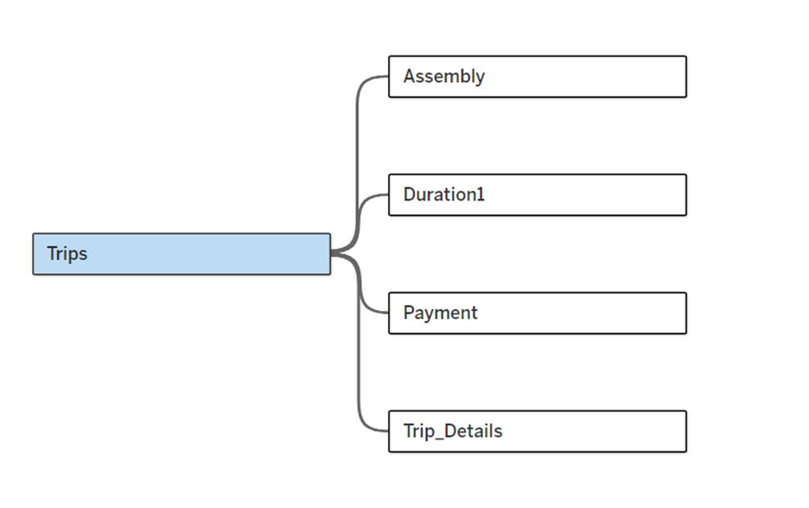
RELATIONSHIP
5
Imported tables: Trips, Trip_Details, Assembly, Duration, Payment
Joins created:TripID ↔ Trip_Details
FareMethod ↔ Payment
Loc_to ↔ Assembly
DurationID ↔ Duration
Ensured unified dataset for analysis

Slide 7
DATA CLEANING
6
Removed duplicates and irrelevant entries
•Converted binary flags (e.g., end_ride, driver_not_cancelled) into calculated fields
Calculative measure
•Created metrics:
•Successful Ride %
•Driver Cancellation %
•Customer Cancellation %
•Completed After Quotes %

Slide 8
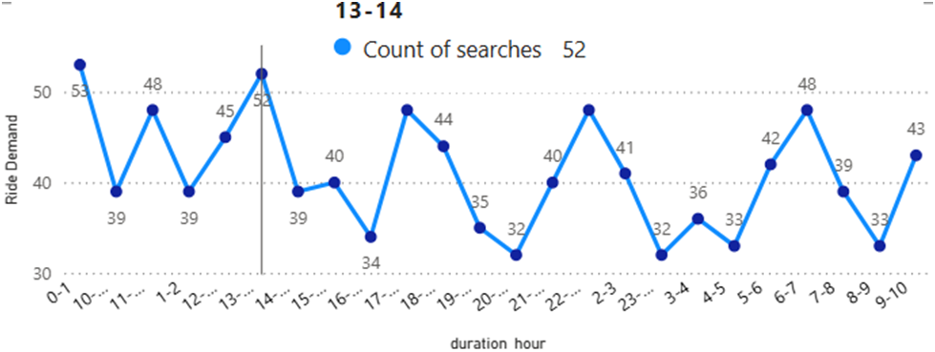
7
EDA – DEMAND OVER TIME
Guarantee 100% gateway stability at 0-1.
Engineer infrastructure for 24/7 continuous resilience.
Implement intelligent routing to boost global PSR.
Forecast micro-demand to align server capacity.

Slide 9
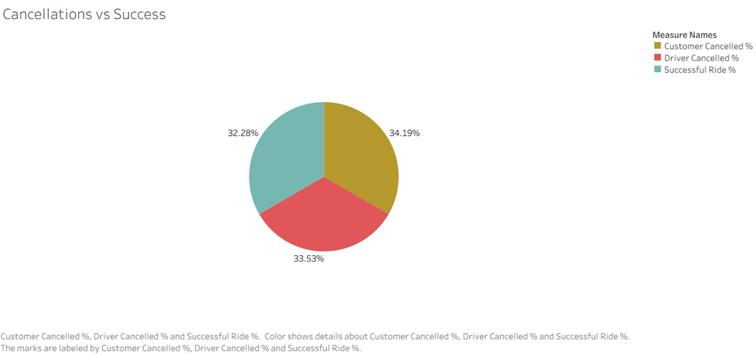
8
EDA
CANCELLATIONS VS SUCCESS
Demand peaks at 8–10 AM and 6–8 PM (commute hours)
Top 5 zones generate the majority of rides & revenue
UPI and Cash dominate payments, with UPI driving higher revenue
Evening time slots contribute maximum revenue share
Driver-side cancellations occur more frequently than customer-side

Slide 10
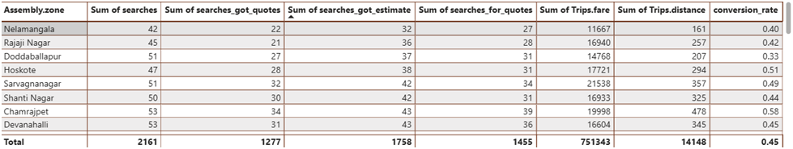
8
METHODOLOGY
Summary of relationship between search, search_got_quotes, search_got_estimate,distance,fare with Zones

Slide 11
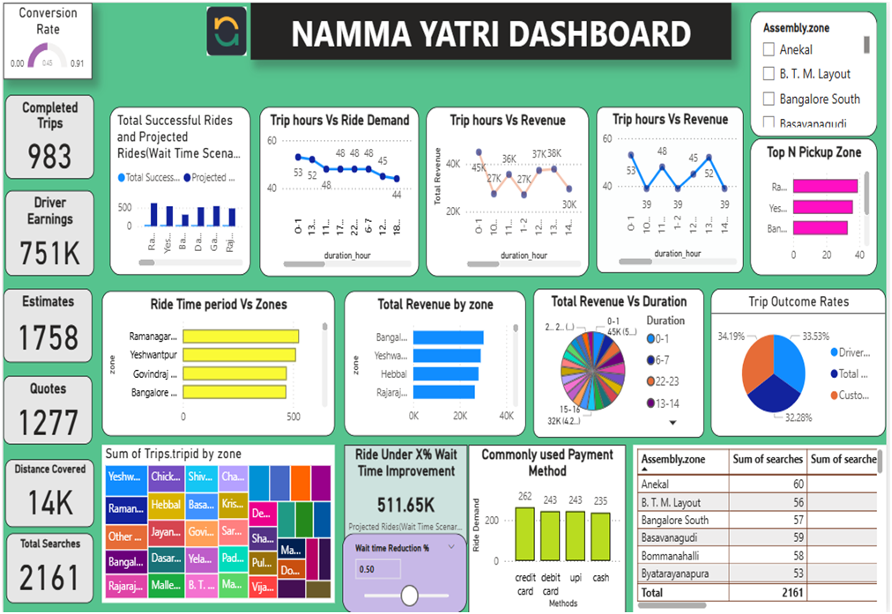
DASHBOARD
10

Slide 12

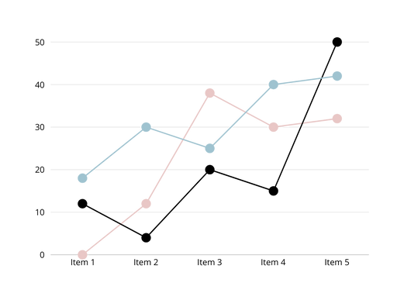
11
CONCLUSION
•The methodology ensured clean and consistent data
•Visualisations highlighted both operational inefficiencies and business opportunities
•Forms the technical base for decision-making and strategy formulation

Slide 13
12
APPENDIX
•Data model screenshot
•Calculated fields (cancellation %, completion ratio, conversion after quotes)
•Dashboard snapshots

Slide 14
THANK YOU
Presented By- Anjali Singh

