Slide 1


Mohanlal Sukhadia University, Udaipur
University College of Science
Department OF Mathematics and Statistics
Session :– 2021-2023
“ANALYSIS & FORECASTING OF PRODUCTION OF MAJOR PETROCHEMICAL PRODUCTS IN INDIA”
Presented By – Anjali Todawat
(M.Sc. Statistics IV Sem)

Slide 2



OBJECT
Our objective is to
Graph the Data of some major petrochemical products for the years 2014 to 2022.
Computing the future trend (5 years) using ARIMA Modelling.
Using Microsoft Excel and R programing language.

Slide 3
Abstract
The present study attempts to predict the future production of some of the major petrochemical products using the past productions of these products over the time period of 2014 to 2022. For this purpose I am using a Time Series Model viz. ARIMA Model, which is used in general for predicting future values based on past values. ARIMA makes use of lagged moving averages to smooth time series data. The statistical tool used for this purpose in this study is R Programming and Microsoft Excel.

Slide 4
Introduction
India's chemical and petrochemical industry is a vital sector of the country's economy and plays a crucial role in its industrial and economic development. It encompasses a wide range of activities, from the production of basic chemicals and intermediates to the manufacturing of various downstream products used in sectors such as agriculture, healthcare, construction, textiles, and automotive.
Notes:
https://chemicals.gov.in/

Slide 5
Minister of Chemical and Fertilizers of India
- Dr. Mansukh Mandaviya
Minister of state for Chemical and Petrochemicals
- Shri Bhagwanth Khuba

Slide 6
Here are some key aspects of India's chemical and petrochemical industry:
Growth and Importance:
  The industry has shown significant growth over the years, making India one of the largest producers of chemicals and petrochemicals in Asia.
  It is a key contributor to the country's GDP, exports, and employment generation.
Segments:
  The industry can be broadly categorized into two segments: basic chemicals and petrochemicals. Basic chemicals include chemicals like sulfuric acid, caustic soda, and ammonia, while petrochemicals are derived from hydrocarbons and include products like polyethylene, polypropylene, and PVC.
Major Players:
  Major companies in the sector include Reliance Industries, Indian Oil Corporation, Bharat Petroleum, Hindustan Petroleum, and several multinational corporations.
Petrochemicals:
  India has a significant presence in the production of petrochemicals, especially in the refining and processing of crude oil and natural gas to produce products like polymers, resins, and synthetic fibers.
Special Economic Zones (SEZs):
  The government has established several Special Economic Zones to promote the growth of the chemical and petrochemical industry. These zones offer tax benefits and incentives to attract investments.
Regulatory Environment:
  The industry is subject to various environmental regulations and safety standards to ensure the responsible production and handling of chemicals.

Slide 7
Exports:
  India is a major exporter of chemicals and petrochemical products to countries across the world. It exports a wide range of products, including dyes, agrochemicals, pharmaceuticals, and specialty chemicals*.
Challenges:
  The industry faces challenges related to environmental sustainability, safety, and compliance with international standards.
  Dependency on imports for raw materials, such as crude oil and natural gas, can affect the sector's growth.
Research and Development:
  Research and development in the chemical and petrochemical sector are essential for product innovation and competitiveness. Many companies invest in R&D to develop new products and processes.
Future Prospects:
  The industry is expected to continue growing due to rising domestic consumption, increased demand for specialty chemicals, and a focus on diversification and value addition.
*Specialty chemicals are either single-chemical entities or mixtures of various chemical ingredients that are designed for specific applications and sometimes for specific customers.

Slide 8
Literature Review
Historical Overview –
The chemical and petrochemical industry in India has evolved over the years, with a focus on traditional chemicals and products. Post-independence, the industry saw early growth, with the first petrochemical complex established in Trombay (an eastern suburb of Mumbai ) in 1951. The Green Revolution in the 1960s and 1970s led to the growth of fertilizer plants. In the 1990s, India initiated economic reforms, promoting private sector participation and foreign investments. The petrochemical boom in the 1990s and early 2000s saw India's industry diversify into plastics, synthetic fibers, specialty chemicals, and pharmaceuticals. India also developed expertise in bulk and specialty chemicals. As of January 2022, the industry is a significant contributor to India's GDP and export earnings, with a well-established domestic market and growing presence in international markets. Future growth is expected due to increasing demand for chemicals, growth in the pharmaceutical and agrochemical sectors, and technological advancements.

Slide 9
Economic Significance –
The chemical and petrochemical industry in India is crucial for the country's GDP, employment, and industrial development. It contributes to the country's GDP through exports of various products, contributes to infrastructure development, supports other industries, fosters innovation, and contributes to government revenue. The industry also supports rural and agro-based economies, helps balance trade deficits, and promotes sustainability and green initiatives. As the sector expands and diversifies, its economic significance continues to grow.
Government Policies and Regulations –
The Indian chemical and petrochemical industry is governed by various government policies and regulations to ensure safety, environmental protection, and growth. These include industrial licensing and investment policies, chemical management and safety regulations, hazardous substances management, Chemical Weapons Convention compliance, and chemical safety and process safety management. Economic policies and trade regulations affect the import and export of chemicals and petrochemical products. Environmental regulations, quality control, pharmaceutical regulations, fertilizer control orders, and petroleum and natural gas regulations also play a role.

Slide 10
An overview of production and consumption of major chemical fertilizers in India
- By Praveen Desai et al.
who concluded that important measures are required to increase consumption of fertilizers include development of irrigation facilities with better water use efficiency.
Productivity in Indian Chemical Sector- An Intra Sectoral Analysis
- By T Sampath Kumar

Slide 11
METHODOLOGY
Time Series Analysis –
Introduction- A set of ordered observations of a quantitative variable taken at successive points in time is known as ‘Time Series’. A time series depicts relationship between two variables one of them being time, e.g., the population (y_{t}) of a country in different years (t); temperature (y_{t}) of a place on different days (t) etc.
According to Ya-lun Chou,
“A time series may be defined as a collection of readings belonging to different time periods, of some economic variable or composite of variables.”

Slide 12
Mathematically, a time series is defined by the functional relationship
Y_{i} = f(t)
where Y_{i} is the value of the phenomenon ( or variable ) under consideration at time t.
Components of Time Series -
The various forces at work, affecting the values of a phenomenon in a time series, can be broadly classified into the following four categories, commonly known as the components of a time series, some or all of which are present (in a given time series) in varying degrees.
(a)Secular Trend or Long-term Movement
(b)Periodic Changes or Short-term Fluctuations
i)Seasonal variations, and
ii)Cyclic variations
(c)Random or Irregular Movements

Slide 13
Uses of Time Series -
The time series analysis is of greater importance not only to businessman or an economist but also to people working in various disciplines in natural, social and physical sciences. Some of its uses are enumerated below:
It enables us to study the past behavior of the phenomenon under consideration, i.e., to determine the type and nature of the variations in the data.
The segregation and study of the various components is of paramount importance to a businessman in the planning of future operations and in the formulation of executive and policy decisions.
It helps to compare the actual current performance of accomplishments with the expected ones (on the basis of the past performances) and analyse the cause of such variations, if any.
It enables us to predict or estimate or forcast the behavior of the phenomenon in future which is very essential for business planning.
It helps us to compare the changes in the values of different phenomenon at different times or places, etc.

Slide 14
ARIMA Model -
ARIMA(p,d,q) is composite of Autoregressive (AR) model, Moving Average (MA) model, and ‘I’ stands for integration; where p is order of autoregression, d is order of differencing, q is order of moving average.
ARIMA Model
Autoregressive (p)
Integrated (d)
Moving Average (q)

Slide 15
Autoregressive model (AR) is effectively merged with the Moving Averages model (MA) to formulate a useful time-series model, ARIMA model. The Autoregression (AR) element of the model shows a changing variable that regresses on its own prior values and the Moving Average (MA) element incorporates the dependency between an observation and a residual error from a moving average model applied to prior observations. However, this model can only be applied to stationary data. Since many real-life datasets consist of an element of non-stationarity, to model such datasets, ARIMA model was developed. This model is open for non-stationary data as the Integrated (I) factor of the model represents the differencing of raw observations to allow the time-series to become stationary.
Uses of ARIMA Modeling -
ARIMA modelling can be used almost in every case where there is Non- Stationary Data Set is present but we can outline some of the fields it is widely used:
• Stock prices
• Weather conditions in specific regions
• Electricity consumption in a household
• Heart rate monitoring
• Total sales in a store

Slide 16
R programing –
R is a language and environment for statistical computing and graphics. It is a free and Open Source Software (FOSS) or GNU or GPL (general public license). A statistician find R easy to use for data analysis because R has built-in commands for most of the common statistical procedures beginning with descriptive statistics through correlation, regression, ANOVA, MANOVA, clustering to factor analysis including quality graphical procedures like histogram, boxplot, scatterplot and so on.
Packages:
All R functions and datasets are stored in packages. Only when a package is loaded are its contents available.
R package used for fitting of ARIMA modeling is “forecast”.
For installing R packages use code install.packages() and for loading of packages use cade library().

Slide 17
Functions used for time series
Time Series Analysis in R is used to see how an object behaves over a period of time. In R Programming Language, it can be easily done by the ts() function with some parameters. Time series takes the data vector and each data is connected with a timestamp value as given by the user. This function is mostly used to learn and forecast the behavior of an asset in business for a period of time. For example, sales analysis of a company, inventory analysis, price analysis of a particular stock or market, population analysis, etc.
Syntax: objectName <- ts(data, start, end, frequency)
where,
data – represents the data vector
start – represents the first observation in time series
end – represents the last observation in time series
frequency – represents number of observations per unit time. For example, frequency=1 for monthly data.
Also, forecasting can be done on time series using some models present in R. In this example, Arima automated model is used.

Slide 18
Nature of the data
The data has been taken from the official government website (data.gov.in). This data was under the datasets of Ministry of Chemical and Fertilizers.
The data consists of production of various chemical and petrochemical products during a period of 2014 to 2022.
Data Figure are in MT(Metric Ton). Production data in respect of Chemicals is based on MPRs received from manufacturer of Chemicals under large and medium scale units monitored by S&M Division of D/o Chemicals & Petrochemicals. Product - It includes those products which are being monitored by S&M Division of D/o Chemicals & Petrochemicals.

Slide 19
Here we have taken the data of a few of these major petrochemical products.
Major Petrochemical products that are produced in India between the time period 2014 to 2022 are
(1) Polypropylene
(Polypropylene, also known as polypropene, is a thermoplastic polymer used in a wide variety of applications. It is produced via chain-growth polymerization from the monomer propylene.)
(2) Ethylene
(Ethylene is a hydrocarbon which has the formula C₂H₄ or H₂C=CH₂. It is a colourless, flammable gas with a faint "sweet and musky" odour when pure. It is the simplest alkene. Ethylene is widely used in the chemical industry, and its worldwide production exceeds that of any other organic compound.)
(3) Propylene
(Propylene, also known as propene, is an unsaturated organic compound with the chemical formula CH₃CH=CH₂. It has one double bond, and is the second simplest member of the alkene class of hydrocarbons. It is a colorless gas with a faint petroleum-like odor.)

Slide 20
Production (in metric ton) of Major Petrochemical products from 2014-2022
Products | 2014-15 | 2015-16 | 2016-17 | 2017-18 | 2018-19 | 2019-20 | 2020-21 | 2021-22
Polyester Filament Yarn | 2178749 | 2179003 | 2200908 | 2283406 | 2316430 | 2520331 | 1997927 | 2560793
Polyester Staple Fibre | 1021245 | 1039648 | 1056002 | 1005300 | 931440 | 1027492 | 909382 | 1160484
Low Density Polyethylene | 184402 | 200032 | 201762 | 185657 | 193051 | 613287 | 616613 | 583038
High Density Polythylene | 1155794 | 1317151 | 1520037 | 1578378 | 1597676 | 1897566 | 1910043 | 1915766
Polyestyrene | 281169 | 308576 | 311345 | 301578 | 292857 | 291720 | 217447 | 247944
Polypropylene (Inc. Co-Polymer) | 3614818 | 4284424 | 4253392 | 4350198 | 4779021 | 4982815 | 4919100 | 5240698

Slide 21
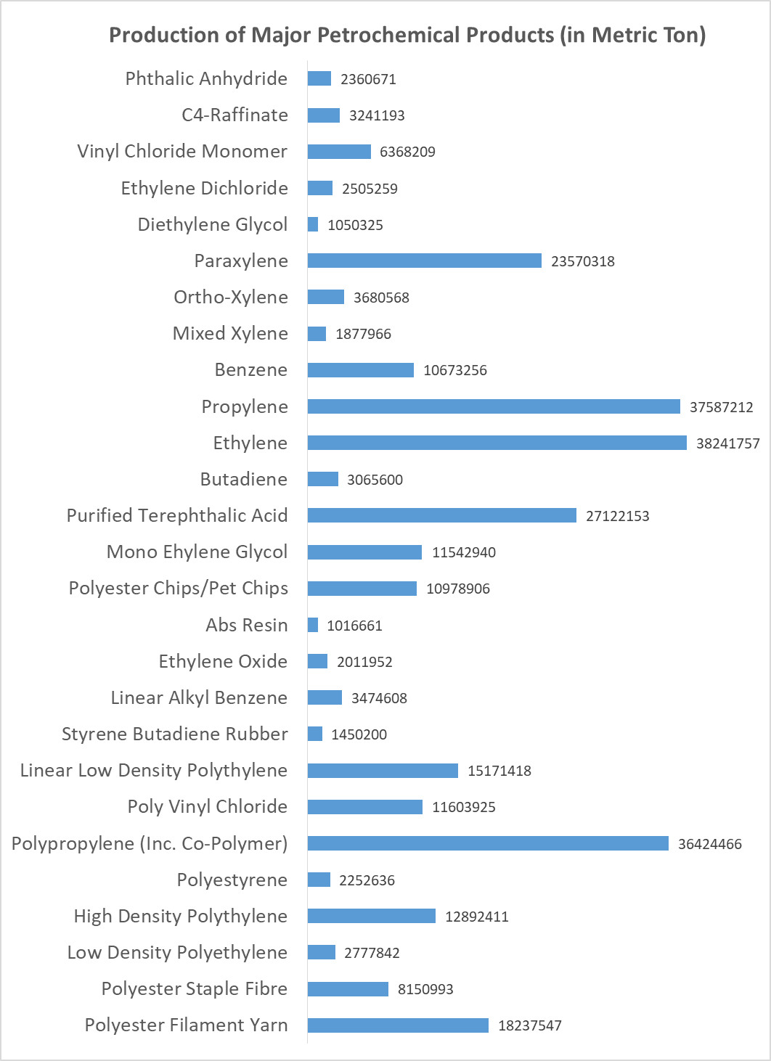

Slide 22
Plotting a graph of production of Ethylene, Propylene and Polypropylene

Slide 24
ARIMA model analysis for Ethylene and predicting next 5 forecast values
Point Forecast Lo 80 Hi 80 Lo 95 Hi 95
2022 6414520 5086058 7742982 4382812 8446228
2023 6414520 4535790 8293250 3541251 9287789
2024 6414520 4113556 8715484 2895499 9933541
2025 6414520 3757595 9071445 2351104 10477936
2026 6414520 3443988 9385052 1871483 10957557
ARIMA Model Analysis for Propylene and predicting next 5 forecast values
Point Forecast Lo 80 Hi 80 Lo 95 Hi 95
2022 5887345 5610670 6164020 5464207 6310483
2023 6139588 5748310 6530866 5541180 6737996
2024 6391831 5912615 6871046 5658934 7124727
2025 6644073 6090723 7197424 5797797 7490350
2026 6896316 6277652 7514981 5950150 7842482

Slide 26
ARIMA Model Analysis for Polypropylene and predicting next 5 forecast values
Point Forecast Lo 80 Hi 80 Lo 95 Hi 95
2022 5472967 5136337 5809596 4958137 5987797
2023 5705235 5229170 6181301 4977156 6433315
2024 5937504 5354445 6520563 5045792 6829215
2025 6169772 5496514 6843031 5140112 7199432
2026 6402041 5649315 7154767 5250846 7553236

