Slide 1
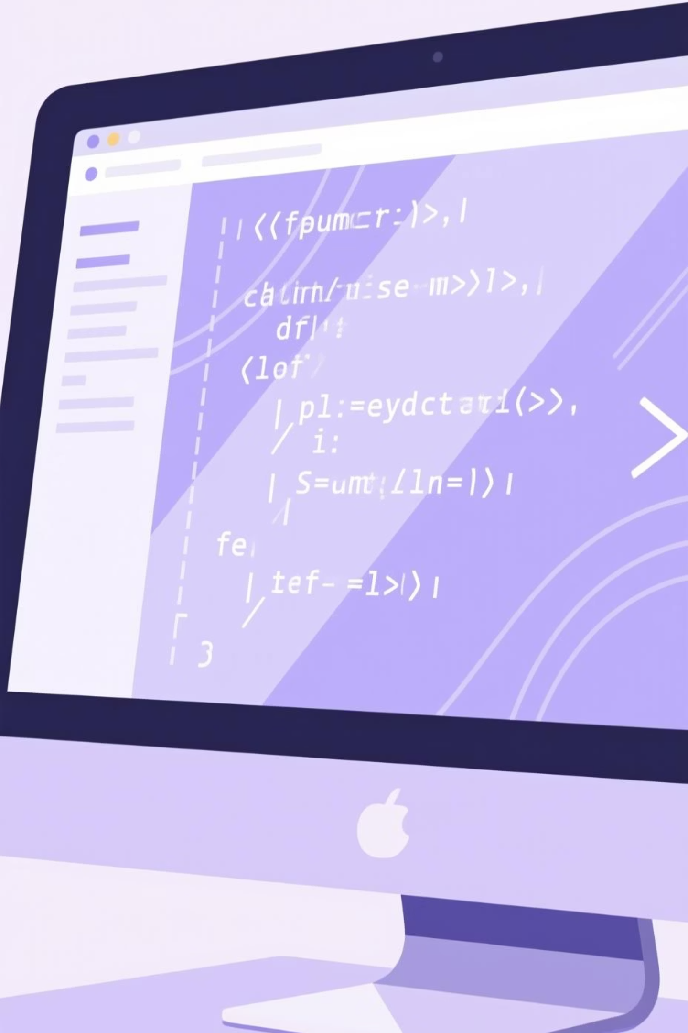
Code Visualizer
Visualization of Stack, Heap Memory, Time & Space Complexity
A research project exploring interactive memory and algorithm complexity visualization for Computer Science & Engineering

Slide 2
Project Overview
Interactive Learning
Memory Visualization
Performance Analysis
The Code Visualizer helps programmers understand code execution behind the scenes through real-time visual representations.
Displays stack memory, heap memory, and variable allocation dynamically as code executes step-by-step.
Simultaneously calculates and visualizes time complexity and space complexity of algorithms in action.
Impact: This tool transforms abstract concepts into interactive experiences, assisting students and developers in debugging, learning algorithms, and improving coding efficiency.

Slide 3

Introduction
The Challenge
Our Solution
Understanding how programs execute internally remains one of the most difficult concepts for programming learners. Memory management, allocation patterns, and algorithm efficiency are often taught theoretically without practical visualization.
An interactive web-based platform that bridges theory and practice by visualizing stack operations, heap allocations, and complexity metrics in real-time as code executes line-by-line.
The Code Visualizer transforms complex internal program behavior into intuitive, visual, and interactive learning experiences—an essential educational tool for students, teachers, and professional developers.

Slide 4
Research Objectives
1
Memory Demonstration
2
Complexity Analysis
Visually demonstrate the working mechanisms of stack and heap memory during program execution.
Calculate and display both time and space complexity metrics for given algorithms with real-time updates.
3
Memory Management
4
Interactive Platform
Help learners understand how memory is allocated, used, and released during program execution cycles.
Create an intuitive web-based platform using React.js and Node.js for seamless user experience and real-time interaction.

Slide 5
Research Gap Study
Existing Tools Fall Short: Current algorithm visualizers focus only on data structures, while debuggers remain complex and unfriendly for beginners. Traditional tutorials and PDFs lack interactivity and real-time execution tracking.
Tool Type
Limitations
Gap
Algorithm Visualizers
Data structures only
No memory view
Debuggers (GDB, VS)
Complex interfaces
Steep learning curve
Tutorials & PDFs
Static content
No interactivity
Our Solution: A unified, beginner-friendly platform combining real-time memory visualization with complexity analysis.

Slide 6
System Architecture & Methodology
01
02
Code Input
Backend Parsing
Users enter code or select predefined algorithms to analyze.
Backend simulates execution line-by-line with AST analysis.
03
04
Memory Simulation
Frontend Rendering
Stack and heap states are tracked through execution.
Simple UI for both students and teachers.

Slide 7



Detailed Methodology: Execution & Memory Analysis
Step 1: Input Reception
User enters code or selects from predefined algorithm library.
Step 2: Code Parsing
Backend generates Abstract Syntax Tree (AST) for instruction sequencing.
Step 3: Memory Simulation
Each function call pushes stack frames. Dynamic allocations populate heap visualization with pointer references.

Slide 8
Detailed Methodology: Complexity & Visualization
Step 4: Complexity Analysis
Complexity analyzer measures time (operation count) and space (variable scope, arrays, recursion depth).
Step 5: Real-Time Rendering
The system counts how many steps or actions the code takes — this helps find the time and space used.
Step 6: Result Presentation
Comprehensive analysis displayed including execution trace, memory state snapshots, and performance metrics.

Slide 9
Future Enhancements & Discussion
Multi-Language Support
Advanced Controls
Extend to C, Python, Java, and JavaScript for broader accessibility.
Step-by-step debugging with Next, Back, Pause, and breakpoint functionality.
AI Optimization
Collaboration Tools
AI-powered suggestions for code optimization and performance improvements.
Real-time collaboration enabling mentors and students to work together seamlessly.
Additional roadmap: Export reports (PDF/images), mobile responsive design, competitive algorithm challenges.

Slide 10

Proposed Outcomes & Conclusion
100%
100%
100%
Interactive Visualization
Enhanced Learning
Educational Impact
Complete memory and complexity representation in action.
Improved understanding of code execution flow and internals.
Powerful tool for institutions and developers worldwide.
Conclusion
The Code Visualizer bridges the critical gap between theoretical and practical coding understanding. By transforming complex memory and performance concepts into simple, visual, and interactive elements, this project serves as a powerful educational and debugging tool, fundamentally enhancing how programmers learn, reason about algorithms, and build robust software.

