Slide 1



LIVE-LOT
MARKETING PLAN
GROUP 17
Intro to Marketing Spring ’25​
Professor Bernstein​
Final Team Project​
Due December 2, 2025

Slide 2



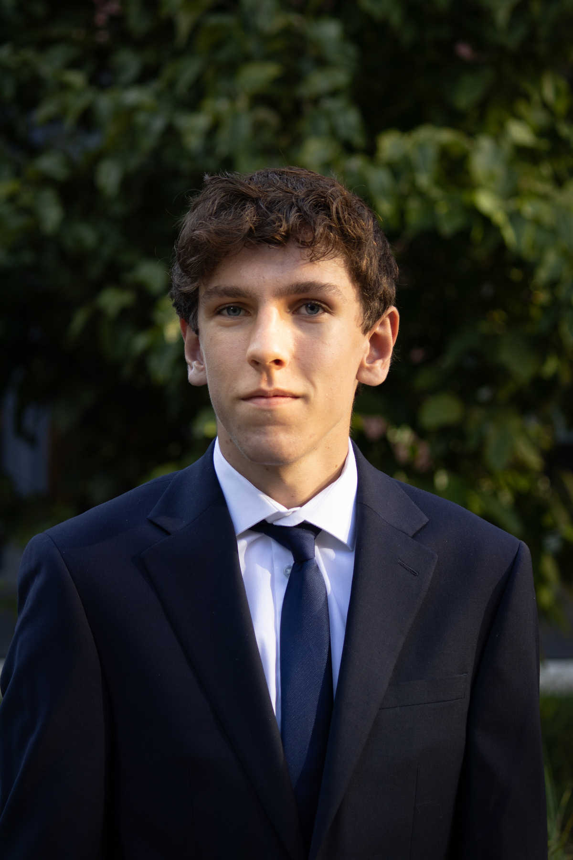




MEET THE TEAM - GROUP 17
Jahsair Acrey
Isabella Bedetto
Toby Hsuan
Nicholas Iwaszko
Competition Analyst
Industry Analysis
Evaluation & Control
Target Audience/Personas
Hamza Moosavi
Rhea Patel
Rohan Patel
Anjali Yadava
Environmental SWOT Analyst
Marketing Mix Strategy
Marketing Goals
Situation Analysis

Slide 3
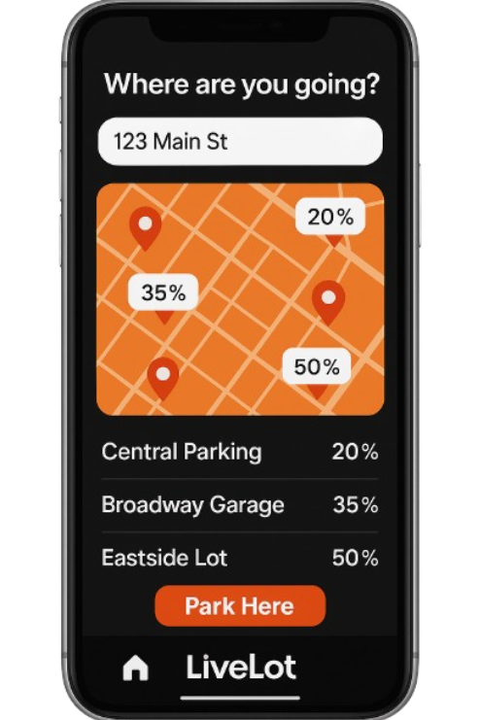
TABLE OF CONTENTS
  Team Introductions
  Executive Summary
  Situational Analysis
  Competitive Analysis
  Environmental Analysis
  Target Audience
  Marketing Objectives and Goals
  Marketing Strategies (Mix)
  Evaluation & Control

Slide 4
EXECUTIVE SUMMARY
  Live-Lot is preparing to launch an app that helps people in metropolitan and densely populated areas save time by partnering with local parking decks to track capacity and monitor pricing.
  Although this is a moderately challenging industry to enter, the smart parking industry is experiencing rapid growth, with an annual growth rate of 18.4% and a market size of $6.1 billion.
  Our company will be positioned using the slogan “Park Smarter, Move Faster” offering a fast and convenient way to find available parking and view parking prices. This saves drivers time and helps parking garages and lots increase occupancy, bringing convenience to users' daily lives.
  Live-Lot targets interns, young professionals, full-time professionals, and event-goers as its target audience.
  Live-Lot believes that our real-time capacity tracking and user-friendly interface will give us a competitive edge in an industry that is rapidly growing. Enhancing our monetization through partnerships with cities, universities, stadiums, and large parking chains will enable us to grow successfully in the long term.

Slide 5
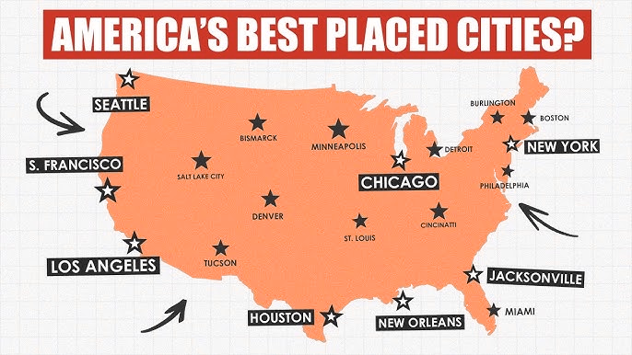
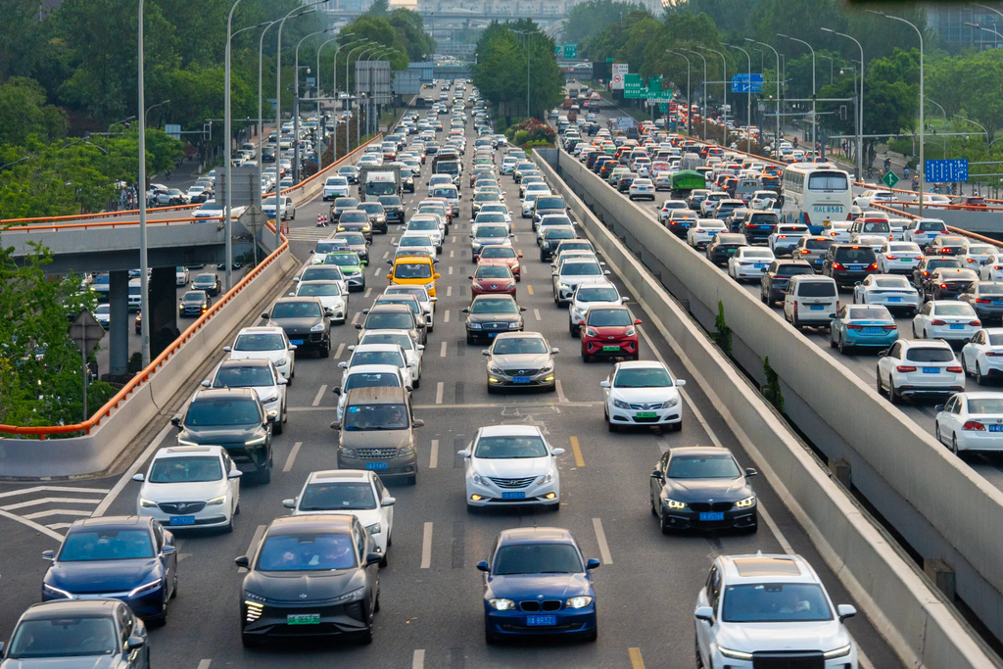
MEET OUR TEAM - GROUP 17
SITUATIONAL ANALYSIS
Drivers spend an average of 17 hours per year searching for parking. (Park NYC, 2025)
  App designed to help people find real-time information on parking capacity and pricing in metropolitan areas.​
    Urban areas experience regular congestion caused by drivers circling for available spaces.
Our app will solve this problem by offering customers reliable real-time updates on parking capacities in their local parking decks in cities and metropolitan areas, helping drivers “park smarter and move faster.”
PARK SMARTER MOVE FASTER

Slide 6
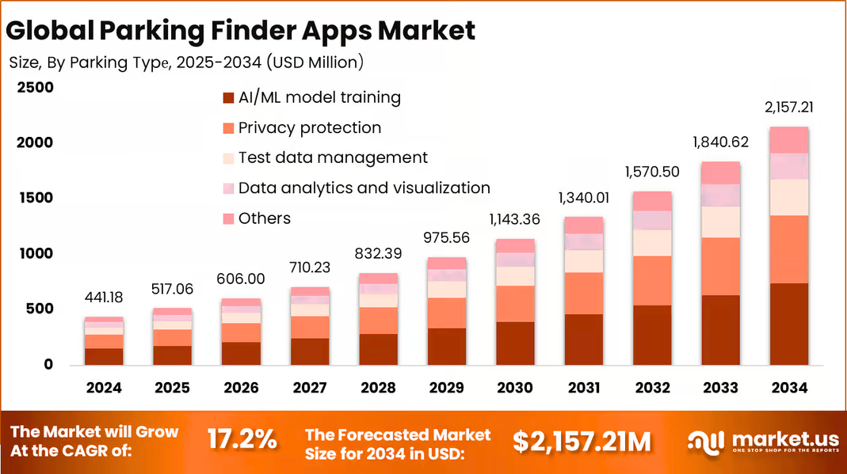
MEET OUR TEAM - GROUP 17
INDUSTRY ANALYSIS
  Industry - Parking Finder Apps Market
  Market Size (2023) - $6.1 billion
  Projected Market Size (2033) - $33.2 billion
  Growth Rate (CAGR 2024–2033) - 18.4%
  Margin Trend: High margins (60–80% depending on revenue model)
  Ease of Entry - Moderate
  Key Trends - Smart sensors, AI prediction, reservations, mobile payments
Source: Market.us
https://market.us/report/parking-finder-apps-market/

Slide 7
COMPETITIVE ANALYSIS
Key Takeaways:
  3 Major Competitors
  Spot Hero largest market penetration
  Offer the same/similar service
  Large return on investment
Spot Hero
Park Mobile
Park Whiz
Sales Revenue
$75 million+ annually
35+ million annually
$8-$11 million+ annually
11,000 locations across 400 cities
600 cities and municipalities and 140 universities
230 cities across the U.S and Canada
Reach
20%-30% taken from each reservation
$0.20-$0.50 transaction fee
Upfront pricing which reported to be 10%
Price Point
Market
Share
10 million+ users
59 million users
40 million customers

Slide 8
ENVIRONMENTAL ANALYSIS
STRENGTHS
WEAKNESSES
  Can partner with parking garages to use integrated sensors and data.
  Strong customer need in densely populated areas.
  Saves drivers' time and increases convenience.
  Heavy reliance on third-party garages for access to sensor data.
  Ongoing maintenance costs.
  High upfront technology costs.
  No existing brand recognition.
OPPORTUNITIES
THREATS
  Growing digital parking market.
  No major competitor offers true real-time nationwide capacity
  High-demand segments: commuters, interns, tourists, event-goers.
  Monetization scalability.
  Partnerships with cities, universities, stadiums, and large parking chains.
  Strong competition (SpotHero, ParkMobile, ParkWhiz)
  Garage resistance or lack of sensor infrastructure.
  Privacy and security concerns with user location data.
  During an economic downturn, demand for parking apps could drop.
  Technological changes in mobility

Slide 9
TARGET AUDIENCE
Interns & Young Professionals
Event Goers
Full Time Employees
  Ages 18-29.
  Major metropolitan cities.
  Mid-level income.
  Commuters to work by car from within the city.
  Frequent phone users.
  Very wide age range.
  Tourists, concert attendees, sports events, celebrations/parties.
  Mid-level and high-level income.
  Full-time employee in the city
  Commuting to my car from outside areas.
  Middle or upper class.
Demographic
  People who work in metropolitan or city areas with limited parking and parking garages.
  Travels into the city mainly for special occasions/ events.
  Live in the suburbs but drive to the city for work.
  Parks in garages every day.
  Faces congestion due to commuting.
Geographic
  Value convenience and saving time.
  Frustrated by searching for cheap and open parking garages.
  Prefer digital apps.
  Good parking without the hassle of driving around crowded parking lots.
  Wants decent prices and proximity to venues.
  Values routine and predictability/planning ahead.
  Will pay for reliable and guaranteed parking.
Psychographic
  People who work in metropolitan or city areas with limited parking and parking garages.
  Oftentimes, they plan the parking before going to events.
  Daily parking customers → high lifetime value.
  Usually parks in a similar area.
Behavioral

Slide 10
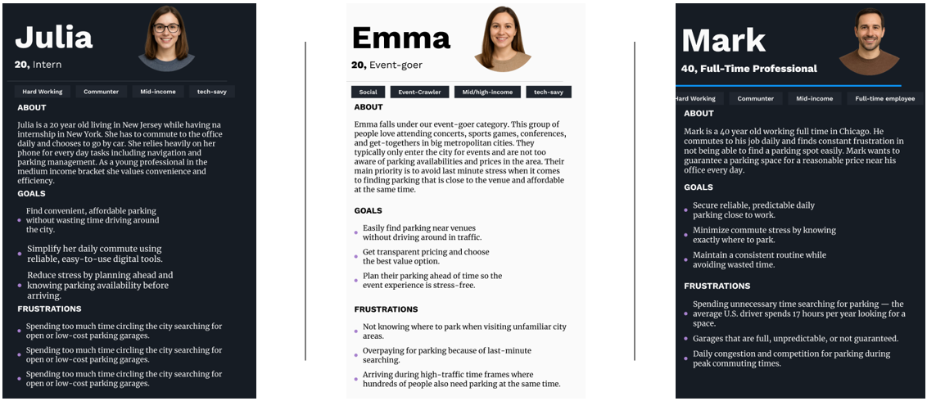
TARGET AUDIENCE
Interns & Young Professionals
Event-Goers
Full-Time Professionals

Slide 11
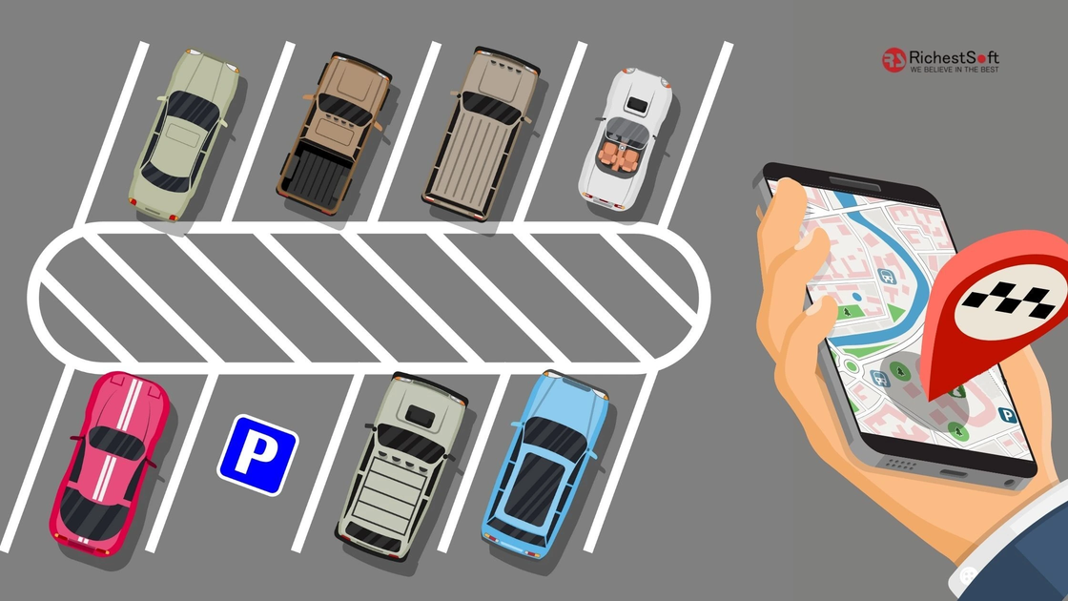
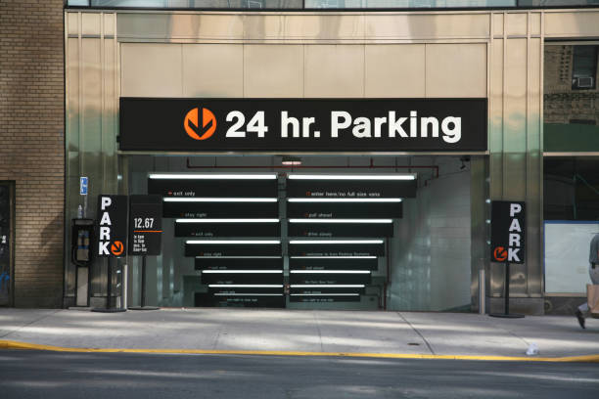
MARKETING GOALS & OBJECTIVES
  User Acquisition​
    25,000 NYC users by Month 6​
    25,000+ app downloads (iOS + Android)​
    4.5+ star rating maintained across platforms​
  Revenue Breakdown​
    $500K Parking Facility Subscriptions EOY1 (83%)​
    50 garages × $10,000/year​
    $100K In-App Advertising EOY1 (17%)​
  Brand & Social Growth​
    10,000+ combined followers across Instagram, TikTok, LinkedIn by EOY 1​
    Target: 15% aided brand awareness in ages 18-45 demographic​
    Launch cities: Focus on NYC market penetration​

Slide 12
MARKETING STRATEGY : PRODUCT
Product Positioning: Value Proposition
A fast and convenient way to find available parking and parking prices, saving drivers time and helping parking garages and lots increase occupancy.
Difference From Existing Competition:
  Works with pre-installed occupancy scanners.
  Presents real time data.
Customer Experience
  Stress-free and user-friendly customer experience.
  App should be easy to navigate.
  Businesses should be easily able to input data.
Product Positioning: Unique Selling Proposition
Instantaneous access to parking garage deck availability and access to parking structure data using already existing parking scanners to track capacity in real time.
Sustain Customer Loyalty
  Usable customer interface.
  Personalized app notifications.

Slide 13

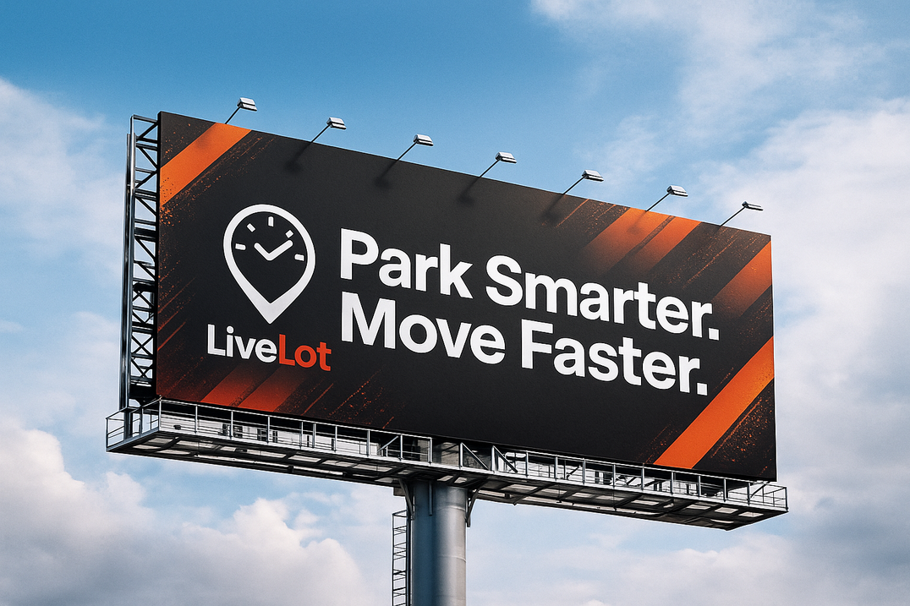
MARKETING STRATEGY : PLACE
  Distribution Channels​
    Apple App Store
    Google Play Store
    Amazon App Store
​
  Local​
    Different cities throughout the nation ​
    User experience would be more local being tailored to the specific cities
  O​mni-Channel
    Digital Channels
      Ads in GPS and travel websites
    Physical Channels
      Billboards

Slide 14
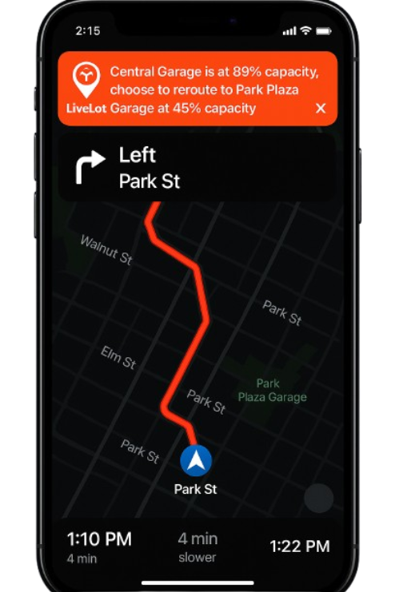
MARKETING STRATEGY : PRICING
Pricing Strategy
  Competition-based pricing.
  App is free for users to download and use.
  Premium-Based Pricing
    In order to have parking garage data, such as pricing and capacity, shown and boosted on the Live-Lots algorithm, garages will be charged a monthly premium based on geographic location.
Comparison to Major Competitors
  Competitors use a more dynamic and personalized pricing strategy.
  Pricing strategy mainly fluctuates with the set market prices.
Promotional or Seasonal Pricing
  No, we will not offer promotional or seasonal pricing.

Slide 15



MARKETING STRATEGY : PROMOTION
Promotion Strategy
  Digital promotions
    Using related apps such as Waze or different travel
Content Marketing
  TikTok, Instagram, Facebook
Advertising
  Online efforts
    Verbal advertisement streamed over radio channels, podcast channels, and Spotify advertisements
  Offline efforts
    Billboards
Social Media Strategy
  Audience: people who subscribe to more travel and lifestyle focused content
  Increase brand awareness
Public Relations and Media Outreach
  Radio stations and social media
  Customers should see the benefits of Live Lot
Influencer Partnerships​
  Travel influencers
  Work bloggers
  Average lifestyle content creators

Slide 16
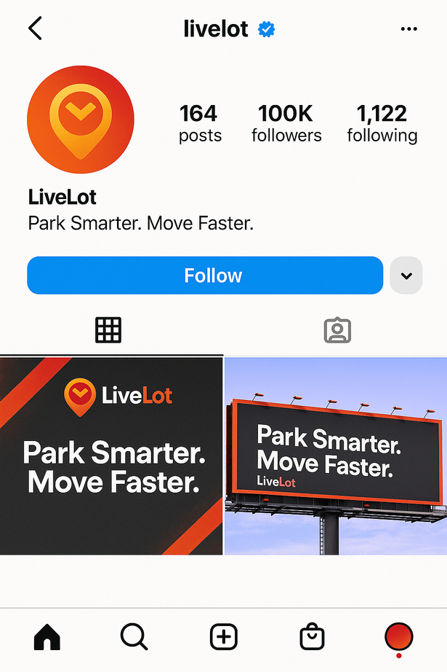
EVALUATION & CONTROL
Weekly: review app health, downloads, social media engagement​
Monthly: assess user growth, revenue process, user engagement​
Quarterly: adjust long term strategy, budget, marketing direction
If our plan is on target:​
  Increase investment and look to expand, add new pricing tiers, and launch loyalty programs​
If our plan is off target:​
  Adjust marketing, strengthen product experience, improve user retention​
KPIs to monitor:​
  User Metrics​
  Revenue Metrics​
  Market Metrics​
  Product Metrics​

Slide 17
SOURCES
Work Cited
Armstrong, Gary, and Philip Kotler. Marketing: An Introduction. 15th ed., Pearson, 2022.
Market.us. "Parking Finder Apps Market Size | CAGR of 17.2%." Market.us, Aug. 2025, market.us/report/parking-finder-apps-market/. Accessed 30 Nov. 2025.
Parking Finder Apps Market.” Market.Us, 20 Aug. 2025, market.us/report/parking-finder-apps-market/.

Slide 18
THANK YOU

