Slide 1
PPS MINIPROJECT ON
ELECTION
BY ALAPAN KONAR
REG. NUMBER: - RA2111053010024
DEPARTMENT: - ELECTRONICS AND COMMUNICATION
ENGINEERING WITH DATA SCIENCE

Slide 2
OVERVIEW
This program is meant to simulate an election or a vote. On Execution the program will display to the user a list of choices. The choices are: Cast vote, display the vote count, display the leading candidate and exit. Based on the choice entered by the user, the program will either record the user’s vote or display the number of votes each candidate has received or display who the leading candidate is or terminate execution

Slide 3
THE IMPORTANT PART OF CODE WITH
SOME EXPLANATION
#include<stdio.h>
#include<string.h>
#include <stdlib.h>
#define CANDIDATE_COUNT 4
char CANDIDATES[][50] = {"Nelson Canella","Christopher Maximus","Jim Brar",
"Ronald Rump"};
struct candidate {
char name[50];
int votes;
} person[CANDIDATE_COUNT];
WE START THE PROGRAM BY DECLARING THE CANDIDATE NAMES IN A CHAR ARAAY AND THEN DEFINE THE STRUCTURE TO USE A FILE THAT STRORES THE NAME OF THE CANDIDATE AND THEN THE FILE TO STORE THE DATA OF THE VOTES COUNT

Slide 4
FILE *fp;
void holdScreen(){
printf("\n\n Press a key to
continue the program ");
char c= getchar();
system("cls");
}
HERE IN THIS PART WE ARE USING THE CONCEPT OF THE STRUCTURE OF C AND TAKE THE FILE TO READ THE NAMES OF THE CANDIDIATE AND HENCE AFTER VOTING STORE THE VOTES COUNT

Slide 5
void castVote(){
int i, choice;
printf("\n\n #### Please choose your Candidate ####\n\n");
for (i = 0; i < CANDIDATE_COUNT; i++)
{ printf("\n %d. %s",i + 1, person[i].name);}
printf("\n %d. %s",CANDIDATE_COUNT + 1, "None of These");
printf("\n\n Input your choice (1 - %d) : ", CANDIDATE_COUNT + 1);
scanf("%d",&choice);
fflush(stdin);
if (choice >= 1 && choice <= CANDIDATE_COUNT)
{ person[choice - 1].votes++;
printf("\n Thanks for vote !!");
}
else if (choice == CANDIDATE_COUNT + 1)
{
spoiledtvotes++;
printf("\n Thanks for vote !!");
}
else
{ printf("\n Error: Wrong Choice !! Please retry")}
IN THIS CODE BLOCK WE USE THE FUNCTION OF COUNT TO INCREMENT THE COUNT OF THE VOTES FOR EACH OF THE 4 CANDIDATES WITH THE (++) INCREMENT FUNCTION. THE INCREMENT DEPENDS UPON THE USERS CHOICE

Slide 6
void votesCount(){
int i;
fp=fopen("Election.txt","r");
for(i=0;i<CANDIDATE_COUNT;i++)
{
fread(&person[i],sizeof(struct candidate),1,fp);
}
spoiledtvotes=getw(fp);
printf("\n\n ##### Voting Statistics #####");
for (i = 0; i < CANDIDATE_COUNT; i++)
{
printf("\n %s - %d ", person[i].name, person[i].votes);
}
printf("\n %s - %d ", "Spoiled Votes", spoiledtvotes);
fclose(fp);
free(fp);
//hold the screen
holdScreen();
}
IN THIS CODE BLOCK WE OPEN THE TXT FILE “ELECTION.TXT ” SO AS TO APPEND IT AND ADD THE COUNT OF THE VOTES IN EACH OF THE NAMES AND APPEND IT ACCORDINGLY

Slide 7
PROGRAM DESCRIPTION
The program is meant to be an election or vote registering and counting system.
It has four candidates and their names programmed into the code. The number or name of the candidates can be changed by modifying the code. The names are also stored in a text file(election.txt) so as to read the names from it and use in the code.
The concept of structure, files and functions are used for the counting of the votes and adding them according to the users choice . So the program was made using all the concepts
On Execution, the program displays a list of choice: Cast Vote, Display vote count, Display leading candidate and to exit. Based on the choice entered, the program either terminates or calls a function. Each choice is carried out by a different function. The functions either increment the vote count of a candidate by incrementing the value of the global variables, or displays vote count of each variable by displaying the value of the global variables or displays the leading candidate by comparing vote count (value of the global variables).

Slide 8
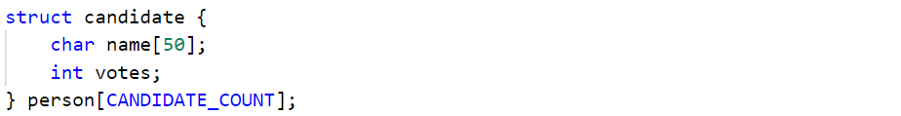
THE USE OF STRUCTURE
A structure called candidate. This structure has two elements: a character array i.e. string to store name of
each candidate and an integer variable to store vote count of the candidate.
An array of the structure candidate called person is declared. This array will contain the name and vote count the candidates.
The number of elements in the array is equal to the number of candidates.
An integer variable is also declared to store the number of votes in “None of the above” category.

Slide 9
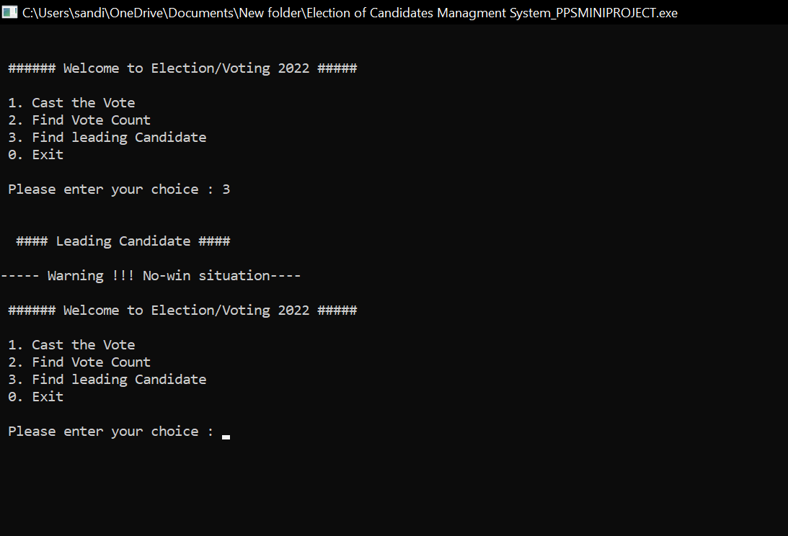
SOME
OUTPUTS

Slide 10
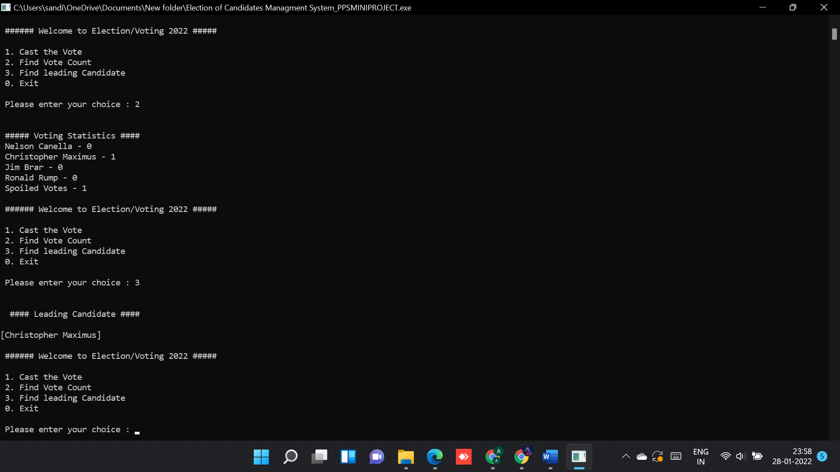

Slide 11
