Slide 1
Building Automation Frameworks from scratch
Anjali Kulkarni

Slide 2
Agenda
Brief History
Framework Overview
Framework Structure
Selenium 4.0
  Architecture
  Features
  Selenium Grid
  Selenium IDE
Coding Best Practices

Slide 3
Some History..
SilkTest
Rational Robot
Selenium
Could not keep up when desktop UIs were replaced by Web UIs
QTP
RPA
They are all very costly….

Slide 4
Framework Overview
Test Runners
TestNG
Junit
Reporting Libraries
Extent
Allure
TestData
Excel
CSV
Frameworks
Selenium
Cucumber
Playwright
Cypress
Design Patterns
POM
Page Factory
Singleton
XML
JSON
Protractor
Logging Libraries
Log4j

Slide 5
Framework Overview
Test Runners
TestNG
Junit
Reporting Libraries
Extent
Allure
TestData
Excel
CSV
Frameworks
Selenium 4.0
Cucumber
Protractor
Playwright
Cypress
Design Patterns
POM
Page Factory
Singleton
XML
JSON
Logging Libraries
Log4j

Slide 6
Framework Structure
PageObjects Package
Testcases Package
Utilities Package
BaseClasses Package
  TestBase.java
  Listeners.java
  Extent-config.xml
TestData folder
Resources/Config.properties
pom.xml
testng.xml

Slide 7
Selenium 4.0
Architecture
Architecture
Selenium 3.0: JSON Wire Protocol
Selenium Client Libraries
Browser Drivers
Browsers
Selenium 4.0: W3C Protocol
Components
Selenium
Selenium WebDriver
Selenium Grid
Selenium IDE

Slide 8
Selenium 4.0 Features
W3C compliant
Reliable
Faster
Reduced flakiness
Richer actions API support
Better Window / tab management
Relative locators
Native file upload support
Chrome dev tools integration
Selenium IDE
Selenium grid
Multiple locators
newWindow(URL)
navigateTo()
Debugging on the fly
Inbuilt runner
Docker Compliant
above, below, rightof and leftof, near, etc
Multi-touch, Zoom, 2 keys simultaneously
No need of third party libraries like robot / auto it
Third party plugins

Slide 9
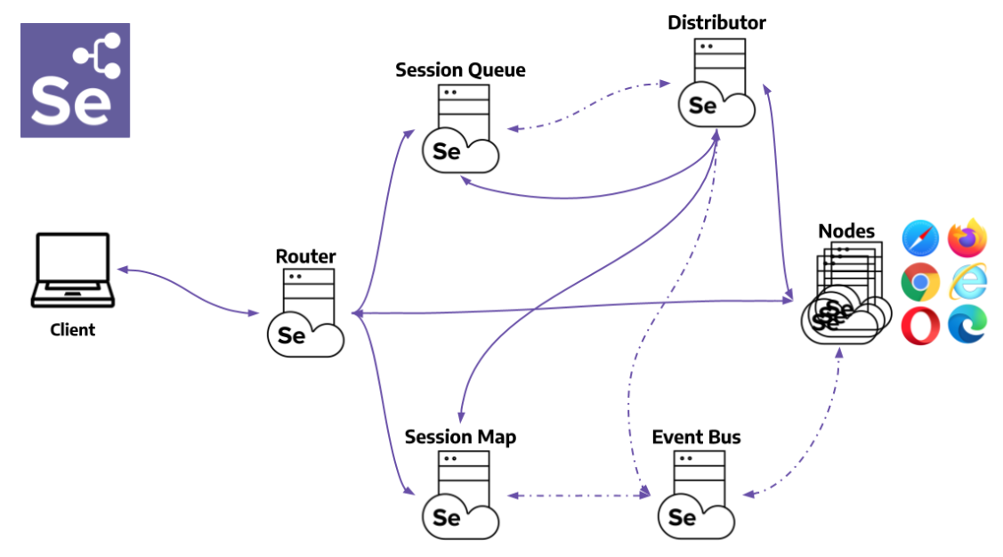
Selenium 4.0 Grid

Slide 10
Selenium 4.0 IDE
Support for third party plugins
SIDE Tool
Improved GUI
Enhanced Control Flow mechanism
Enhanced locator strategy
Inbuilt runner

Slide 11
Selenium Automation Best Practices
Use appropriate naming conventions
Avoid sleep() - use implicit and explicit wait instead
Keep pom.xml clean - removing unused dependencies
Put in good comments
Remove any console print statements
Implement logging and reporting
Use Design patterns
Externalize testdata

Slide 12
Thank You!!

