Slide 1
TERMINAL-BASED MINI
OPERATING SYSTEM
SIMULATOR
Foundation of Programming
A simplified command-line interface to understand core OS concepts

Slide 3
INTRODUCTION
Definition of an Operating System
An Operating System (OS) is system software that manages computer hardware, software resources, and provides common services for computer programs. It acts as an intermediary between users and computer hardware.
Role of OS in a Computer System
• Process Management: Controls execution of programs and manages CPU scheduling
• Memory Management: Allocates and deallocates memory space as needed
• File Management: Organizes, stores, retrieves, and manages data on storage devices
• Device Management: Controls and coordinates hardware devices
Importance of Studying OS Basics
Understanding OS fundamentals helps programmers write efficient code, debug system-level issues, and comprehend how software interacts with hardware at a fundamental level.

Slide 4
PROBLEM STATEMENT
Difficulty of Understanding Real Operating Systems
Lack of Practical Exposure for Beginners
Modern operating systems like Windows, Linux, and macOS are extremely complex with millions of lines of code. Their intricate architecture makes it challenging for beginners to grasp fundamental OS concepts without getting overwhelmed.
Students often study OS theory from textbooks but lack hands-on experience with actual OS operations. This gap between theory and practice hinders deep understanding and practical skill development.
Need for a Simplified Learning Approach
There is a clear need for educational tools that:
• Simplify complex OS concepts into manageable, understandable components
• Provide interactive, hands-on learning experiences
• Allow students to experiment with OS operations in a safe, controlled environment
• Bridge the gap between theoretical knowledge and practical implementation
• Build foundational understanding before advancing to complex real-world systems

Slide 5
PROJECT OBJECTIVES
Learning Goals
• Understand core operating system concepts through practical implementation
• Learn command-line interface design and user interaction patterns
• Comprehend process management, file handling, and system architecture
• Develop problem-solving skills by simulating real OS functionalities
Skill Development Objectives
• Master programming fundamentals: loops, conditionals, functions, and data structures
• Implement string manipulation and command parsing techniques
• Practice modular programming and code organization
• Enhance debugging and testing capabilities
Educational Purpose of the Project This project serves as a foundational learning tool that demonstrates how operating systems work at a simplified level, making abstract OS concepts tangible and understandable for beginner programmers.

Slide 6
TERMINAL-BASED MINI OS
Definition
A Terminal-Based Mini Operating System is a simplified command-line program that simulates basic operating system functionalities without a graphical user interface. Users interact with the system by typing text commands, similar to Linux terminal or Windows Command Prompt.
How It Differs from GUI-Based OS
Why Terminal-Based Systems Are Used for Learning
Text-Based Interaction
Commands are typed rather than clicked with a mouse
Simplified Functionality
Focuses on core features without complex graphics
Direct System Control
Provides immediate feedback and precise control over operations
• Removes visual complexity, focusing on core logic
• Easier to implement and understand for beginners
• Teaches command syntax and system interaction
• Builds strong foundation in programming logic
• Lightweight and runs on any system
• Prepares students for Linux/Unix environments • Encourages precise, logical thinking

Slide 7
SYSTEM OVERVIEW
How the Mini OS Works
The Mini OS operates in a continuous loop, accepting user commands, processing them, and displaying results. It simulates an environment where users can perform file operations, manage processes, and execute system-level tasks through simple text commands.
USER INPUT
COMMAND
PROCESSING
OUTPUT
Basic Workflow Explanation
1. User Input: User types a command at the prompt (e.g., "create file.txt")
2. Command Processing: The system parses the command, identifies the operation and parameters, validates syntax, and executes the corresponding function
3. Output: The system displays the result, error message, or confirmation, then returns to the command prompt ready for the next input

Slide 8
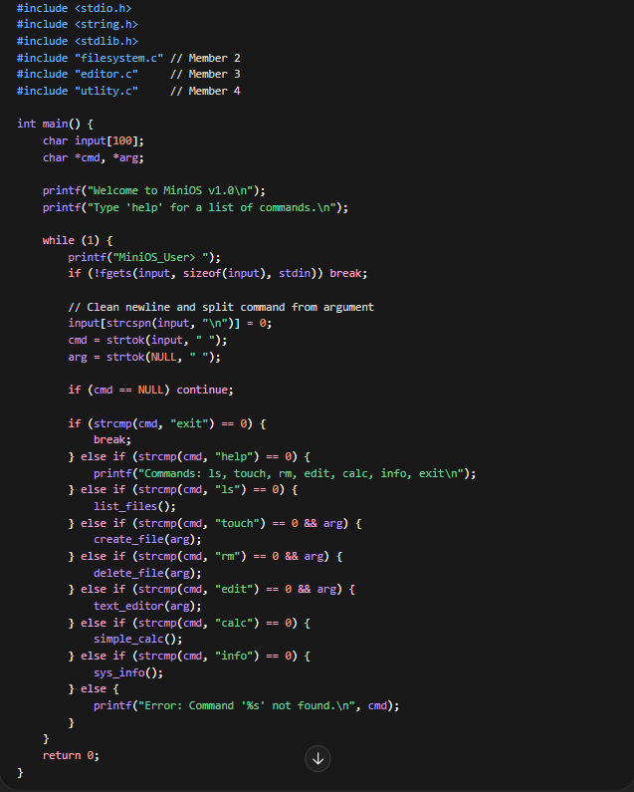
KEY FEATURES
MAIN FILE
Initialisation: Imports external modules and displays the system welcome banner.
Input Parsing: * Uses fgets() to capture user input safely.
Uses strtok() to tokenise the string, separating the command (e.g., touch) from the argument (e.g., file.txt).
Execution Logic (The Switchboard): A conditional logic block maps user strings to specific C functions defined in other modules.
Continuous Loop: The while(1) structure ensures the OS remains active until the explicit exit command is received.

Slide 9
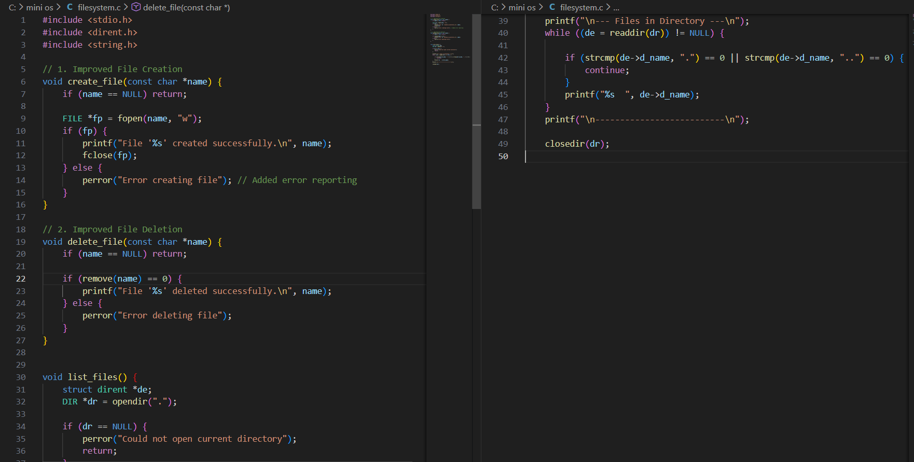
FILE SYSTEM
File Creation: Implements a create file to init new files using the fopen "write" mode.
File Deletion: Employs delete_file to invoke system-level remove calls based on user input.
Directory Listing: Uses list_files to scan and display all contents of the current directory.

Slide 10
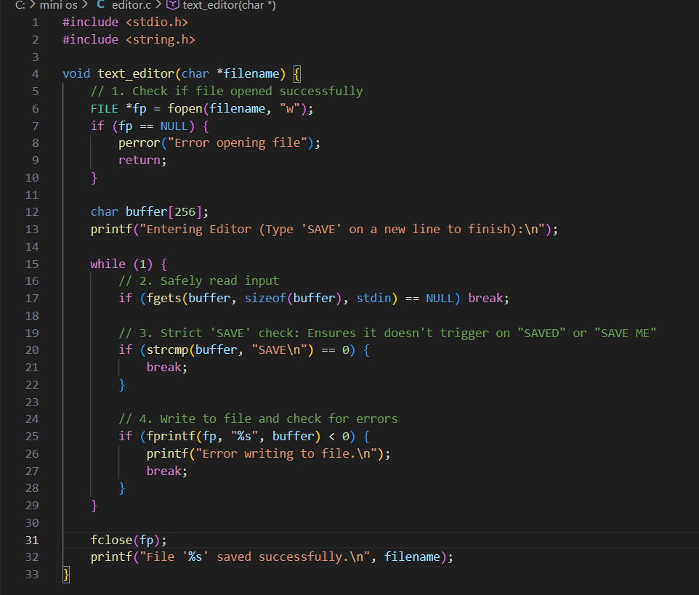
EDITOR
Integrated File System Operations: The filesystem.c module enables direct disk interaction by implementing create_file and delete_file using standard C I/O and system-level remove() calls, alongside a list_files function that scans directories while filtering out system navigation pointers like . and ...
Buffer-Safe Text Editor: The text_editor function provides an interactive writing environment that safely captures user input via fgets and implements a strict "SAVE" keyword check to ensure data is correctly written to the file before closing the stream.
System Diagnostics & Computation: The utility module includes sys_info for displaying development metadata—such as the team name and automatic build timestamps—and a simple_calc tool that performs precise arithmetic while using getchar() to maintain input buffer stability.

Slide 11
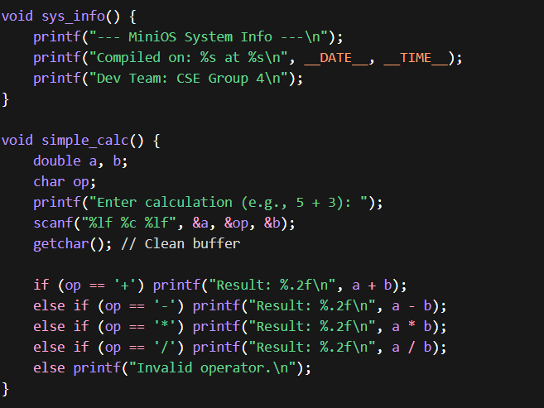
UTILITY
System Diagnostics & Metadata: The sys_info function provides critical transparency by displaying the development team name ("CSE Group 4") and automatically capturing the exact compilation date and time using preprocessor macros.
Interactive Computational Utility: The simple_calc tool enables basic arithmetic (addition, subtraction, multiplication, and division) with double precision, utilizing a getchar() buffer-clearing technique to ensure input stability within the main OS loop.

Slide 12
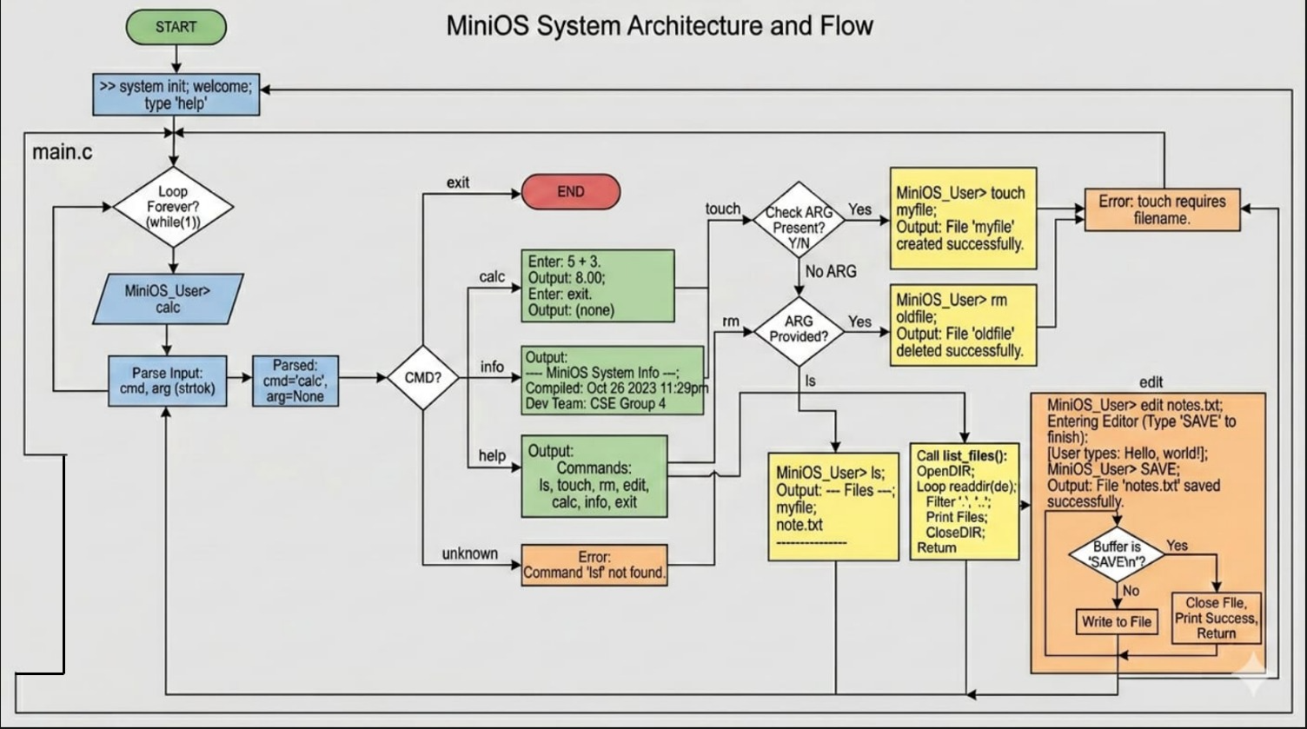

Slide 13
TECHNOLOGIES USED
Programming Language
C Programming Language: Chosen for its low-level control, efficiency, and ability to demonstrate system programming concepts. C provides direct memory access and is the traditional language for OS development.
portability)
Development Environment
Tools and Compiler
IDE/Text Editor:
• Code::Blocks, Visual Studio Code
• Dev-C++, Eclipse CDT
Operating System:
• Windows, Linux, or macOS
• Cross-platform compatibility
Version Control:
• Git for source code management
Compiler:
• GCC (GNU Compiler Collection)
• MinGW for Windows environments
Build Tools:
• Make utility for automated compilation
Debugging Tools:
• GDB (GNU Debugger)
• Built-in IDE debuggers

Slide 14
PROGRAM STRUCTURE
Main Program Flow
Use of Functions
1. Initialization Phase
• Set up data structures (file system, process table)
• Display welcome message and system information
• Initialize variables and configurations
2. Main Loop (Command Processing)
• Display command prompt
• Read user input
• Parse command and extract parameters
• Call appropriate function based on command
• Display output or error messages
• Repeat until exit command received
3. Termination Phase
• Clean up resources
• Save any persistent data
• Display exit message
• Modular design with separate functions for each command
• Helper functions for parsing, validation
• Reusable utility functions
Use of Loops
• While loop for main command processing cycle
• For loops for iterating through data structures
• Do-while for menu-driven operations
Use of Conditions
• If-else for command validation
• Switch-case for command routing
• Logical operators for complex checks

Slide 15
ADVANTAGES
SIMPLICITY
EDUCATIONAL VALUE
LIGHTWEIGHT & EFFICIENT
• Easy to understand and implement
•
No complex GUI components required
• Focuses on core programming logic
• Suitable for beginners with basic C knowledge
• Clear input-output relationship
• Demonstrates real-world OS concepts
• Enhances problem-solving abilities
• Builds foundation for advanced topics
• Encourages logical thinking and design
• Provides practical coding experience
• Minimal system resource requirements
• Runs on any computer or platform
• Fast execution and quick response time
• No external dependencies or libraries
• Portable and easily distributable

Slide 16
LEARNING OUTCOMES
Knowledge Gained
• Deep understanding of operating system fundamentals and architecture
• Comprehension of how commands are parsed, interpreted, and executed
• Knowledge of file system operations and data organization
• Understanding of process lifecycle and management concepts
• Insight into how user interfaces communicate with system core
Skills Developed
• Proficiency in C programming: variables, functions, loops, conditionals, arrays, structures
• String manipulation and text processing abilities
• Problem decomposition and modular design thinking
• Debugging skills and systematic error handling approaches
• Code documentation and maintenance practices
Practical Understanding Achieved
Students gain hands-on experience translating theoretical OS concepts into working code, bridging the gap between abstract learning and real-world implementation. This practical foundation prepares them for advanced systems programming and professional development work.

