Slide 1
RATINGS-PROJECT
Submitted by
ANJANA.P

Slide 2
CONTENT
Problem Statement
Data Review
EDA Analysis
Visualizations
Steps and Assumptions
Model Dashboard
Conclusions

Slide 3
PROBLEM STATEMENT
The rise in E — commerce, has brought a significant rise in the importance of customer reviews.
Customers have changed their way of shopping and studies show that70 percent of customers use rating filters to filter out low rated items in their searches.
We have a client who has a website where people write different reviews for technical products. We have to add a new feature to their website named rating based on customer reviews
we have to scrape reviews and ratings of different productsfrom different e-commerce websites.
We have to test various classification models and select a best model to predict the rating of the product based on review

Slide 4
DATA REVIEW
Data is scraped from different e-commerce sites like Amazon, flipkart, snapdeal etc. The main datas that are scraped includes customer reviews and ratings.
20000 datas are scraped with 4000 datas each for 1star,2star,3star,4star, and 5star
Dataset contains 20000 rows and 2 columns
Extra columns for label is added which shows 0 and 1 value,1 represent good reviews with rating above 3 and 0 represent bad reviews with rating below 3.
Sentiment analysis is done and various classifications models should be performed and best model is selected to predict the ratings

Slide 5
EDA ANALYSIS
There are 2 columns and 20000 rows.
Presence of null values are checked.
Object datatype of Rating column is converted to integer datatype to add label column.
All punctuations and stopwords are removed.
Label column is added with values 0 and 1 for classifying good and bad reviews
Wordcloud library is used to see the most frequent words appeared in good and bad reviews.

Slide 6
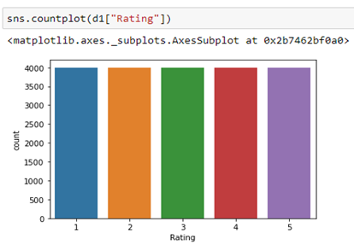
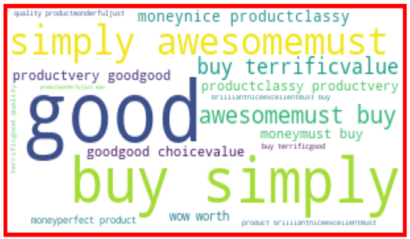
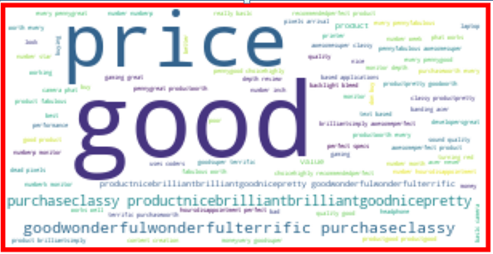
VISUALIZATIONS

Slide 7
STEPS AND ASSUMPTIONS
After removing punctuations and stop words Tf-idf vectoriser is used to convert the text into machine learning algorithm format.
Train test split is done and various classification models like multinomial NB, Randomforest classifier, decision tree classifier, knearest neighor,svc are found and the best model is saved as pickle file.
Accuracy score of various models are:
Knearest neighbor-0.41
Random forest classifier-0.59
Multinomial NB-0.45
Decision tree classifier-0.49
SVC-0.49
Random Forest Classifier gives maximum accuracy so it is selected as our model and saved in pickle format

Slide 8
CONCLUSION
Natural Language Process method is used to solve this problem.
The data is cleaned, preprocessed and tested various models and best model which gives maximum accuracy is selected
The dataset we used here resembles a real business dataset. The ability to successfully decide whether a review will be helpful to other customers and thus give the product more exposure is vital to companies that support these reviews
The rise in E — commerce, has brought a significant rise in the importance of customer reviews. There are hundreds of review sites online and massive amounts of reviews for every product. Customers have changed their way of shopping
This project basic Natural Language Processing based on sentiment analysis and build a new model which will predict the rating of the product based on the review of the product.

