Slide 1
ZS – Associate ML Challenge Patient Tag Detection
Presented BY : ANJANA YADAV

Slide 2
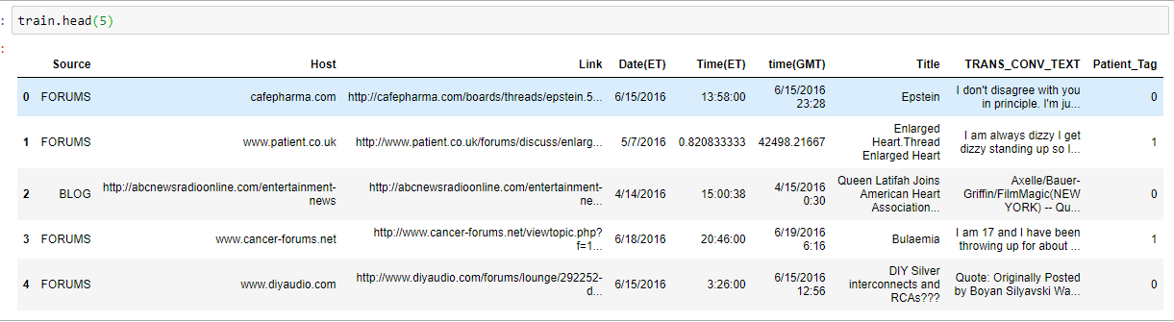
Train Data

Slide 3
Missing Data Distribution

Slide 4
Class Imbalanced

Slide 5
Process Flow
EDA and Feature Engineering
SMOTE for balancing the imbalanced classes
Or
AL
TF-IDF Feature Processing
and
Label Encoding
Extract Features [Stopword, Text Length]
Random Search for Hyper-parameter tuning,
Cross Validation,
Thresholding
Model Fit X = Stacked Features y = Patient Tags

Slide 6
Source

Slide 7
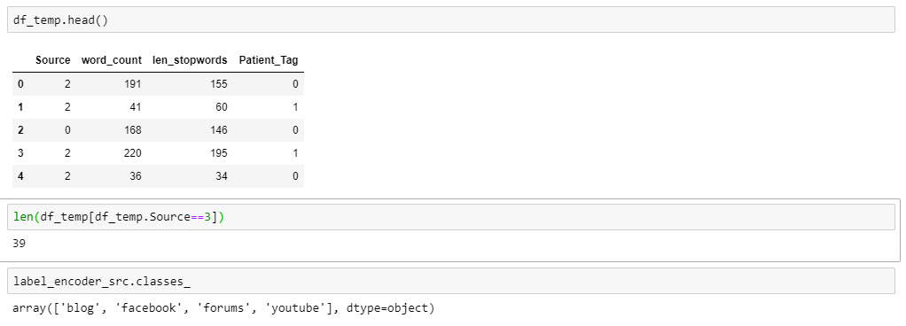

Slide 8
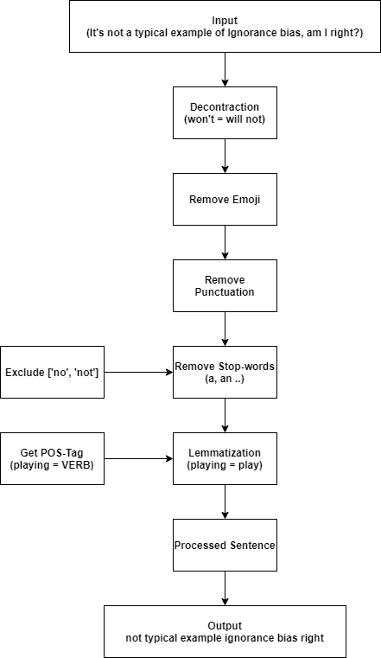
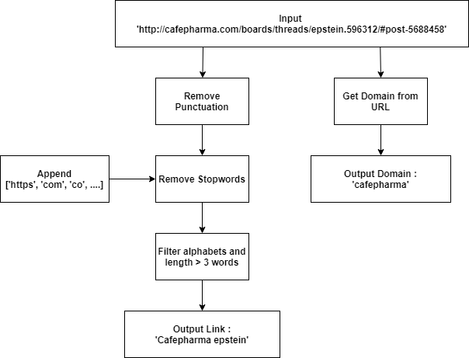

Slide 9
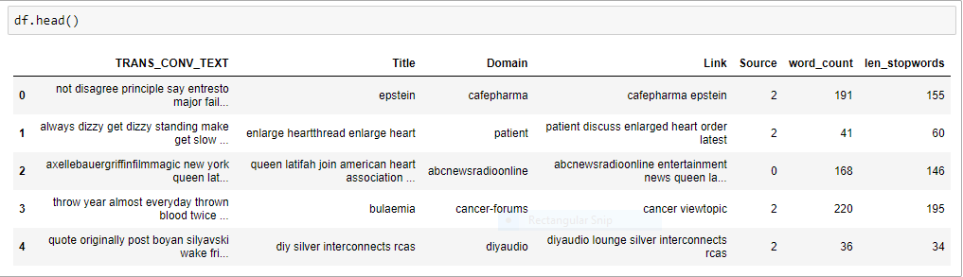
Features for model fitting

Slide 10
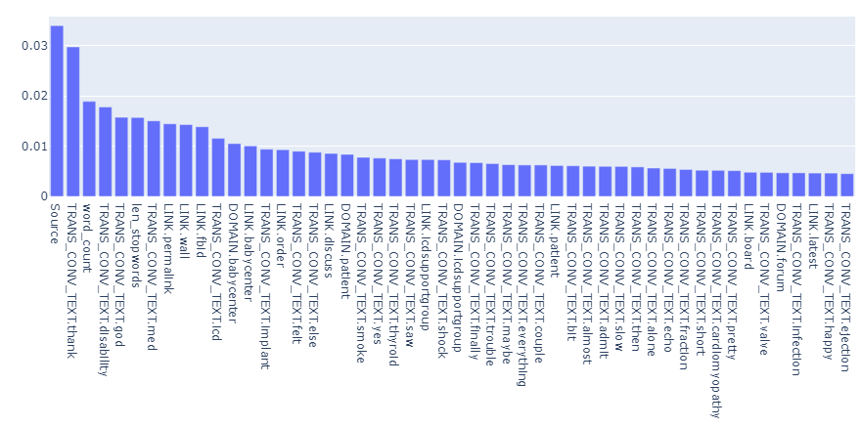
Feature Importance

Slide 11
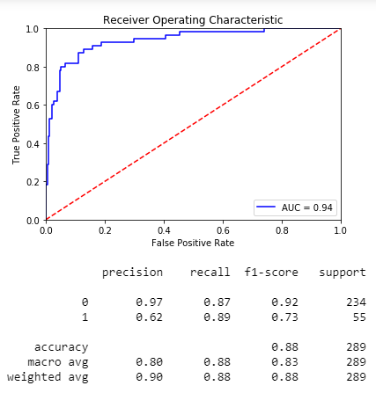
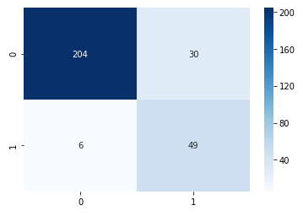
Performance Metrics
Threshold for original data = 0.3

Slide 12
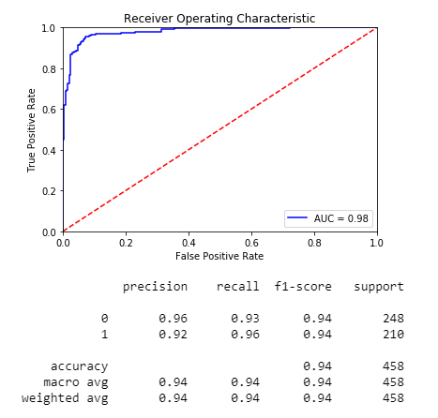
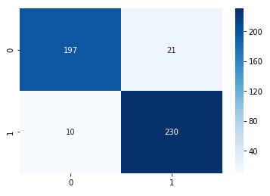
Performance Metrics for SMOTE
Threshold for data with SMOTE = 0.5

Slide 13
THANK YOU

